Slide 1
Closure Properties of CFL
CFL are closed under
Substitution
Union
Concatenation
Closure (*)
Homomorphism
Reversal
Intersection with a Regular Language (L∩R)
Set-difference with a Regular Language (L\R)
Inverse Homomorphism

Slide 2
Unsolvable Problems (informal) I
Problem: Is the first string that a C program prints the string “hello, world”?
I.e. is there are program that always tells correctly whether a program P with input I prints “hello, world” as its first string?
This question is very easy to answer for the program:
main() {
printf(“hello, world\n”);
}

Slide 3
Unsolvable Problems (informal) II
This question is not easy to answer for the program:
main() {
int n, total, x, y, z;
scanf(“%d”,&n);
total = 3;
while(1) {
for (x=1; x<=total; x++) {
for (y=1; y<=total-x-1; y++) {
z = total-x-y;
if (exp(x,n)+exp(y,n)==exp(z,n))
printf(“hello, world\n”);
}
}
total++;
}
}

Slide 4
Unsolvable Problems (informal) III
Step 1: Assume H exists
Step 2: Modify H to H₁
I
Hello-world
tester
yes
I
yes
H₁
H
P
no
P
hello, world
Step 3: Modify H₁ to H₂
What happens if H₂ gets H₂ as input?
yes
yes
P
H₂
H₂
H₂
hello, world
hello, world

Slide 5
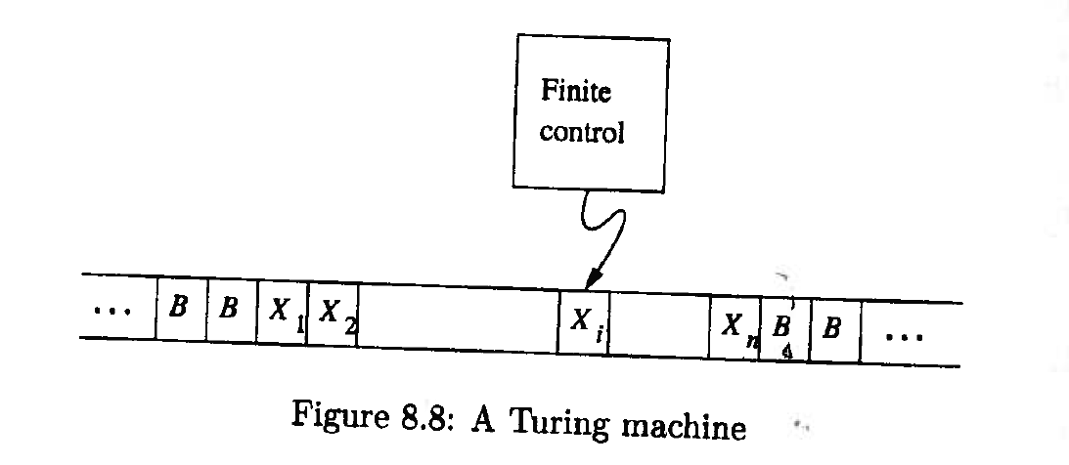
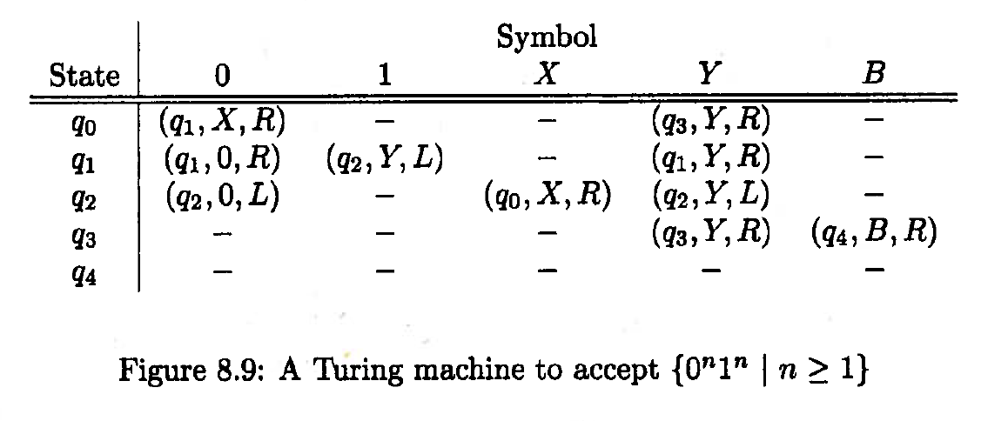
Turing Machine

Slide 6
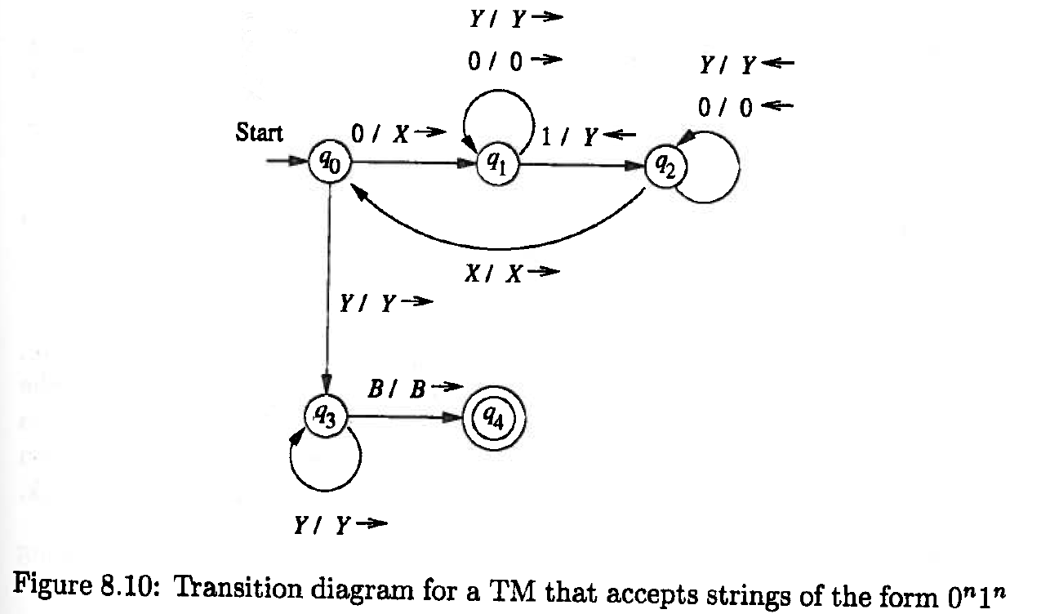
Transition Diagram for TMs

Slide 7
Alternative Concepts
The following extensions, restrictions to the basic TM and other computational models are possible. All of them are equivalent to the basic TM:
Multitape TMs
Nondeterministic TMs
TM with Semi-Infinite Tapes
Multistack Machines
Counter Machines

Slide 8
Linear Bounded Automaton
A Linear Bounded Automaton (LBA) is a nondeterministic TM that satisfies the following three conditions:
Its input alphabet includes two special symbols, serving as left and right end markers.
Its transitions may not print other symbols over the end markers.
Its transitions may neither move to the left of the left end marker nor to the right of the right end marker.
Not every recursively enumerable language can be accepted by a LBA.

Slide 9
Grammars
Types of grammars G=(V,T,P,S) based on the form α→β of the production
in P:
α∈V, β=w or β=wA with w∈T* and A∈V regular grammar
α∈V, β∈(V∪T)* CFG
α∈ (V∪T)*, β∈(V∪T)* with |α|≤|β| context-sensitive grammar
α∈ (V∪T)*, β∈(V∪T)* Semi-Thue System

Slide 10
Chomsky Hierarchy
Type-3: Regular Languages, Regular Expressions, DFAs, Regular Grammars
Type-2: CFLs, CFGs, PDAs
Type-1: Context-Sensitive Grammars/Languages, Linear Bounded Automatons
Type-0: Recursively Enumerable Languages, Semi-Thue Systems, TMs

