Slide 1
Pumping Lemma as a game
Player 1 picks the language L to be proven nonregular.
Player 2 picks n secretly.
Player 1 picks w (may depend on n).
Player 2 divides w into x, y, and z so that y≠ε and |xy|≤n.
Player 1 wins by picking k (may depend on n, |x|, |y|, and |z|) so that xy^{k}z is not in L.

Slide 2
Closure Properties of Regular Languages
The union of two regular languages is regular.
The intersection of two regular languages is regular.
The complement of a regular language is regular.
The difference of two regular languages is regular.
The reversal of a regular language is regular.
The closure (by *) of a regular language is regular.
The concatenation of two regular languages is regular.
A homomorphic image of a regular language is regular.
An inverse homomorphic image of a regular language is regular.

Slide 3
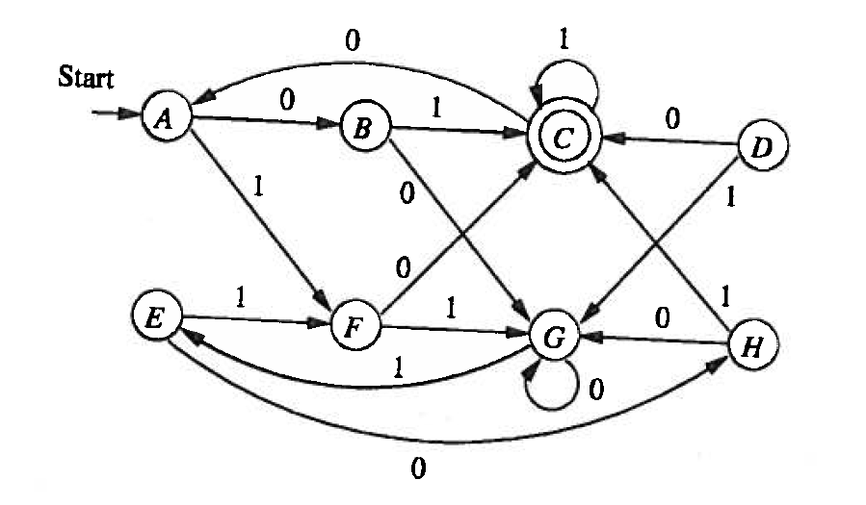
Example I

Slide 4
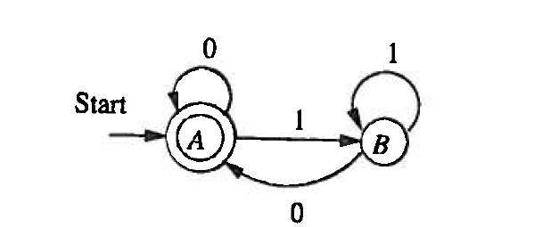
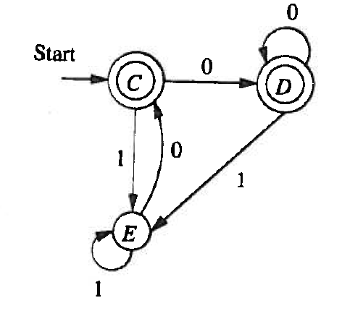
Example II

Slide 5
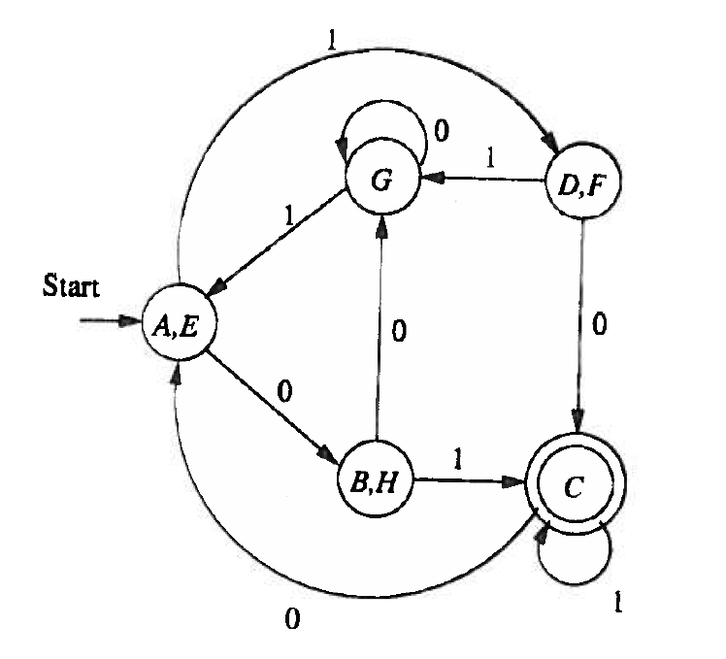
Example I (continued)

