Slide 1
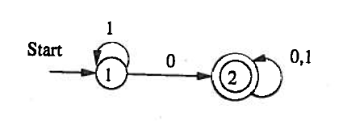
Example
Substitution
Simplified
Substitution
Simplified

Slide 2
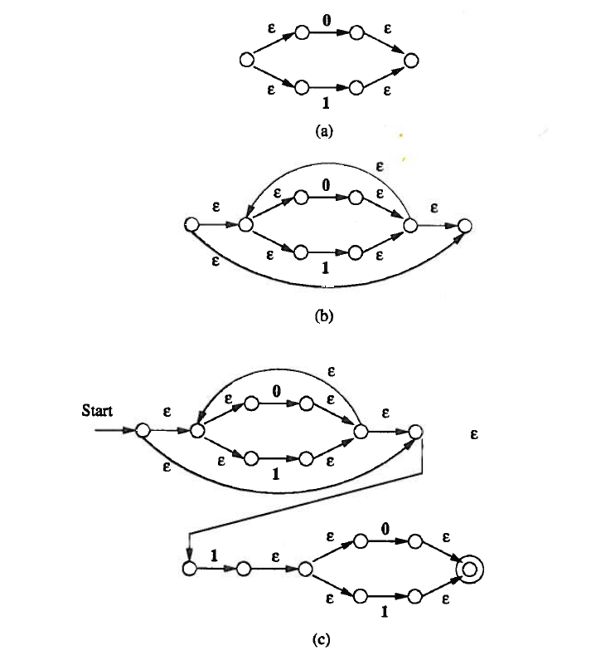
Example

