Slide 1
Minimum-weight Spanning Tree
12
12
1
2
1
2
15
15
10
20
10
20
3
4
3
4
18
18
Weighted Graph
Spanning Tree with weight: 10+18+20=48

Slide 2
Minimum-weight Spanning Tree
12
12
1
2
1
2
15
15
10
20
10
20
3
4
3
4
18
18
Weighted Graph
Spanning Tree with minimum weight: 12+10+18=40

Slide 3
Kruskal’s Algorithm
Maintain for each node the connected component in which the node appears, using the edge selected so far. Initially every node is in a component by itself.
Consider the edge with the lowest weight that has not been considered yet.
  If this edge connects two node from currently different components, then add the edge to the result and merge the two components.
  If this edge connects two node from the same component, then do not add the edge to the result.
Continue until all edges have been considered.
Complexity: O(e(e + m))
where m is the number of nodes and e is the number of edges.

Slide 4
Kruskal’s Algorithm
12
12
12
1
2
1
2
1
2
15
15
15
10
20
10
20
10
20
3
4
3
4
3
4
18
18
18
12
12
1
2
1
2
15
15
10
20
10
20
3
4
3
4
18
18

Slide 5
Travelling Salesman Problem (TSP)
12
1
2
15
10
20
3
4
18
Hamilton (only one): (1,2,4,3,1)
Find all cycles and choose the one with minimum weight.
Complexity: O(m!)

Slide 6
NP Complete Problems
SAT
CSAT
3SAT
Independent Set Problem (IS)
Node-Cover Problem (NC)
Directed Hamilton-Circuit Problem (DHC)
Undirected Hamilton-Circuit Problem (HC)
TSP

Slide 7
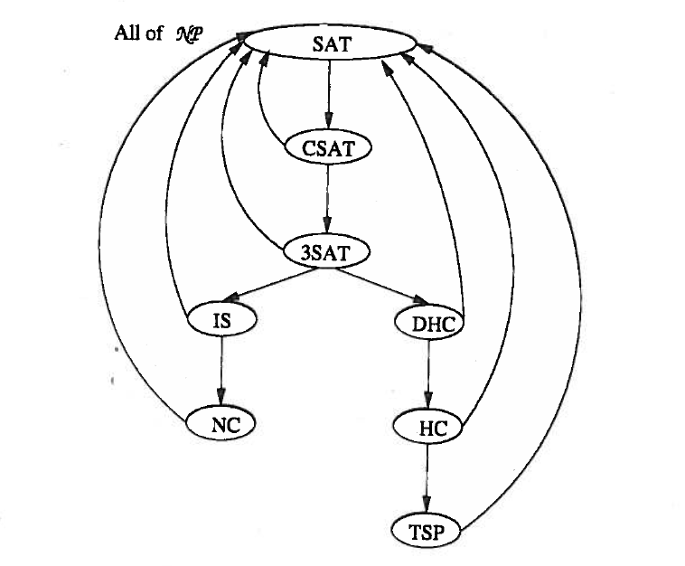
Reductions

