Slide 1
COSC/MATH 4P61
Theory of Computation
Michael Winter
  office: J323
  office hours: Mon & Fri, 10:00am-noon
  email: mwinter@brocku.ca
course web page: http://www.cosc.brocku.ca/~mwinter/Courses/4P61/
Main Text
  John E. Hopcroft, Rajeev Motwani, and Jeffrey Ullman: Introduction to Automata Theory, Languages, and Computation (3rd ed.), Addison-Wesley (2007).

Slide 2
Course Work
Marking Scheme
  Term Tests (3x20%) 60%
  Final Exam 40%
Term Test 1 (30 min): October 01, 2015 (in class)
Term Test 2 (30 min): November 05, 2015 (in class)
Term Test 3 (30 min): November 26, 2015 (in class)

Slide 3
Course Outline
Week | Date | Topic
1 | Sep 10 | Introduction, Formal Languages and Computability
2 | Sep 17 | Finite Automata & Regular Languages: Definition, Kleene's Theorem
3 | Sep 24 | Finite Automata & Regular Languages: Minimalization, Closure Properties, Pumping Lemma for Regular Languages
4 | Oct 01 | Context-Free Languages, CFG's, Parse-Trees, Normal Forms of CFG's (Test 1)
5 | Oct 08 | Pushdown Automata, Equivalence for PDA's and CFG's, Pumping Lemma for Context-Free Languages
6* | Oct 22 | Turing Machines, Universal Turing Machines
7 | Oct 29 | Context-Sensitive Languages
8 | Nov 05 | Recursively Enumerable Languages (Test 2)
9 | Nov 12 | Undecidable Problems, Halting Problem
10 | Nov 19 | Partial Recursive Functions, Primitive Recursive Functions
11 | Nov 26 | Complexity (Test 3)
12 | Dec 03 | Complexity, P vs. NP
* October 12-16 is Fall Reading Week, no classes

Slide 4
Computability – What’s the deal?
Imaging the following situation:
You are working in a software company and your boss has the idea to develop a new antivirus system. This program should analyse automatically any incoming program file and will do the following:
If the program will harm your computer, it will be deleted.
If the program will not harm your computer, it will be started.
Do you want to be the team leader for this project?

Slide 5
Computability – What’s the deal?
Imaging the following situation:
You are working in a software company and your boss has the idea to develop a new antivirus system. This program should analyse automatically any incoming program file and will do the following:
If the program will harm your computer, it will be deleted.
If the program will not harm your computer, it will be started.
Do you want to be the team leader for this project?
Probably not, because this is a so-called undecidable problem, i.e., such a program does not exist.

Slide 6
Non-computable Functions
Let us consider functions of the form f : ℕ → ℕ and programs (in any language of your choice) that take a natural number as input and return a natural number.
How many functions/program do we have?

Slide 7
Diagonalization

Slide 8
Non-computable Functions
Let us consider functions of the form f : ℕ → ℕ and programs (in any language of your choice) that take a natural number as input and return a natural number.
How many functions/program do we have?
There are uncountable many functions of this form.

Slide 9
Coding Strings by Numbers
Suppose we have the alphabet .
Then we can code every string over this alphabet as a number natural number to the base .
Example:

Slide 10
Non-computable Functions
Let us consider functions of the form f : ℕ → ℕ and programs (in any language of your choice) that take a natural number as input and return a natural number.
How many functions/program do we have?
There are uncountable many functions of this form.
There are countable many programs of this kind.
There are more non-computable functions than there are computable ones.
Can we provide reasonable examples for non-computable functions?

Slide 11
Potential Questions
What are typical examples of non-computable functions?
How long does it take to compute a certain result?
Which of the algorithms at hand is better?
Can I solve my problem using language xyz?
Is it possible to make my program faster?
In order answer those questions we need mathematical models of computation. During this course we will consider:
Functions on natural numbers
Languages (sets of strings)
Finite Automatons
Grammars
Pushdown Automatons
Turing Machines
Recursive Functions

Slide 12
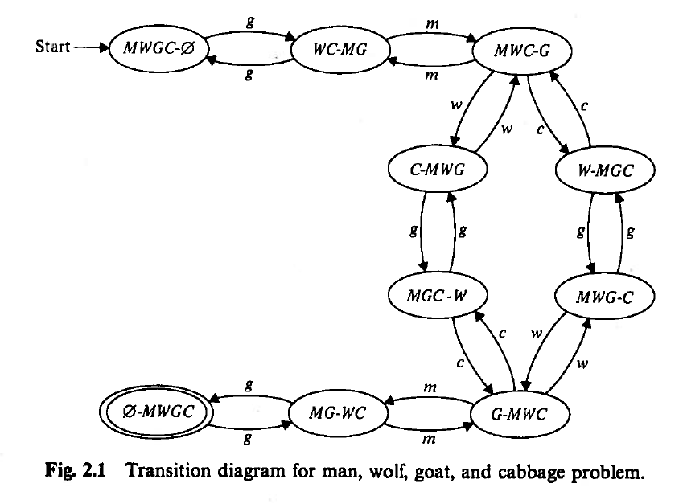
Finite Automaton

Slide 13
Finite Automaton
where

Slide 14
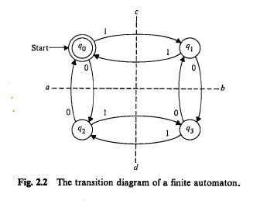
Finite Automaton

Slide 15
Nondeterministic Finite Automaton
where

Slide 16
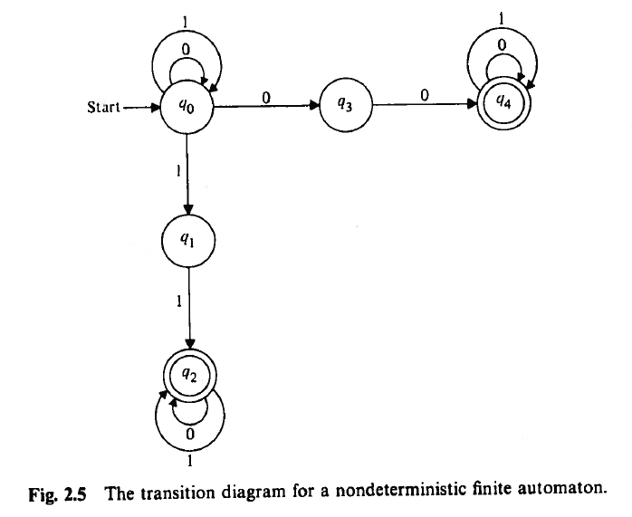
Nondeterministic Finite Automaton

Slide 17
NFA with ε-Moves
where

Slide 18
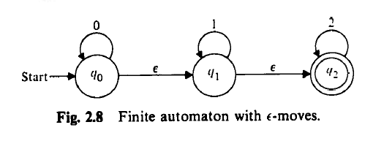
NFA with ε-Moves

