Slide 1
4P13 Week 7
Talking Points

Slide 2
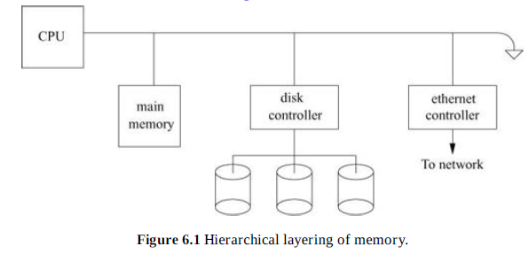

Slide 3
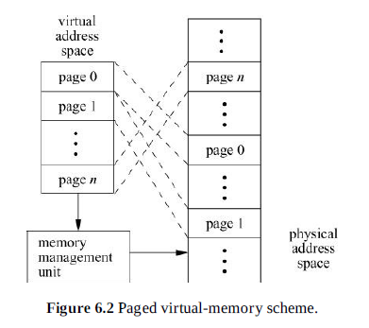

Slide 4
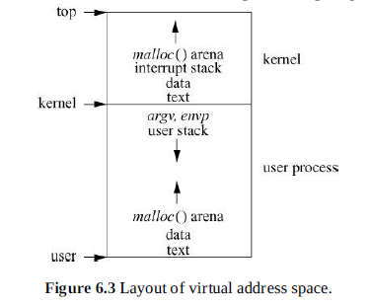

Slide 5
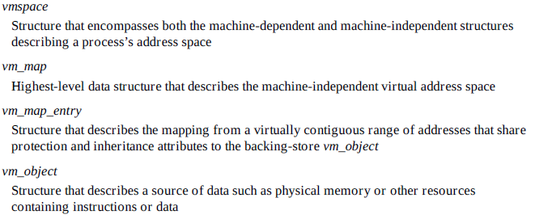
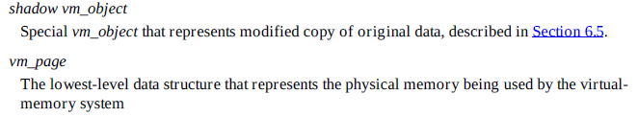
Memory Mgmt Data Structs

Slide 6
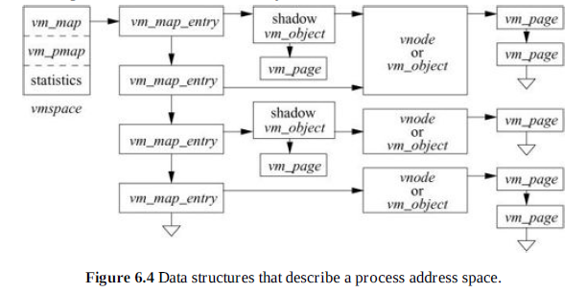

Slide 7
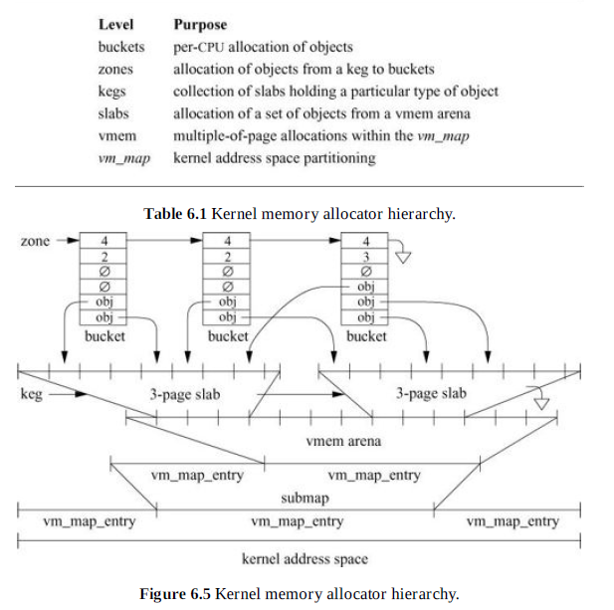

Slide 8
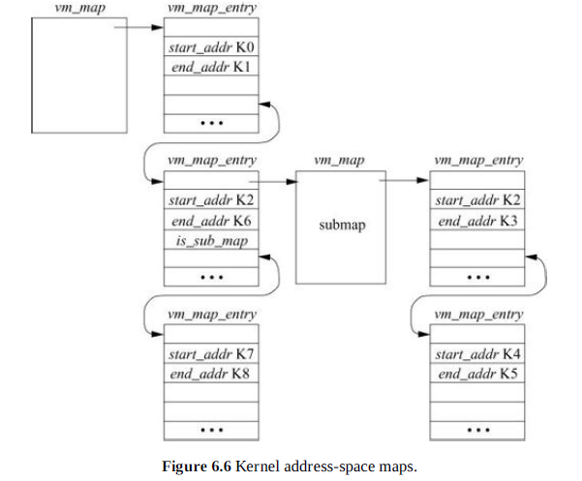

Slide 9
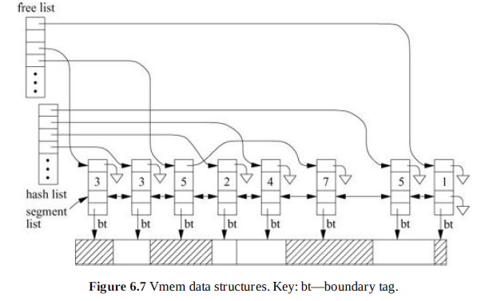

Slide 10
Segment Allocation Policies
VM_BESTFIT: Search for the smallest segment on freelist[n] that can satisfy the allocation. If none are found, search for the smallest segment on freelist[n + 1] that can satisfy the allocation.
VM_INSTANTFIT: If the size is exactly 2n, take the first segment on freelist[n]. Otherwise, take the first segment on freelist[n+1]. Any segment on this freelist is necessarily large enough to satisfy the allocation, yielding constant-time performance with a reasonably good fit. Instant fit is the default in FreeBSD because it guarantees constant-time performance, provides low fragmentation in practice, and is easy to implement.
VM_NEXTFIT: Ignore the freelists altogether and search the arena for the next free segment after the one previously allocated. This option is not supported in FreeBSD 10. The vmem in Solaris supports it for allocating resources like process identifiers.

Slide 11
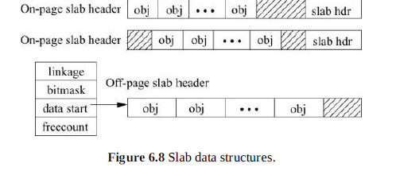

Slide 12
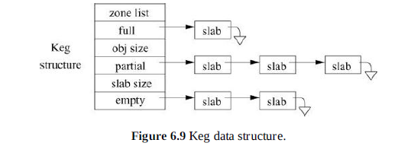
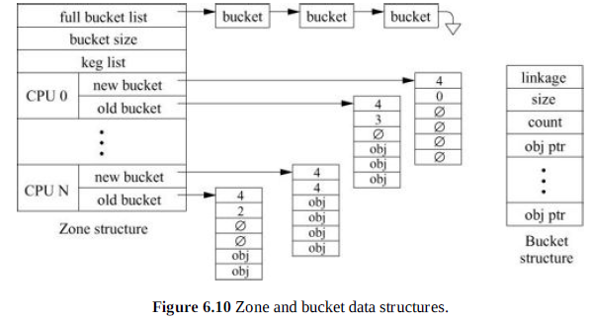

Slide 13
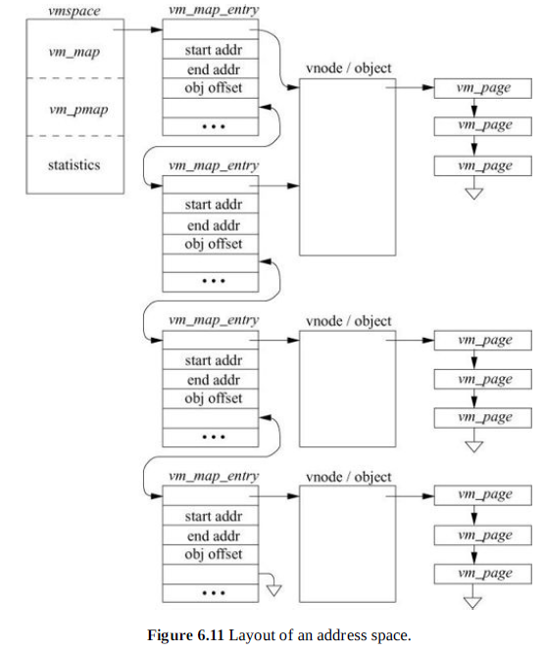

Slide 14
Vm_object Stores
A collection of the pages for that vm_object that are currently resident in main memory; a page may be mapped into multiple address spaces, but it is always claimed by exactly one vm_object
A count of the number of vm_map_entry structures or other vm_objects that reference the vm_object
The size of the file or anonymous area described by the vm_object
The number of memory-resident pages held by the vm_object
For shadow objects, a pointer to the next vm_object in the chain (shadow objects are described in Section 6.5)
The type of pager for the vm_object; the pager is responsible for providing the data to fill a page and for providing a place to store the page when it has been modified (pagers are covered in Section 6.10)

Slide 15
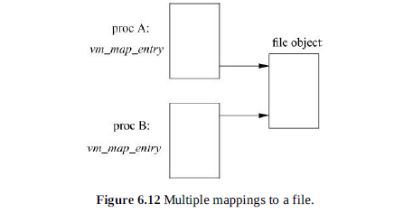

Slide 16
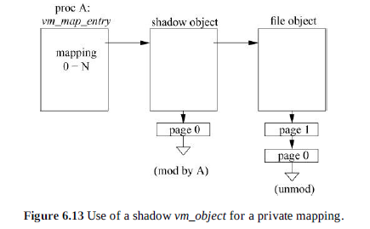

Slide 17
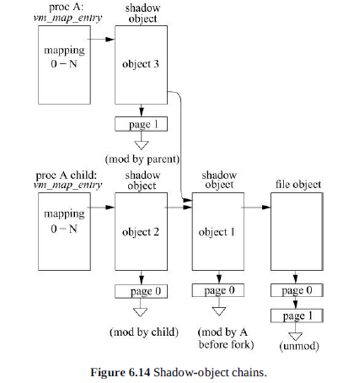

Slide 18


Slide 19
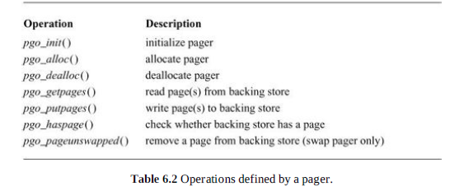

Slide 20
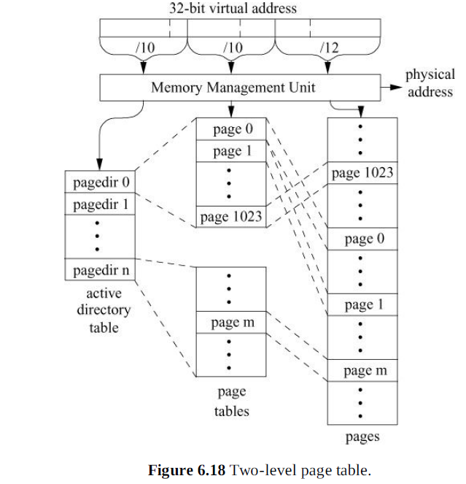

Slide 21
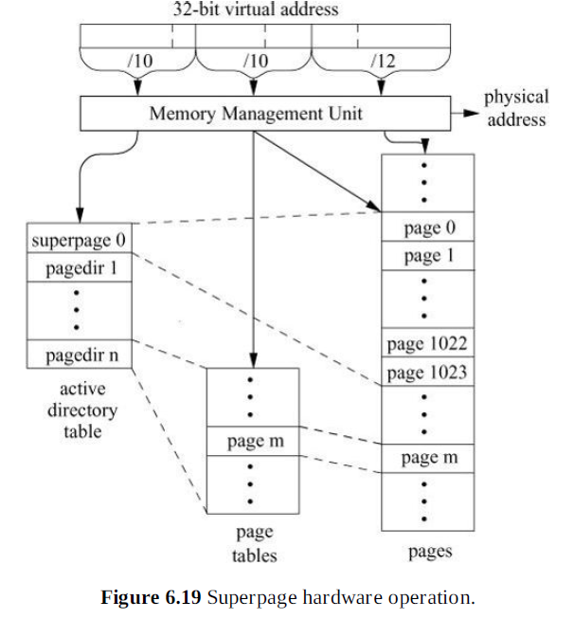

Slide 22
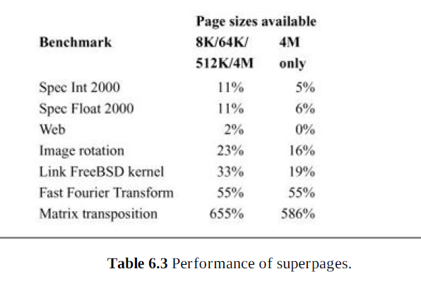

Slide 23
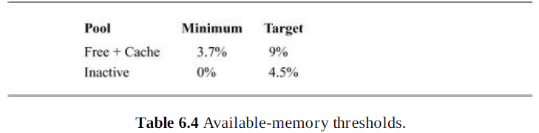

Slide 24
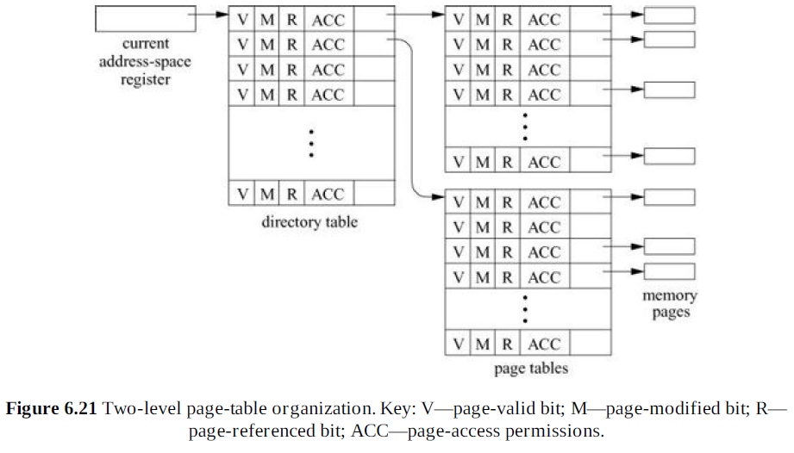

Slide 25
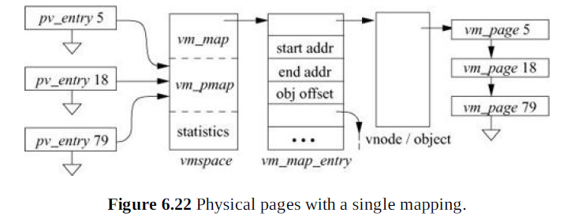

Slide 26
