Slide 1
Floating Point Arithmetic
“Two things are infinite: the universe and human stupidity; and I'm not sure about the universe.”
― Albert Einstein

Slide 2
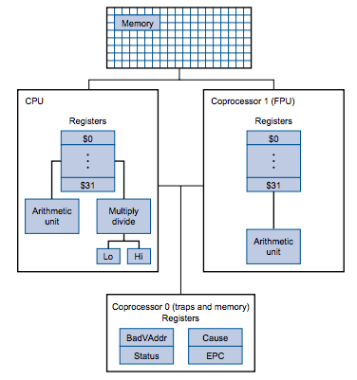
MIPS FPU

Slide 3
Single Precision Format
S 1 sign bit
E 8 bits biased 127
F 23 bit significand (normalized)
32 bits
32 bit SEF FPS
SEEEEEEE EFFFFFFF FFFFFFFF FFFFFFFF

Slide 4
Single Precision
Representation in IEEE FPS
32 bit SEF
SEEEEEEE EFFFFFFF FFFFFFFF FFFFFFFF
S - sign, 0=positive, 1=negative
E - exponent, biased 127
F - fraction, normalized with hidden bit

Slide 5
Representation in IEEE FPS showing the hidden bit
32 bit SEF
SEEEEEEE E(1)FFFFFFF FFFFFFFF FFFFFFFF
- because the fraction is normalized
the hidden bit is always 1

Slide 6
Double Precision Format
S 1 sign bit
E 11 bits biased 1023
F 52 bit significand (normalized)
64 bits
64 bit SEF
SEEEEEEE EEEEFFFF FFFFFFFF FFFFFFFF
FFFFFFFF FFFFFFFF FFFFFFFF FFFFFFFF

Slide 7
Addition and Subtraction
Align radix points
  adjust the fraction and exponent of the number with the smaller exponent
Add or subtract the mantissas
Normalize the result
Scientific Notation Examples
1.5 x 10² + 2.0 x 10¹ = ?
5.5 x 10² + 6.5 x 10² = ?

Slide 8
Example 1
1.5 x 10² + 2.0 x 10¹
1.5 x 10²
+ 0.20 x 10²
1.70 x 10²
OR
170
1.5 x 10² + 2.0 x 10¹
1.0010110 x 2⁷
1.0100 x 2⁴
adjust
0.0010100 x 2⁷
So
1.0010110 x 2⁷
0.0010100 x 2⁷
1.0101010 x 2⁷
170
Shift to line up radix points

Slide 9
Example 2
5.5 x 10² + 6.5 x 10²
5.5 x 10²
6.5 x 10²
12.00 x 10²
1.20 x 10³
1200₁₀
5.5 x 10² + 6.5 x 10²
1.000100110 x 2⁹
1.010001010 x 2⁹
10.010110000 x 2⁹
1.0010110000 x 2¹⁰
1200₁₀
Shift right once to normalize
Shift right once to normalize

Slide 10
Multiplication
Do unsigned multiplication on mantissas
Add the (biased) exponents
Normalize the result
Set the sign bit of the result
  XOR or the sign bits
Example (1.25 x 10²) x (2.0 x 10¹)

Slide 11
Division
Do unsigned division on mantissas
Subtract (biased) exponent of divisor from (biased) exponent of dividend
Normalize the result
Set the sign bit of the result
  XOR of sign bits

Slide 12
Undesirable effects of Rounding
Errors accumulate over time
Operations performed in a different order may give a different result
Infeasible to do an exact comparison of two floating point numbers

Slide 13
Overflow and Underflow
overflow - the number is too large..
the biased exponent is too large to fit in 8 bits
i.e. > 1111 1110 > 127
underflow - the number is too small
the biased exponent is too small to fit in 8 bits
i.e. < 000 0001 < -126

Slide 14
Cos(x)
Can be calculated using a Taylor Series.
  Cos(x) = 1 – x²/2! + x⁴/4! - x⁶/6! + x⁸/8!
We sum up the series until we get a low error between successive terms.
Thus Cos(x) and Cos(x)+next_term must be sufficiently small.
  Less then an error Threshold value
    Typically 0.00000001

Slide 15
Cos(x)
Algorithm
Enter an Angle in degrees and convert to radian measure.
  Cos(x)_{old} = 0;
  Cos(x)_{new}=1;
while (|Cos(x)_{old}-Cos(x)_{new}| > Threshold) Do
Cos(x)_{old} = Cos(x)_{new}
Cos(x)_{new}= Cos(x)_{old} + Next_Term

Slide 16
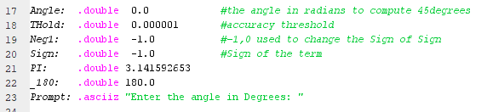
Cos(x)
Degrees to Radians
AngleR = AngleD*Pi / 180.
Basic Values are defined and initialized as memory variables

Slide 17
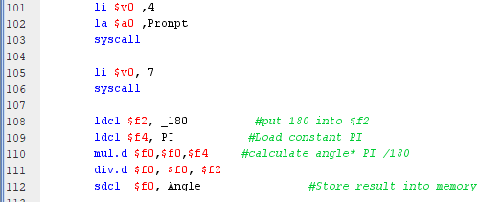
Cos(x)
Load Pi and 180 into FP registers, these are doubles.
After conversion to radian measure, and Angle is stored back into memory.

Slide 18
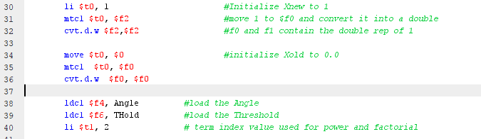
Cos(x)
Cos(x)_{old} and Cos(x)_{new} are represented by FP registers $f0 and $f2.
These are loaded by moving integer from a T register to an FP register and then converting to FPS.
Angle and Threshold are loaded from memory.
T1 will be used to define the power and factorial values for each term, initialize to 2.

Slide 19
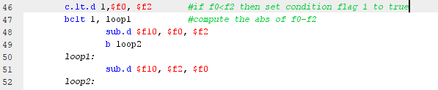
Cos(x)
MIPS contains 8 condition flags for branching.
To test abs( … ) we need to check if f0 < f2 or visa versa
  c.lt.d tests, if true will set condition flag 1 to true.
  belt 1, loop1 tests this flag and branches accordingly

Slide 20
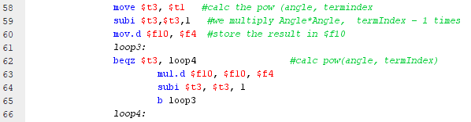

Cos(x)
Calculate pow(Angle,T1)
Run a loop to multiply Angle*Angle
Use the factorial function from lab 8 and convert the result to a double.

Slide 21
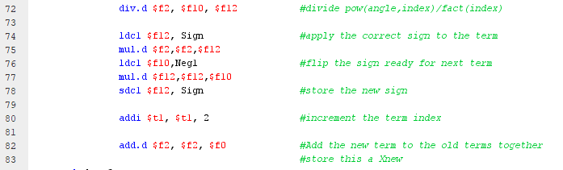
Cos(x)
Divide pow(Angle,t1)/Fact(t1) creating the new term.
Sign alternates, after multiplying the term by the sign, we multiply the sign by -1 and store it back to memory.
Increment t1 by 2, which aligns with the next term
Create Cos(x) new by adding in Cos(x) old to the new term.

Slide 22
End

