Slide 1
Logical Operations
Boy who sow wild oats better hope for crop failure.
  Chinese Proverb

Slide 2
7 Logical Operations in MIPS
not x, y
and x, y, z
nand x, y, z
or x, y, z
nor x, y, z
xor x, y, z
xnor x, y, z
x get y’
x gets result of y,z operation

Slide 3
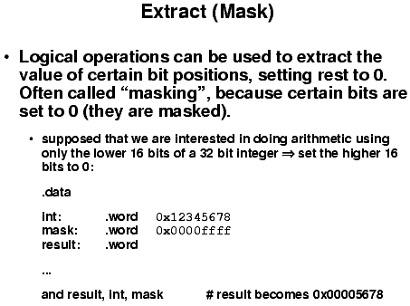

Slide 4
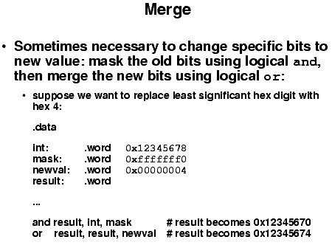

Slide 5
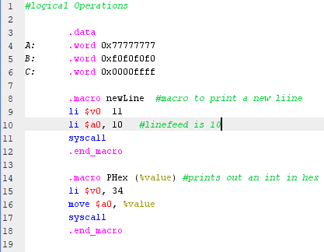
Mask and Merge Example
Macros can be useful to cut down on writing repetitive code blocks like print statements.
NewLine macro will print a linefeed to the console, called by newline
PHex will print an int in hex format, %value is a substitution string, in this case it should be a register.
E.g. PHex($t4)

Slide 6
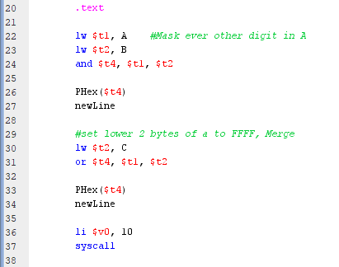
Mask and Merge Example.
Mask using bitwise and will mask out bits, E.g.
    0x70707070
Merge using bitwise or, sets bits. E.g
    0x7777FFFF
Note: the macro calls

Slide 7
Shifts
Move bits to new locations in a word
3 Type of Shifts allowed
  Logical shift
  Arithmetic Shift
  Rotate
Can shift right or left by a specified number of bits (0 - 31)

Slide 8
MAL’s Shift Operations
sll shift left logical
srl shift right logical
rol rotate left
ror rotate right
sra shift right arithmetic
Format
  operation destination, source, Amount

Slide 9
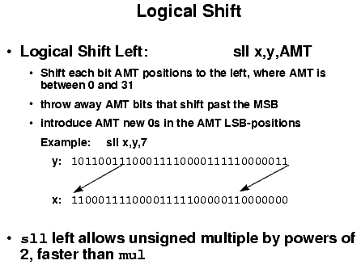

Slide 10
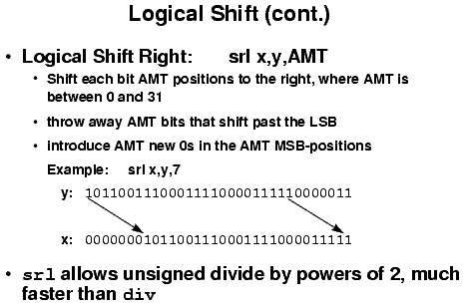

Slide 11
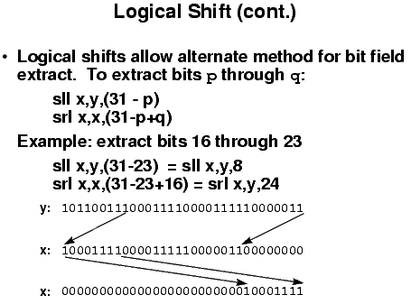

Slide 12
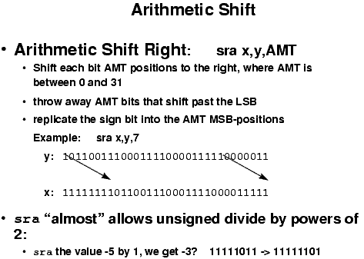

Slide 13
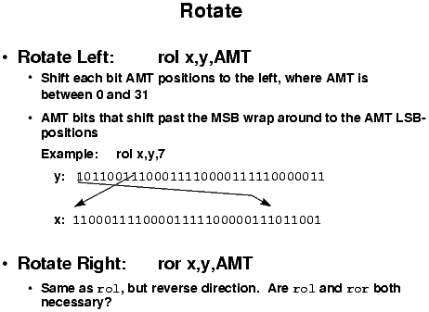

Slide 14
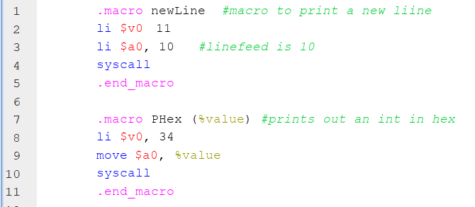
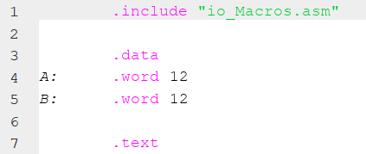
Macro Inclusion

Slide 15
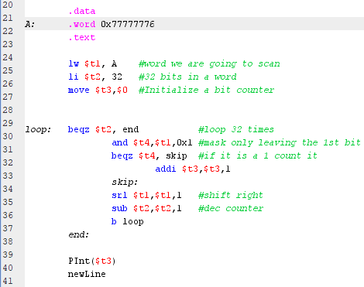
Count # of 1’s in a word
Mask out all bits except the LSB, if it is a 1 count it.
Rotate right 1 bit and repeat

Slide 16
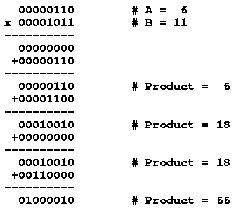
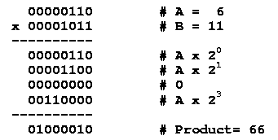
Partial Products
Partial products are added as they are generated

Slide 17
Standard Multiply Algorithm
Multiply can be done using a series of shift and add operations
product = 0
while multiplier is non-zero
if multiplier LSB = 1
product = product + multiplicand
multiplier = multiplier >> 1
multiplicand = multiplicand << 1

Slide 18
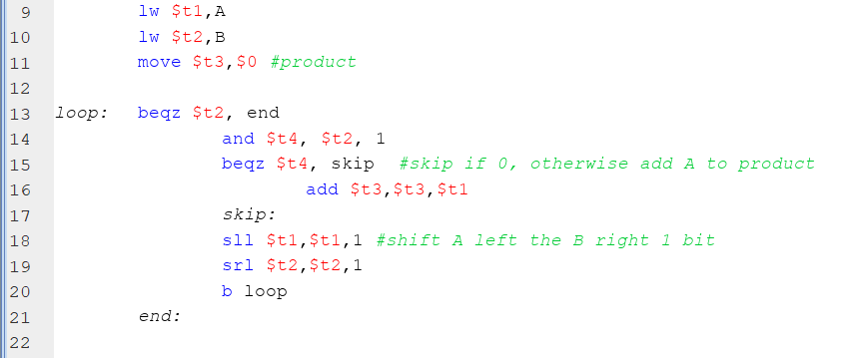
Multiply

Slide 19
Alternate Multiply Algorithm how h/w does it.
32 bit x 32 bit = 64 bit result
Multiplicand is added into Product_High, Multiplier loaded into Product low.
Shift
Product_High
Product_Low
A
Multiplicand
B
Multiplier

Slide 20
Alternate Multiply Algorithm how h/w does it
product_high = 0
product_low = multiplier
do {
If (LSB of B) == 1 then
add multiplicand to product_High
shift multiplier (product_low) right 1
shift product_high right 1
} while (product has not been shifted 32 times)
Note: the shift will be done together as 1 cycle in h/w.
  Broken down for clearity.
After 32 shifts, the multiplier will be moved out.

Slide 21
End Notes on Multiply
The algorithm loops 32 time
  Product_low has been shifted 32 times
  Product_high has been shifted 32 times
    LSB become MSB of Product_low on shift
Rather then shift the multiplicand left and keeping the product stationary, we keep the multiplicand stationary and shift the product right.
Easier to build in h/w

Slide 22
Signed Multiplication
Same algorithm but with small adjustment
  Save XOR of sign bits to get product sign bit
  Convert multiplier & multiplicand to positive
  Perform normal multiplication algorithm
  Negate result if product sign bit is 1

Slide 23
Unsigned Division Algorithm
remainder = dividend
quotient = 0
for i=1 to # of significant digits
divisor = divisor >> 1
quotient = quotient <<1
if divisor <= remainder
remainder = remainder - divisor
quotient = quotient +1

Slide 24
Unsigned Division
01000010 --Dividend = 66
00000110 --Divisor = 6
Determine # of significant digits in quotient, shift divisor left until shifted divisor is > dividend
01000010 --dividend
01100000 --Shifted divisor

Slide 25
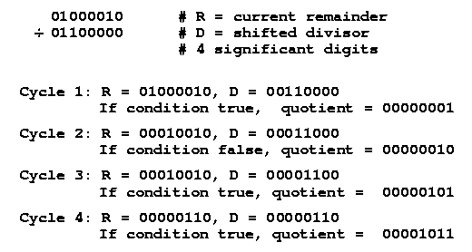
Division Example

Slide 26
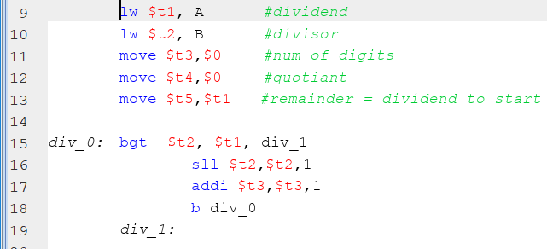
Division
Determine number of significant bits in quotient

Slide 27
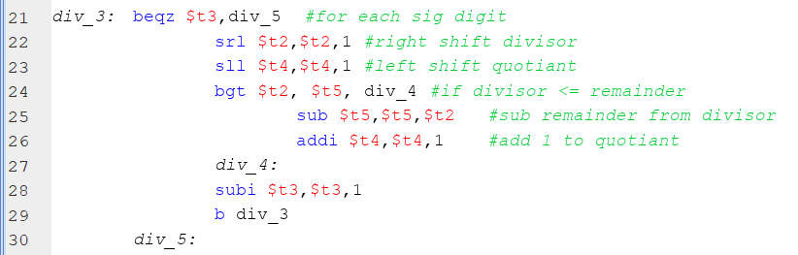
Division

Slide 28
Alternate Division Algorithm how h/w does it
Low
High
Shift
Remainder
Dividend
+/-
Quotient
Divisor
Initialize High to 0 and Low to the Dividend.

Slide 29
Alternate Division Algorithm how h/w does it
  High = 0
  Low = Dividend
  { shift left
  High = High – divisor
  If High < 0
  High = High + divisor
  Else
  Low = Low or 0x01
  } (While not shifted 32 times)
Note: Low OR 0x01 will set the LSB of Low, same as adding a 1 since the shift left would shift in a 0.

Slide 30
End!

