Slide 1
Week 7
Where is all the knowledge we lost with information?
T. S. Eliot

Slide 2
Procedures
1 - MAL Procedure Call & Return Mechanisms
2 - Dynamic Storage Allocation
3 - Activation Records
4 - Parameter Passing
5 - Saving Registers
6 - MIPS Register Usage
7 - Sample MAL Program that uses Procedures

Slide 3
Why Use Procedures?
Code is easier to understand.
Easier to develop and maintain.
Different programmers can write different parts of the program
Code becomes modular

Slide 4
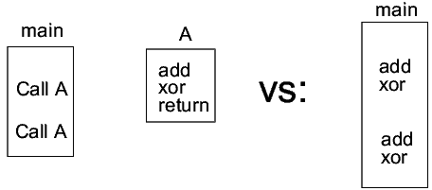
Why Procedures Cont.
Allows reduction in size of program in exchange for somewhat reduced performance (overhead of Call, Return, and certain associated overhead)

Slide 5
HLL Compilers ..
generate assembly language
instructions to implement
  calling the procedure
  returning from the procedure
  passing parameters to the procedure
  returning parameters from the procedure

Slide 6
MAL Procedure
Call & Return Mechanism
1 - Save the return address
2 - Call the procedure
3 - Execute the procedure
4 - Return to calling program

Slide 7
Reality -Procedure Execution Steps
1. Save parameters. Where?
  In registers (fast) or in memory (slow)
2. Save return address. Where?
  In registers (fast) or in memory (slow)
3. Call procedure. How?
  new jump instruction

Slide 8
Procedure Execution Steps Cont.
4. Allocate space to store procedure’s variables (local variables). Why?
  Variables are used temporarily, space can be reclaimed upon return.
  For recursive procedure call, must have multiple copies of local variables, one for each recursion.
How?
  using a special stack, the “system stack”

Slide 9
Procedure Execution Steps Cont.
5. Execute procedure
6. Deallocate local variables. How?
  Pop them off the system stack
7. Save return values, if any. Where?
  In registers (fast) or in memory (slow)
8. Get return address
9. Return. How?
  new jump instruction

Slide 10
Procedure Call
MAL has a special jump instruction for procedure calls, Jump and Link ( jal )
Instruction’s assembly format:
  jal proc_label
Instruction’s action:
  program jumps to the address represented by proc_label
  return address (address of instruction after jal ) is saved in $31, called the “link register” because it links the procedure back to the return location.

Slide 11
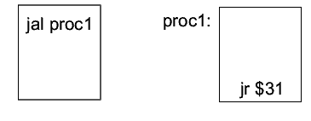
Procedure Return
A new instruction Jump Register ( jr ) is used for returning from a procedure
Instruction’s assembly format:
  jr $x
Instruction’s action:
  program jumps to the address contained in register x.
Together jal and jr allow for simple and fast subroutine calls/returns:

Slide 12
MAL Procedure Call Summary
jal proc1
next_instruction: ...
...
done
proc1: ...
...
jr $31
next_instruction

Slide 13
MIPS Jump Instructions
j jump to a label (similar to branch)
  Absolute address
jal jump and link
  jumps to a procedure
  saves the return address in $31
jr R jump register
  jumps to the location
  pointed to by register R

Slide 14
Procedure Call and Return
jal label1
  # Jump and Link
  jumps to the instruction at label1
  saves the return address in $31
jr $31
  # Jump Register
  copies value in register $31 to the PC

Slide 15
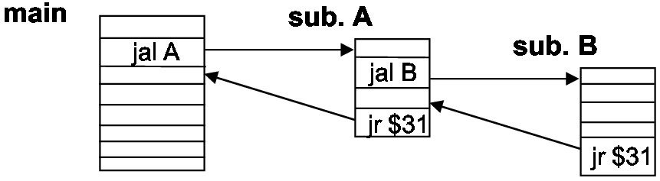
Nested Procedure Calls
We have a problem: when procedure A calls another procedure B (a “nested procedure call”) the contents of $31 are overwritten and the return address for A is lost:

Slide 16
Nested Procedure Calls Cont.
Solution: transfer the return address to another register
  In A, before call to B:
  move $16,$31 # save return address in reg 16
  To return from A:
  jr $16 # return address is in reg 16
This has limitations:
  Limited by number of nested procedures
  Programmer must keep return addresses straight

Slide 17
Dynamic Storage Allocation
return address in register $ra ($31)
must save this return address for
  nested procedure calls
  recursive procedure calls

Slide 18
Recursive Procedure Calls
It is possible for a procedure to conditionally call itself, a “recursive procedure call”.
  The number or recursive calls can be indefinite
  Cannot save return address in registers
Solution: save return addresses on the “system stack”
  Want a stack, because addresses are needed in the reverse order they are produced.
A register ($29) is designated as the system stack pointer

Slide 19
MIPS System Stack
stack pointer $sp ($29)
base of stack at high memory
stack grows down (toward smaller addresses)
$sp points to first empty location at the top of the stack
0x7fffffff
Stack Segment
Data Segment
Test Segment
0x400000
Reserved

Slide 20
Push
sw $8, 0($sp)
addi $sp, $sp, -4
or
addi $sp, $sp, -4
sw $8, 4($sp)

Slide 21
Stacking the Return Address
The system stack grows from high-numbered memory toward low-numbered memory
Proc1: addi $sp, $sp, -4 # make room on stack for return addr.
sw $ra, 4($sp) # save return address to the stack
...
beq $8, $9, exit # test some condition
jal Proc1 # recursive call
...
exit: lw $10, 4($sp) # restore return address from the stack
addi $sp, $sp, 4 # deallocate the stack space
jr $10 # return to the calling routine

Slide 22
Pop
addi $sp, $sp, 4
lw $8, 0($sp)
or
lw $8, 4($sp)
addi $sp, $sp, 4

Slide 23
Activation Records - Concept
When a procedure is invoked
  old environment must be saved.
  new environment is created
When the procedure terminates this new environment disappears and the old environment must be restored.
An activation record consists of all the information that corresponds to the state of a procedure.

Slide 24
Saving and Restoring
Activation Record (or Stack Frame) is pushed onto the stack just like a word.
  Can consist of multiple words
  Varies in size.
Stack pointer ($29) must be adjusted by this size
  After pushing
  After popping.

Slide 25
Pushing one at a time
sw $8, 0($sp)
add $sp, $sp, -4
sw $12, 0($sp)
add $sp, $sp, -4
sw $6, 0($sp)
add $sp, $sp, -4
jal proc
...
proc: sw $31, 0($sp)
add $sp, $sp, -4

Slide 26
Push Activation Record then Increment sp
sw $8, 0($sp)
sw $12, -4($sp)
sw $6, -8($sp)
jal proc
...
proc: sw $31, -12($sp)
add $sp, $sp, -16
...
add $sp, $sp, 16

Slide 27
Increment sp then
Push Activation Record
Most Common Method
add $sp, $sp, -16
sw $8, 16($sp)
sw $12, 12($sp)
sw $6, 8($sp)
jal proc
add $sp, $sp, 16
...
proc: sw $31, 4($sp)

Slide 28
Accessing Parameters in the Procedure
lw $4, 4($fp) # parameter 1
lw $5, 8($fp) # parameter 2
lw $6, 12($fp) # parameter 3
This assumes that the parameters are not passed via register.

Slide 29
Caller-Saved/Callee-Saved Registers
To avoid unnecessary register saves/restores, software convention divides the registers into two sets:
  “callee saved registers” (also called “saved registers”):
  preserved across a call
    caller does not have to worry about saving them.
  The callee must save them if it wants to use them.
    callee saved registers are $16-$23, $30 ($fp)

Slide 30
Caller-Saved/Callee-Saved Registers Cont.
  “caller saved registers” (also called “temporary registers”):
  may be destroyed by the callee without saving them.
  The caller must save these registers if it wants to preserve the values
    caller saved registers (except those reserved for system use): $2-$15, $24-25, $31 ($ra)

Slide 31
Passing Parameters
A fast method of passing parameters to a procedure is using registers (they are fast)
  MIPS uses the software convention that the first 4 parameters are passed in registers $4-$7
  Handles most procedure calls, because usually few parameters are passed.
  Additional parameters are passed on the system stack.

Slide 32
Passing Parameters Cont.
move $4, param1
move $5, param2
move $6, param3
move $7, param4
addi $29, $29, -12 # make room on stack for two params
# and return address
sw $31, 4($29) # save return address in top stack
# location
sw $14, 8($29) # store 6th param in next stack location
sw $15, 12($29) # store 5th param in next stack location
jal Proc1 # call procedure
...

Slide 33
Passing Parameters Cont.
Proc1: # params 1-4 are in registers $4-$7,
# can use them directly from those regs.
lw $8, 12($29) # put 5th parameter in a register
lw $9, 8($29) # put 6th parameter in a register
...
lw $10, 4($29) # put return address in a register
addi $29, $29, 12 # deallocate stack space
jr $10 # return to caller
...

Slide 34
Return Values
Procedure return values are handled similarly:
  First 2 return values are returned in registers, $2 and $3.
  Additional return values are passed back on the stack.
By convention with HLL, only 1 value is returned
  Vo and V1 support double length return values.

Slide 35
Dynamic Storage Allocation
A procedure’s local variables can be allocated on the system stack, on procedure entry
  Allows instances of variable for recursive calls
  Provides proper variable scope
  Allows easy deallocation
E.g., allocating 2 local index variables. Rather than write:
  .data
  i: .word
  j: .word
You write:
  .text
  myproc: addi $29, $29, -8 #allocate space for 2 local variables

Slide 36
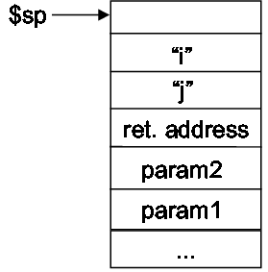
Dynamic Storage Allocation (cont.)
  The first index variable is accessed as:
  lw/sw $x, 4($29) # its location is on the top of the stack
  The second index variable is access as:
  lw/sw $x, 8($29) # its location is second from top of the stack
Local variables are pushed on top of return address and any parameters passed on stack:
Top Of Stack
The only local variables allocated space on the stack are those that cannot stay in a register their entire life.

Slide 37
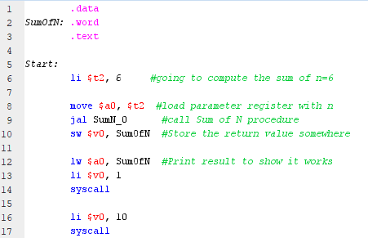
SumN Example

Slide 38
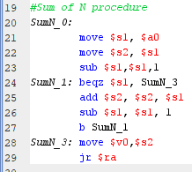
SumN Example.

Slide 39
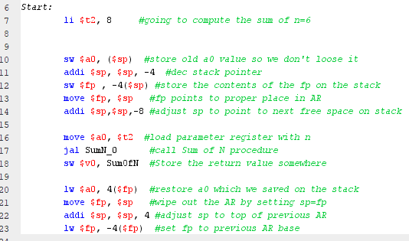
SumN, Full AR creation

Slide 40
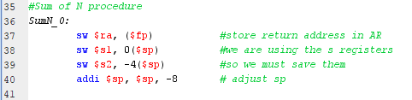
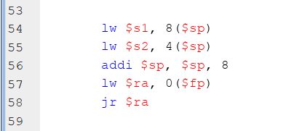
SumN, Full AR creation.
Same code as before

Slide 41
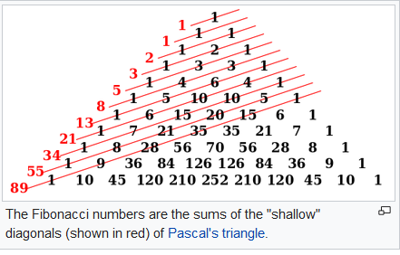
Fibonacci Sequence
Defined as a recursive function
  F(n) = 0 ; n=0
  1 ; n=1
  F(n-1) + F(n-2) ; otherwise
Generates the numbers

Slide 42
Fibonacci Sequence
Java code
public int fibonacci(int n) {
if(n == 0)
return 0;
else if(n == 1)
return 1;
else
return fibonacci(n - 1) + fibonacci(n - 2);
}

Slide 43
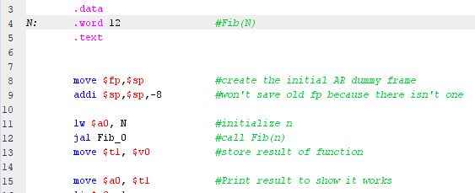
Fibonacci Sequence
Must create a dummy AR for initial procedure call
Don’t have to save old a0 first time in
N is loaded into a0 the parameter
Save return value somewhere safe

Slide 44
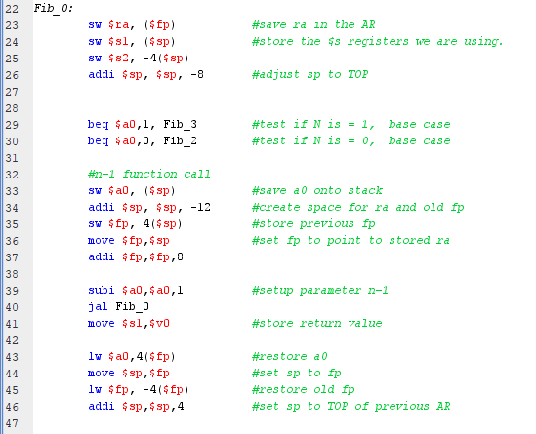
Fibonacci Sequence
ra is stored in AR, we decide to use s1 and s2, so they must be saved onto the AR
There are 2 base cases, each must be identified
Create a new AR for Fib(n-1), saving a0 onto stack.
After Fib(n-1) return we must undo the AR created above

Slide 45
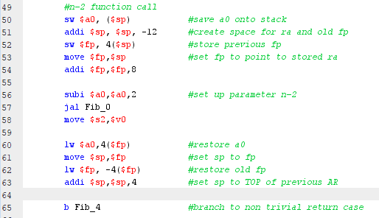
Fibonacci Sequence
Same as previous call, except on return we save the result in a different register.
Branch to code to add S1 and S2, the results of the 2 Fib calls

Slide 46
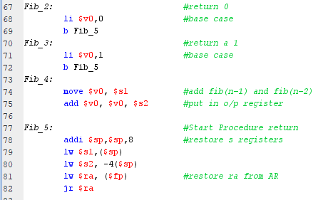
Fibonacci Sequence
Load return value of each base case as appropriate into return register
Branch to code to add S1 and S2, the results of the 2 Fib calls
Restore the saved S1 and S2 from AR, load the stored ra from the AR, then return from the procedure

Slide 47
When to create an AR
Leaf function is one that does not call any other function, including it’s self.
  In this case an AR can be avoided.
  Jal target, and jr $ra will suffice
All other cases require a full AR

Slide 48
Dynamic and Static Links
Dynamic links are simply the old fp, which binds together the AR.
When a function contains a function, a static link will point back to the level of nested function.
E.g. If p is contained in f then the static link points from p to the AR of f. Regardless if p calls itself recursively.

Slide 49
Static link Example
F(){
int x
P(int y){
x=2;
if (y>0)
P(y-1);
}
}
The AR for F will have x declared at
  x -> fp-12
  To access x from P
  lw t0, -8(fp)
  lw t1, -12(t0)
RA
Dynamic
Static

Slide 50

Main () as a Procedure
Main () is called by the operating system, somewhat like a procedure, except:
  Return address is not saved, so called using jump rather than JAL
    OS does not necessarily want to execute the next instruction after jump to user code
  Return is via a special instruction SYSCALL, which jumps to a special return location in the OS.
    User is blocked from jumping to other locations in the OS, for security and reliability
    SYSCALL exit.

Slide 51
Global Data.
.globl
Allows the label to be referenced by other programs.
Similar to public and private in Java.

Slide 52
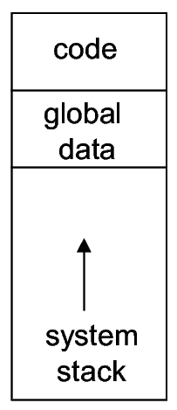
Global Data
Non-local data that can be accessed in all procedures (called Global Data) is kept in a special region of memory
  Global data space is accessed via global pointer ($gp)
  Created by:
    .extern name size_in_bytes.
Compiler and linker then reference this data as offsets to $gp
Normally used when multiple programs wish to access common resources.

Slide 53
End

