Slide 1
Week 6
Tell me and I forget. Teach me and I remember. Involve me and I learn.
-Benjamin Franklin

Slide 2
Branching Statements
Simplest is unconditional branch
  b address
Address is a label and points somewhere in the code section of the memory.
Allows the PC to jump to a new location in memory to read the next opcode.

Slide 3
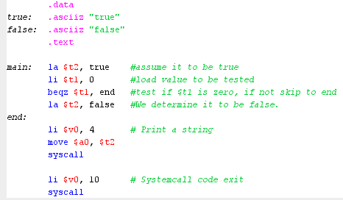
If Statement

Slide 4
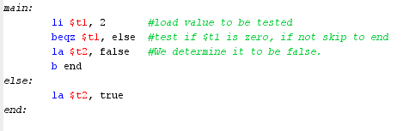
If else

Slide 5
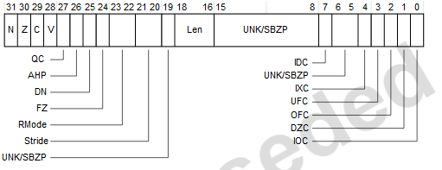
Condition Codes
Register where the bits represent specific states of the processor
Each Processor will have a unique set of condition codes, but the general function remains the same.
Below is the ARM processor

Slide 6
Explicit Compare and Branch
This type of branching uses 2 ALUs
  1st for address modification
    PC = PC + offset
  2nd for the comparison.
E.g.
  blt R1, 10, target #if R1 < 10 then goto target

Slide 7
Implicit Condition Codes.
General concept
  Set the condition codes by performing an ALU Operation.
    Virtually all ALU operations will set the condition codes.
  Branch according to the state of a particular code.
  E.g.
    Sub R1, R1, 1 #subtract 1 from register 1
    Bez End #if condition code Z = 1 then branch
  It is assumed that subtracting 1 from R1 could result in R1 becoming Zero
    When R1 becomes 0, the Z flag is set in the condition code.
    Bez (branch if zero) will branch if Z is set, otherwise it will fall through to the next instruction.

Slide 8
Condition Registers, Separate Branch inst.
Special instructions which will test for a specific property and only set that condition code
  E.g. Branch if $t2 < 10
  blt $t2, 10, skip
  Is expanded to:
  slti $1, $t2, 10 #set $1 = 1 if t2 < 10
  bne $1, $0, 2 #2 is the offset for the PC in our example
  Note: reg $1 is the assembler reserved register.

Slide 9
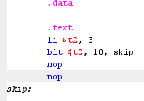
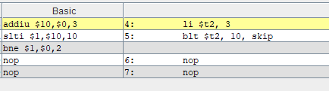
Code example

Slide 10
MIPS
Uses a combination of Implicit and Condition registers
  86% of branches are equality or inequality, beq and bne
    Compare 2 registers and branch
    These comparisons are implemented directly in hardware.
    OR
    Comparison to zero - bgtz, bgez, bltz, blez
    Hardware implemented.
  14% of branches are Compare to an immediate
    Thus we have 2 instructions, slt, sltu, slti, etc. and the branch
Makes sense that the first branch option is very efficient.

Slide 11
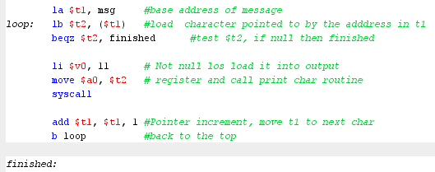
Print String Char by Char while loop

Slide 12
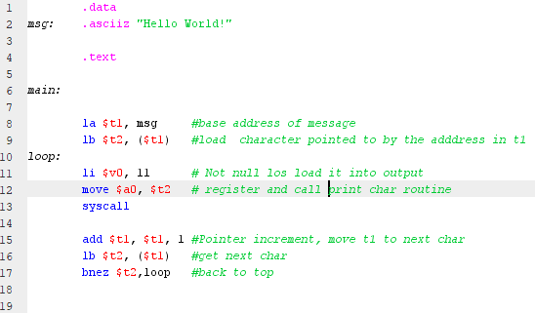
Print Char by Char do_while loop

Slide 13
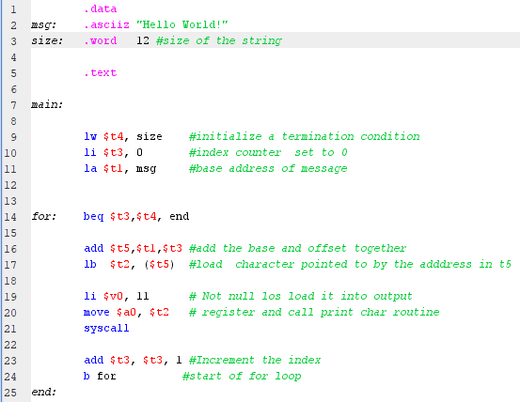
Print Char by Char for loop

Slide 14
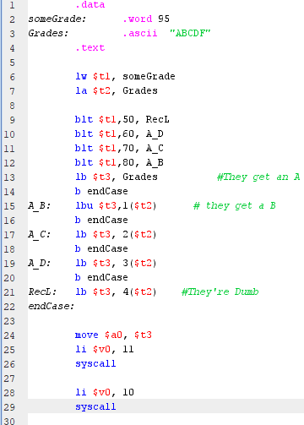
Letter Grade case statement

Slide 15
Branch vs. Jump
A branch is relative to the PC.
  An unconditional branch should be used within procedures to allow code to be moved in memory.
  An unconditional jump is uses for absolute entry points.
E.g.
  Dynamic link libraries (*.dll) use an export address table to define the methods which the dll supports. The address table is modified to reflect the entry points to methods in the dll. This is done by the OS on dll load. Addresses in this table would use jump.
Always use b for unconditional branching within a procedure.

Slide 16
End

