Slide 1
Week 5
Computers are like Old Testament gods; lots of rules and no mercy.
Joseph Campbell

Slide 2
MIPs Assembler
Like most High Level Languages, assembly uses much of the same practices.
  Enter text as Assembly Code
  Assemble the code producing machine code
  Run the machine code.

Slide 3
Basic program format
data
    Variables are declared here
text
    Code goes here

Slide 4
Basic Program
#This is where variable definitions go
.data
theSolution: .word 42 #in decimal
#This is where code goes
.text
Main:
lw $t0,theSolution #load value stored at address
addi $t0,$t0, 3 #add 3 onto 42
move $a0, $t0 #output our value
li $v0, 1
syscall
li $v0, 10 # Systemcall code exit
syscall

Slide 5
Basic Program
All labels are denoted as:
  someVariableName:
  All of these can be viewed as memory addresses.
  These are sometimes referred to as symbolic addresses
  The Assembler will use these to:
    Reference memory location
    Control program flow

Slide 6
BIOS functions
Basic Input Output System
  All cpu architectures have one, just the name may be different.
  X86 it is called the BIOS
    Recall your PC has a BIOS
  MIPs refers to it as the firmware routines
BIOS routines are drivers located in the firmware which interface the OS to the hardware.
  The OS has access to these, but are protected from user programs.
  User software can access these OS routines which access the firmware by making system calls to the OS.
  To protect these subroutines, the OS switches to Kernel Mode.

Slide 7
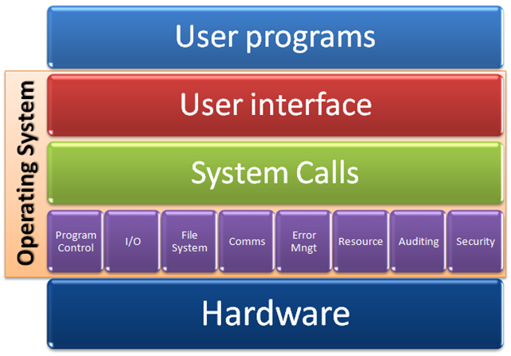
OS Kernel
Figure to the right shows a typical system.
The kernel is viewed as the green and purple sections.
To get to any functionality you must go through protected system calls

Slide 8
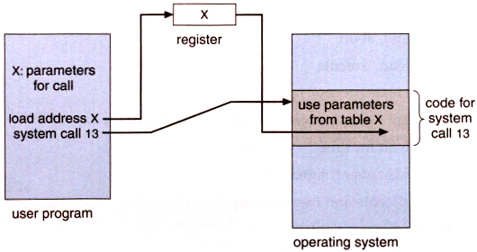
Typical BIOS routine example
User programs will load specific registers with output data, service #.
Issue a syscall.
OS determines what type of syscall, and processes the data accordingly.
When complete, control returns to the user program.

Slide 9
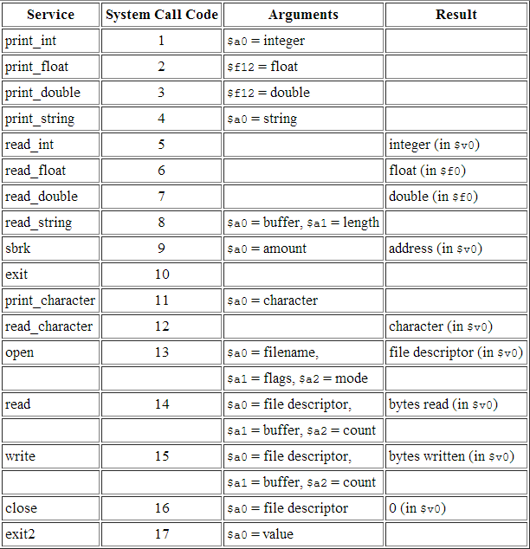
Sys Calls
MIPs has 17 standard system calls.
MARS simulator has extended system calls.

Slide 10
Load and Store Word
40% of all instructions will load and store data to/from the registers.
  Lw $t0, some_label
    Get the contents of memory address “some_label” and place it into register $t0.
At times it may be convenient to have the data address in the register
  Lw $t0, ($t1)
    ($t1) indicates that the contents of $t1 is an address and should be treated as such.
    This implies that addresses can be contained in registers and are thus susceptible to arithmetic operations.
    This allows for dynamic addressing control.
  La $t0, some_label
    Loads the some_label address into a register.
Store instructions will work the same way
  Sw $t0, some_label -- in this case the contents of $t0 is placed into memory at some_label
  Sw $t0, ($t1) - has a similar effect.

Slide 11
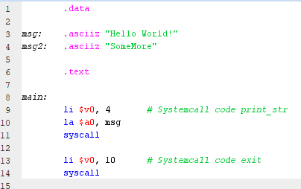
Hello World
Strings can be defined as being null terminated or not.
.asciiz is null terminated.
La $a0, msg will load the base address of msg into $a0 for the syscall
Syscall will output the entire message upto the null character at the end of the string.

Slide 12
Hello World!.
Stored in memory as a series of bytes.
Note the low byte of each word is on the right.
Null terminator is a 0.
String terminator.

Slide 13
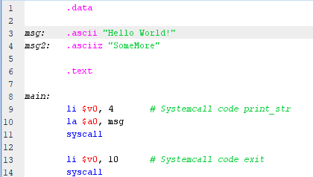

Hello World!
Note what happens when we remove the terminator from the first string.

Slide 14
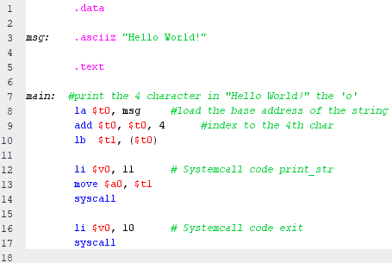
Byte Addressable Memory
MIPs uses byte addressable memory.
Each address refers to a unique byte in memory.
Words are collections of 4 bytes, and reside on addresses exactly divisible by 4.
First 3 lines can be reduced to: lb $t1, msg + 4

Slide 15
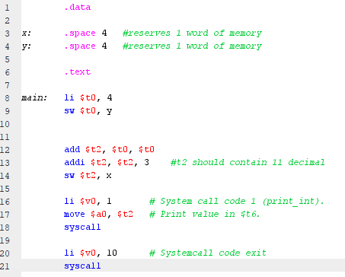
Simple Arithmetic
Variables x and y are defined and given 4 bytes of space in memory.
Result is placed in x which appears first in the .data section, see below.

Slide 16
End

