Slide 1
Week 4
Enemies make you stronger, allies make you weaker.
Frank Herbert

Slide 2
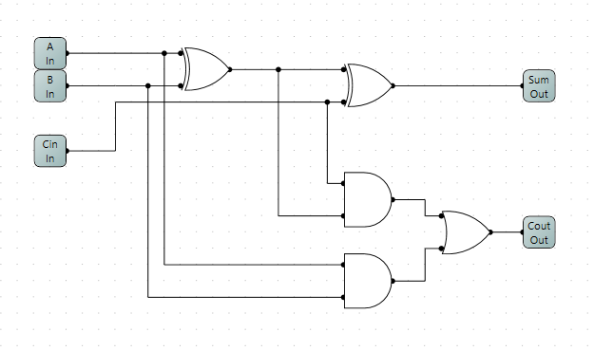
Full Adder

Slide 3
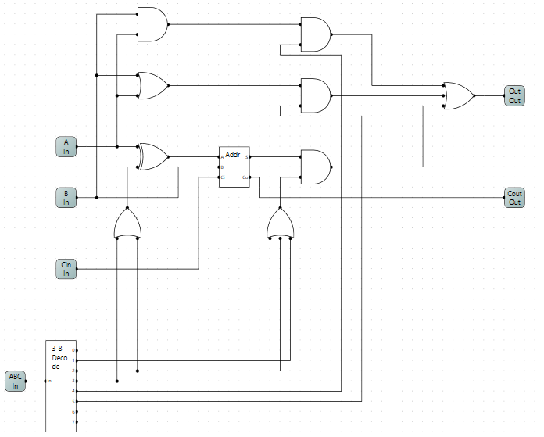

1 Bit ALU
OR and AND functions are implemented separately
AND gates control which functional unit will have output
Adder is used to Add, Sub, Invert
Inversion is controlled by the XOR
Decoder determines what the ALU will do. Outputs of the decoder will activate AND gates and control the inputs (inversion) as appropriate

Slide 4
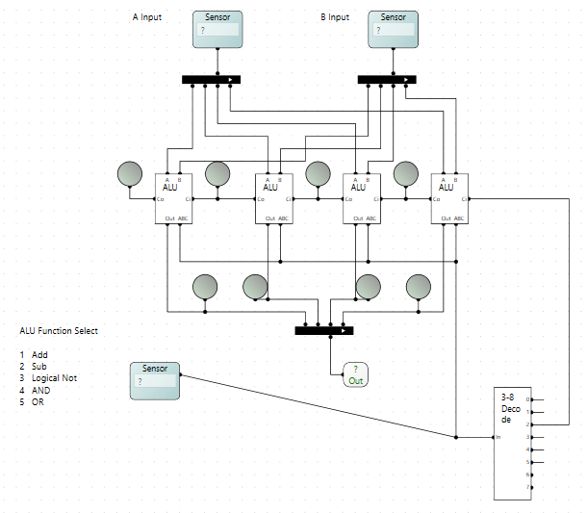
4 Bit ALU
These sensors input define the 4 bit A and B inputs to the ALU
Replicate the 1 Bit ALU 4 times
Sensor is used to select the ALU function
Subtraction is ALU function 2, must force 2’s complement by adding 1 to the inverse of the A input, force Cin to 1.

Slide 5
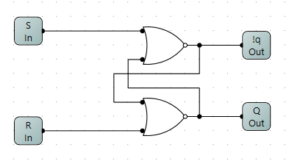
SR Latch

Slide 6
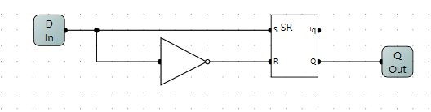
D-Latch

Slide 7
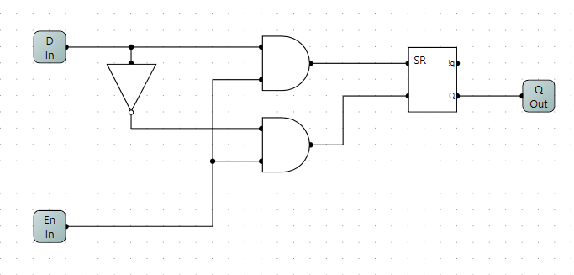
D-Latch with enable

Slide 8
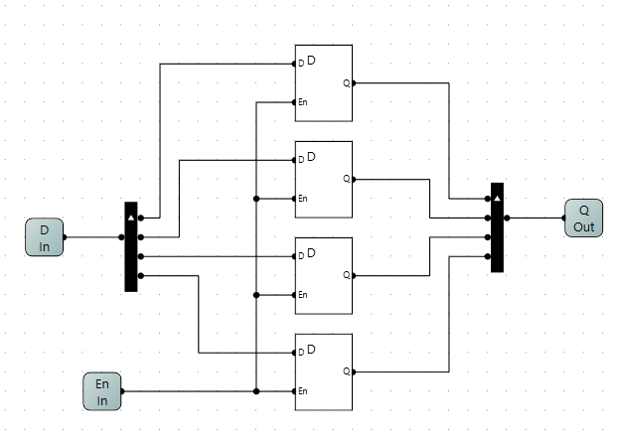
1x4 Memory Circuit

Slide 9
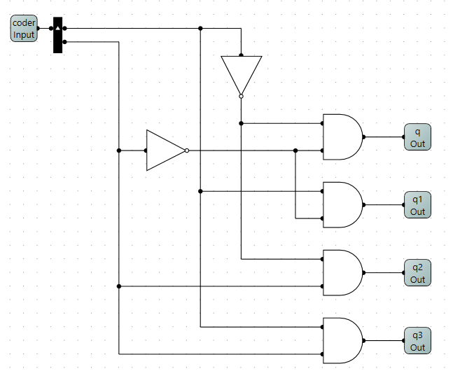
2-4 Decoder

Slide 10
MIPs Architecture

Slide 11
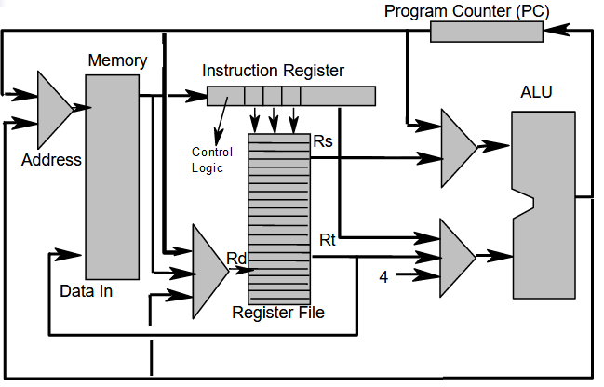
Introduction To MIPs Architecture
Register file is central.
All operations will involve the registers.

Slide 12
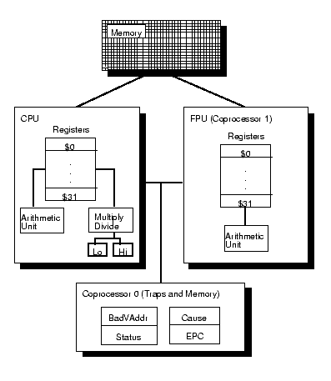
Another View of the R2000

Slide 13
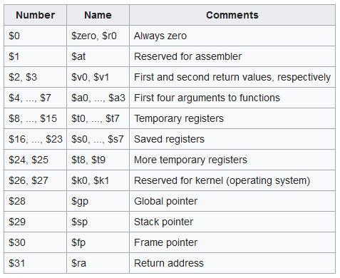
MIPS Register File

Slide 14
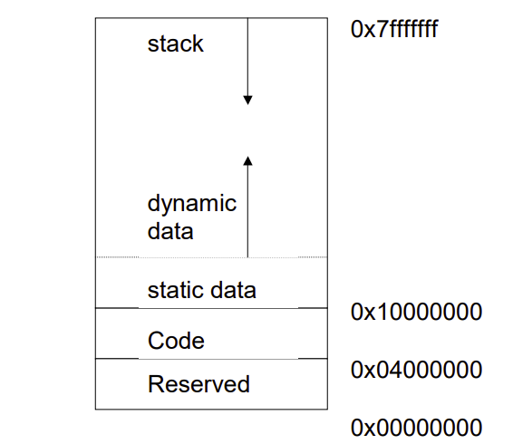
Memory Layout in R2000/3000
text segment: the code data segment
  • static data: objects whose size is known to the compiler & whose lifetime is the whole program execution
  Pointed to by gp.
  Shared memory.
  • dynamic data: objects allocated as the program executes (malloc) Heap Space

Slide 15
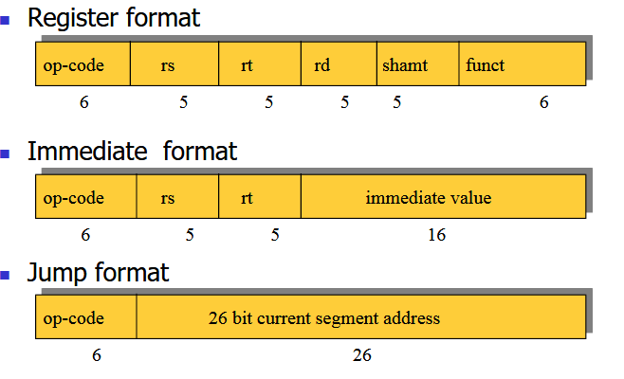
MIPs Instruction Format

Slide 16
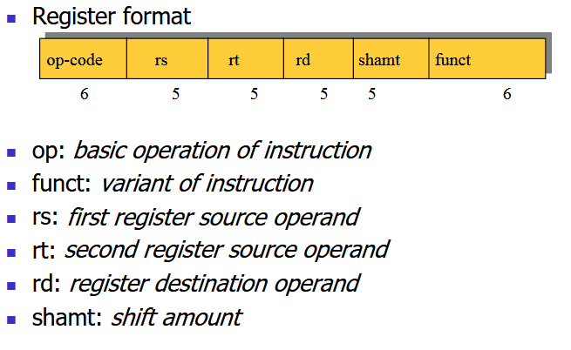
Register Format

Slide 17
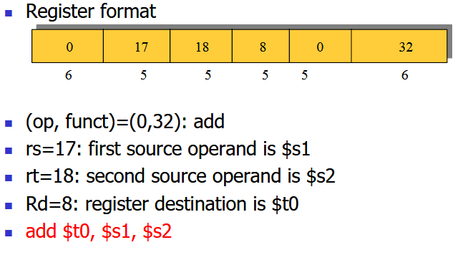
Register Format Example

Slide 18
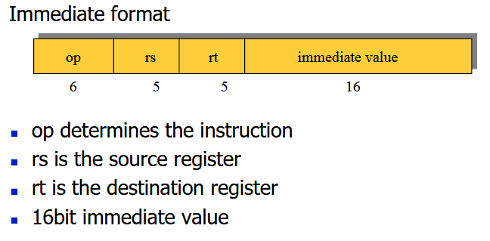
Immediate Format

Slide 19
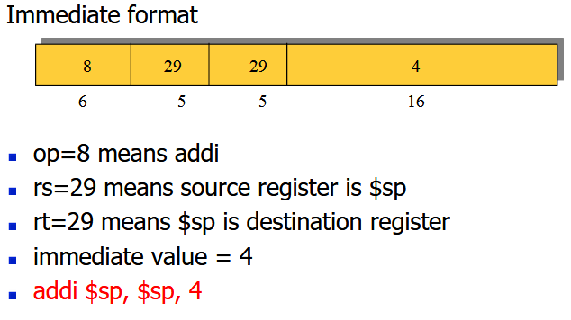
Immediate Format Example

Slide 20
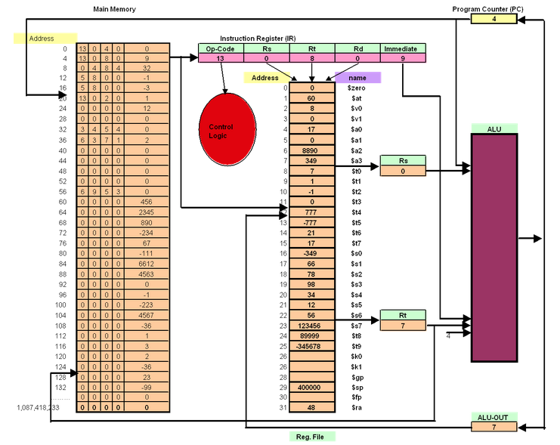
Immediate values directly enter the ALU.
IR contains some example instruction
Based on the format, Rs,Rt and Rd will always reference the register file. There values enter the ALU
ALU results go back to register file, these in turn can be loaded or stored to main memory.

Slide 21
Addressing Modes
Defines how information is moved
  To memory
  From memory
  Through the ALU
Each type of CPU will have a defined set of valid modes.
  MIPS - 5 addressing modes
  X86 – 12 addressing modes
The modes are realized in the instruction set architecture
  Define the assembly syntax.
Modes are responsible how address resolution of each instruction is accomplished.

Slide 22
Effective Address
The result of an assembly instruction decode is an operator (opcode) and operand resolution.
Operand resolution often calculates the effective address of the operand
  Memory location
  Register
E.g.
  Add $t0, $t1,$t2 – each operand resolves to a register in the register file
  LW $t0, ($t2) -- ($t2) resolves to a memory location
  SW $t0, 4($t2) -- resolves to a memory location ($t2) + 4.
  LW $t0, label -- label defines a memory address

Slide 23
Register Addressing
Instruction will only use registers from the register file.
  E.g. add $t0, $t1, $t2
Can be read as the contents of $t1 + $t2 is stored in $t0.
View registers in the register file as variables which can be directly accessed.

Slide 24
Base Displacement
Contents of a register is an address in memory.
  Defined when a register is in brackets
  E.g. lw, $t0, ($t1), where register t1 contains a memory address.
Offsets from this address are defined as:
  Lw $t0, 4($t1)
  Read as 1 word displaced from base address ($t1).
Usage: Record processing, where base of record is stored in the register, variables are offsets from the base.
Note: 1 word is 4 bytes, so each word has a 4 byte offset.

Slide 25
Immediate Addressing
Directly load a register with a defined value or literal
E.g. li $t0, 0 -- puts the value 0 into register $t0.

Slide 26
PC Relative
Effective address is calculated relative to the PC.
  E.g. b label -- Branch unconditionally
  Effective address is calculated as:
    PC + Offset where offset is signed allowing forward and backward branching

Slide 27
Pseudo PC Direct
Effective address is a direct memory address:
  E.g. J target where target is an absolute memory address
Usage jumping to a procedure
  Jumping to another process.

Slide 28
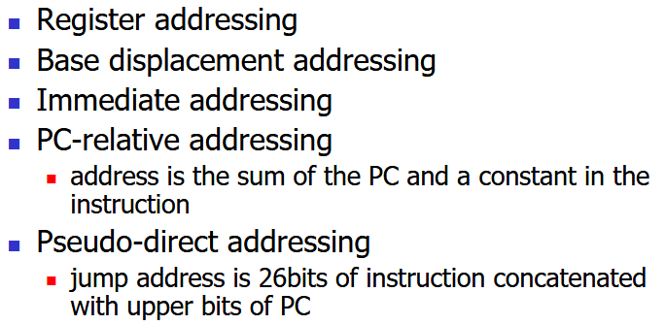
MIPs Addressing Modes

Slide 29
Pseudo vs True Assembly Instructions
For convenience MIPs has a large set of Pseudo instructions, also called macro instructions.
Assembler will expand these to true Assembly (instruction set architecture instructions).
  Makes coding easier.
E.g. Load address
  la $t0, some_variable
  will load the memory address of some_variable into $t0.
This is expanded to:
    lui $1, memory_address of some_variable
    ori $t0, $1,0

Slide 30
The End

