Slide 1
Cosc 2P12 Week 2

Slide 2
Some Definitions
Rational Number
Can be represented by dividing 2 integers, E.g. A/B
Irrational Number
A/B results in a non-repeating, non-terminating decimal, Pi, sqr(2).
Terminating Decimal
Rational Numbers which have a terminating decimal equivalent
Non-Terminating Rational numbers
Contain a repeating sequence of numbers, call the Reptend

Slide 4
Goals of Integer Representation

Slide 5
Unsigned
base ten base two
0 0000
1 0001
2 0010
3 0011
4 0100
…
8 1000
15 1111

Slide 6
Sign Magnitude
left bit is for the sign
0 for positive
1 for negative
remaining bits for the magnitude
e.g. 0011 = +3 1011 = -3

Slide 7
One's Complement
to change the sign:
toggle all bits i.e. 1--> 0 0-->1
e.g. 0011 = +3 1100 = -3
note: zero has two representations
0000 = + 0 1111 = - 0

Slide 8
1’s Compliment

Slide 9
Two's Complement
to change the sign:
toggle all bits i.e. 1--> 0 0-->1
and then add 1
e.g. 0011 = +3
1100 + 0001 = 1101 = -3
note: largest positive number (in 4 bits)
is 0111 = +7
1000 = -8 is the largest negative number
But is invalid since -8 and 2’s comp is the same

Slide 10
2’s compliment

Slide 11
Biased Representation
Subtract a constant value (the bias) from the unsigned interpretation
For a 3 bit representation with a bias of 4
range of unsigned is 0 .. 7
range of biased is -4 .. +3
Note: bias value is typically 2^{n}-1
An 8 bit bias value would be 0111 1111.

Slide 12
Negative Numbers

Slide 13
Notes on Integer Representation
positive integers are represented the same in all but biased
S-M & complements msb is the sign
(0 for +, 1 for -)
two's comp. & bias 128 represent the same values except msb is inverted

Slide 14
Sign Extension
Typical Integer Representations are
8, 16, 32, 64 bits.
We want to:
Change a smaller representation to a larger one.
Representations
unsigned
sign-magnitude
complement

Slide 16
Char Dec Oct Hex | Char Dec Oct Hex | Char Dec Oct Hex | Char Dec Oct Hex
-------------------------------------------------------------------------------------
(nul) 0 0000 0x00 | (sp) 32 0040 0x20 | @ 64 0100 0x40 | ` 96 0140 0x60
(soh) 1 0001 0x01 | ! 33 0041 0x21 | A 65 0101 0x41 | a 97 0141 0x61
(stx) 2 0002 0x02 | " 34 0042 0x22 | B 66 0102 0x42 | b 98 0142 0x62
(etx) 3 0003 0x03 | # 35 0043 0x23 | C 67 0103 0x43 | c 99 0143 0x63
(eot) 4 0004 0x04 | $ 36 0044 0x24 | D 68 0104 0x44 | d 100 0144 0x64
(enq) 5 0005 0x05 | % 37 0045 0x25 | E 69 0105 0x45 | e 101 0145 0x65
(ack) 6 0006 0x06 | & 38 0046 0x26 | F 70 0106 0x46 | f 102 0146 0x66
(bel) 7 0007 0x07 | ' 39 0047 0x27 | G 71 0107 0x47 | g 103 0147 0x67
(bs) 8 0010 0x08 | ( 40 0050 0x28 | H 72 0110 0x48 | h 104 0150 0x68
(ht) 9 0011 0x09 | ) 41 0051 0x29 | I 73 0111 0x49 | i 105 0151 0x69
(nl) 10 0012 0x0a | * 42 0052 0x2a | J 74 0112 0x4a | j 106 0152 0x6a
(vt) 11 0013 0x0b | + 43 0053 0x2b | K 75 0113 0x4b | k 107 0153 0x6b
(np) 12 0014 0x0c | , 44 0054 0x2c | L 76 0114 0x4c | l 108 0154 0x6c
(cr) 13 0015 0x0d | - 45 0055 0x2d | M 77 0115 0x4d | m 109 0155 0x6d
(so) 14 0016 0x0e | . 46 0056 0x2e | N 78 0116 0x4e | n 110 0156 0x6e
(si) 15 0017 0x0f | / 47 0057 0x2f | O 79 0117 0x4f | o 111 0157 0x6f
(dle) 16 0020 0x10 | 0 48 0060 0x30 | P 80 0120 0x50 | p 112 0160 0x70
(dc1) 17 0021 0x11 | 1 49 0061 0x31 | Q 81 0121 0x51 | q 113 0161 0x71
(dc2) 18 0022 0x12 | 2 50 0062 0x32 | R 82 0122 0x52 | r 114 0162 0x72
(dc3) 19 0023 0x13 | 3 51 0063 0x33 | S 83 0123 0x53 | s 115 0163 0x73
(dc4) 20 0024 0x14 | 4 52 0064 0x34 | T 84 0124 0x54 | t 116 0164 0x74
(nak) 21 0025 0x15 | 5 53 0065 0x35 | U 85 0125 0x55 | u 117 0165 0x75
(syn) 22 0026 0x16 | 6 54 0066 0x36 | V 86 0126 0x56 | v 118 0166 0x76
(etb) 23 0027 0x17 | 7 55 0067 0x37 | W 87 0127 0x57 | w 119 0167 0x77
(can) 24 0030 0x18 | 8 56 0070 0x38 | X 88 0130 0x58 | x 120 0170 0x78
(em) 25 0031 0x19 | 9 57 0071 0x39 | Y 89 0131 0x59 | y 121 0171 0x79
(sub) 26 0032 0x1a | : 58 0072 0x3a | Z 90 0132 0x5a | z 122 0172 0x7a
(esc) 27 0033 0x1b | ; 59 0073 0x3b | [ 91 0133 0x5b | { 123 0173 0x7b
(fs) 28 0034 0x1c | < 60 0074 0x3c | \ 92 0134 0x5c | | 124 0174 0x7c
(gs) 29 0035 0x1d | = 61 0075 0x3d | ] 93 0135 0x5d | } 125 0175 0x7d
(rs) 30 0036 0x1e | > 62 0076 0x3e | ^ 94 0136 0x5e | ~ 126 0176 0x7e
(us) 31 0037 0x1f | ? 63 0077 0x3f | _ 95 0137 0x5f | (del) 127 0177 0x7f

Slide 18
How it used to work.

Slide 19
Floating Point Representation
IEEE FPS (Floating Point Standard)
exponent - 8 bit biased - 127 integer
mantissa - normalized, scaled,
sign-magnitude integer
scaled - mantissa is implicitly divided by a constant ( 2 ²³)
Shifted due to hidden bit.

Slide 20
Hidden Bit
m = 1.b₋₁b₋₂b₋₃•••b₋₂₂b_{-23 two}
Since we know m ≤ 1 < 2 (b₀) we don’t have to represent it.
b₀.b₋₁b₋₂b₋₃•••b₋₂₂b_{-23 two}
So all we Store is:
b₋₁b₋₂b₋₃•••b₋₂₂b_{-23 two}

Slide 21
Representation in IEEE FPS
SEF
S - sign of the significand
E - referred to as exponent
F - fractional part of significand (mantissa)
e - true exponent (E -127) due to bias representation

Slide 22
Representing Zero
Since b₀ is not stored we need another method
Reserve -127 of Exponent
Forces Exp to be pos unsigned integer, because of bias
FPS defines 0 as Mantissa=Exp=0
F=E=0 in SEF standard

Slide 23
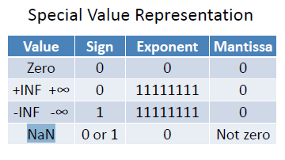

Slide 24
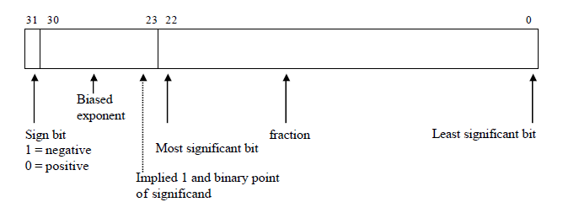
Short FP

Slide 25
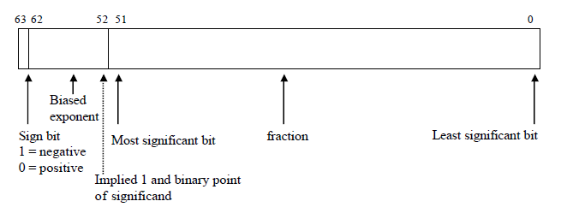
Long FP

Slide 26
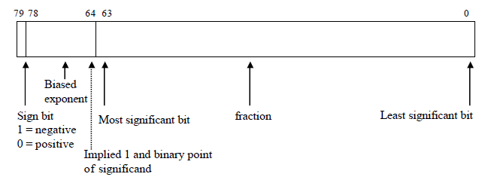
Extended FP Numbers

Slide 27
Conversion to Floating Point
Break decimal number into two parts.
Convert integer part to binary
Convert fraction to binary
Put the two pieces back together
Normalize and put into Scientific Notation
E.g. 33.3125

Slide 28
FPS Standard

Slide 29
End

