Slide 1
Parallel Evolution
By: Andrew Moir

Slide 2
Table of Contents
Overview of Evolutionary Computation
Programming Strategies
  Related Architecture
  Efficiency Comparison
Implementations
Conclusion

Slide 3
Origins
Based on the study of evolution by Charles Darwin
In 1859 he published ”On the origin of species by Natural Means of Selection”
The problem is perfect for parallel computation because nature is highly parallel

Slide 4
Genetic Algorithms
A technique for exploiting and exploring a search space for NP complete problems (very complicated problems)
A subclass of evolutionary computation that is commonly used
The genetic algorithm uses a population of chromosomes (problem specific) and evolves them through both mutation and crossovers

Slide 5
The Chromosome
A representation of a solution for a given problem
  E.g.: Traveling Salesman – The chromosome could be a list (order matters) of cities to visit
There will be a population of these that is usually large (more than 100)

Slide 6
Evolving the Population
At every step the population must evolve
Mutation
  Several methods including complete recreation, swapping of members (e.g. swapping two cities)
Crossover
  The are many different techniques:
    Uniform Order Crossover -> take two chromosomes and a mask (random 1’s and 0’s) and creates two children (explained next slide)
    One Point Crossover -> choose a point and swap the parents at each point (note: this will not work for the TSP as there is a chance we will have the same city twice, and miss a city)

Slide 7
Uniform Order Crossover
This is one of the most common crossover types as it works for most problem types that GA’s are used for:
  Example with the TSP:
    Parent 1: 263849517
    Parent 2: 923754816
    Mask: 010110010
    Child 1: 962843715
    Child 2: 623758419

Slide 8
Evaluation
At every generation each chromosome is evaluated
The evaluation is problem specific
  E.g.: For the TSP the distance/time required to traverse the entire array of cities is the value
The evaluation is used to rate a chromosome, at the end of the evolution the best (winner) is chosen as the solution
  It can also be used in ‘elitist’ evolution as well as being used for crossover methods, and tournament selection

Slide 9
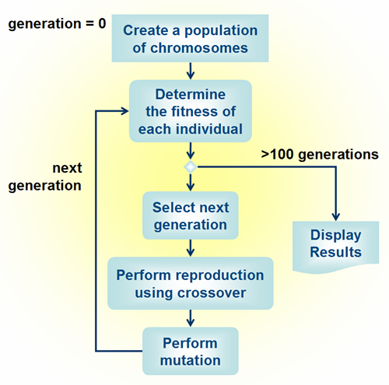
Overview

Slide 10
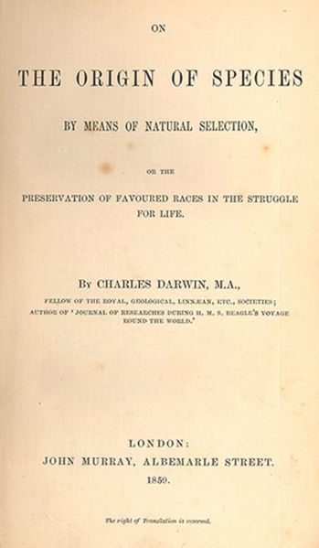
Questions on GA’s

Slide 11
Parallel Evolution
For obvious reasons (nature perhaps), we can see that evolution is a parallel process
The question is: how can we incorporate evolutionary computation with parallel computing
There exist many simple ways to implement a Parallel Genetic Algorithm

Slide 12
Identical Independent Processing
This method (IIP) is simple: Have multiple processors with the same program running at the same time (the random number generators using a different seed)
This is useful because a GA may get different results each time it is run, and may need to be run many times to get the best (closest to optimal) solution
The speedup obtained is both proven empirically and theoretically
Works on a basic SIMD architecture

Slide 13
Speedup for IIP
The speedup expected (in theory) is approximately:
  SU ≈ ms^{m-1}
Where SU = Speedup, M = The number of given processors, and S = some number (greater than 1)
The exact value of s is dependant on the problem, and how complicated it is

Slide 14
The Password Problem
By running a parallel GA on a problem that has a flat objective function we can find ‘s’ (in previous formula) for the speedup, based on iterations
Empirically, the study found a speedup of 1.000255, which is unfortunately not a huge increase

Slide 15
The Sandia Mountain Problem
Is a difficult problem for many AI techniques as there is a large basin for suboptimal minima compared to the small basin for the true optimal (i.e. there is a very good chance it will be stuck in a local minima as oppose to the global optimal)
The study found an ‘s’ value of 1.1488966, which is an improvement over the basic GA by using the IIP method

Slide 16
The Inverse Fractal Problem
This is a difficult problem, where there is a probability that the time to reach a goal state can be infinite
The problem was run on a Sun Sparc workstation and took about an hour per 10,000 iterations (generation)
In 24 runs, on a single problem, a run time (# of iterations) was in excess of 100,000
A ‘successful’ solution was one such that the Hausdorff distance was less than 500

Slide 17
IFP continued
The difference in run time for the problem in serial vs. The run in parallel was in the order of 600-700 (the s value)

Slide 18
Conclusion of IIP solutions
IIP solutions for Genetic Algorithms can give small speed increases on simple problems, or problems with a flat objective function
However when set on problems that are ‘deceptive’ (i.e. Problems that have many local minima and are very hard to traverse, in some cases may take infinite time) the IIP solution can yield massive (in the order of hundreds) speed improvements

Slide 19
Master Slave Genetic Algorithms
There is a single population, however evaluation of fitness is distributed between many ‘slave’ processors (workable on a SIMD machine)
Evaluation of fitness can be a very complex process (may take a relatively long time), therefore breaking the population into subsections and having the evaluation done on multiple processors gives a substantial decrease in total time

Slide 20
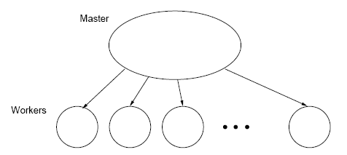
Master and Slaves

Slide 21
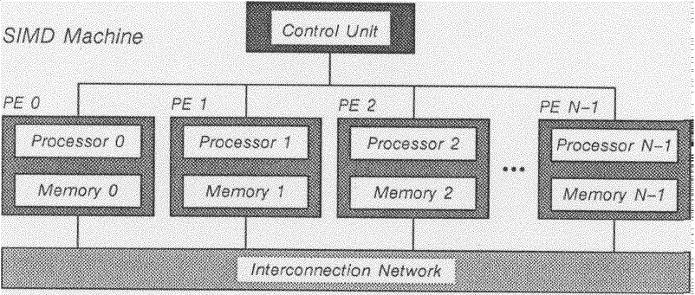
SIMD Architecture

Slide 22
Conclusion of Master-Slave
Note that this is very similar to our typical GA, the population mating is random, and the process in entirely the same. It simply uses the extra processors to divide the evaluation
Pros: Very easy to implement, use the fundamentals of a GA, and greatly improve GA’s with complicated evaluation functions
Cons: communication overhead and dealing with ‘slow’ processors

Slide 23
Fine-Grained GA
This method uses a single population where each chromosome is a processor (optimally of course)
Members may only compete and procreate with other members of their neighbourhood
Because each member has a neighbourhood the neighbourhoods overlap and allow good solutions to emanate across the population
The method is similar to a regular GA, however restricts breading to neighbourhoods, which inevitably led to solutions faster

Slide 24
Single Population Fine Grained
Can be used on a massively parallel computer with an architecture like a Torus
Ideal: we have 1 chromosome per individual processor (you can see why it would need to be a supercomputer)
It was found that neighbourhood sizes that were too large led to poor solutions
The algorithm can be run on many architectures (Torus, Hypercube, 10-D binary hypercube) but is optimal on the Torus

Slide 25
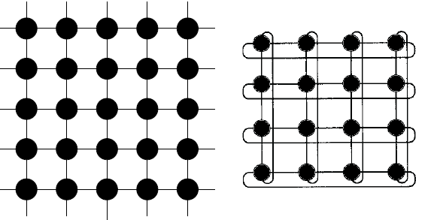
Single Population Fine Grained

Slide 26
Conclusion on Fine-Grained GA’s
Gordon, Whitley and Bohm showed that a massively parallel architecture would require much less time to finish execution regardless of the population size

Slide 27
Multiple-Deme Genetic Algorithm
Unlike the previous examples of parallel GA’s the Multiple-deme (or Multiple-Population) GA is fundamentally different
Require a MIMD machine
Computation to communication ratio is relatively high (large internal computation with little migration)
Resembles the “island model” in population genetics

Slide 28
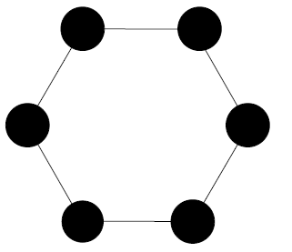
Multiple-Deme

Slide 29
Simple Version
Basically:
  Take a few GA’s and run them (with different random seeds) on different connected processors
  After X generations exchange a few (possibly the best Y) between two of them
Unfortunately it is not so simple (at least there can be some issues)

Slide 30
Complications
MUST be made with a known machine architecture, or else it will not work
We don’t know what migration rate (number of generations before we use migration)
Although it runs faster, does it give the same quality?

Slide 31
Migration
A synchronous process in which two of the connected processors communicate to transfer a few members of the population
  They must wait for each other
  Usually handled on a number of generations method (after 20 generations try to communicate)

Slide 32
Conclusion of Multiple-Deme GA’s
Interesting note: The work in this field was done purely practically at first, and only after achieving huge success was it studied in theory
Many of the problems discussed above have been explored:
  The migration rate should be proportional to the size of the Deme – The larger the deme the less migration is needed
According to many biologists this is the most accurate way (along with Hybrid Multiple-Deme models) to simulate biological evolution

Slide 33
Hybrid Multiple-Deme Model
Notice the Multiple-Deme model is a change in the structure of the GA’s computation, but works mostly like an IIP – Therefore we can use a substructure of another method (such as ‘fine-grained’ or ‘master slave’)

Slide 34
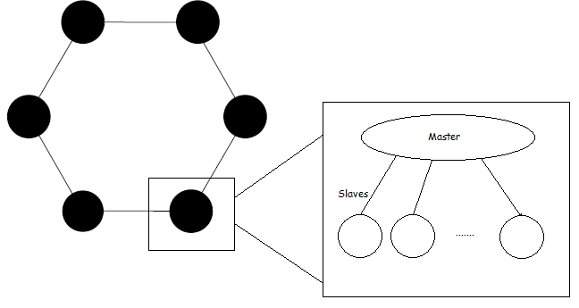
Hybrid Multiple-Deme

Slide 35
Conclusion of Hybrid Multiple-Deme GA
The speed increase is massive: equal to the speed increase by using the Multiple-Deme times the speed increase of using the other incorporated architecture

Slide 36
Applications
Parallel GA’s can be used in any scenario where a regular GA can be used, they are also better for more complicated problems
Parallel GA’s have also taken off in the study of natural evolution, because they very accurately imitate the real world (specifically Hybrid Multiple-Deme systems

Slide 37
Conclusion
Parallelising evolutionary computation offers massive speed increases
Architecture plays a huge role in the programming of each GA (meaning the more parallel the less portable)
In some cases the conversion of a GA to a parallel GA is simple, however in some cases it can be a complex process

Slide 38
References
1) Erick Cantu-Paz, ‘A Survey of Parallel Genetic Algorithms’, http://citeseerx.ist.psu.edu/viewdoc/download?doi=10.1.1.111.1498&rep=rep1&type=pdf
2) R. Shonkwiler, ‘Parallel Genetic Algorithms’, http://citeseerx.ist.psu.edu/viewdoc/download?doi=10.1.1.106.389&rep=rep1&type=pdf
3) http://en.wikipedia.org/wiki/Genetic_algorithm, ‘Genetic Algorithms’, March, 2010
4) http://www.edc.ncl.ac.uk/, (for the graph)
5) V. Scott Gordon, D. Whitley, ‘Serial and Parallel Genetic Algorithms as Function Optimizers’, http://citeseerx.ist.psu.edu/viewdoc/download?doi=10.1.1.54.3472&rep=rep1&type=pdf
6) Robert J. Collins, David R. Jefferson, Selection in Massively Parallel Genetic Algorithms, http://citeseerx.ist.psu.edu/viewdoc/download?doi=10.1.1.38.9252&rep=rep1&type=pdf

