Slide 1
Java ME Parallelism and implementations for embedded devices
Adam Stirtan

Slide 2
for (int i = 0; i < slides.size(); i++)
What is Java ME and why should you care
The virtual machine and you
The phone you can’t break (go ahead and try)
Implementation details
Minority report (end results)

Slide 3
Java Micro Edition
A Java platform designed specifically for mobile and embedded devices
Devices include over 2 billion cellular phones and smart cards, Blu-ray players, VOIP telephone systems
Allows easy development for an extensive array of markets using existing Java knowledge

Slide 4
Java ME Structure
Implementation
Implementation
Optional Packages
Optional Packages
Java SE
MIDP
CLDC
Java ME
Java Platforms reside on host operating systems

Slide 5
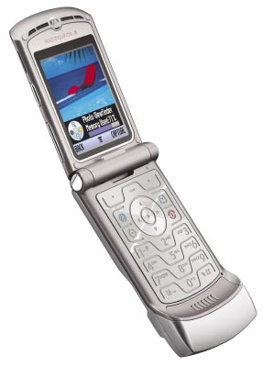
Java ME Architecture
MIDP Profile Layer
(Interface, Storage, Network)
MIDP
Profile Layer
(Minimum set of API features)
Configuration Layer
(Available libraries for categories)
Java Virtual Machine
(Customized JVM for device OS)
CLDC

Slide 6
Key Java ME Ideas
Aimed at being highly portable and extendable
Once aimed at low-end devices (CDC for high-end) but technological convergence is blurring the lines
Configurations are horizontally defined for categories while profiles are vertical and specific to the family of devices

Slide 7
CLDC
CLDC: Connected Limited Device Configuration
A specification of a framework for Java ME applications which describes the basic set of libraries and VM features which must be present
Abstracts low level device interaction which runs optimally on restricted hardware devices

Slide 8
CLDC (Continued)
Entire Java libraries are resident in devices 160 KB ROM with minimum 192 KB allocated for VM RAM
Compared to Java SE, many features are rewritten entirely for CLDC or are entirely absent
As of 2010 there are two version of CLDC which devices can implement, 1.0 and 1.1

Slide 9
CLDC Java vs. Java SE
Version 1.0
  Floating point math and Java data structures are not present, this is due to minimum requirement of 16 MHz processor
Version 1.1
  Serializable interface is not supported
  No thread groups or daemon threads
  Java reflection are altered and incompatible with SE
  Limited error handling where runtime errors are handled by terminating device or restarting application

Slide 10
MIDP (Acronyms Shmacronyms)
Java ME devices all implement a profile
The most commonly used is the MIDP (Mobile Information Device Profile) which is aimed at mobile devices such as phones, embedded devices use the Personal Profile instead
Profiles are subset of the CLDC and classes live in the javax.microedition.* namespace

Slide 11
MIDP (Continued)
MIDP provides a rich set of features to devices
javax.microedition.rms
  Persistent form of storage for VMs using CRUD
javax.microedition.messaging
  Optional wireless messaging with SMS and MMS
javax.microedition.lcdui
  GUI elements which are drawn on the screen

Slide 12
Machines running machines
The CLDC is responsible for running multiple Java applications inside a single OS process
The Java applications run on their own Java VM
In previous releases of CLDC (on old phones you might have owned) it only ran single Java applications, running more than one meant separate OS processes which was not possible with old hardware

Slide 13
So where is the parallel?
It’s true, we don’t have traditional multi-processing inside Java ME due to lack of processors
Primary reason at this point is battery life (it sucks)
But… And it’s a big one…. Parallelism is achieved through concurrent virtual machines inside Java ME and through standard Java threading we all love and hate

Slide 14
The Rundown
Since Java applications are running in their own VM if an application encounters an error it can terminate in a consistent manner
Each application is isolated from the others which prevents deadlock and corruption in other running applications on errors in one
Java ME Multitasking means multiple virtual machines within a single OS process

Slide 15
The CLDC VM
Pure 32-bit virtual machine
  Provides large address space and scalable architecture
Compact object layout
  Objects have two parts: the header and body - header provides reflective information and hash coding (low memory compared to Java VM) while the body contains object fields
Fast thread synchronization
  Uses a variant of block structured locking found in Java VM, as a result performance is no longer a bottleneck

Slide 16
Machines in machines
IPC
OS Process
(System threads, garbage collection, memory allocation)
MIDlet
MIDlet
MIDlet
Thread
Thread
Thread
Thread
Thread
Thread
IPC
IPC
Java VM
Java VM
Java VM
Java Operating System

Slide 17
Java ME IPC
Inter-Process Communication channels are the solution to allowing concurrent VMs to talk with each other
Java API libraries include the classes ‘PipedInputStream’ and ‘PipedOutputStream’
Streams are managed by the global VM to direct stream traffic to the correct destinations

Slide 18
Michael J. Fox Flynn
Dual architecture being utilized to accomplish concurrent virtual machines
The entire Java operating system could be thought of as a SIMD architecture, while inside virtual machines are SISD
This creates a parallel software architecture

Slide 19
Programming with MIDP APIs
The combination of CLDC and MIDP provides a complete environment for creating applications
The core of a MIDP Profile is a MIDlet application which extends the MIDlet class to allow the application management software to control the MIDlet and communicate states changes
MIDlet class provides: Invoking, pausing, restarting and terminating MIDlet applications

Slide 20
Breaking a MIDlet
Many new problems exist on embedded systems
We have to account for things such as receiving a phone call, SMS, MMS, or external data services invocations during execution and allow the external OS or host VM to take control
MIDlets must be able to live in different states to accomplish this

Slide 21
United MIDlet States of Java ME
Three possible states for a MIDlet to be in
  Running in the foreground (Active)
  Running in the background (Active without UI)
  Suspended in the background (Inactive)
In active states MIDlet can respond to all events
In background can respond to all events except keys, camera, speaker and microphone
Inactive MIDlets must have their VMs notified by OS

Slide 22
2 Classes of MIDP APIs
User Interface API
  Based upon a succession of displayable screens
  Each screen contains data and commands
  The API handles commands and changes the display
Persistent Storage API
  Organize and manipulate the devices database
  Maintains information across multiple invocations

Slide 23
System.out.println(“Hello World!”);
import javax.microedition.midlet.*;
import javax.microedition.lcdui.*;
public class COSCMidlet extends MIDlet implements CommandListener {
private Command exitCmd = new Command("Exit", Command.EXIT, 1);
public COSCMIdlet() { }
protected void startApp() throws MIDletStateChangeException {
Display display = Display.getDisplay(this);
Form mainForm = new Form(“Hello COSC");
mainForm.addCommand(exitCmd);
mainForm.setCommandListener(this);
display.setCurrent(mainForm);
}
public void commandAction(Command c, Displayable d) {
if (c == exitCmd) {
destroyApp(false); notifyDestroyed(); }
}
}
All apps extend MIDlet
Simple “Hello World”
Allows exiting with menu

Slide 24
Threading (in) a nutshell
Java Process
Java Thread
Managed by the OS
No shared memory space
Communication only with VM defined inter process communication channels (IPC)
Managed by the containing VM
Shared memory space
Single sequential flow of control
10 threads in CLDC

Slide 25
Java Multithreading
Implement the ‘Runnable’ interface
  Derived classes override the ‘run’ method
  Preserves inheritance for implementation
Extend the ‘Thread’ class
  Declare a new Thread and call ‘start’ method
  Occupies Java’s single extension heritance
Can also use anonymous inner classes for small jobs

Slide 26
Java UDP Client
Need have threaded method for sending information across network which doesn’t abuse battery life of the device
Allows for the MIDlet to give message to be sent and only activate the network protocol when necessary
public synchronized void send(String addr, String msg) {
address = addr;
message = msg;
notify();
}

Slide 27
Java UDP Client (Continued)
public synchronized void run() {
while (true) {
if (message == null) {
try {
wait();
} catch (InterruptedException e) { }
}
try {
byte[] bytes = message.getBytes();
Datagram datagram = new Datagram(bytes, bytes.length, address);
datagramConnection.send(datagram);
datagramConnection.close();
} catch (Exception ioe) {
ioe.printStackTrace();
}
message = null;
}
}

Slide 28
UDP Client Result
We have a dedicated thread for accessing the network components on the CLDC
Classes which have an instance of the client class can simply use: client.sendMessage(“Hello!”)
Only pitfall is if multiple strings are to be sent, but we could easily modify the String object to a Queue

Slide 29


Real-time GPS location services allows businesses or parents to track devices on a web interface
Used in vehicles as stand-alone devices or as software applications on handsets
Solutions Into Motion contracted me to port Trackem to a new device which will be shipped as part of a new Java ME device

Slide 30
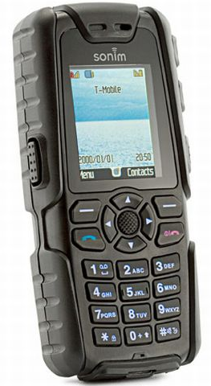
Sonim XP3 Quest
A new to market device aimed at those who need a rugged phone
ARM-9 Processor
25 MB Memory
176x220 16-bit Resolution
You can whack it off your desk (or iPhone) and it will still work

Slide 31


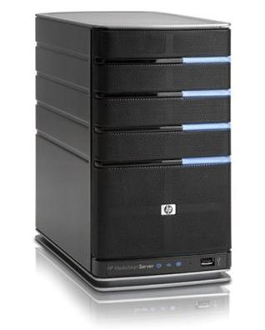
Implementation Overview
SQL / Web Server
HTTP
GPS
HTTP
UDP
HTTP

Slide 32
Trackem MIDlet
Device needs to in parallel aggregate information from CLDC components to formulate a beacon
  Location services (latitude, longitude, altitude)
  Accelerometer data
  Store and forward persistence
On an interval the beacon is pushed to the server
A web interface allows mapping of where the device has been, its stops, and geo-fence boundaries

Slide 33
Trackem MIDlet (continued)
Location
Storage
Network
CLDC
User Interface
Aggregator
UDP Client
Trackem MIDlet

Slide 34
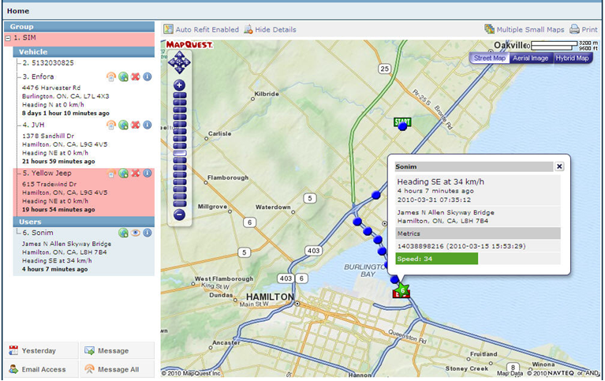
The Guardian (Boss of level 9)
http://qa.demo.guardian-tracker.com/

Slide 35
References
Think small with J2ME
http://www.ibm.com/developerworks/java/library/wi-j2me/
Understanding MIDP System Threads
http://developers.sun.com/mobility/midp/ttips/threading3/index.html
Using Threads in J2ME Applications http://developers.sun.com/mobility/midp/articles/threading2/

Slide 36
References
A portable platform
http://www.javaworld.com/javaworld/jw-11-2003/jw-1107-wireless.html
Introduction to J2ME
http://www.javabeat.net/articles/27-introduction-to-j2me-1.html
Sonim Java Programmers Guide
http://dl.dropbox.com/u/1211335/Sonim%20Java%20Programmers%20Guide%20-%20PB1.pdf

