Slide 1
CUDA Continued
Adrian Harrington
COSC 3P93

Slide 2

Last class of Undergrad

Slide 3
Material to be Covered
What is CUDA
Review
  Architecture
  Programming Model
Programming Examples
  Matrix Multiplication
Applications
Resources & Links

Slide 4
The Problem
Sequential programs take too long to execute for computationally expensive problems
These problems beg for parallelism
Our desktops and laptops are not performing to their potential

Slide 5

What is CUDA?
Compute Unified Device Architecture
Parallel Computing architecture
Harnesses the power of the GPU
GPGPU (General Purpose computing on GPUs)
Notes:
- NVIDIA’s parallel computing architecture
"co-processing" on the CPU and GPU
GeForce, ION, Quadro, and Tesla GPUs
scientific research
GPU computing is going mainstream
Applications remain on CPU, heavy duty parallel computations are moved to the GPU

Slide 6
Why should we care?

Slide 7
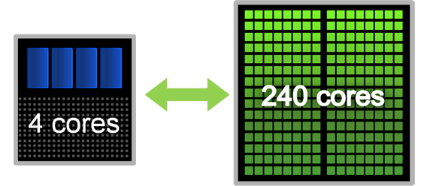
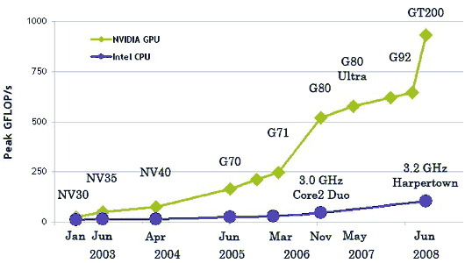
Performance Gain
Co-Computing
Notes:
- Co-Computing / Heterogeneous model
- GPUs are Massively multithreaded multicore chips

Slide 8
Applications
Computational Biology, Bio-informatics and Life Sciences
Computer Vision
Computational Electromagnetics and Electrodynamics
Fluid Dynamics simulation
Ray Tracing
Molecular Dynamics
Medical Imaging and Applications
Geographical Applications
Computational Chemistry
Financial Applications
Notes:
DNA Sequencing, Protein analysis
Pattern recognition, classification

Slide 9
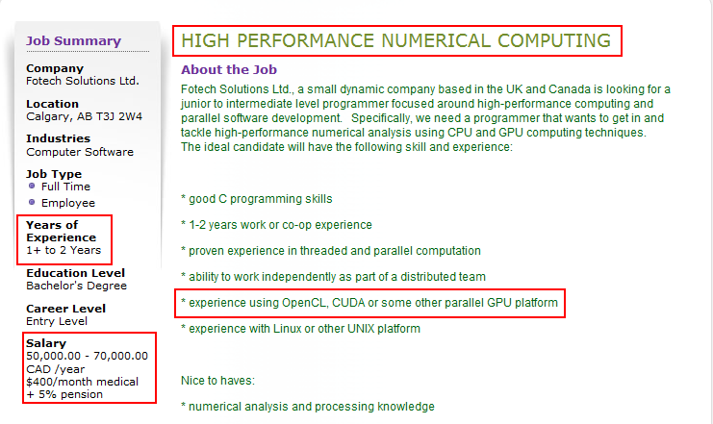
Jobs
Not just for Hobby & Academia
Interesting Jobs

Slide 10
Stay ahead of the Curve
Parallel computing is the future
Parallel algorithms result in large speedups
Use untapped resources
Monitor parallel technologies as they evolve
I Just bought a
Notes:
Moore’s second law
Hit the wall on single CPU

Slide 11
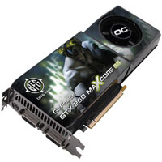
New Video Card I Just Bought
BFG GeForce GTX 260 OC
Core Clock: 590MHz
Shader Clock: 1296MHz
Processor Cores: 216
$200
$0.92 per core
Upgrade from my
GeForce 7950 GT OC

Slide 12
CUDA Review
Programming Model Overview
CUDA Architecture Overview

Slide 13
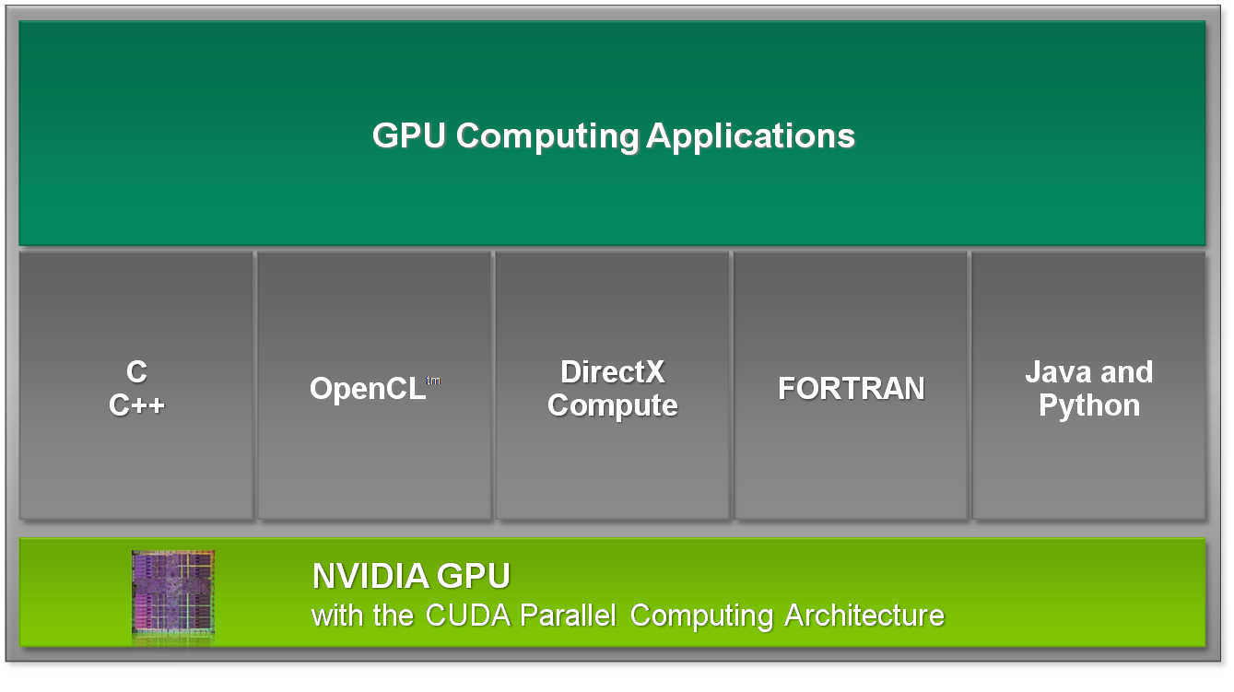
Programming Model

Slide 14
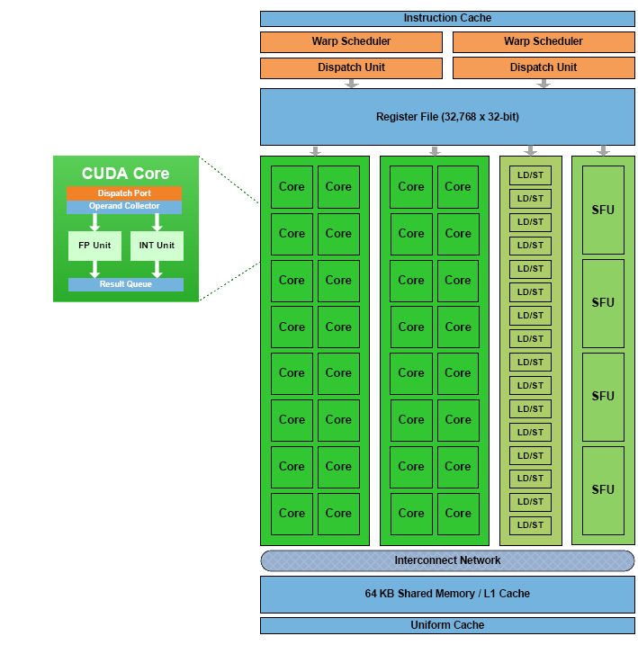
Graphics Card
Lots of Cores

Slide 15
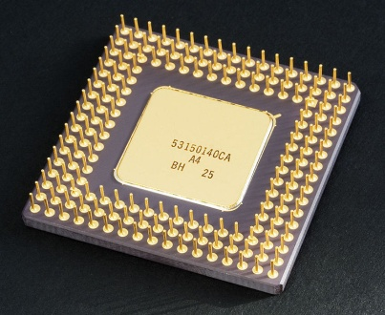
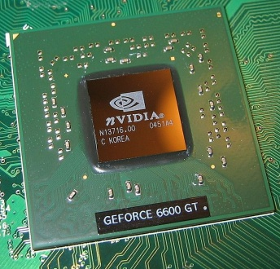
CUDA
CPU and GPU are separate devices with separate memory
CPU code is called ‘Host Code’
GPU code is called ‘Device Code’
Parallel portions are executed as ‘Kernels’ on GPU
Notes:
The modules that exhibit little or no data parallelism are typically implemented in host code.
The modules that exhibit data parallelism are implemented in the device code (or kernel).

Slide 16
CUDA
Split code into components
CPU code is standard C
GPU code is C with extensions
GPU code is compiled and run on device as a Kernel
Notes:
The modules that exhibit little or no data parallelism are typically implemented in host code.
The modules that exhibit data parallelism are implemented in the device code (or kernel).

Slide 17
CUDA
Kernels are executed by arrays of threads
Threads run same code (SIMD)
Thread cooperation is important
Full Thread cooperation is not scalable
Notes:
Thread cooperation can reduce redundant computation

Slide 18
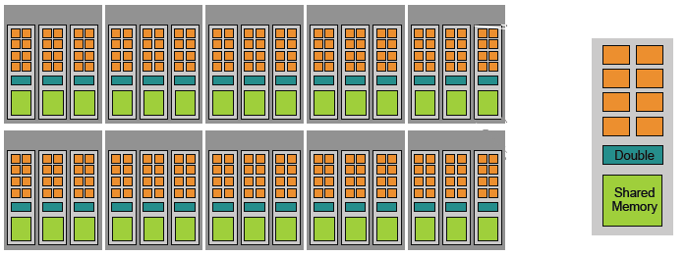
CUDA Architecture
MP
Device
Grid
Blocks
Threads
  240 Thread Processors
  30 multiprocessors contain 8 thread processors each
  Shared memory on each MP
Notes:
- Kernels are run on devices
- We need to be aware of the architecture when coding.

Slide 19
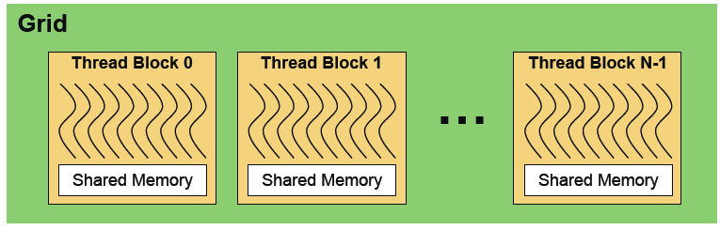
CUDA Architecture
Device
Grid
Blocks
Threads
  Kernels are launched as a grid of thread blocks

Slide 20
CUDA Architecture
Device
Grid
Blocks
Threads
  Thread Blocks share memory and allow for inter-thread communication
  Threads in different blocks cannot communicate or synchronize
Notes:
Threads within a block cooperate via shared memory
Threads within a block can synchronize
Threads in different blocks cannot cooperate

Slide 21

CUDA Architecture
Device
Grid
Blocks
Threads
  Threads are executed by thread processor
  Very lightweight
  CUDA can run 1000s of Threads more efficiently than CPU
Notes:
Threads are aware of their position and can communicate with the shared memory

Slide 22
Thread Blocks
Portions of parallel code are sent to individual thread blocks
Thread blocks can have up to 512 Threads
Thread blocks contain threads which can synchronize communication and share memory within that block

Slide 23
Kernels and Threads
Kernel code is executed on the GPU by groups of threads
Threads are grouped into Thread Blocks
Each thread is associated its own Id and executes its portion of the parallel code
All threads run the same code
Notes:
CUDA Model
three abstractions: a hierarchy of thread groups, shared memory, and thread synchronization

Slide 24
CUDA
Advantages
Disadvantages
Significant Speedup
Untapped resource
Split up parallel code into Kernels & leave sequential code alone as Host code
Supercomputing for the masses
New C Compiler with extensions
Knowledge of architecture (Grid, Blocks, Threads)
Handling Host/Device code

Slide 25
Programming Example
Matrix Multiplication

Slide 26
Matrix Multiplication
Let’s go through the steps of parallelizing matrix multiplication
4x4 Matrices
Parallel Decomposition
CUDA Code Example

Slide 27
Some Matrix Problem
Function | Time Steps
Initialization | 4
Get Inputs for M1 & M2 | 8
Matrix Multiplication 1 | 16
Get Inputs for M3 & M4 | 8
Matrix Multiplication 2 | 16
Matrix Multiplication 3 | 16
Total Time | 68

Slide 28
Parallel Decomposition
Speedup: approximately 3x
Function | Time Steps
Initialization | 4
Get Inputs for M1 & M2 | 8
Matrix Multiplication 1 | 1
Get Inputs for M3 & M4 | 8
Matrix Multiplication 2 | 1
Matrix Multiplication 3 | 1
Total Time | 23

Slide 29
Parallel Decomposition
Speedup: approximately 5x
Function | Time Step | Function | Time Step
Initialization | 4
Get Inputs for M1 & M2 | 8 | Get Inputs for M3 & M4 | 8
Matrix Multiplication 1 | 1 | Matrix Multiplication 2 | 1
Matrix Multiplication 3 | 1
Total Time | 14
Notes:
2 CPUs & 2 GPUs

Slide 30
Matrix Multiplication Code Example
main()
{
// 1. allocate host memory for matrices
int sizeA = WA * HA;
int memsizeA = sizeof(float) * sizeA;
float* A = (float*) malloc(memsizeA);
// Do again for B
// 2. Initialize the matrices with some value
// 3. allocate host memory for the result C
// Do again for C
// 4. perform the calculation
// 5. print out the results
}
Notes:
Allocate host memory for A & B
Allocate host memory for C

Slide 31
Matrix Multiplication in C for CUDA
main()
{
// Allocate host memory and initialize A & B
// allocate device memory (B not shown)
float* deviceA;
cudaMalloc((void**) &deviceA, memsizeA);
// copy host memory to device
cudaMemcpy(deviceA, hostA, memsizeA, cudaMemcpyHostToDevice);
cudaMemcpy(deviceB, hostB, memsizeB, cudaMemcpyHostToDevice);
// allocate host memory for the result C
// allocate device memory for the result
float* deviceC;
cudaMalloc((void**) &deviceC, memsizeC);
// perform the calculation
** Coming soon
// 11. copy result from device to host
cudaMemcpy(h_C, d_C, mem_size_C,
cudaMemcpyDeviceToHost);
}
Notes:
cudaMalloc allocates memory on the device
cudaMemcpy copies memory

Slide 32
Matrix Multiplication - Kernel
// CUDA Kernel
__global__ void
matrixMul( float* C, float* A, float* B, int wA, int wB)
{
// 2D Thread ID
int tx = threadIdx.x;
int ty = threadIdx.y;
// value stores the element that is computed by this thread
float value = 0;
for (int i = 0; i < wA; ++i)
{
float elementA = A[ty * wA + i];
float elementB = B[i * wB + tx];
value += elementA * elementB;
}
// Write the value to device memory
C[ty * wA + tx] = value;
}
Notes:
__global__ indicates that this function is a kernel
Will generate a grid of threads on the device
threadIdx are the indices of the thread inside the kernel as a way to differentiate threads between each other

Slide 33
Matrix Multiplication – Final Touches
Main()
{
// Allocate memory for A, B and C
// perform the calculation
// setup execution parameters
dim3 threads(4, 4);
dim3 grid(1, 1);
// execute the kernel
matrixMul<<< grid, threads >>>(d_C, d_A, d_B, WA, WB);
// Get Results
}
Notes:
- Dim3 is a new data type defined by CUDA.
Block size is how many threads we want
Give us one grid
matrixMul<<< >>>, launches the kernel

Slide 34
Matrix Mutliplication
4x4 Matrix multiplication is boring and trivial
Lets do a 1024x1024 Matrix multiplication
Thread Block can only handle 512 Threads
We will have to divide the problem across thread blocks
So lets split it into 64x64 Grids of 16x16 Threads
1024x1024 = 64x64x16x16

Slide 35
Matrix Multiplication – Part 2
main(int argc, char** argv)
{
// Allocate & Initialize host memory for matrices A, B and C
// Allocate device memory
// Copy host memory to device
cudaMemcpy(deviceA, hostA, memsizeA, cudaMemcpyHostToDevice);
// Allocate device memory for the result
float* deviceC;
cudaMalloc((void**) &deviceC, memsizeC);
// Perform the calculation on device
dim3 threads(16, 16);
dim3 grid(WC / threads.x, HC / threads.y);
// Execute the kernel
matrixMul<<< grid, threads >>>(deviceC, deviceA, deviceB, WA, WB);
// Copy result from device to host
cudaMemcpy(hostC, deviceC, memsizeC, cudaMemcpyDeviceToHost);
}

Slide 36
Matrix Multiplication – Part 2
#define BLOCK_SIZE 16
#define TILE_SIZE 16
#define WA 1024 // Matrix A width
#define HA 1024 // Matrix A height
#define WB 1024 // Matrix B width
#define HB WA // Matrix B height
#define WC WB // Matrix C width
#define HC HA // Matrix C height
__global__ void
matrixMul( float* C, float* A, float* B, int wA, int wB)
{
// 2D Thread ID
int tx = blockIdx.x * TILE_SIZE + threadIdx.x;
int ty = blockIdx.y * TILE_SIZE + threadIdx.y;
float value = 0;
for (int i = 0; i < wA; ++i)
{
float elementA = A[ty * wA + i];
float elementB = B[i * wB + tx];
value += elementA * elementB;
}
C[ty * wA + tx] = value;
}

Slide 37
Applications of CUDA
GPU-Based Cone Beam Computed Tomography
Particle Swarm Optimization

Slide 38
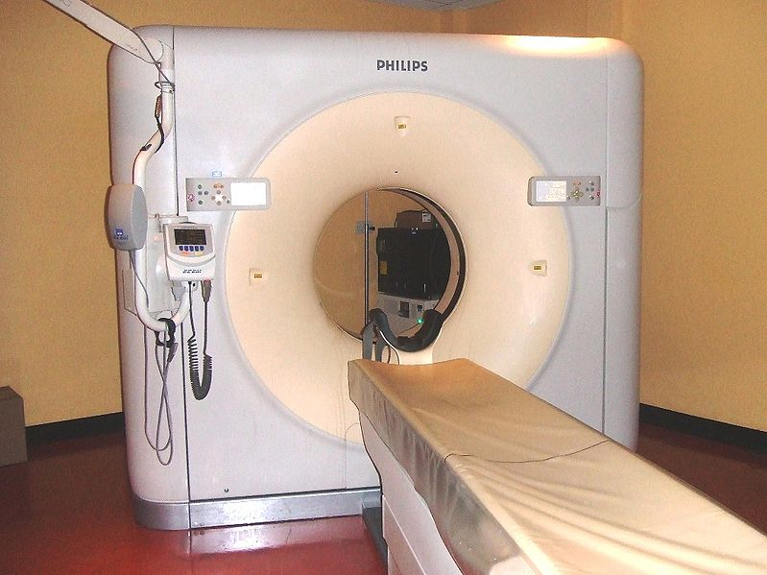
GPU-Based Cone Beam Computed Tomography

Slide 39
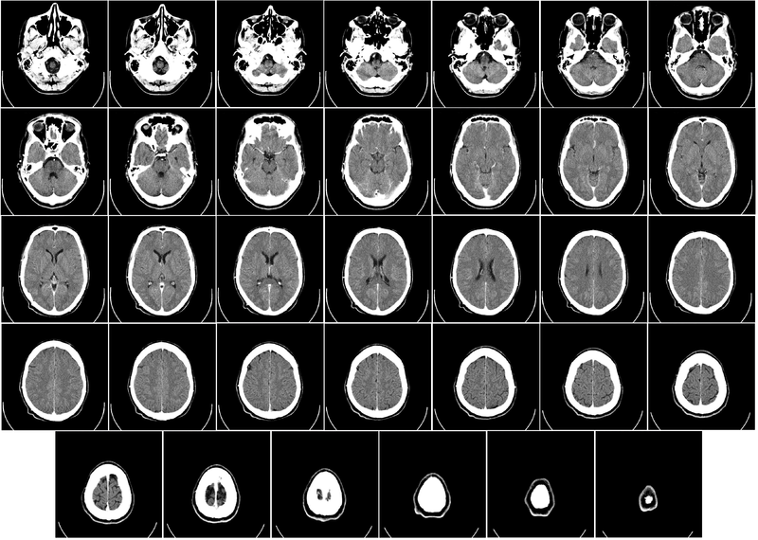
GPU-Based Cone Beam Computed Tomography

Slide 40
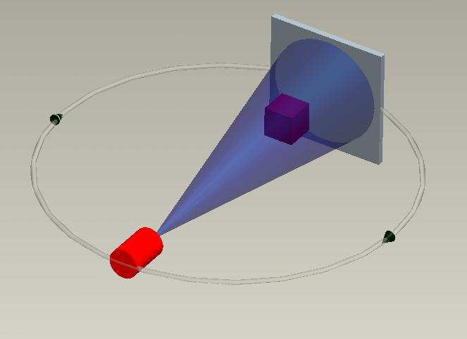
CT Scans
Scans take 60 seconds
3D Reconstruction takes 30 minutes – hours
Used an NVIDIA GeForce 8800 GT
  112 Stream processors
  366 GFlops
Reduced to as low as 5 seconds on the GPU using CUDA

Slide 41
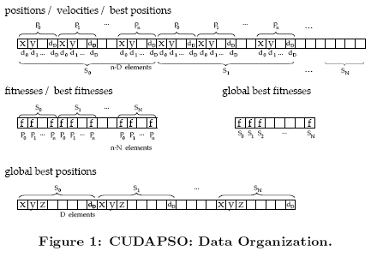
Particle Swarm Optimization
Split Particle updates into kernels
Kernel handles updates and
fitness evaluation
Global memory contains best positions

Slide 42
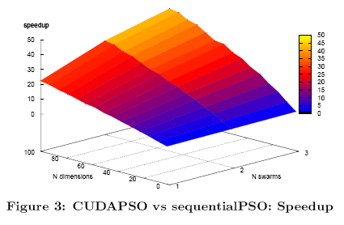
Particle Swarm Optimization
Results:
As Dimensions and swarm count increases overall speedup increases

Slide 43
Other Applications
Genetic Algorithms
Particle Swarm Optimization
Neural Networks
Graphical Applications
Image Classification

Slide 44
Fun Video of Particle Physics
http://www.youtube.com/watch?v=RqduA7myZok

Slide 45
Conclusion
CUDA is an architecture which allows programmers to access the power of the GPU
Useful for computationally expensive problems
Programmers can obtain significant speedups

Slide 46
For those interested
CUDA Downloads:
  http://developer.nvidia.com/object/cuda_3_0_downloads.html
CUDA Resources:
  http://developer.nvidia.com/object/gpucomputing.html
CUDA Community Showcase:
  http://www.nvidia.com/object/cuda_apps_flash_new.html
CUDA Industry Solutions:
  http://www.nvidia.com/object/tesla_computing_solutions.html

Slide 47

Questions

Slide 48
References
http://www.nvidia.com/object/cuda_home_new.html
http://developer.nvidia.com/object/gpucomputing.html
http://gpgpu-computing.blogspot.com/2009/08/hitting-wall.html
http://en.wikipedia.org/wiki/CUDA

Slide 49
References (2)
http://www.cse.buffalo.edu/hpmiccai/pdf/HPMICCAI2008-R3.pdf
http://www.gpgpgpu.com/gecco2009/1.pdf

