Slide 1
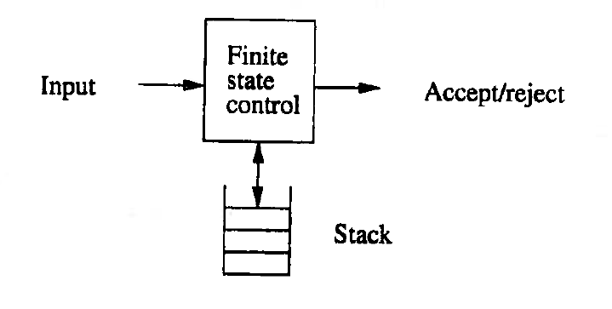
Principle of a PDA

Slide 2
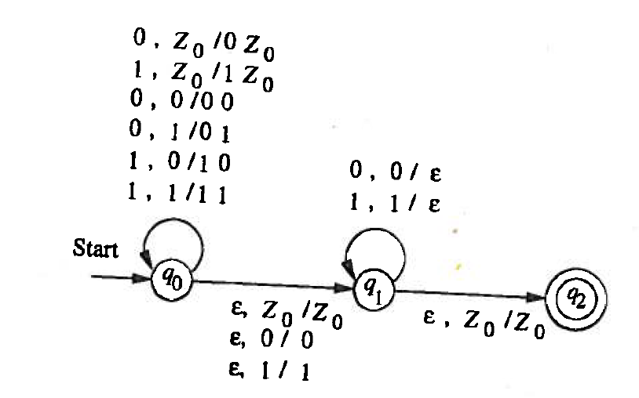
Representation of a PDA

Slide 3
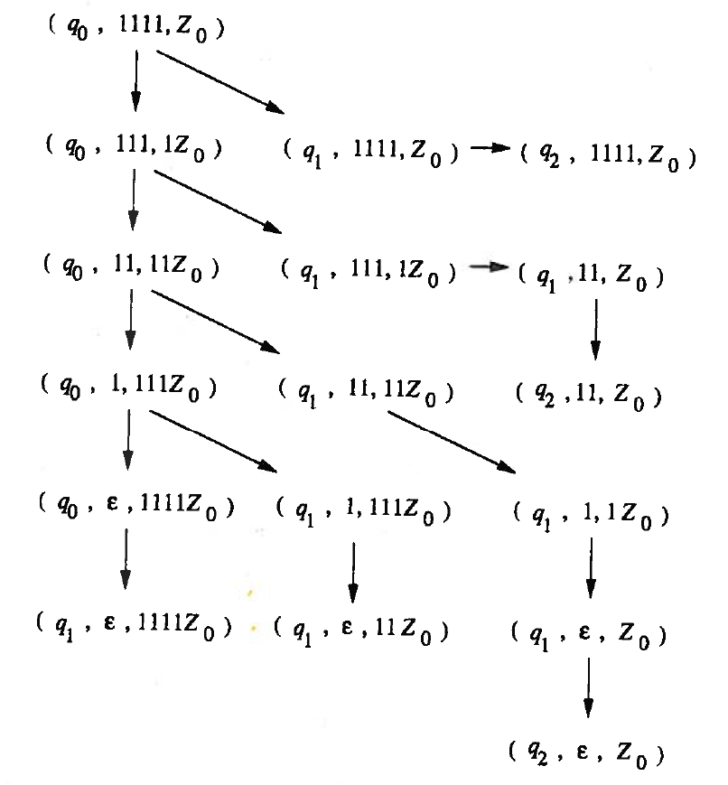
ID’s of a PDA

Slide 4
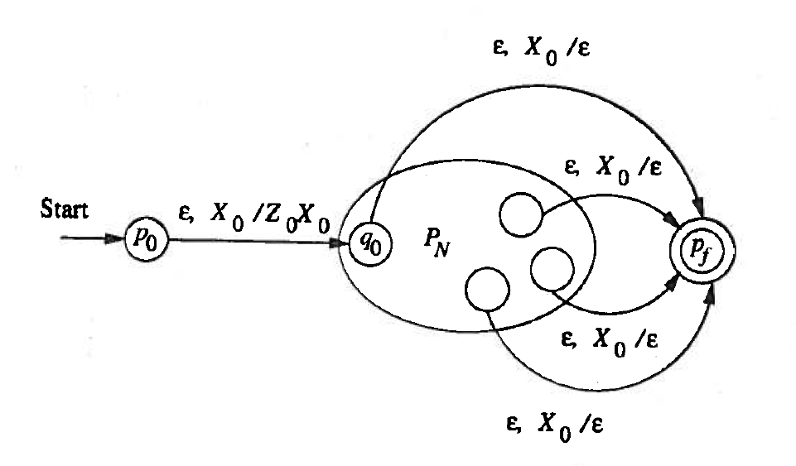
From Empty Stack to Final State

Slide 5
From Final State to Empty Stack

Slide 6
Equivalences

