Slide 1
Automatic Evolution of Conceptual
Building Architectures
Corrado Coia Brian J. Ross
Brock University
Department of Computer Science
St. Catharines, Ontario,
Canada L2S 3A1
year7c0@gmail.com bross@brocku.ca

Slide 2
Outline
Problem overview
Background
Experiment design
Results
Conclusions
More details:
  C. Coia, Automatic Evolution of Conceptual Building Architectures,
  Master’s thesis, Dept of Computer Science, Brock U., 2011.
  http://www.cosc.brocku.ca/~bross/BuildingsCE/

Slide 3
Architecture
Architectural design is complex, multi-faceted...
  Space: physical size, constraints
  Function: ability to accomplish its task
  Form: external appearance
  Also historical & cultural factors, engineering, cost, ...
Use of computers as design tools is long established.
  CAD systems
Research applying AI and ML technology to architectural design is active.

Slide 4
Research in Evolutionary Design
Comprehensive survey (Kicinger et al. 2005)
Beam sections, trusses (Gero et al. 1994; Buelow 2007)
GenR8, 3D surfaces (Hemberg et al. 2008)
2D and 3D shape grammars (O’Neill et al. 2009, 2010)
Context Free Design Grammars (Machado et al. 2010)
3D table designs (Hornby 2005)
Flowers and plants (Jacob 1996)
L-Systems (Beumont & Stepley 2009)
... and much more.

Slide 5
Motivation
Use genetic programming to automatically generate 3D building models.
  Automatic shape grammar creation.
  Using multiple objective criteria to guide search.
  Working with an established commercial product: CityEngine.

Slide 6
Applications
Explore design concepts: creative, inspiration
Possible foundations for real architectures.
Use models as-is in animations and games.

Slide 7
Limitations
We focus on basic building topology.
  fitness uses simple geometric properties that are easy to compute.
We do not consider:
  engineering (structural feasibility, physics,...)
  functionality
  cost
  aesthetics (directly)
  interiors
  relationship with environment

Slide 8
Approach
Genetic programming used to evolve shape grammars.
Shape grammars generate 3D models when interpreted.
3D model is evaluated according to set of geometric feature tests

Slide 9
Shape Grammar
Invented by Stiny & Gips (1971)
Production rules generate shapes as terminals
  2D: polygons, circles, lines, ...
  3D: blocks, spheres, ...
Operators manipulate shapes
  size, rotation, ...
Applications in architecture & design
  Computer automation
  Tweak a design → generate a variation of a model.

Slide 10
City Engine
Commercial product of Procedural Inc. (www.procedural.com)
Creates single buildings, or entire cities.
Sophisticated 3D shape grammar.
  different operators for buildings, houses
  textures
  3D file formats
However, there’s a learning curve: specialized programming.

Slide 11
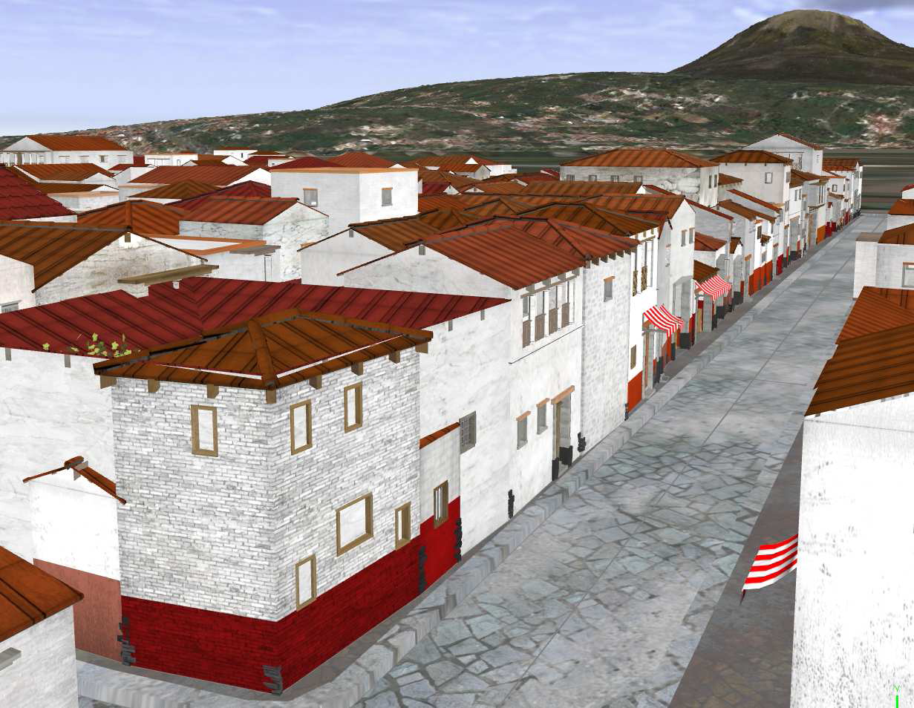
CityEngine: Pompeii
© 2009 Procedural, Inc.

Slide 12
CityEngine Shape Grammar
Small subset of shape grammar used:
Function | Meaning
extrude(N) | Extrudes the shape N unites along the face normal
split(X)C | Subdivides current shape along axis X, and applies command C to each subdivision
r(R_{x}, R_{y}, R_{z}) | Rotates current shape around the pivot point using angles R_{i}
s(S_{x}, S_{y}, S_{z}) | Resize using scales S_{i}
insert(S) | Adds an object S
[ and ] | Stack operations (save contexts)

Slide 13
Grammar Constraints
An unconstrained shape grammar is too general
Need to balance...
Generality ↔ Constraints
Creative. Predictable.
Often irrelevant. Often practical.
Some constraints used:
  avoid some primitives: translate, taper
  Initialize with a “lot” area or basic shape to work upon.
  Mostly use cubes, occasionally spheres

Slide 14
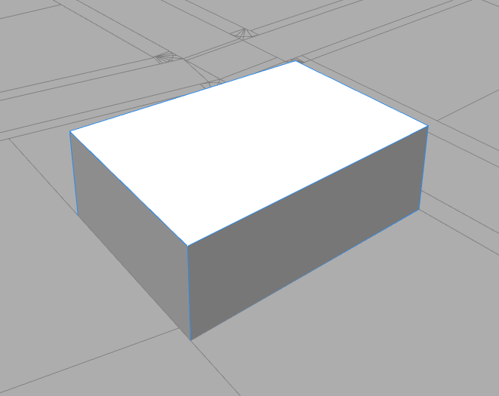
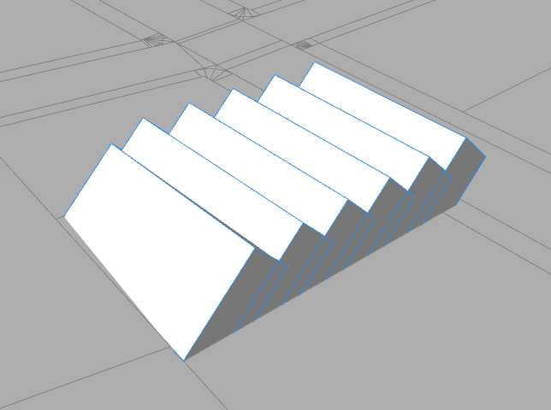
Example shape grammar
Start → extrude(10) split(z){ 5: RuleA }
RuleA → rotate(45, 0, 0)

Slide 15
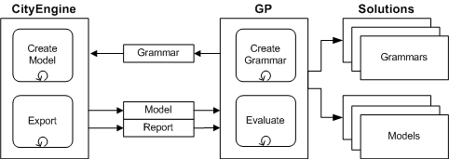
System overview
GP translates GP tree into CityEngine grammar.
CityEngine executes grammar, generates 3D model file.
GP reads model, and analyzes geometry as required.

Slide 16
GP
RobGP:
  http://sourceforge.net/projects/robgp/
  C++
  strong typing
  Good ADF implementation
Shape grammar rules denoted by ADFs.
Avoid indefinite looping, iteration
  no recursion

Slide 17
Evaluation of models
Geometric criteria include...
  number of unique surface normals
  height of building
  staying within a boundary
  shape-fitting with bitmap image
Criteria may conflict.
  Maximize unique surface normals, while staying within a boundary
A natural multi-objective problem.

Slide 18
MOP strategies
Pareto ranking
Sum rank
  aka “average rank” (Bentley & Wakefield 1997)
  Intended for high-dimensional MOPs
  Also useful for low-dimensional problems.
  Advantage: discourages outliers.
Normalized sum rank
  normalize ranks before summing them
  more balanced trajectory through search space

Slide 19
Sum Rank
Fitness vector | Pareto rank | Rank vector | Sum | Rank | Normalized Sum | Rank
( 1, 9, 5, 4) | 1 | (2, 1, 2, 2) | 7 | 1 | 1.47 | 1
( 2, 100, 4, 8) | 1 | (3, 2, 1, 3) | 9 | 2 | 2.03 | 2
(10, 9, 9, 10) | 2 | (4, 1, 4, 4) | 13 | 4 | 2.6 | 5
( 16, 100, 8, 4) | 2 | (5, 2, 3, 2) | 12 | 3 | 2.56 | 4
(16, 9, 500, 0) | 1 | (5, 1, 5, 1) | 12 | 3 | 2.37 | 3
( 0, 1000, 1000, 1000) | 1 | (1, 3, 6, 5) | 15 | 5 | 3.2 | 6
Note: (0,1000, 1000, 1000) is an outlier.
Outliers can quickly obtain preferable Pareto scores!

Slide 20
Typical GP Parameters
Parameter | Value
Runs | 10
Generations | 60
Population | 300
Crossover rate | 90%
Mutation rate | 8%
Elitism rate | 2%
ADFs | 7
Initial tree method | Grow
Max tree size | 50
Tournament size | 3
Fitness | MOP
Diversity penalty | 20

Slide 21
Some technical issues
City Engine has known memory leaks.
  We were forced to reboot City Engine every generation.
  Added ~1 hour to each run.
Only one license for City Engine.
  One run at a time.
  One run might take 24+ hours to complete.
Resulting limitations...
  population size of 300
  max 60 generations
  10 runs per experiment

Slide 22
Case 1: single objective
maximize number of unique surface normals.
  a property of a sphere
But GP very adept at maximizing polygons
→ memory overflow!
Limit to 30 generations.

Slide 23
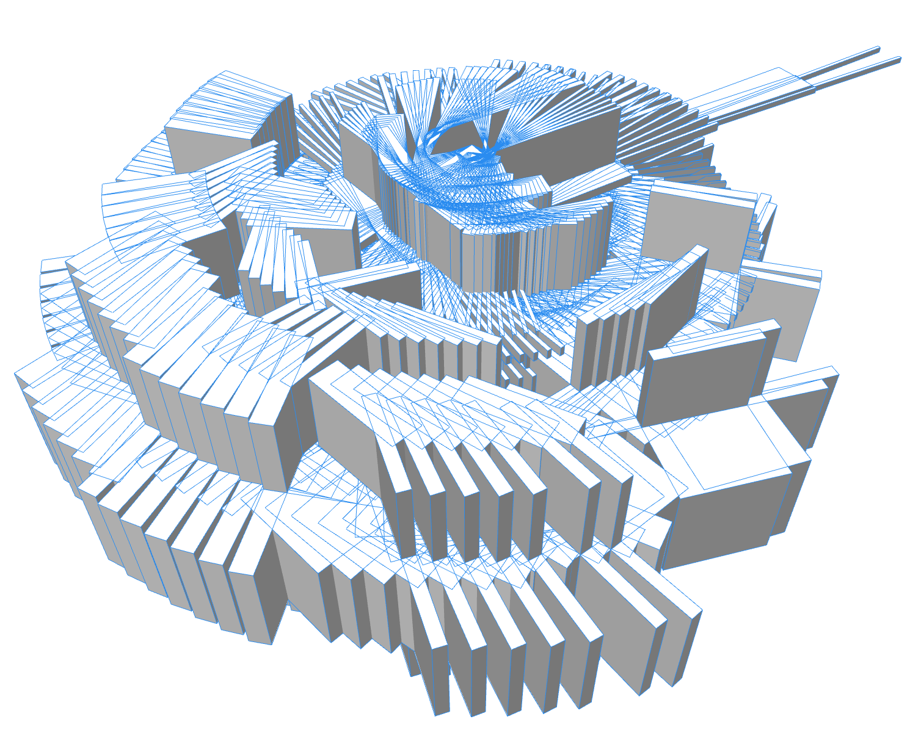
1a

Slide 24
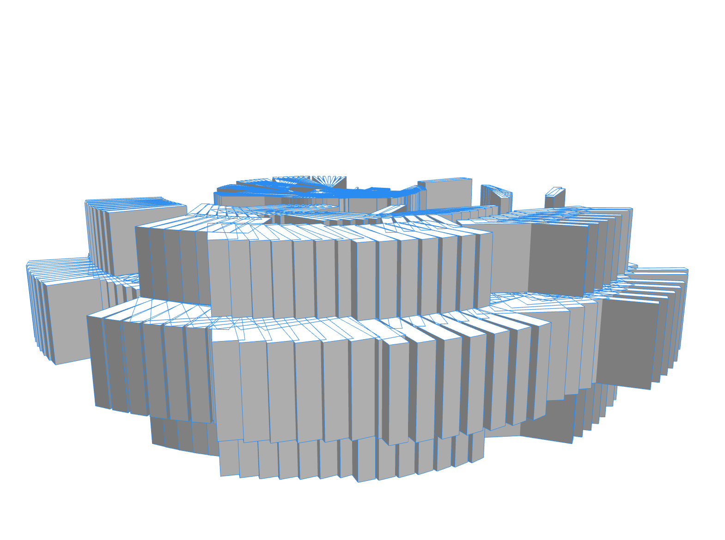
1a

Slide 25
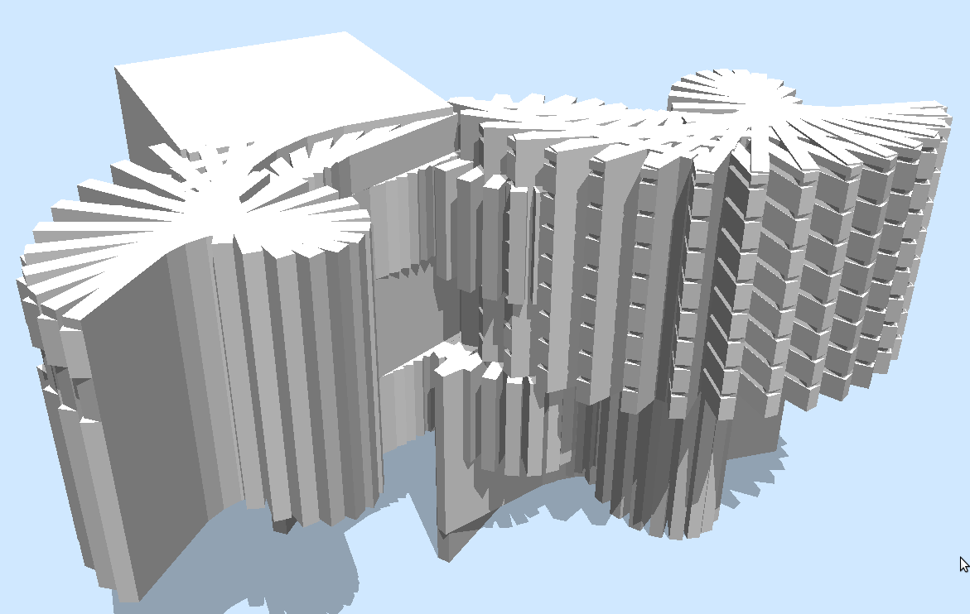
1b

Slide 26
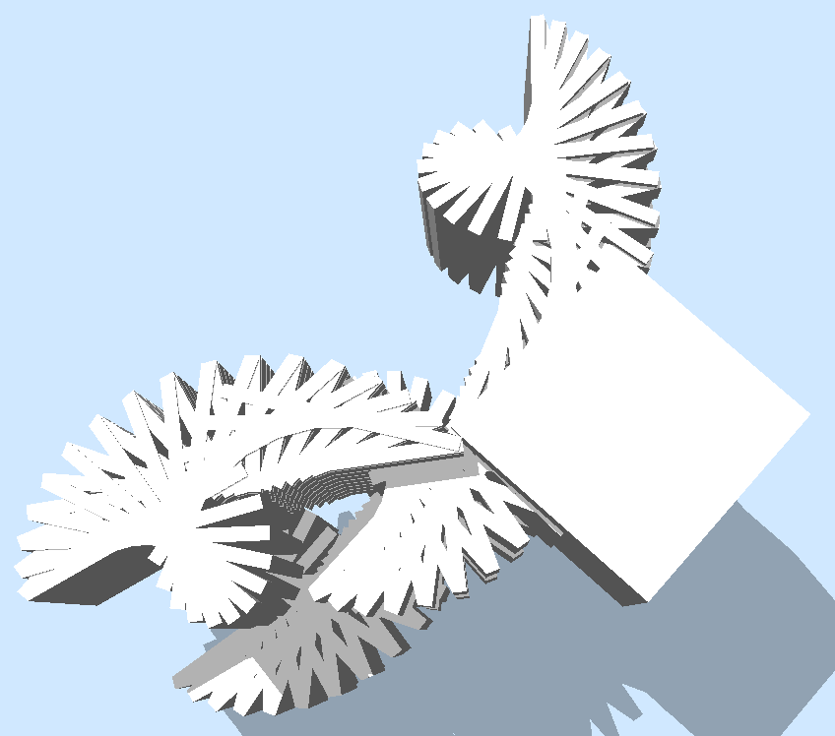
1b

Slide 27
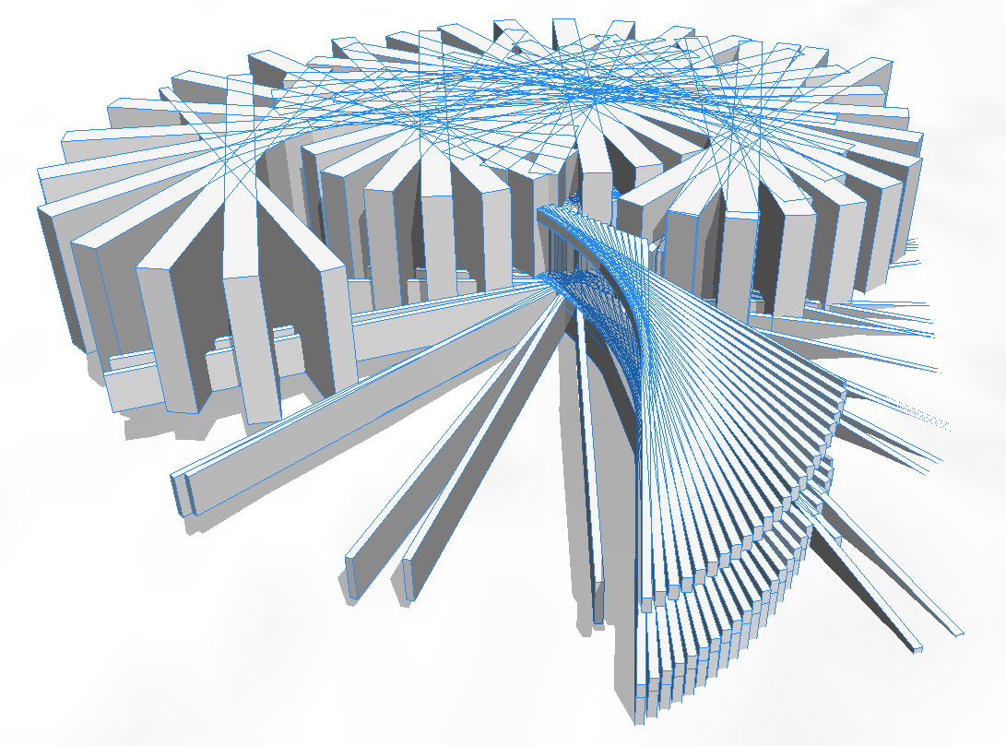
1c

Slide 28
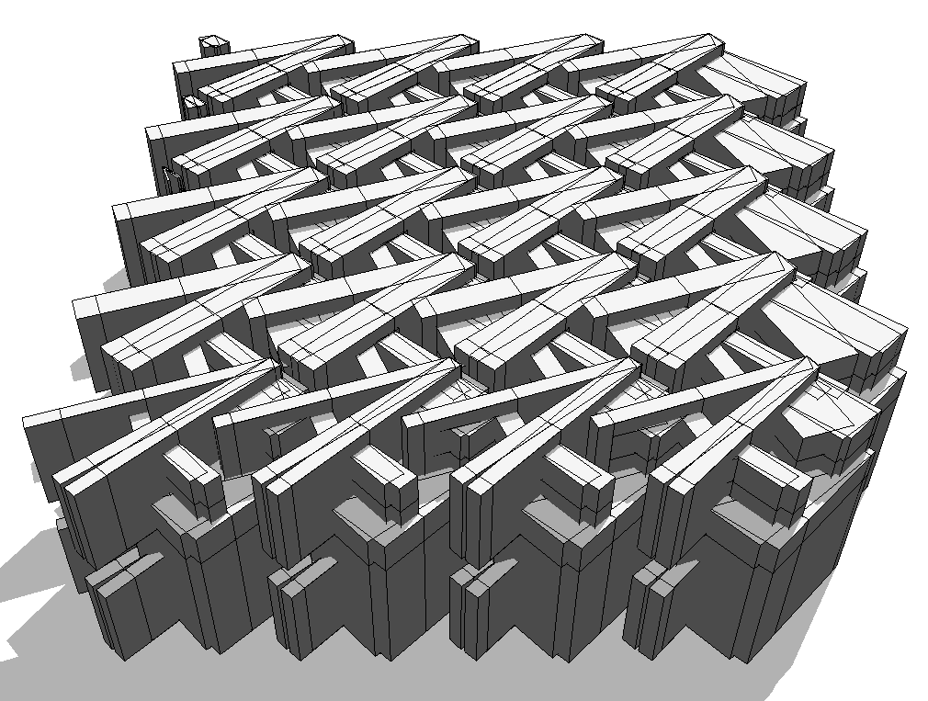
1d

Slide 29
Case 2: Two objectives
Maximize unique normals
Stay within boundary (square lot).
Sum rank
Include cube and sphere primitives.

Slide 30
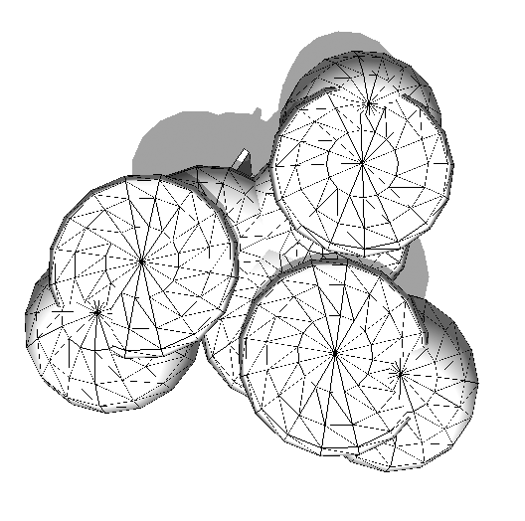
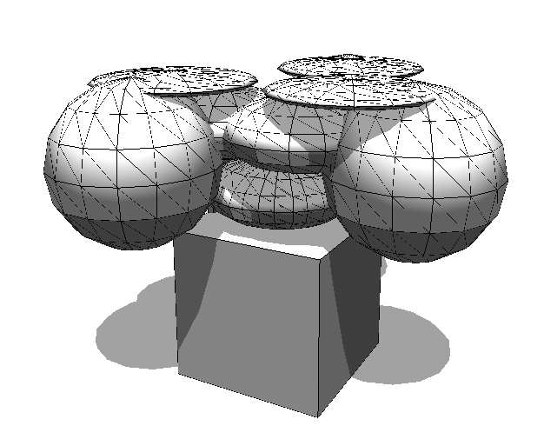
2a

Slide 31
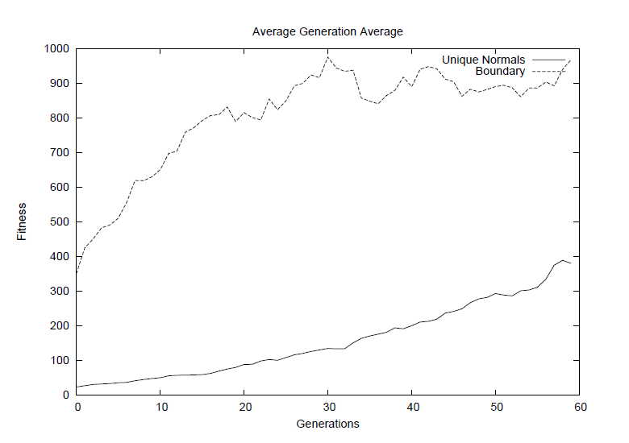
Case 2 performance graph

Slide 32
Case 3: Three objectives
Maximize unique normals
Reach target height of 750 units.
Constrain model to a given square lot.
Compare: Pareto, sum rank, normalized sum rank

Slide 33
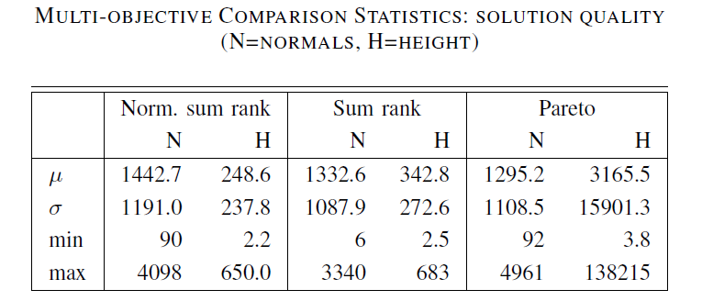
Case 3: MOP comparison
  NSR superior to SR wrt height (t-test, p < 0.08)
  Both NSR, SR superior to Pareto wrt height (t-test, p < 0.05)
  (not shown) only Pareto violated boundary requirements.
  Pareto created lots of outliers.

Slide 34
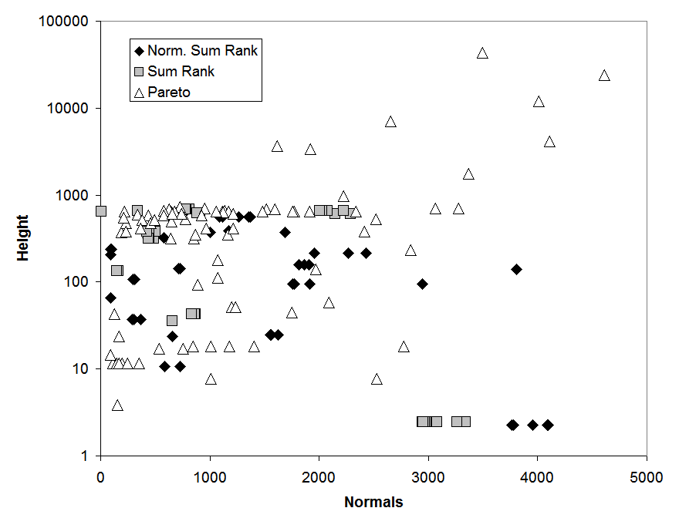
Case 3: Scatter plot of top solutions

Slide 35
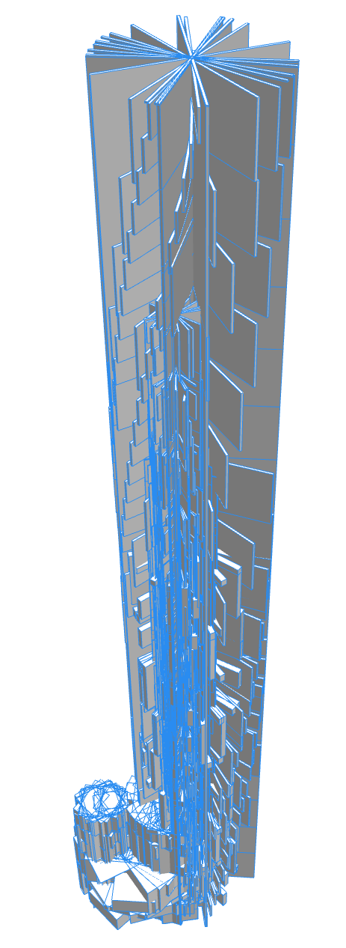
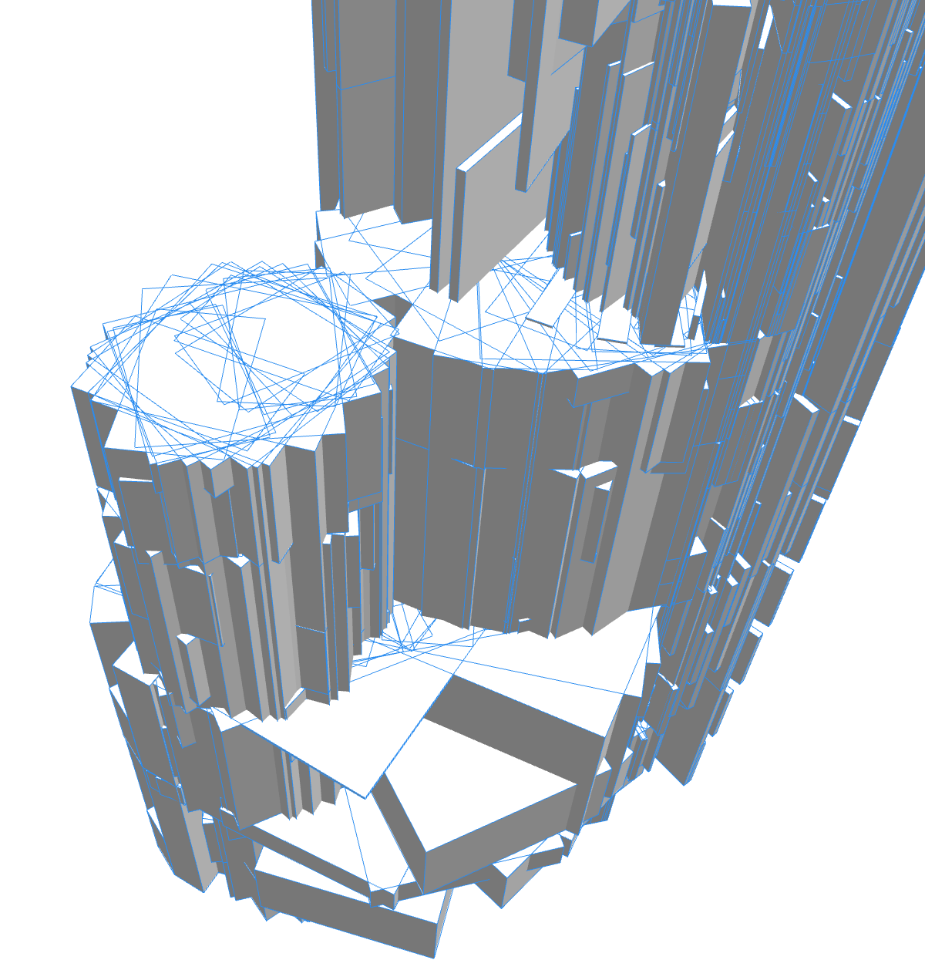
3a (norm. sum rank)
1624 normals, height 726, boundary OK

Slide 36
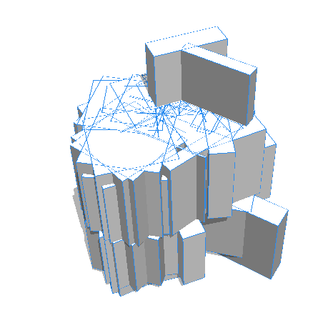
3b (Pareto)
Boundary OK,
222 normals,
height is 99 (target 750).
An outlier...
Satisfying the boundary meant
it was a rank 1 solution.

Slide 37
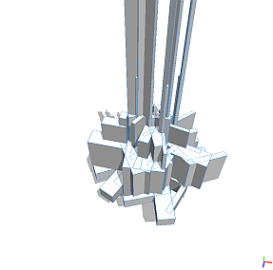
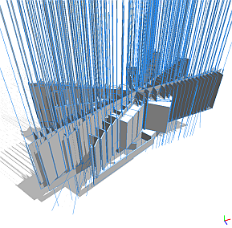
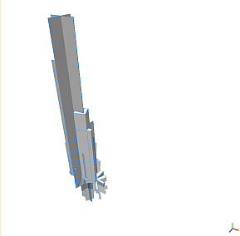
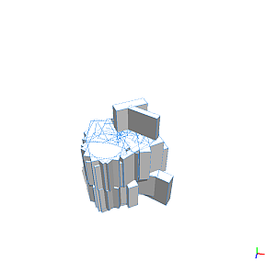
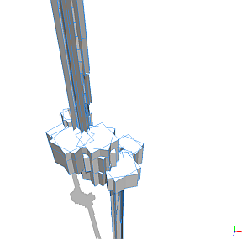
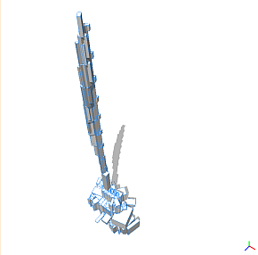
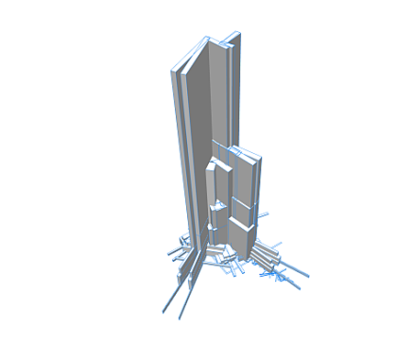
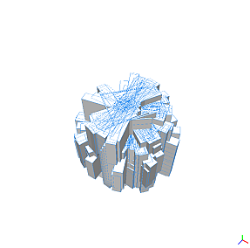
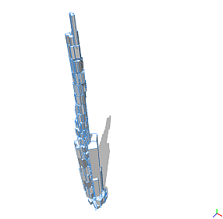
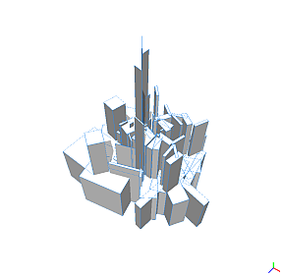
Top solutions from 10 Pareto runs

Slide 38

Case 4: advanced MOP
Maximize normals.
Reach target height.
Fit vertical projection to target shape →
Normalized sum rank

Slide 39
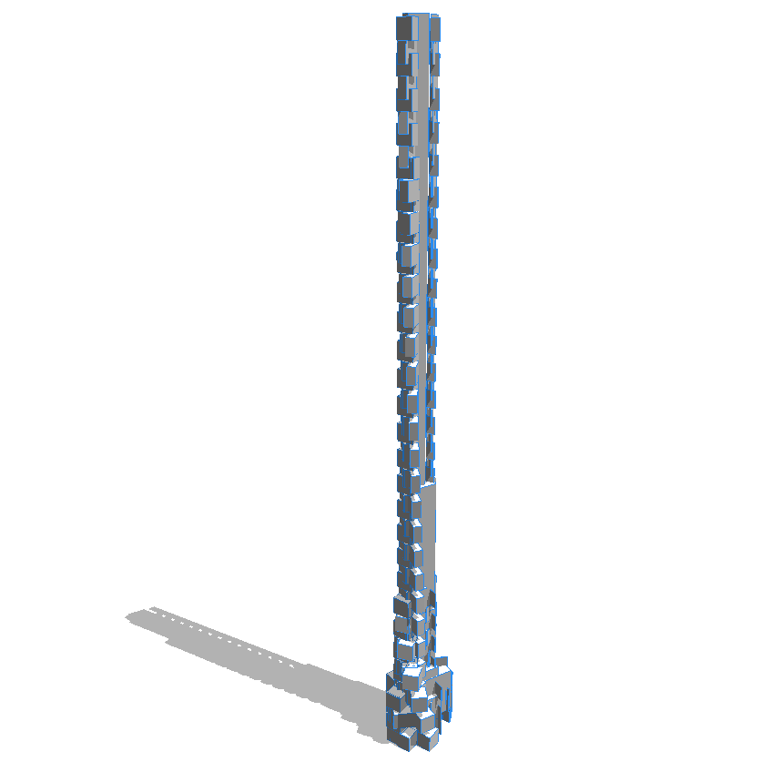
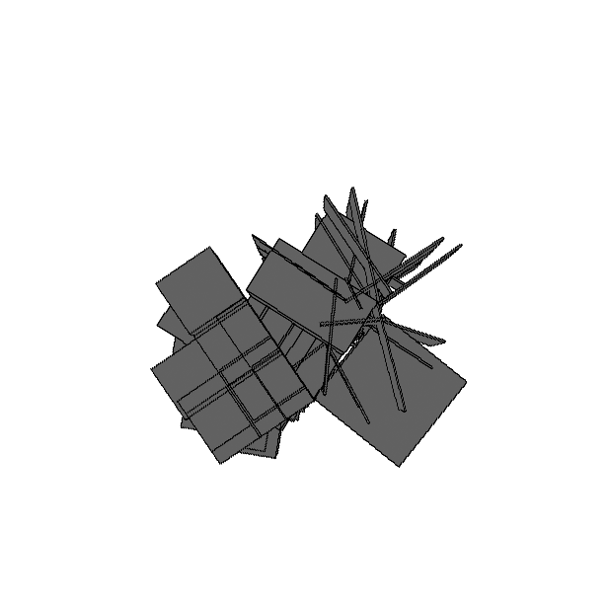
4a
height = 314 (targ 1500), norms = 538

Slide 40
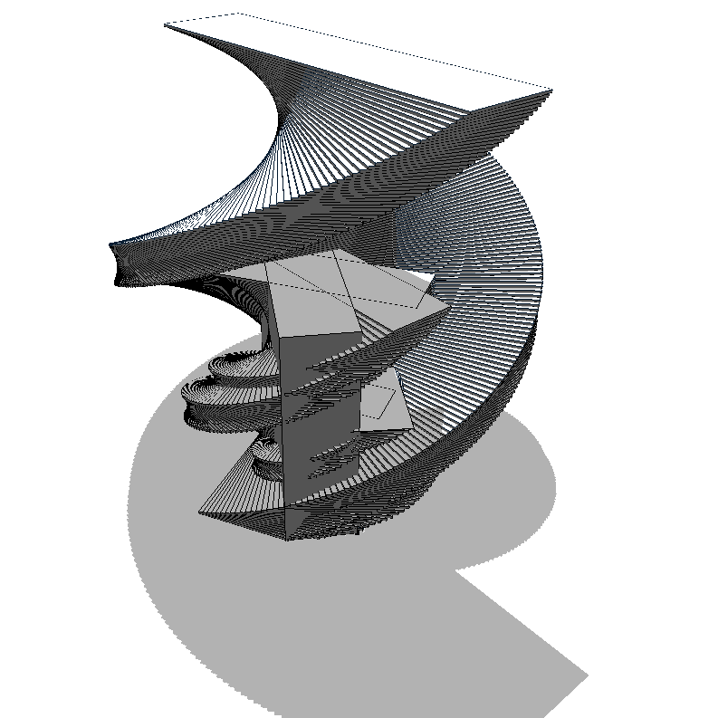
4b
  height=189, 1610 normals, weak shape fit score

Slide 41
Misc images
(see our web site for more images, animations)

Slide 42
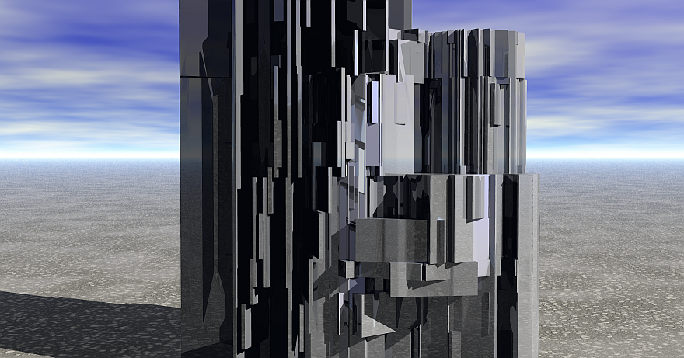

Slide 43
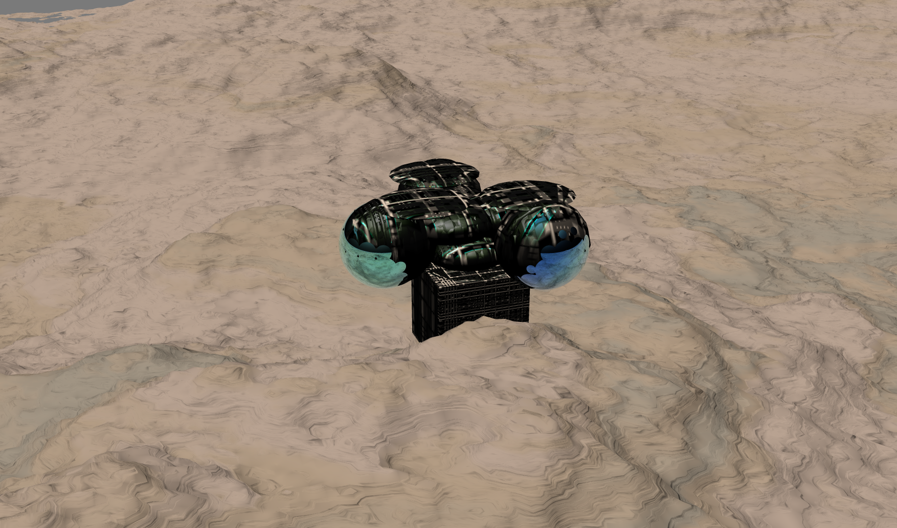

Slide 44
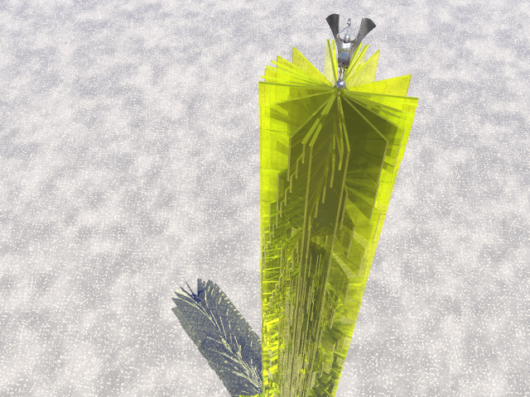

Slide 46
Conclusions
Variety of models generated.
Multi-objective evaluation worked well.
Good results, considering limitations of runs.
Style of our buildings: “Brutalist” architecture?
  1960/70’s university campuses: concrete blocks
  New shape grammar primitives, new fitness measures → new styles.
Future work
  Expand the shape grammar language.
  More knowledge-based grammar refinements.
  New evaluation criteria
    aesthetics
    functionality
    cost
    physical feasibility

