Slide 1
Evolution of Stochastic Bio-Networks Using Summed Rank Strategies
Brian J. Ross
Brock University
Department of Computer Science
St. Catharines, Ontario,
Canada L2S 3A1
bross@brocku.ca

Slide 2
Outline
Problem overview
Background
Experiment design
Results
Conclusions

Slide 3
Bio-network Modeling
Systems biology: model bio-chemical reactions
  Purposes: simulation, analysis
  uses mathematical and computer modeling
Formalisms include:
  Petri Nets [Baldan 2010]
  Bayesian networks [Friedman et al. 2000]
  P-systems [Perez-Jiminez & Romero-Campero 2006]
  cellular automata [Deutsch & Dormann 2005]
  ODEs [Schwartz 2008]
  Process algebra [Blossey et al. 2006, Regev et al. 2004]

Slide 4
EC and Bio-networks
Petri nets [Kitagawa & Iba 2003, Moore & Hahn 2004]
S-systems [Wang et al. 2007]
ODE [Floares 2008, Qian et al. 2008]
Metabolic networks as circuits [Koza et al. 2000]
Process algebra
  SPI calculus [Ross & Imada 2009, 2010]
  PEPA [Marco, Cairns & Shankland 2011]
  SPI – gene gates [Imada 2009]
  SPI – PIM [Ross 2011]
Related work: GP/GA and noisy time series
  [Borrelli et al. 2006, Jin and Branke 2005, Rodriquez-Vazquez & Fleming 2005, Zhang et al. 2004]

Slide 5
Stochastic pi-calculus (SPI)
A process algebra that denotes:
  concurrency
  stochastic modeling: simulation and analyses
  mobility (dynamic network changes... but not examined here)
Features useful for bio-network modeling:
  stochastic simulation: characterizes noise, chaotic signals
  compositional: complex systems arise from combinations of smaller processes
Characteristics:
  Concise denotation of complex behaviours.
  Has “programming language” characteristics.
Issues:
  unintuitive, sharp learning curve
  arcane: recommended to have a background in formal methods research

Slide 6
Evolving SPI calculus models
Use genetic programming to evolve SPI models
  Some simple models successfully reverse engineered.
    [Ross & Imada 2009, 2010]
  Grammar-guided GP constrains SPI models explored.
  Statistical features characterize process behaviours:
    required because of noisy, stochastic behaviours
    compare to deterministic processes: compare sum of errors between candidate and target processes
  2010 paper: used MOP with Pareto on the feature test
Issues:
  Some simple cases defied exact solutions. But lots of close calls.
  Pareto ranking results in outliers: one objective is very good, but majority are poor
    considered an undominated solution, even though it is useless

Slide 7
Goals
Re-examine use of GP to synthesize SPI models.
See if an alternative multi-objective scoring strategy may help: sum of ranks.
  proposed by Bentley & Wakefield (1997) for high-dimensional MOP evolution
  Also useful for low- to moderate dimension MOP problems
    [Bergen & Ross 2010, Flack 2010, Coia & Ross 2011]
  Main advantages:
    discourages outliers
    solutions are stronger on majority of objectives
    parameterless: no need for niche dimensions, etc.
Variation: sum of dominance ranks
  dominance: # individuals that are superior
Can include weights too.

Slide 8
Sum of Ranks
Fitness vector | Pareto rank | Rank vector | Sum | Rank | Normalized Sum | Rank
( 1, 9, 5, 4) | 1 | (2, 1, 2, 2) | 7 | 1 | 1.47 | 1
( 2, 100, 4, 8) | 1 | (3, 2, 1, 3) | 9 | 2 | 2.03 | 2
(10, 9, 9, 10) | 2 | (4, 1, 4, 4) | 13 | 4 | 2.6 | 5
( 16, 100, 8, 4) | 2 | (5, 2, 3, 2) | 12 | 3 | 2.56 | 4
(16, 9, 500, 0) | 1 | (5, 1, 5, 1) | 12 | 3 | 2.37 | 3
( 0, 1000, 1000, 1000) | 1 | (1, 3, 6, 5) | 15 | 5 | 3.2 | 6
Note: (0,1000, 1000, 1000) is an outlier.
Outliers can quickly obtain preferable Pareto scores!

Slide 9
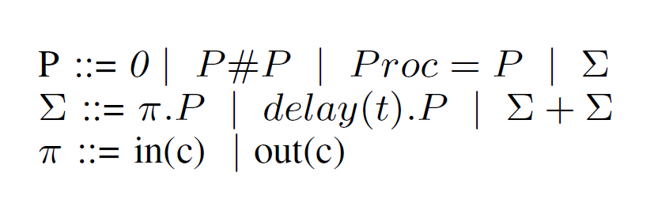
SPI calculus [Priami 1995]
# : concurrent execution
. : sequential exec
+ : stochastic choice
in(c), out(c) : atomic action
delay(t) : stochastic delay
handshake: in(x).P # out(x).Q → P # Q
  when multiple active terms available for handshaking, they are selected stochastically via Gillespie algorithm

Slide 10
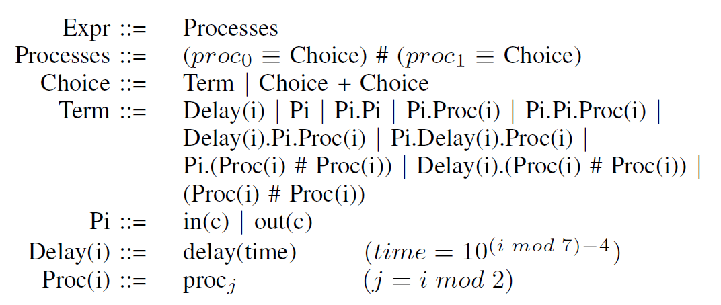
SPI calculus: context free grammar
Grammar-guided GP: DCTG-GP
  Prolog-based
  DCTG: define syntax and semantics in one framework
  syntactic, knowledge-based constraints easy to introduce
  exploration of more sensible areas of search space

Slide 11
Feature analyses
Time series: highly studied phenomena
  modeling
  prediction
  eg. financial prediction, weather forecasting,...
Imada (2009) used statistical features to characterize stochastic process behaviours
  based on those in [Nanopoulos et al 2001; Wang et al. 2006]
  stochastic, noisy behaviours can be reasonably characterized
  The general problem is intractable: time series for Turing machine states.

Slide 12
Features selectively used here
μ: mean
σ: standard deviation
Kurtosis: peakness wrt normal distribution
Serial correlation (sc): fit to white noise model
Chaos: sensitivity on initial values
Teravirta: degree on non-linearity
Adjusted frequency: cyclic activity of possibly varying frequency

Slide 13
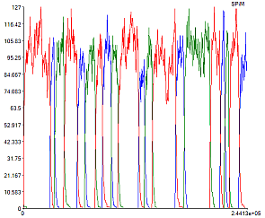
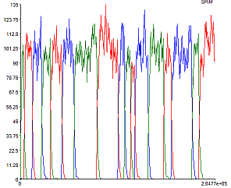
Dealing with stochastic processes
One process may produce different behaviours...
Feature scores will vary accordingly: fitness noise.
  Might perform multiple interpretations per fitness evaluation.
How to identify a solution from a run?
  “Best” score may be accidentally good.
  A higher quality solution might have a worse score, due to statistical chance.

Slide 14

Obtaining target behaviours
Target SPI model simulated 1000 times.
Mean and standard deviation for all feature values determined.
Candidate features selected:
  Stability(z-score):
  Select features based on stability, and perceived value of that feature for target behaviour of interest.
  Note: Some features may be more stable than others.
  This does not necessarily mean they are descriptively valuable.

Slide 15
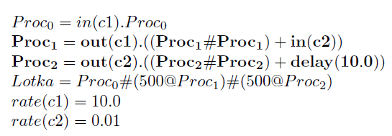
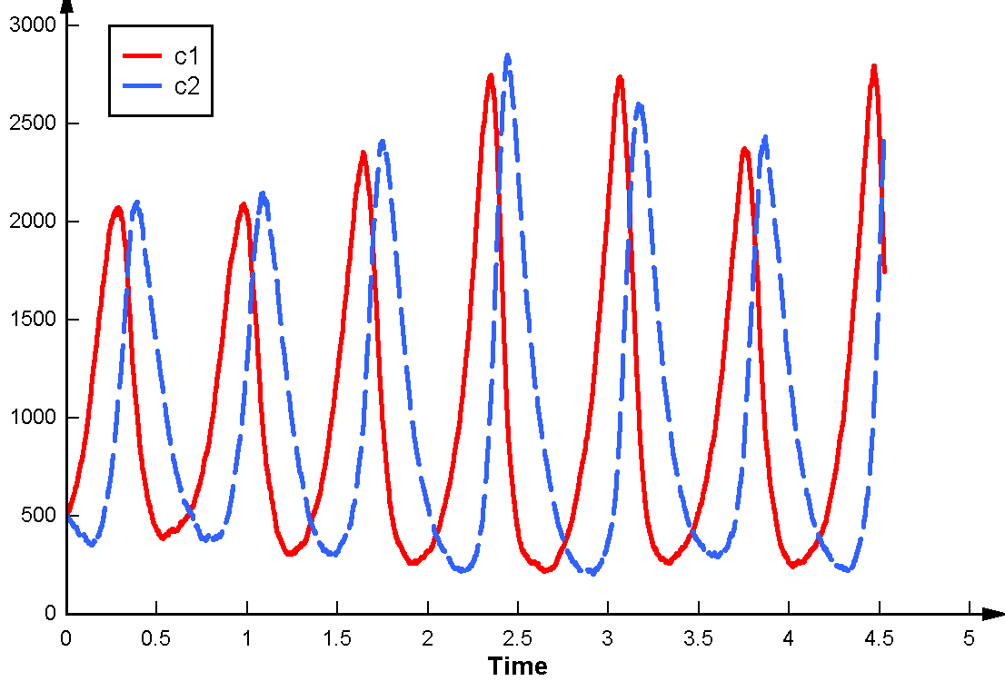
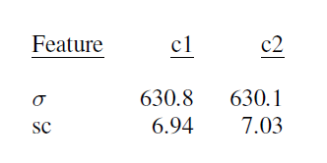
1. Lotka-Volterra
Dynamic model of predator-prey equilibrium

Slide 16
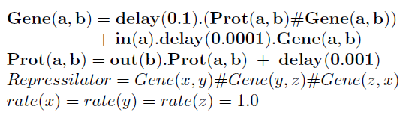
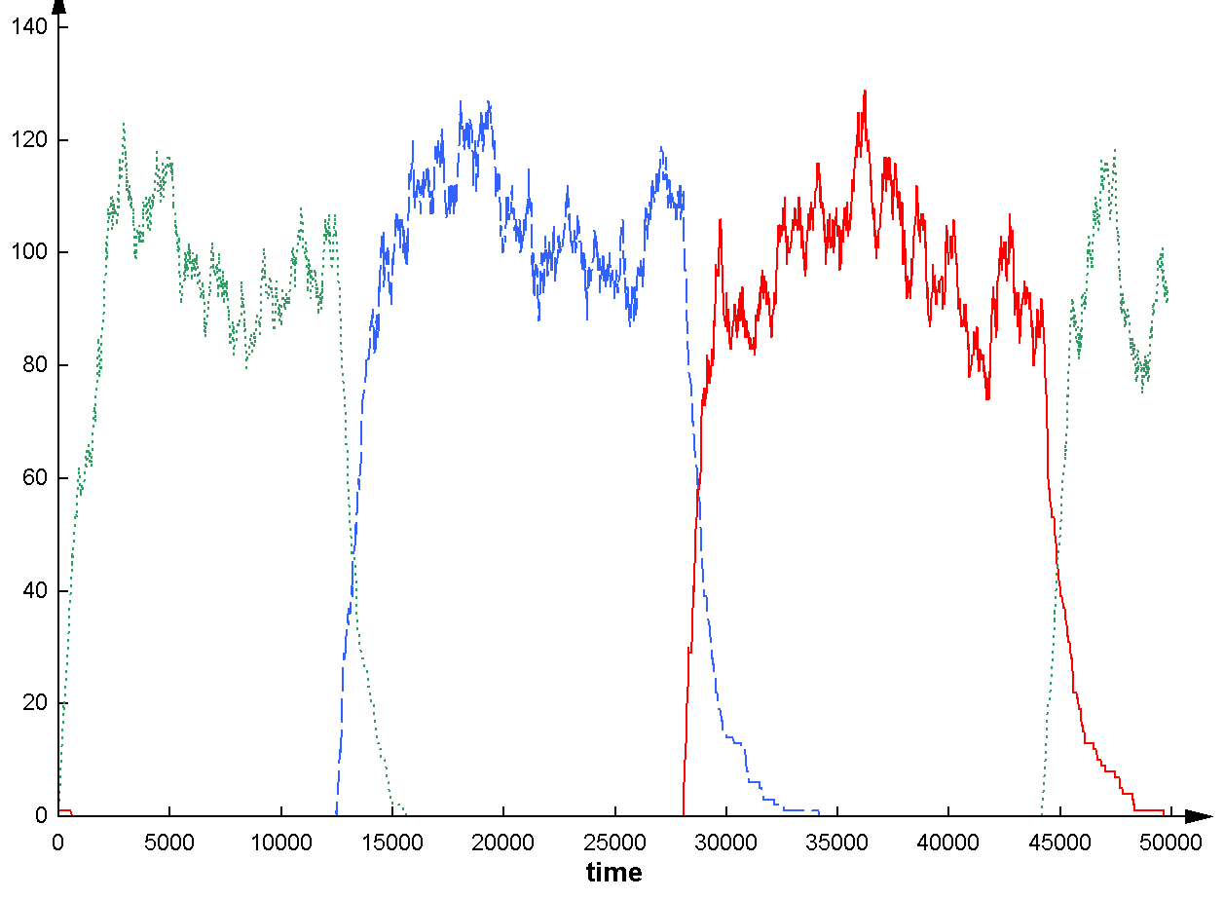
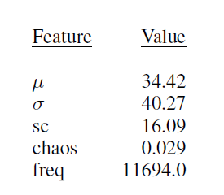
2. Repressilator
Autocatalytic reaction with noisy oscillating behaviour

Slide 17
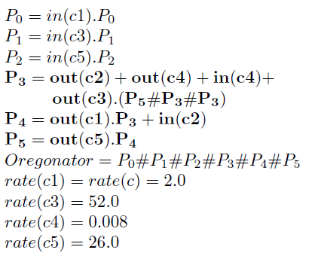
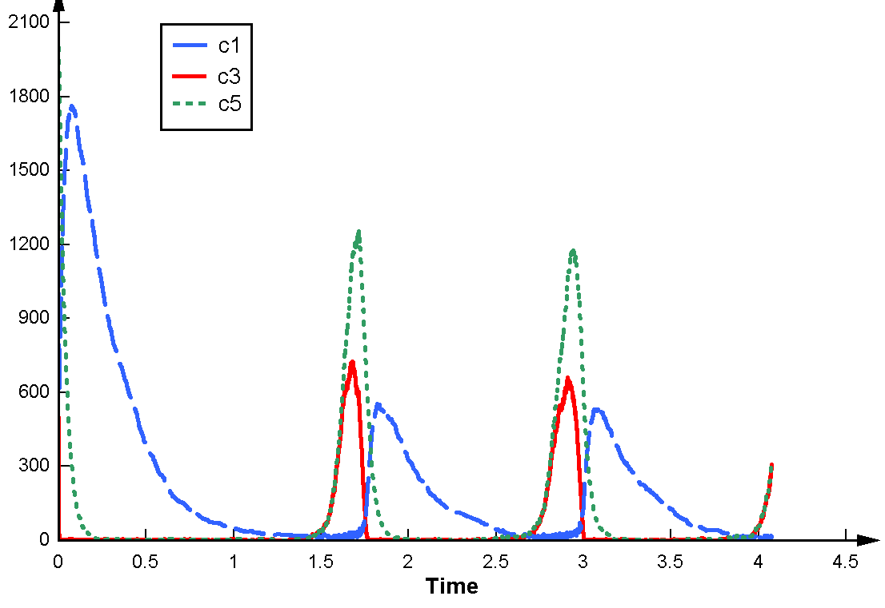
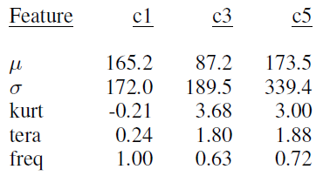
3. Oregonator
Another autocatalytic reaction

Slide 18
SPI parameters
Parameter | Lotka-Volterra | Repressilator | Oregonator
MOP strategy | Sum dominance | Sum ranks | Sum ranks (norm)
Rank weights (def 1) | no | w(freq) = 3 | w(freq) = 2
Stream filter | 50 | 3 | 25
Max time | 5.0 | 200,000 | 3.5
Max ticks | 400,000 | 20,000 | 250,000
Log delays | yes | yes | no

Slide 19
GP Parameters
Parameter | Value
Runs | 20
Solutions per run | 25
Initial population size | 4,000
Population size | 1,500
Unique population | Yes
Max tree depth (init) | 8
Max tree depth | 12
Probability crossover | 90%
Probability internal crossover | 85%
Probability terminal mutation | 75%

Slide 20
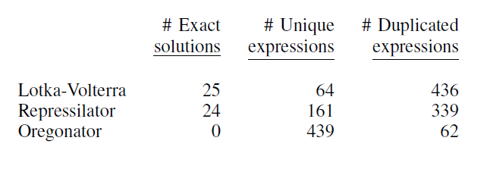
Results
Total: 500 solutions per experiment (20 runs each)
Exact solution is syntactic match with target model.
All behavioural matches turned out to be syntactic matches.

Slide 21
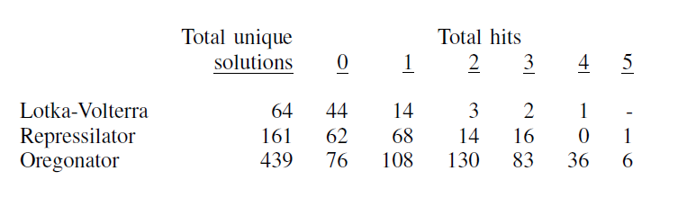
Results: feature matches
Each candidate solution interpreted 100 times.
z-score match of feature at 95% significance is a “hit”
Oregonator has 15 features in total

Slide 22
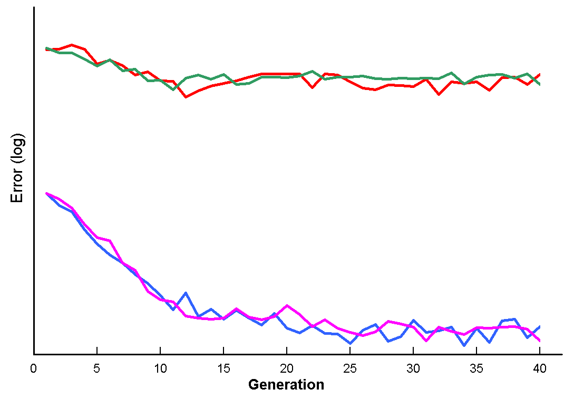
Error plot: Lotka-Volterra (avg best)

Slide 23
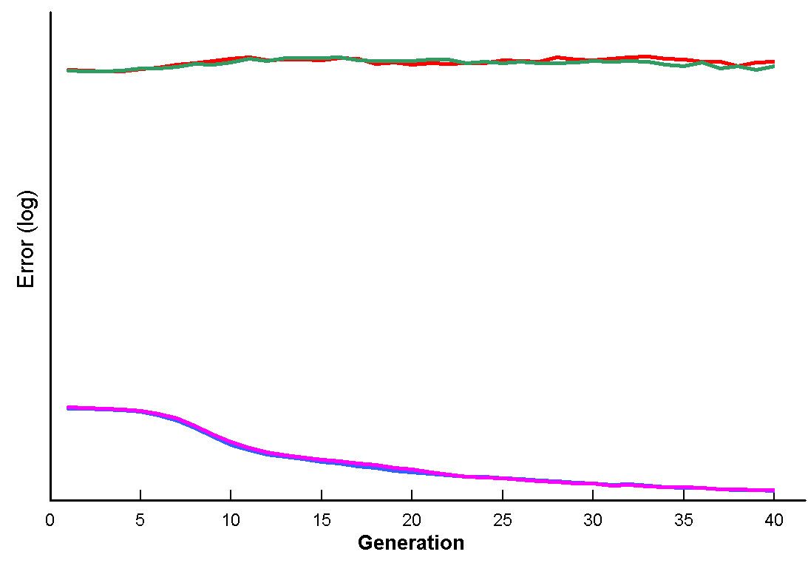
Error plots: Lotka-Volterra (avg popn)

Slide 24
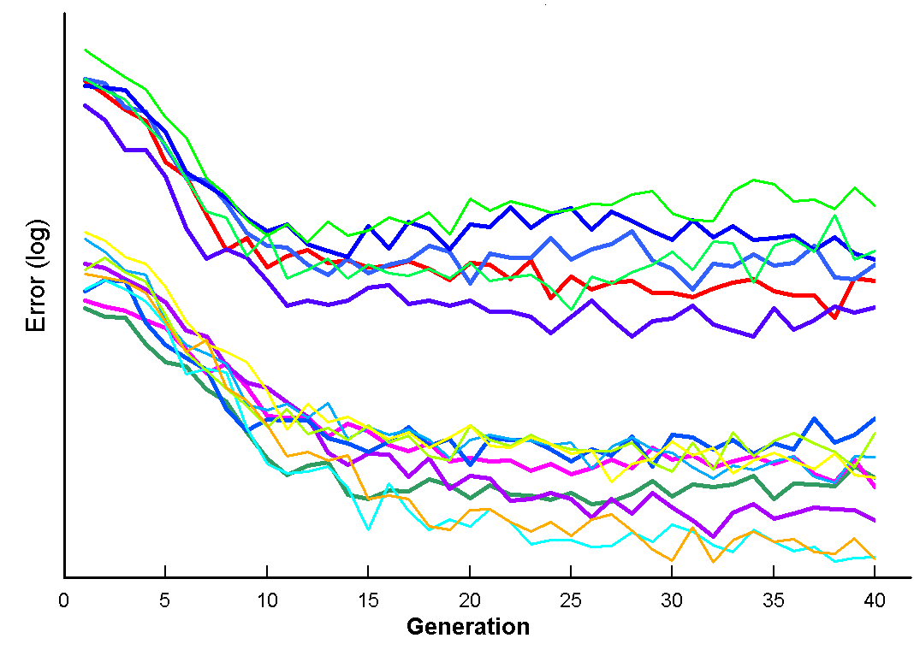
Error plot: Oregonator (avg best)

Slide 25
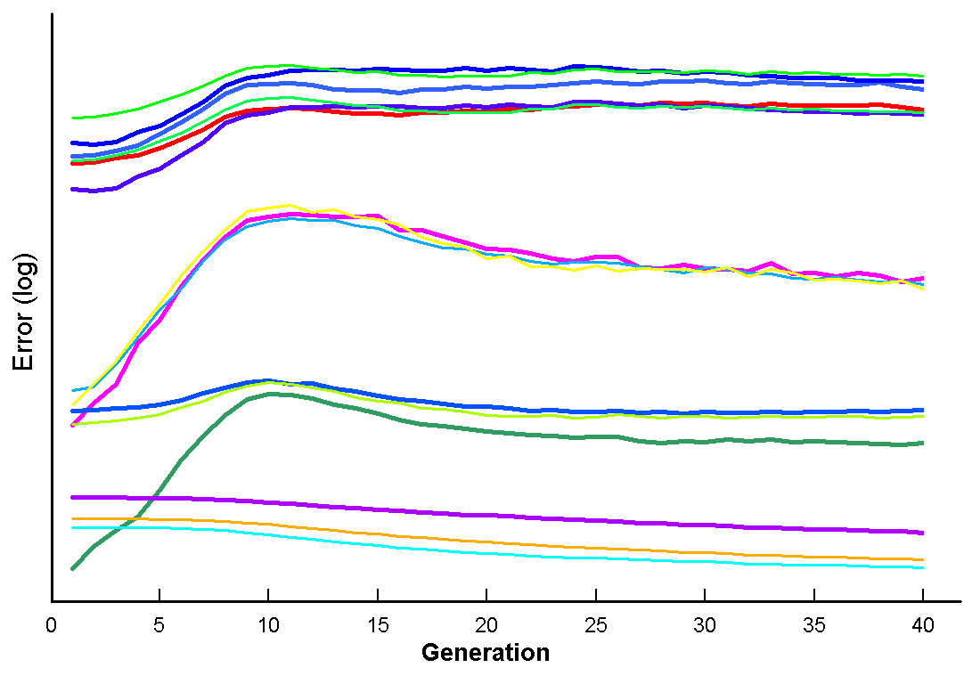
Error plot: Oregonator (avg popn)

Slide 26
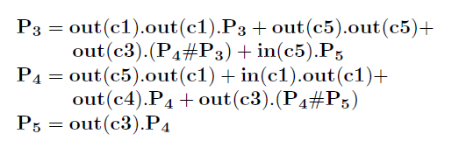
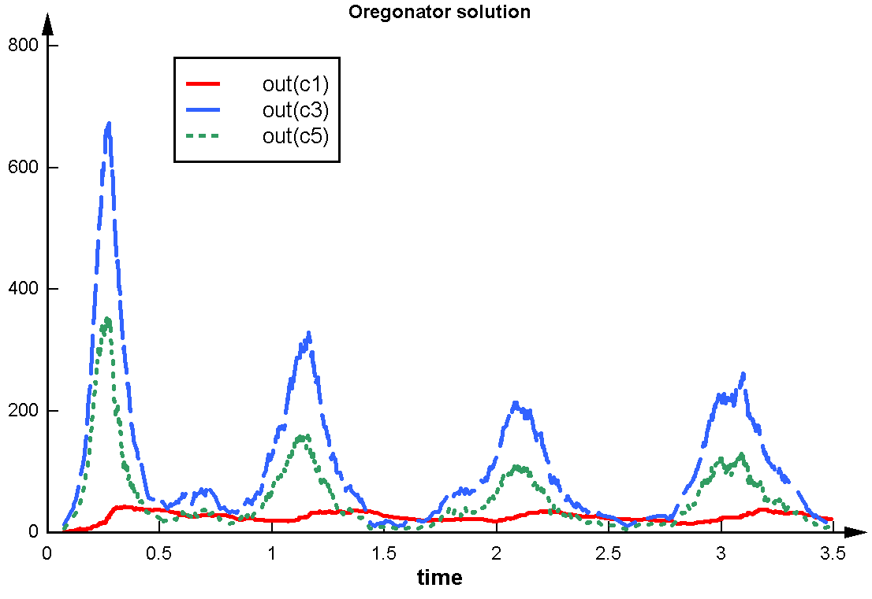
One Oregonator solution

Slide 27
Results
Good results for Lotka-Volterra and Repressilator.
  Behavioural matches = syntactic matches with target.
  Fortuitous selection of features for these processes.
Unsuccessful for Oregonator. Reasons may include...
  Inappropriate feature selections.
  Excessive number of features and channels.
  Simulation time was too short. Could not capture oscillation easily.
  Need further refined constraints in CFG, to manage complex search space.

Slide 28
Conclusions
Best results so far using GP to evolve models in raw SPI calculus.
  summed rank variations shown to be superior to Pareto ranking [Ross & Imada 2010], statistical weighting [Ross & Imada 2009]
SPI calculus is a challenging language for GP.
  Not well behaved during evolution: lots of non-functional expressions.
  But challenges are gifts!
Future work: scaling upwards...
  Feature selection strategies.
  More effective grammatical constraints for SPI calculus.
  Higher-level modeling languages: gene gates, PIM, BlenX, etc

