Slide 1
Virtual Photography using Multi-Objective Particle Swarm Optimization
William Barry
Faculty of Applied Science and Technology
Sheridan College
Oakville, ON, Canada
Brian J. Ross
Dept. of Computer Science
Brock University
St. Catharines, ON, Canada

Slide 2
Outline
Motivation
Background
System Design
Experiments
Future Work

Slide 3
Motivation
Photography has been an important tool for communication.
Recently, researchers have been attempting to develop a way to assist amateur photographers to generate images that follow rules of composition
Although there has been recent developments in this field, there has been little work using evolutionary computation algorithms.
This research is about developing automatic photography agents
History and Research
Video Games
Robotics
Film and Television
Community

Slide 4
Motivation
Today's games strive to generate virtual worlds that look beautiful to the gamer.
These worlds also contain objects of interest and require designers and programmers to spend countless hours creating special cameras to focus on these objects
This research can assist game developers by determining the best location and rotation for a camera in the scene, giving the end user a better experience.
History and Research
Video Games
Robotics
Film and Television
Community

Slide 5
Motivation
NASA and planetary exploration such as the Mars Rover [1].
United States Army uses unmanned robotic predator drones
Flying robot swarms have been created to explore, create flying formations, maneuver around obstacles, and even play music [2]
History and Research
Video Games
Robotics
Film and Television
Community

Slide 6
Motivation
Most recently the US has been considering the allowance of Drones to shoot media for film and television [14].
The usage of drones for this could allow media to be shot in smaller spaces where helicopters or planes cannot fly and will also help reduce gas emissions.
History and Research
Video Games
Robotics
Film and Television
Community

Slide 7
Motivation
This research will be of interest to researchers in evolutionary computation, computer graphics, and computer gaming, as well as artists and photographers
History and Research
Video Games
Robotics
Film and Television
Community

Slide 8
Related Work
Bares and Kim [20] solve visual elements in an image with respects to the composition of these elements
Gaspero, Ermetici, and Ranon [21] use a particle swarm optimization to generate images in a virtual environment with a specific set of rules
Lino, Christie, Ranon and Bares [22] allow a filmmaker or cinematographer to use a virtual motion-tracked hand-held camera that will assist the user in generating a suitable starting point
Abdullah, Christie, Schofield, Lino, and Olivier [23] used a particle swarm to start optimizing actual image composition rules

Slide 9
Related Work
 | Bares [15] | Liu [16] | Lino [17] | Abdullah [18] | Barry
PSO |  |  |  |  | 
Pareto |  |  |  |  | 
Weighted Sum |  |  |  |  | 
Sum of Ranks |  |  |  |  | 
Custom Ranking |  |  |  | 
Rule of Thirds |  |  |  |  | 
Object Detection |  |  |  |  | 
Horizon Line |  |  |  |  | 
Colour Similarity |  |  |  |  | 
Depth of Field |  |  |  | 
Diagonal Dominance |  |  |  | 
Virtual Environment |  |  |  |  | 
Photograph Analysis |  | 

Slide 10
Background
Aesthetics is a very subjective topic when dealing with image composition.
General rules of image composition include
Subject Matter
Rule of Thirds
Colour Similarity
Horizon Line
These rules outline the basics of making an image aesthetically pleasing.
Rules of Aesthetics

Slide 11
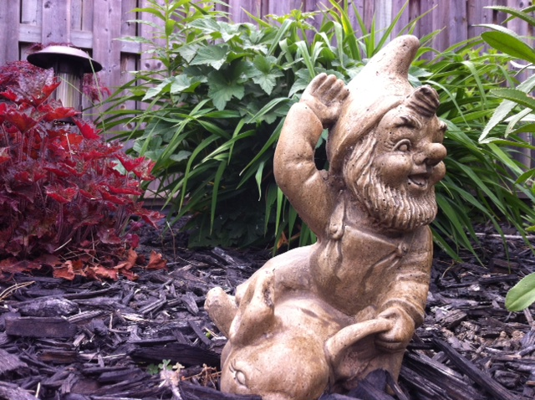
Background
Should be the focal point of the image
Objects are read from the 3D models, as automatic object identification was not a goal of the research (but could be used in the future).
Rules of Aesthetics
Subject Matter
Rule of Thirds
Colour Similarity
Horizon Line

Slide 12
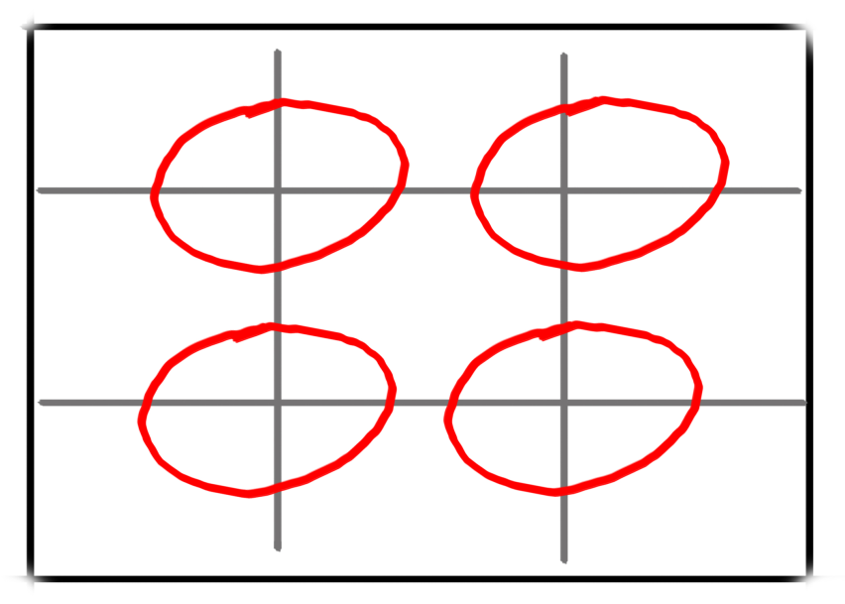
Background
Image is broken into thirds horizontally and vertically.
One intersection should coincide with an object of interest.
Considered to be one of the most important rules [3].
Rules of Aesthetics
Subject Matter
Rule of Thirds
Colour Similarity
Horizon Line

Slide 13
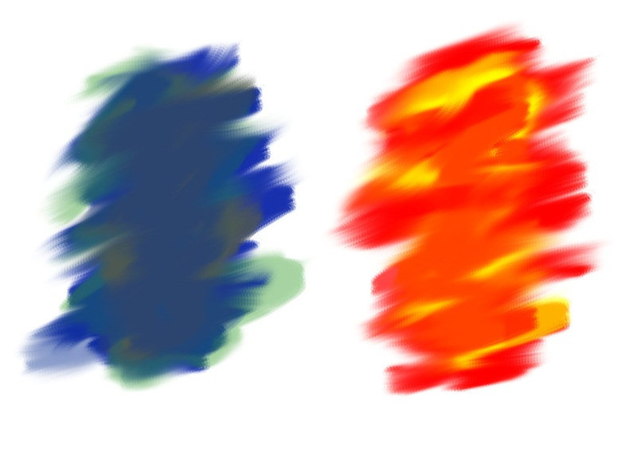
Background
Using the right colour scheme you can make an image seem hot or cold [3].
Predefined set of colour palettes and optional customizable palette.
Existing images were the target or ideal colour scheme.
Colour matching algorithm used from VisualSEEK (visual image matching, as done in image database matching) [4]
Colours can be used to identify objects of interest.
Rules of Aesthetics
Subject Matter
Rule of Thirds
Colour Similarity
Horizon Line

Slide 14
Background
Horizon line is defined by a separation line across the image [3].
The line should be at located horizontally at:
$\frac{1}{3} OR \frac{2}{3}$ of the image
Rules of Aesthetics
Subject Matter
Rule of Thirds
Colour Similarity
Horizon Line

Slide 15
Background
Population based algorithm that uses a stochastic optimization technique that was developed by Eberhart and Kennedy [5] in 1995
Inspired by the social behavior known as flocking [6,7]
Particle Swarm Optimization
${\vec{v}}_{i}=w{\vec{v}}_{i}$ + $c_{1}r_{1}\left(\vec{pbest}−\vec{p_{i}}\right)\text{+ }c_{2}r_{2}\left(\vec{gbest}−\vec{p_{i}}\right)$
$\vec{p_{i}}$ = $\vec{p_{i}}$ + ${\vec{v}}_{i}$
$\vec{v}$i - Is the particle velocity
w - Is an inertia value for the velocity
$\vec{p}$i - Is the current particle (solution).
pbest and gbest - Are defined as stated before.
r1 and r2 - Random number between (0,1).
c1 and c2 – Constants to control the swarm (also considered to be learning factors)

Slide 16
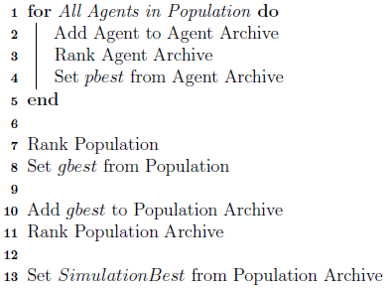
Background
Based on an approach for high-dimensional multi-objective evaluation in GA's [9,10].
Similar to Mostaghim and Teich the new algorithm maintains an archive for each agent so it can find its personal best
The motivation for this type of algorithm removes user intervention by having to apply weights to each objective
Multi-Objective Search Strategies
Sum of Ranks
Pareto Ranking

Slide 17
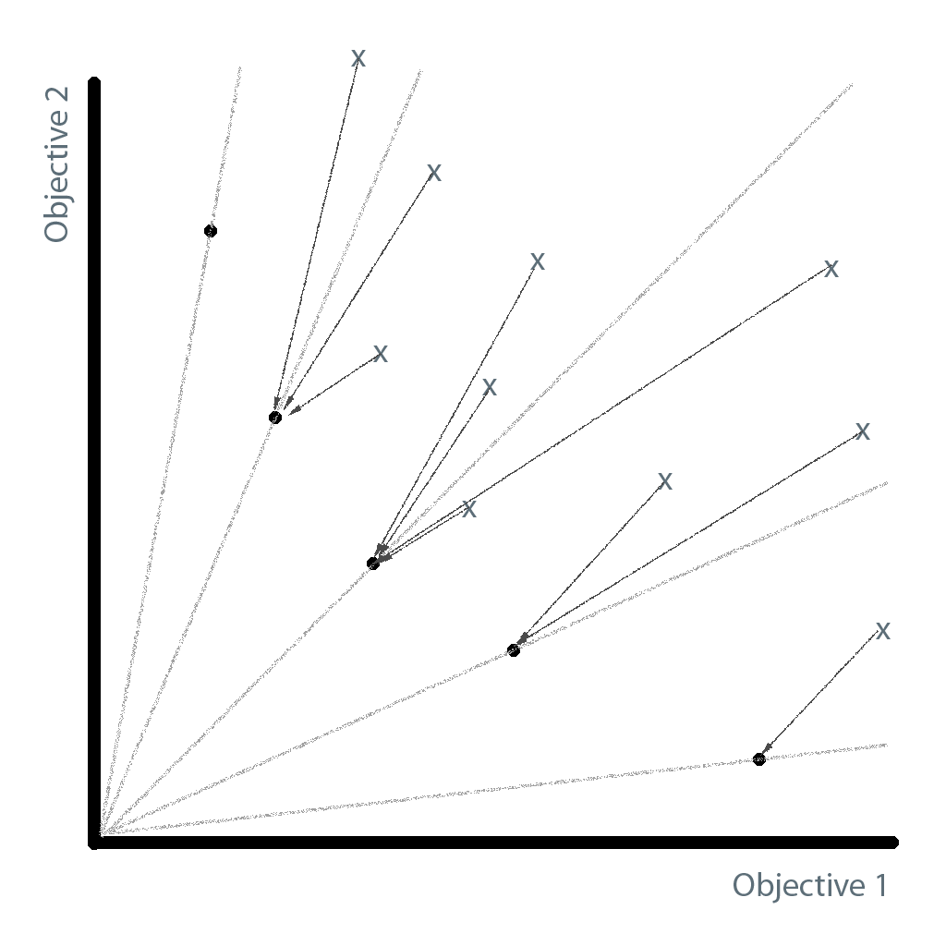
Background
PSO Pareto ranking algorithm by Mostaghim and Teich (2003) was selected for this research [8]
This strategy is implemented by assigning each agent in the world a value which defines a slope from the agent to the most optimal solution.
Multi-Objective Search Strategies
Sum of Ranks
Pareto Ranking

Slide 18
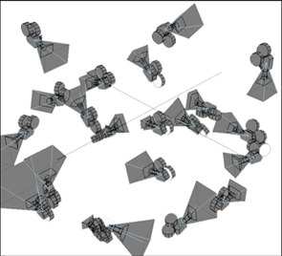
System Design
PSO
Image Analysis
Renderer
Image Library
Particle
Swarm
Optimization
Output
Image
Library
.
.
.
.
.
Image
Analysis

Slide 19
Bootstrap
Due to the random generation of camera positions and rotations it is possible for these cameras to miss all objectives.
Bootstrap allows the system to detect at least one image analysis objective before optimizing on the problem
Once one objective is found the simulation then starts decrementing from the total number of iterations

Slide 20
Experiment Settings
Particle Swarm Optimization Settings
Number of Runs | 20
Population | 25
Max Iterations | 100
Inertia | 0.8
Personal Best Constraint | 0.45
Global Best Constraint | 0.5
System Parameters
Simulation Settings
Image Width | 320
Image Height | 240
Rotation Enabled | TRUE
FOV Enabled | TRUE
Notes:
- Rotation was enabled for Pitch and Yaw only

Slide 21
Experiment Settings
Search Algorithm Definitions
NB | Normal PSO Bootstrapped
SRB | Sum of Ranks Bootstrapped
PRB | Pareto Ranking Bootstrapped
System Parameters
Fitness Objective Ranges (ƒ)
Object Detection (OD) | 0 ≤ ƒ ≤ 153600
Rule of Thirds (ROT) | 0 ≤ ƒ ≤ 800
Colour Similarity (CS) | 0.0 ≤ ƒ ≤ 1.0
Horizon Line (HZ) | 0 ≤ ƒ ≤ 240
Notes:
- If an object was not found in OD or ROT the worst score was doubled allowing the system to know this was a bad fitness

Slide 22
Experiments
Table Conversation Objectives
1. | Object Detection: Male Face (10%)
2. | Object Detection: Female Back Shoulder (15%)
3. | Rule of Thirds: Male Face
4. | Horizon Line
5. | Colour Similarity
Over the Shoulder Conversation
Objectives
Colour Similarity Target Image
Scene
Image Results
Statistical Results
Not in GECCO Paper

Slide 23
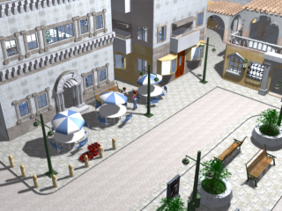
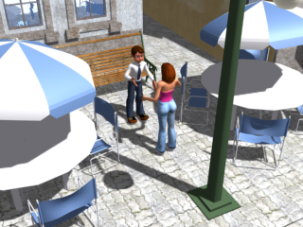
Experiments
Over the Shoulder Conversation
Objectives
Colour Similarity Target Image
Scene
Image Results
Statistical Results
Not in GECCO Paper

Slide 24
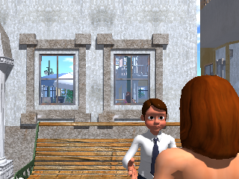
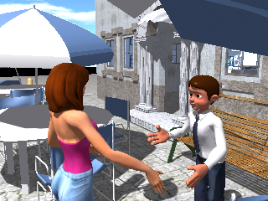
Experiments
Over the Shoulder Conversation
Objectives
Colour Similarity Target Image
Scene
Image Results
Statistical Results
(a)
(b)
Not in GECCO Paper
(c)
(d)

Slide 25
Experiments
Objective | (a) | (b) | (c) | (d)
OD Male Face | 18.8 | 19.4 | 19.5 | 19.8
OD Female Face | 28.7 | 29.1 | 29.4 | 29.6
ROT Male Face | 17.5 | 38.1 | 5.6 | 40.5
HZ | 0.06 | - | 0.07 | 0.13
CS | 0.001 | 0.14 | 26.0 | 0.001
Over the Shoulder Conversation
Objectives
Colour Similarity Target Image
Scene
Image Results
Statistical Results
Not in GECCO Paper

Slide 26
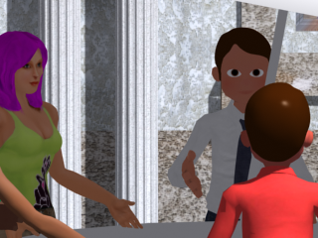
Experiments
Table Conversation Objectives
1. | Object Detection: Male Face (10%)
2. | Object Detection: Female Face (10%)
3. | Rule of Thirds: Male Face
4. | Rule of Thirds: Female Face
5. | Horizon Line
6. | Colour Similarity
Table Conversation
Objectives
Colour Similarity Target Image
Scene
Image Results
Statistical Results

Slide 27
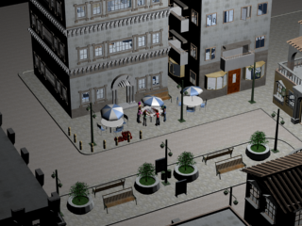
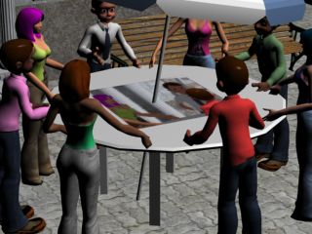
Experiments
Table Conversation
Objectives
Colour Similarity Target Image
Scene
Image Results
Statistical Results
Need to add images here

Slide 28
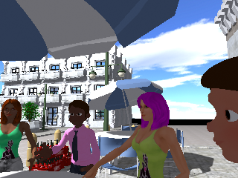
Experiments
Table Conversation
Objectives
Colour Similarity Target Image
Scene
Image Results
Statistical Results
(a)
(b)
(c)
(d)

Slide 29
Experiments
Objective | (a) | (b) | (c) | (d)
OD Male Face | 19.5 | 19.7 | 18.1 | 19.7
OD Female Face | 19.8 | 19.9 | 19.7 | 19.8
ROT Male Face | 8.54 | 10.79 | 7.45 | 36.73
ROT Female Face | 0.10 | 7.01 | 21.94 | 13.81
HZ | 3 | 0 | 0 | 28.0
CS | 0.110 | 0.61 | 0.86 | 0.08
Table Conversation
Objectives
Colour Similarity Target Image
Scene
Image Results
Statistical Results

Slide 30
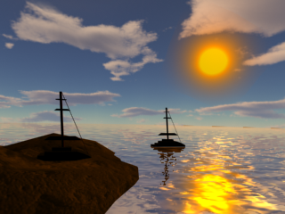
Experiments
Sunrise Objectives
1. | OD1 - Object Detection: Boat on Land (10%)
2. | OD2 - Object Detection: Boat in Water (10%)
3. | OD3 - Object Detection: Sun (5%)
4. | ROT1 - Rule of Thirds: Boat on Land
5. | ROT2 - Rule of Thirds: Boat in Water
6. | ROT3 - Rule of Thirds: Sun
7. | HZ1 - Horizon Line
8. | CS1 - Colour Similarity
Sunrise
Objectives
Colour Similarity Target Image
Scene
Image Results
Statistical Results

Slide 31
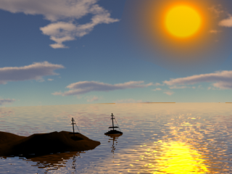
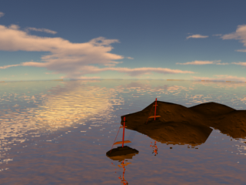
Experiments
Sunrise
Objectives
Colour Similarity Target Image
Scene
Image Results
Statistical Results

Slide 32
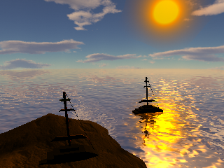
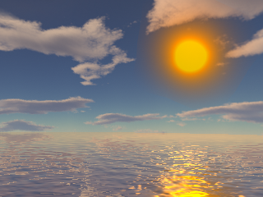
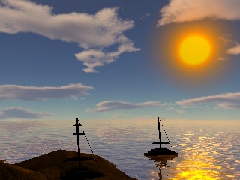
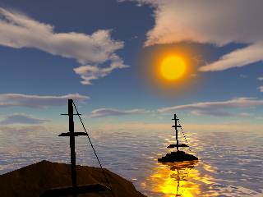
Experiments
Sunrise
Objectives
Colour Similarity Target Image
Scene
Image Results
Statistical Results
(a)
(b)
(c)
(d)
Notes:
A – Closer to Target image in respects to locations
B – No Boats but a nice picture
C – Better positions
D Best position in respects to ROT

Slide 33
Experiments
Objective | (a) | (b) | (c) | (d)
OD boat land (%) | 17.0 | - | 18.3 | 17.8
OD boat water (%) | 19.3 | - | 19.3 | 19.1
OD Sun (%) | 9.9 | 9.9 | 9.8 | 9.9
ROT boat land | 0.33 | - | 2.6 | 2.7
ROT boat water | 10.87 | - | 0.3 | 7.8
ROT Sun | 75.89 | 22.3 | 56.3 | 6.1
HZ | 18 | 1.9 | 0.001 | 8
CS | 0.01 | 0.2 | 0.01 | 0.01
Sunrise
Objectives
Colour Similarity Target Image
Scene
Image Results
Statistical Results
 | B
A | SRB | NB | PB
SRB | - | 4 | 5
NB | 1 | - | 4
PB | 0 | 0 | -
Notes:
Mann-Whitney U-Test with a 95% confidence level.
This was chosen because it is a non-parametric confidence test
NB beat SRB in OD > Values are largest and these are usually found to optimize more
both groups are independent of each other
responses are ordinal (i.e. one can at least say, of any two observations, which is the greater)

Slide 34
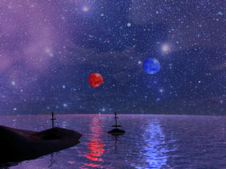
Experiments
Space Objectives
1. | OD1 - Object Detection: Boat on Land (10%)
2. | OD2 - Object Detection: Boat in Water (10%)
3. | OD3 - Object Detection: Red Moon (5%)
4. | OD4 - Object Detection: Blue Moon (5%)
5. | ROT1 - Rule of Thirds: Boat on Land
6. | ROT2 - Rule of Thirds: Boat in Water
7. | ROT3 - Rule of Thirds: Red Moon
8. | ROT4 - Rule of Thirds: Blue Moon
9. | HZ1 - Horizon Line
10. | CS1 - Colour Similarity
Space
Objectives
Colour Similarity Target Image
Scene
Image Results
Statistical Results

Slide 35
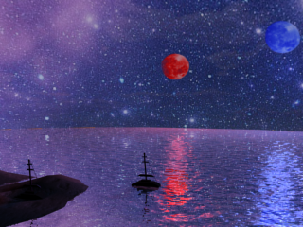
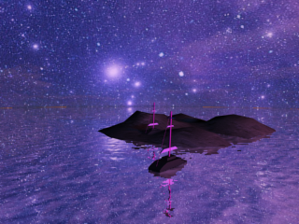
Experiments
Space
Objectives
Colour Similarity Target Image
Scene
Image Results
Statistical Results

Slide 36
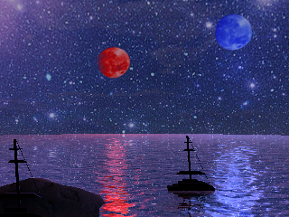
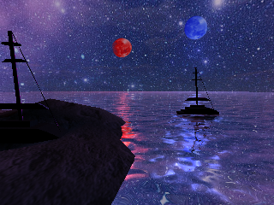
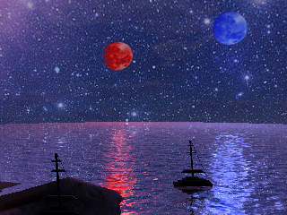
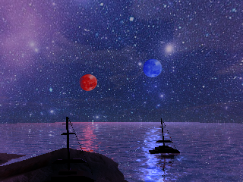
Experiments
Space
Objectives
Colour Similarity Target Image
Scene
Image Results
Statistical Results
(a)
(b)
(c)
(d)

Slide 37
Experiments
Objective | (a) | (b) | (c) | (d)
OD1 boat land | 18.4 | 16.2 | 18.9 | 18.1
OD2 boat water | 19.0 | 19.2 | 19.3 | 19.4
OD3 red moon | 9.9 | 10.0 | 9.9 | 10.0
OD4 blue moon | 9.9 | 10.0 | 9.9 | 10.0
ROT1 boat land | 1.33 | 43.52 | 44.49 | 13.62
ROT2 boat water | 79.40 | 18.11 | 0.67 | 1.94
ROT3 red moon | 31.48 | 37.67 | 30.49 | 31.69
ROT4 blue moon | 45.88 | 24.40 | 44.09 | 37.42
HZ | 11 | 27 | 23.0 | 1
CS | 0.023 | 0.028 | 0.017 | 0.005
Space
Objectives
Colour Similarity Target Image
Scene
Image Results
Statistical Results
 | B
A | SRB | NB | PB
SRB | - | 4 | 8
NB | 0 | - | 9
PB | 0 | 0 | -
Notes:
SRB failed to out rank the PB in respects to the Blue moon

Slide 38
Experiment Results
Table Conversation
Video
Sunrise Scene
Space Scene
Swarm

Slide 39
Experiment Results
Table Conversation
Sunrise Scene
Video
Space Scene
Swarm

Slide 40
Experiment Results
Table Conversation
Sunrise Scene
Space Scene
Video
Swarm

Slide 41
Experiment Results
Table Conversation
Sunrise Scene
Space Scene
Swarm
Video

Slide 42
Conclusion
Capable of generating images that can be considered to be aesthetically pleasing.
Effective in finding solutions in an environment based on simple parameters
Once running, there is no user interaction needed
The system is flexible and can adapt to any virtual environment
Although not in paper, when working with smaller dimensional problems all optimization algorithms were capable of solving the problem.
However, not all algorithms were capable of solving high-dimensional problems successfully
Sum of Ranks PSO attempts to satisfy as many objectives as possible (unlike Pareto)
Proposed System & Algorithms

Slide 43
Future Work
New advanced aesthetic could be incorporated into the system [11].
As computers become more powerful; problems like this could possibly run in real-time.
Merging the system proposed in this research with Google Maps [13] or Google Earth [12].
Compare Sum of Ranks PSO to other MO PSO in the literature, on other multi-objective problems
Aesthetic Rules
Real-time
New virtual environments
Sum of Ranks Algorithm

Slide 44
Bibliograpy
[1] NASA, Mars rover, http://marsrover:nasa:gov/, August 2012.
[2] N. Michael, J. Fink, and V. Kumar, Cooperative manipulation and transportation with aerial robots, Autonomous Robots 30 (2011), no. 1, 73-86.
[3] Greg Albert, The simple secret to better painting: How to immediately improve your work with the one rule of composition, North Light Books, 2003.
[4] Smith, Visualseek: a fully automated content-based image query system, pp. 87{98, ACM, 1996.
[5] R. C. Eberhart and J. Kennedy, A new optimizer using particle swarm theory., Neural Networks,. Proceedings., IEEE International Conference on 4 (1995), 1942 - 1948.
[6] Kennedy J. Eberhart, R.C., Particle swarm optimzation, IEEE Internation Conference on Neural Networks vol. 4 (1995), 1942-1948.
[7] R.C. Shi Y. Kennedy J, Eberhart, Swarm intelligence, Morgan Kaufmann Publishers, 2001.

Slide 45
Bibliograpy
[8] J Mostaghim, S. Teich, Strategies for Finding good local guides in multiobjective particle swarm optimization (mopso), Swarm Intelligence Symposium, 2003.
[9] P. J. Bentley and J. P. Wakefield, Finding acceptable pareto-optimal solutions using multiobjective genetic algorithms.
[10] David W. Corne and Joshua D. Knowles, Techniques for highly multiobjective optimisation: Some nondominated points are better than others, CoRR abs/0908.3025 (2009).
[11] E. den Heijer and A.E. Eiben, Comparing aesthetic measures for evolutionary art, Proc. EvoMusArt, vol. 2, Springer, 2010, LNCS 6025, pp. 311-320.
[12] Google, Google earth, https://earth:google:com/, August 2012.
[13] Google, Google maps, https://maps:google:com/, August 2012.
[14] BBC News Dones, http://www.bbc.com/news/business-27674131.

Slide 46
Bibliograpy
[15] William Bares and Byungwoo Kim, Generating virtual camera compositions, IUI '01 Proceedings of the 6th international conference on Intelligent user interfaces (2001), 9 - 12.
[16] Lior Wolf Ligang Liu, Renjie Chen and Daniel Cohen-Or, Optimizing photo composition, Computer Graphics Forum 29 (2010), 469478.
[17] Roberto Ranon Christophe Lino, Marc Christie and William Bares, The directors lens: An intelligent assistant for virtual cinematography, MM'11 Proceedings of the 19th ACM international conference on Multimedia (2011), 323-332.
[18] Guy Schofield Christophe Lino Rafid Abdullah, Marc Christie and Patrick Olivier, Advanced composition in virtual camera control, SG'11 Proceedings of the 11th international conference on Smart graphics (2011), 13-24.
[19] William Barry, Generative Aesthetically Pleasing Images in a Virtual Environment Using Particle Swarm Optimization, http://www.cosc.brocku.ca/files/downloads/research/cs1208.pdf, October 2012.

Slide 47
Bibliograpy
[20] William Bares and Byungwoo Kim, Generating virtual camera compositions, Proceedings of the 6th international conference on Intelligent user interfaces (New York, NY, USA), IUI '01, ACM, 2001, pp. 9-12.
[21] Andrea Ermetici Luca Di Gaspero and Roberto Ranon, Swarming in a virtual world: A pso approach to virtual camera composition, ANTS 2008 LNCS 5217 (2008), 155-166.
[22] Christophe Lino, Marc Christie, Roberto Ranon, and William Bares, The directors lens: An intelligent assistant for virtual cinematography, Proceedings of the 19th ACM international conference on Multimedia (New York, NY, USA), MM '11, ACM, 2011, pp. 323-332.
[23] Guy Schofield Christophe Lino Rafid Abdullah, Marc Christie and Patrick Olivier, Advanced composition in virtual camera control, SG'11 Proceedings of the 11th international conference on Smart graphics (2011), 13-24.

Slide 48
Questions?

