Slide 1
Evolutionary Art Using Summed
Multi-Objective Ranks
Steven Bergen and Brian J. Ross
Brock University
Department of Computer Science
St. Catharines, Ontario,
Canada L2S 3A1
sb04qv@brocku.ca, bross@brocku.ca

Slide 2
Outline
Problem overview
Background
Experiment design
Results
Discussion

Slide 3
Problem Overview
JNetic Textures: evolutionary art system evolves images using suite of feature tests for fitness evaluation
  up to 4 tests, measuring aesthetics and colour properties
A natural multi-objective problem: each feature test is an objective.
Earlier work used Pareto ranking with diversity.
Results were generally good.

Slide 4
Problem Overview
Problem with Pareto ranking: outliers
These are solutions that are fit on only a minority of objectives, while not so impressive on the rest.
A natural outcome of Pareto domination.
For our art application, outliers are usually unacceptable: we require good performance on most objectives, not just a few of them.
Multi-objective is preferable over weighted sum.

Slide 5
Problem Overview
We borrow an idea from work in high-dimension multi-objective evolutionary computation: summed ranks.
  Replaces Pareto ranking score.
We will compare summed rank results to Pareto.
We are not justifying aesthetic model, nor evaluating the quality of results. Analysis done strictly on population scores.
  Art application is of secondary importance in this research.

Slide 6
Background: Evolutionary Art
Evolutionary computation as an artist.
Pioneers: Sims 1993, Dawkins 1996
Typical approach: use genetic programming to evolve a “texture formula”
  f(x,y) → (R,G,B)
Most systems use interactive (human) fitness function.
More recently, models of aesthetics have been considered.
  ANN (Baluja 1994), distance metrics (Svangard & Nordin 2004), image complexity (Machado & Cardoso 1998; Neufeld, Ross & Ralph 2008)
Goal: automated synthesis of aesthetically pleasing images.

Slide 7
Background: Ralph’s Aesthetic Model
(Ralph 2006): Analyses of masterpieces (Impressionist, etc.) showed that many paintings exhibit normal distribution of colour gradient.
Similar analyses of photographs, graphic design, “bad art”: no such normal distribution.
This Bell curve distribution may be one aspect of aesthetics.
It is very difficult to purposefully accomplish!
  Such a distribution is globally determined throughout an image.
  Changes in (say) high-frequencies will require subsequent changes in lower, etc.
This distribution may be part of well-known 1/f noise distributions.

Slide 8
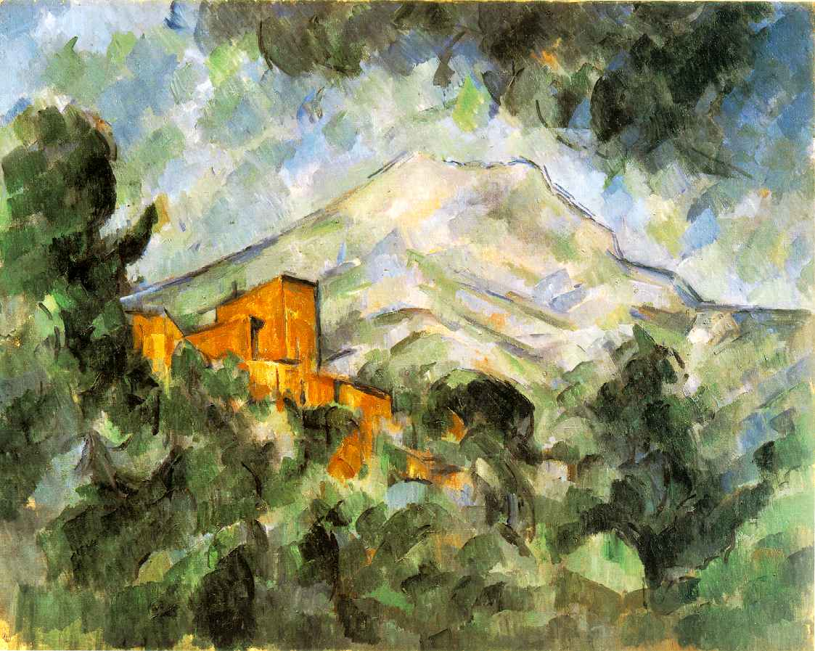
Cezanne- Mont Sainte-Victoire and Chateau Noir

Slide 9
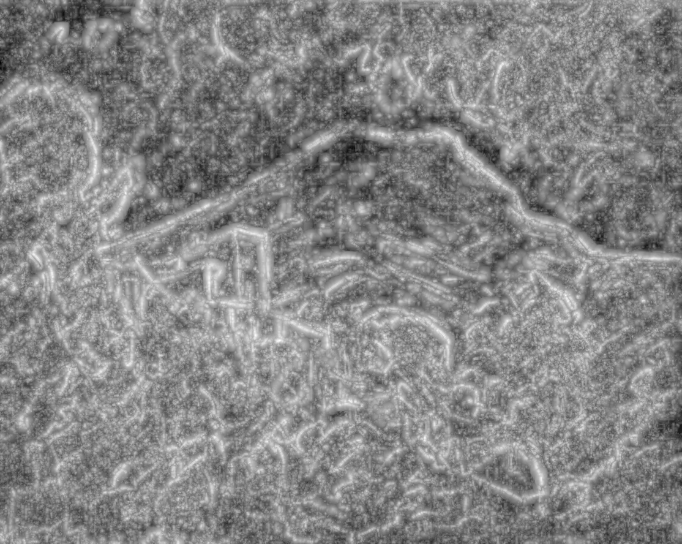
Gradient of luminosity

Slide 10
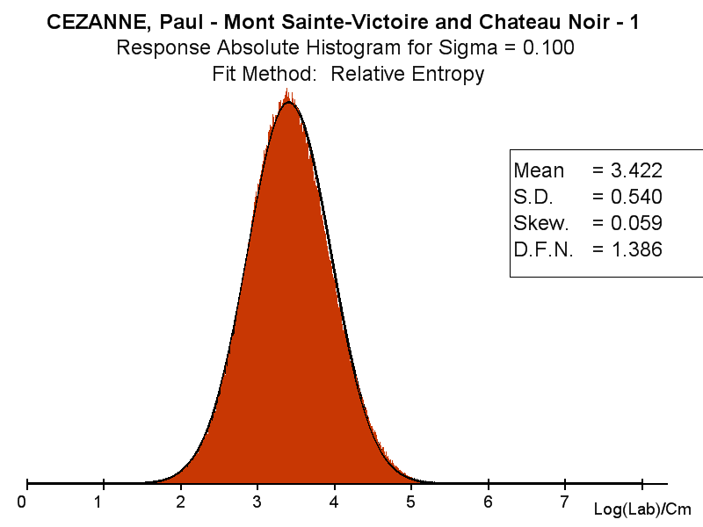

Slide 11
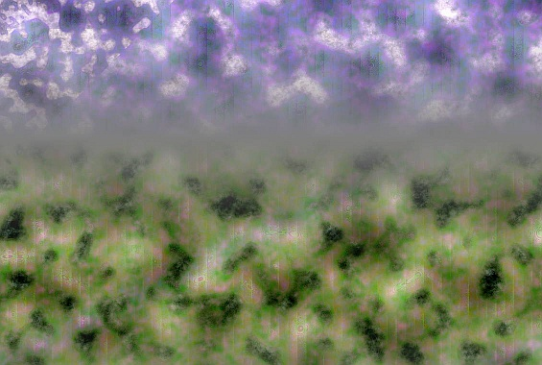
GP and Ralph’s model: Texture formula

Slide 12
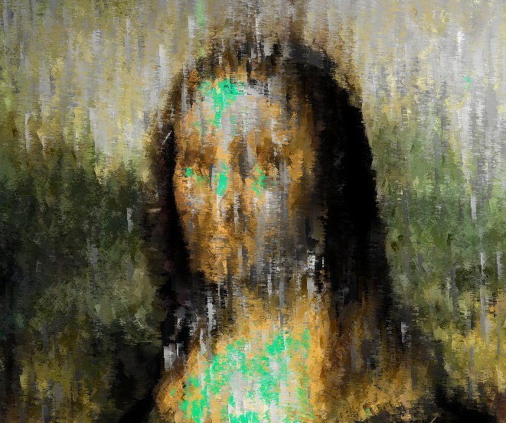
GP and Ralph’s model: image filter

Slide 13
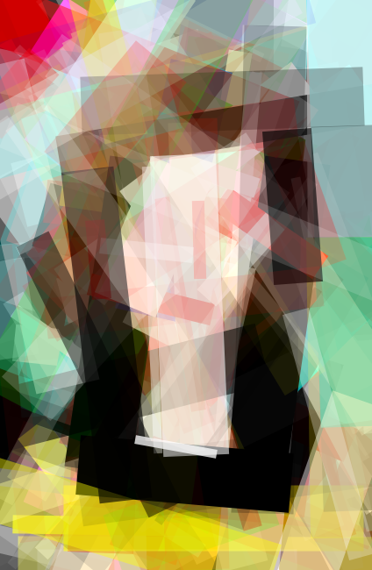
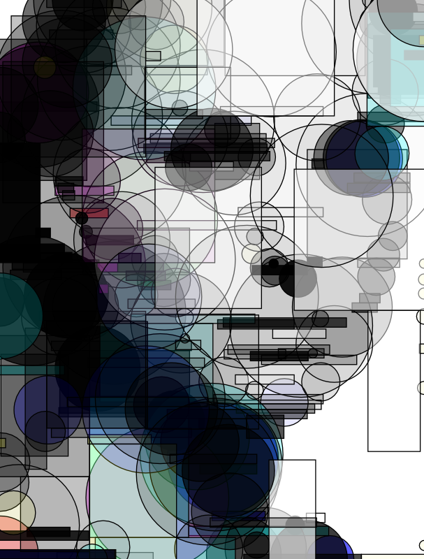
JNetic: vector graphics

Slide 14
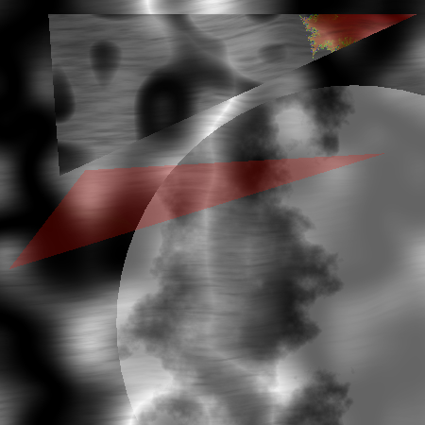
JNetic Textures

Slide 15
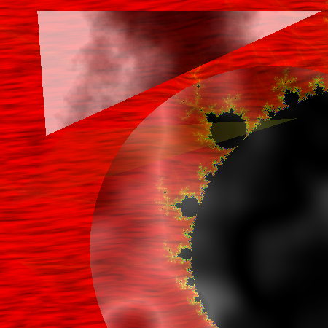
JNetic Textures

Slide 16
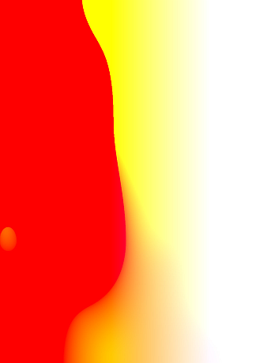
Jnetic Textures

Slide 17
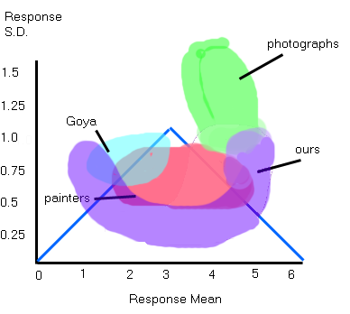
Range of evolved results
We found that the Bell curve aesthetic model favoured images with broad
“paint strokes”, as common in Impressionist paintings.

Slide 18
Outliers
Earlier work with GP and Ralph’s model use max of 4 objectives:
  DFN (deviation from normality -- fit to normal curve)
  mean
  standard deviation
  colour palette match to a target image (colour histogram analysis)
Outliers: Pareto dominance permits rank 1 solutions that are good scores in a minority of objectives.
  Such images are usually of little interest.
  eg. matching only standard deviation won’t be useful, if DFN is too large!

Slide 19
Pareto ranks
Let a be feature vector of form (a₁, a_{2, ...,} a_{k)}
Pareto dominance:
a dominates b iff exists i: a_{i} < b_{i}
and for all i: a_{i} ≤ b_{i}
All undominated individuals: rank 1.
Undominated individuals in remaining set: rank 2. (etc)
Well-known fact: Pareto ceases to give reasonable scoring for problems with more than 4 dimensions
  most of population will be undominated by default.

Slide 20
Summed ranks
From (Bentley & Wakefield 1997)
Vector a = (a₁, a_{2, ...,} a_{k)}
Find rank number r for each vector value within its dimension:
  a_{r} = (r₁, r_{2, ...,} r_{k)}
Fit = ∑ _{i} w_{i} r_{i}
where w are optional weights (default = 1)
Main benefit: reasonable scoring for high dimensional problems (eg. 20 dimensions)

Slide 21
Example (minimization)
Fit vector | Pareto Rank | Rank vector | Sum Ranks
(10, 20, 20) | 1 | (1, 2, 2) | 5
(20, 10, 10) | 1 | (2, 1, 1) | 4
(20, 20, 30) | 2 | (2, 2, 3) | 7
(30, 40, 30) | 3 | (3, 4, 3) | 10
(500, 30, 500) | 3 | (4, 3, 4) | 11
Note how last entry is an outlier in rank 3.
if (5, 100, 2000) added to population, then all Pareto ranks become “1”
Hence outliers can quickly obtain preferable scores!

Slide 22
JNetic Textures
GP-based image evolution system.
Implemented in Java.
GP engine is ECJ.
Main features:
  Automatic and interactive evolution. Easy to switch back and forth.
  Complex primitives: Mandelbrot, Perlin, Fur,...
  Incorporates texture formula and vector graphics (geometry). Vector graphics ideas are from earlier JNetic system (next slide).
  MOP scoring: Pareto, summed ranks.
  Population visualization.

Slide 23
Chromosome Representation
Chromosome made up of three function types – mathematical, texture rendering and geometric primitive rendering
  Mathematical functions are typical operators (+, -, log, etc) and ERC (float and integer)
  Texture rendering functions use RGB values to generate a texture image with UV (or X and Y) components as variables
  Primitive rendering functions consist of two parts; a background texture and descriptor values specific to each primitive type (rectangles, triangles, etc). These create a primitive to render on an image
All chromosome ‘result’ images rendered with background texture, then primitives added sequentially

Slide 24
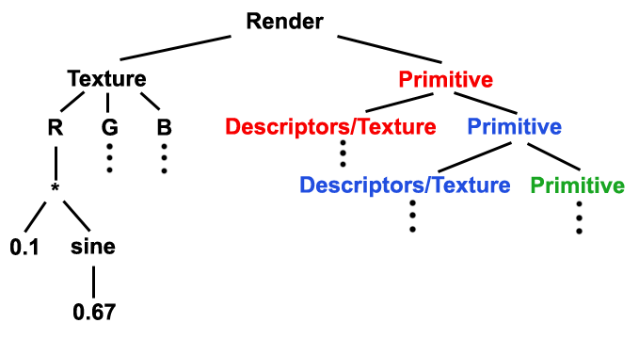
JNetic – Chromosome Representation
ADFs incorporated as well, which return textures to be used for the image background or with primitives
The number of primitives are bound by the depth limitations of the GP tree
When rendering a texture, UV values are supplied to the tree for every X and Y coordinate in the temporary image. This image is then used as a texture for primitives or the image background

Slide 25
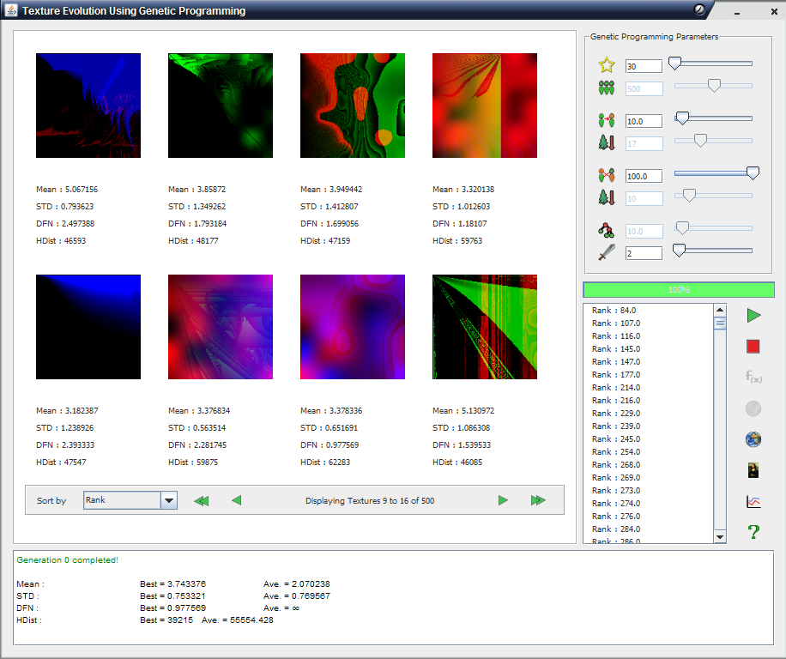
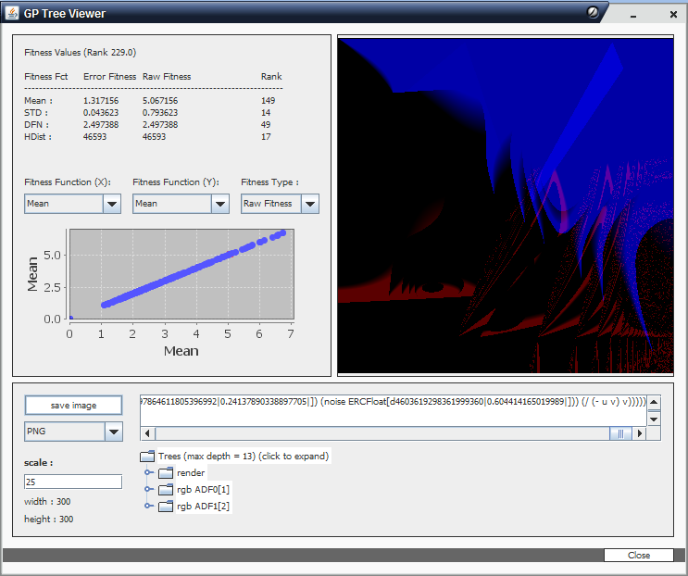
JNetic Textures - Interface
Made with Java and Java Swing components
User interactive environment with visual updates every generation

Slide 26
Experiment design
Goal: compare Pareto vs. summed ranks
  → population and solution scores
4 feature tests
  DFN = 0.0
  mean = 3.75
  std dev = 0.75
  Colour palette match = 0.0
small images processed (faster)
complex textures and primitives avoided (too slow)

Slide 27
Feature evaluation
DFN (deviation from normality): 0.0 is a perfect match to normal distribution.
Mean (3.75) and standard deviation (0.75) similar to “sweet spot” in Ralph’s analysis.
Colour palette matching: 0.0 score indicates match between quantized colour histograms of candidate and target images.
  “nearly same colours in same quantities”
See paper for technical details of these feature tests.

Slide 28
GP parameters
Parameter Value
Colour target images 5
Runs per target image 5
Max gens 25 (SR), 25 & 100 (Pareto)
Popn size 500
GP functions math, noise, circles, rectangles
Prob. crossover 90%
Max tree depth 17
Tournament size 4
Features DFN, mean, std dev, colour

Slide 29
General comments about results
Summed rank behaves like typical single objective GA.
  Strong population convergence to a single solution image.
  Essentially only one solution per run.
  Compare to Pareto: variety of rank 1 solutions per run.
Colour test is challenging.
  Colour histogram matching is performed.
  It is a strict match, and probably unreasonable to use.
  Other less strict techniques exist.
  Its purpose here is to help complicate the search space.
Very low DFN scores (< 1.0) are challenging.

Slide 30
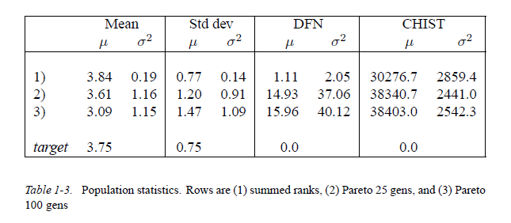
Results: Population statistics

Slide 31
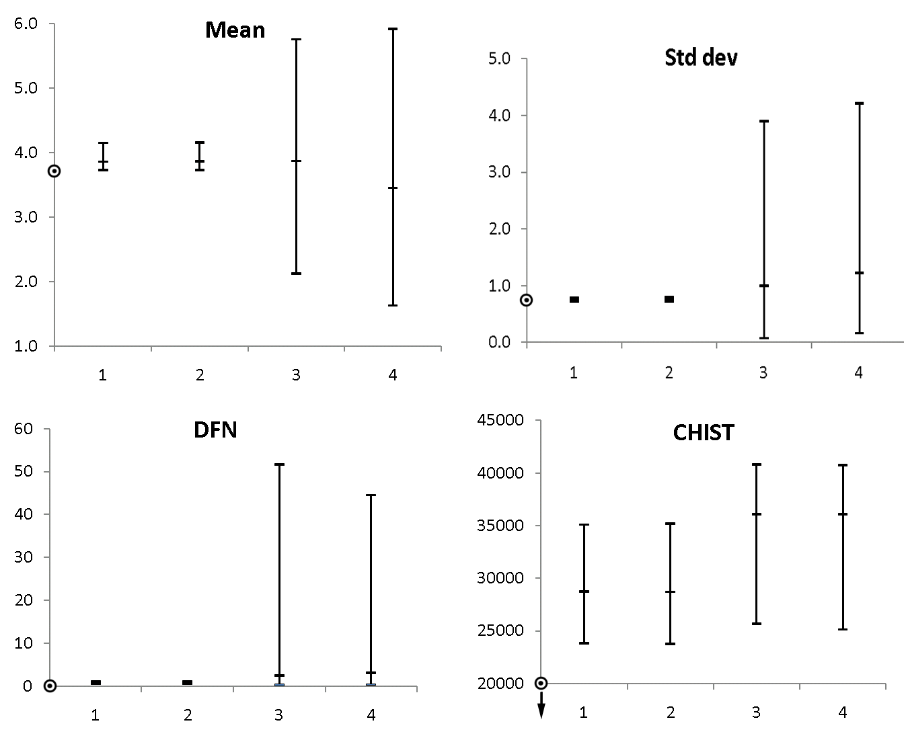
Solution score ranges
1 – SR, 2 – SR w/o dups, 3 – Pareto (25 gen), 4 – Pareto (100 gen)

Slide 32
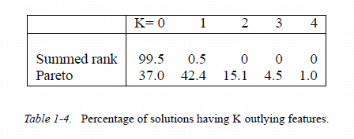
Outliers
A feature is considered an outlier if it is over 1 standard deviation unit
outside the population average.
The above table uses the Pareto standard deviation as the SD unit.

Slide 33
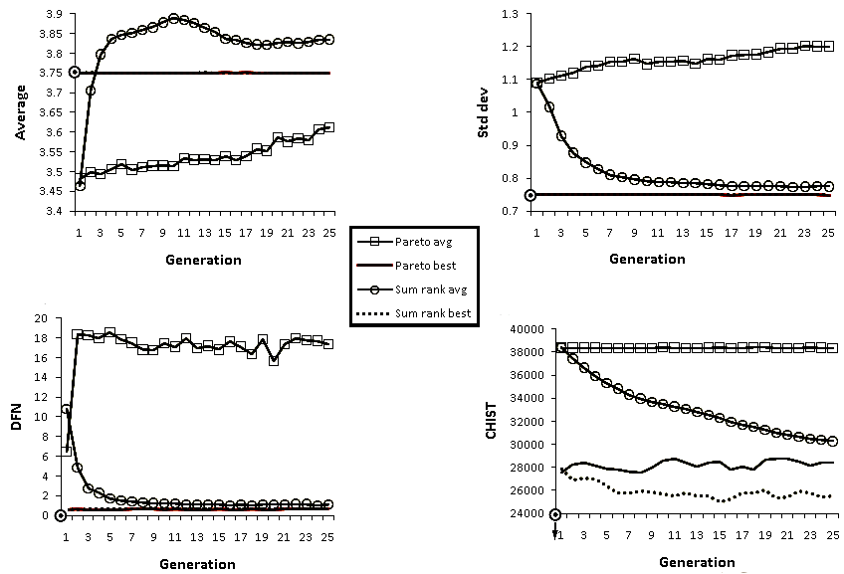
Performance curves

Slide 34
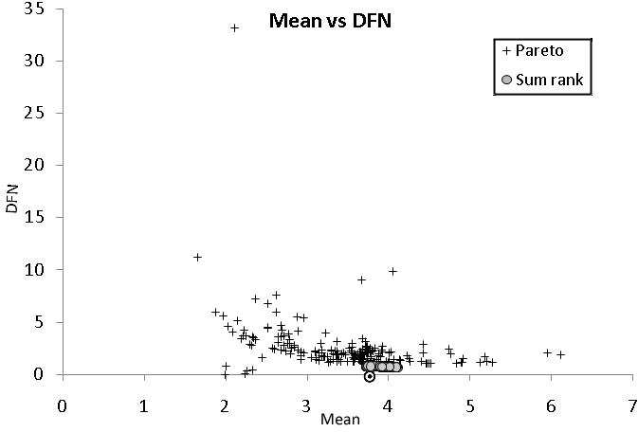
Scatter plot of top 50 solutions

Slide 35
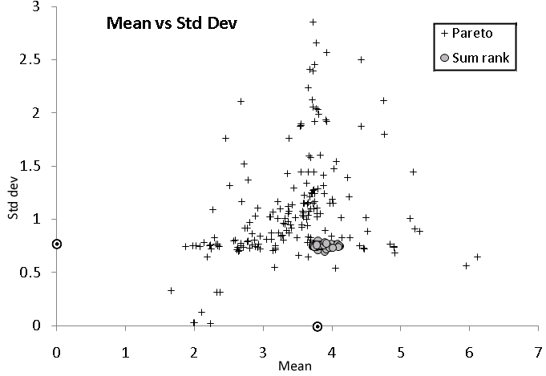
Scatter plot

Slide 36
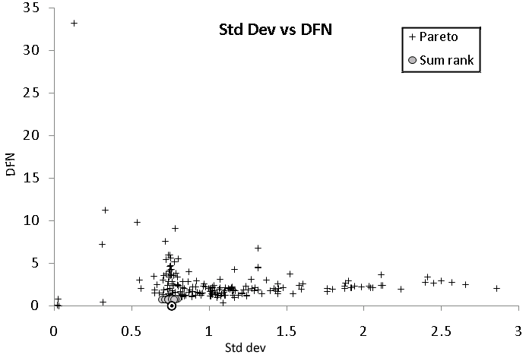
Scatter plot

Slide 37

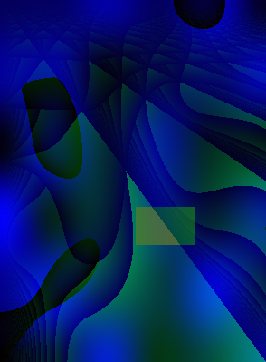
Two example images
Pareto
mean=2.71, sd=0.76,
DFN=6.37, Color=23268
Sum ranks
mean=3.75, sd=0.77,
DFN=1.12, Color=15942

Slide 38
Two images
Pareto solution is superior in standard deviation only.
Neither dominates the other.
Summed rank solution would likely be superior to Pareto’s in a summed rank run, because it is better in 3 of the 4 features.
In a Pareto scoring situation, relative score difference depends upon their relationship to others in population.
Main point: Pareto solution is an outlier.

Slide 39
Discussion
Advantages of summed ranks
Solutions better in majority of features.
Fast convergence to good-quality solutions.
Advantages of Pareto ranks
Multiple solutions per run: an advantage in some problem domains (especially subjective ones?)
Higher population diversity.

Slide 40
Discussion
Other MOP strategies for high-dimensional problems may be applicable.
ARF (Corne & Knowles 2007) shown to be very effective in difficult high-dimensional problems.
It is like summed ranks, except only the non-dominated individuals in population are used for ranking and selection.
This relies on a high-dimensional objective space (12-20 dimensions).
It is not a good approach for a low-dimension problem like ours, because there are too few undominated individuals to choose from (typically 15). Too great of a loss in genetic diversity.

Slide 41
Other alternate approaches
Weighted sums
  Lose multi-objective benefits
  bias in setting weights.
Statistical normalization
  Eg. Use population or pre-computed statistics as weights for normalizing objectives.
  Can still be subject to variations within population and search space.

Slide 42
Other problem domains
We are successfully using summed rank scoring in diverse problems in GA and GP:
  3D design
  2D floor plan design
  Stochastic bio-network synthesis
Another factor being tested: normalization of ranks
  Divide each rank by the maximum value in its objective.
  Seems to result in fairer improvement across objectives.

Slide 43
Conclusion
Summed ranks is an interesting strategy to consider for lower-dimensional multi-objective problems.
It is an alternative to Pareto when outlier solutions are undesirable.
Retains advantage of Pareto: scaleless, parameterless fitness evaluation of diverse objectives.
  weights possible (we could have used them for colour test!)
Loss of solution diversity is an issue.
  Summed ranks require one run per unique solution.

