Slide 1
4P13
Week 3
Talking Points

Slide 2
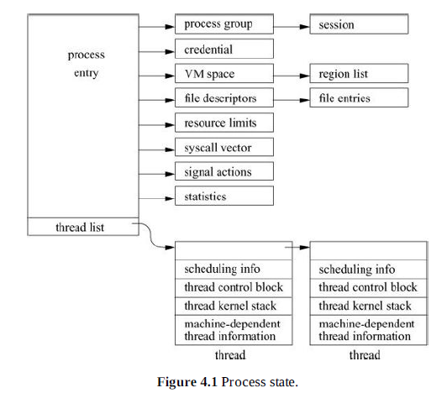
Process State

Slide 3
Process Structure
Catagories
  Process identification: the PID and the parent PID
  Signal state: signals pending delivery and summary of signal actions
  Tracing: process tracing information
  Timers: real-time timer and CPU-utilization counters
Process Substructures
  Process-group identification: the process group and the session to which the process belongs
  User credentials: the real, effective, and saved user and group identifiers; credentials are described more fully in Chapter 5

Slide 4
Process Structure Cont.
  Memory management: the structure that describes the allocation of virtual address space used by the process; the virtual-address space and its related structures are described more fully in Chapter 6
  File descriptors: an array of pointers to file entries indexed by the process’s open file descriptors; also, the open file flags and current directory
  System call vector: the mapping of system call numbers to actions; in addition to current and deprecated native FreeBSD executable formats, the kernel can run binaries compiled for several other UNIX variants such as Linux and System V Release 4 by providing alternative system call vectors when such environments are requested
  Resource accounting: the rlimit structures that describe the utilization of the many resources provided by the system (see Section 3.7)
  Statistics: statistics collected while the process is running that are reported when it exits and are written to the accounting file; also includes process timers and profiling information if the latter is being collected
  Signal actions: the action to take when a signal is posted to a process
  Thread structure: the contents of the thread structure (described at the end of this section)

Slide 5
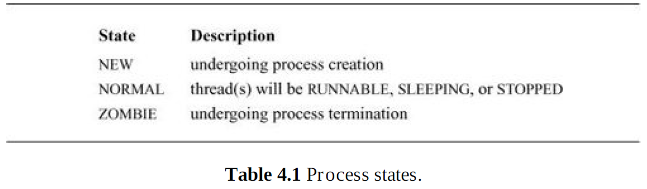

Slide 6
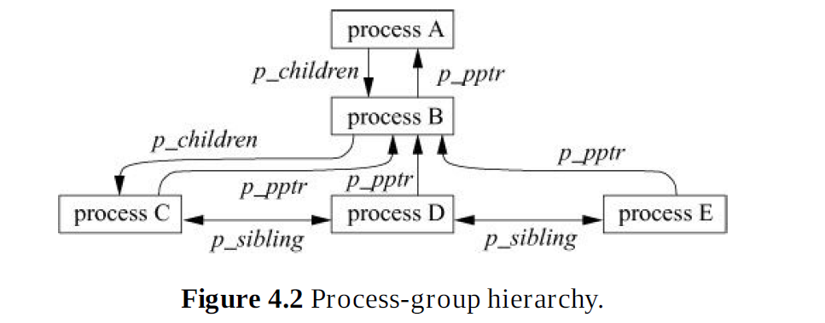

Slide 7
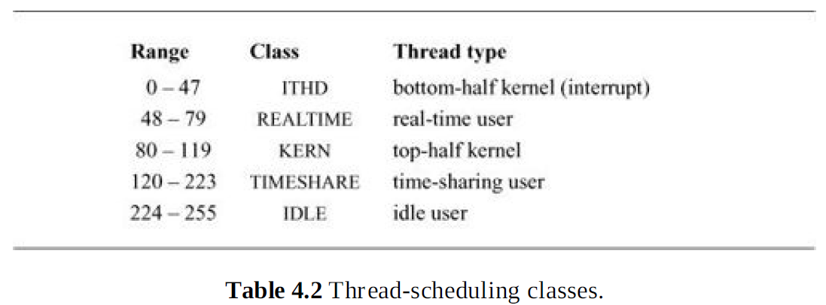

Slide 8
Thread Structure
Scheduling: the thread priority, user-mode scheduling priority, recent CPU utilization, and amount of time spent sleeping; the run state of a thread (runnable, sleeping); additional status flags; if the thread is sleeping, the wait channel, the identity of the event for which the thread is waiting (see Section 4.3), and a pointer to a string describing the event
TSB (Thread State Block): the user- and kernel-mode execution states
Kernel stack: the per-thread execution stack for the kernel
Machine state: the machine-dependent thread information

Slide 9
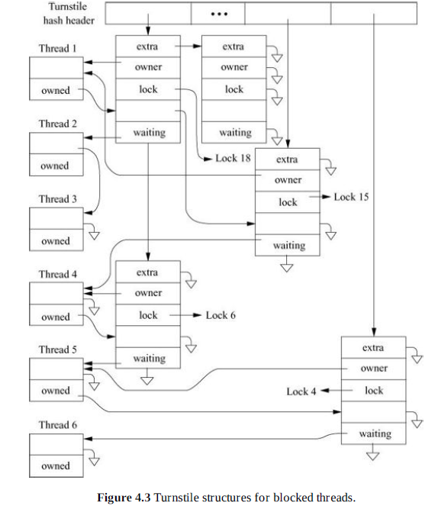

Slide 10
Resuming a Thread
1. Removes the thread from its turnstile or sleepqueue. If it is the last thread to be awakened, the turnstile or sleepqueue is returned to it. If it is not the last thread to be awakened, a turnstile or sleepqueue from the free list is returned to it.
2. Recomputes the user-mode scheduling priority if the thread has been sleeping longer than one second.
3. If the thread had been blocked on a turnstile, it is placed on the run queue. If the thread had been blocked on a sleepqueue, it is placed on the run queue if it is in a SLEEPING state and if its process is not swapped out of main memory. If the process has been swapped out, the swapin process will be awakened to load it back into memory (see Section 6.12); if the thread is in a STOPPED state, it is not put on a run queue until it is explicitly restarted by a user-level process, either by a ptrace system call (see Section 4.9) or by a continue signal (see Section 4.7).

Slide 11
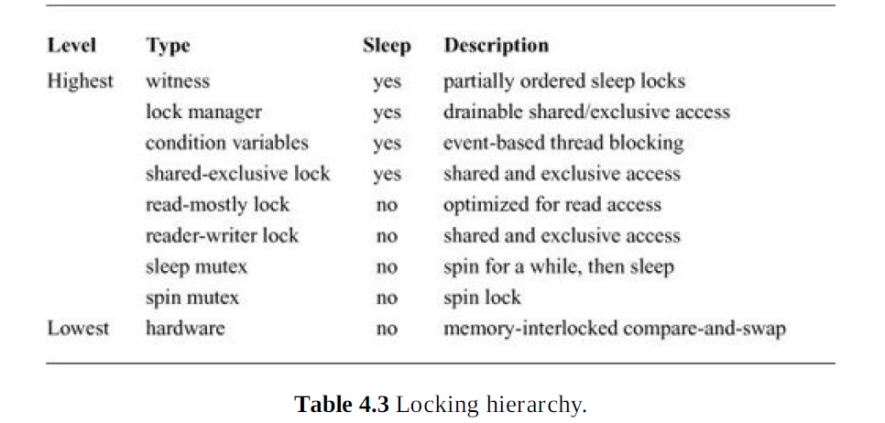

Slide 12
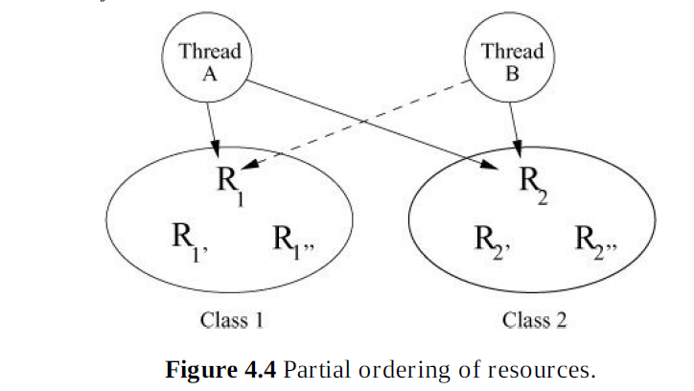

Slide 13
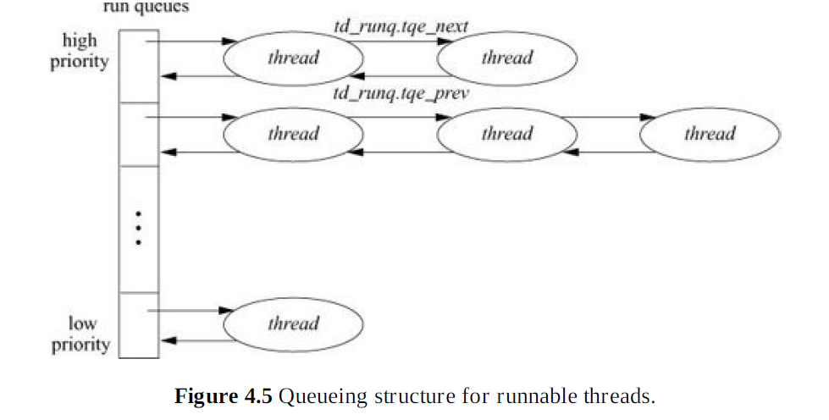
Queue Head, current runnable queue.

Slide 14
Run Thread Queues
1. Ensures that our caller acquired the lock associated with the run queue.
2. Locates a nonempty run queue by finding the location of the first nonzero bit in the rq_status
bit vector. If rq_status is zero, there are no threads to run, so selects an idle loop thread.
3. Given a nonempty run queue, removes the first thread on the queue.
4. If this run queue is now empty as a result of removing the thread, clears the appropriate bit in
rq_status.
5. Returns the selected thread.

Slide 15
Interactivity Score
If sleep exceeds runtime.
If runtime exceeds sleep time
Scaling factor is used to provide enhanced separation between interactive and non-interactive threads.

Slide 16
Fork
1. Allocating and initializing a new process structure for the child process
2. Duplicating the context of the parent (including the thread structure and virtual-memory (resources) for the child process
3. Scheduling the child process to run

Slide 17
Fork Copies to Child
The process group and session
The signal state (ignored, caught, and blocked signal masks)
The p_nice scheduling parameter
A reference to the parent’s credential
A reference to the parent’s set of open files
A reference to the parent’s limits

Slide 18
Fork sets child parameters
The process’s signal-actions structure
Zeroing the process’s statistics structure
Entry onto the list of all processes
Entry onto the child list of the parent and the back pointer to the parent
Entry onto the parent’s process-group list
Entry onto the hash structure that allows the process to be looked up by its PID
A new PID for the process

Slide 19
Exit()
Canceling any pending timers
Releasing virtual-memory resources
Closing open descriptors
Handling stopped or traced child processes
After termination
  Usage statistics are processed for accounting.

Slide 20
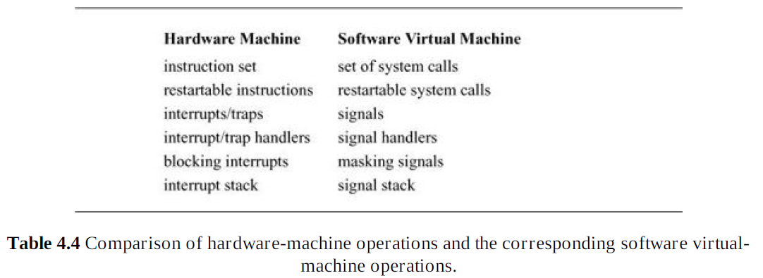

Slide 21
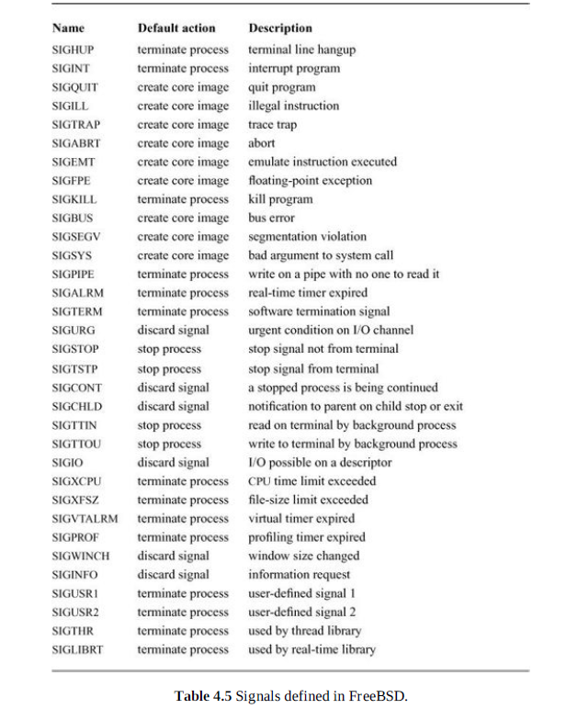

Slide 22
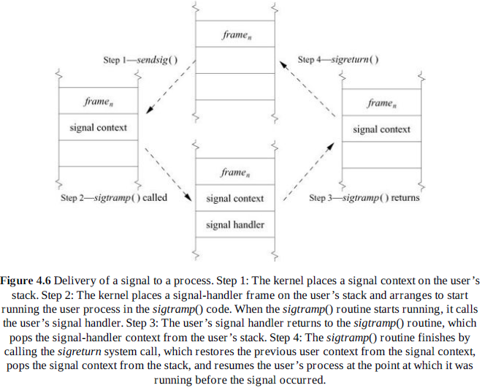

Slide 23
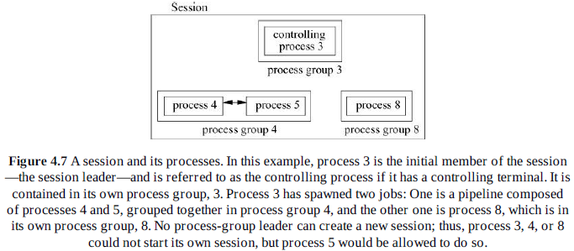

Slide 24
