Slide 1
4P13
Week 2 & 3
Talking Points

Slide 2
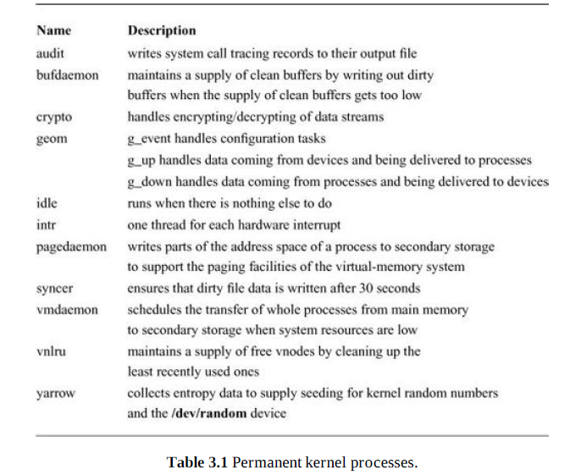
Kernel Processes

Slide 3
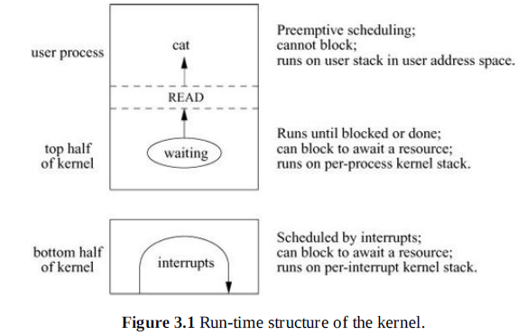
Run-Time Organization

Slide 4
Kernel Entry
The hardware switches into kernel (supervisor) mode, so that memory-access checks are made with kernel privileges, references to the stack use the per-process kernel stack, and privileged instructions can be executed.
The hardware pushes onto the per-process kernel stack the program counter, processor status longword, and information describing the type of trap. (On architectures other than the PC, this information can include the system-call number and general-purpose registers as well.)
An assembly-language routine saves all state information not saved by the hardware. On the PC, this information includes the general-purpose registers and the user stack pointer, also saved onto the per-process kernel stack.

Slide 5
Entry can be caused by:
  Syscall()
  Trap()
  Device interrupt

Slide 6
Kernel Return
An assembly-language routine restores the general-purpose registers and user-stack pointer previously pushed onto the stack.
The hardware restores the program counter and program status longword, and switches to user mode, so that future references to the stack pointer use the user ’s stack pointer, privileged instructions cannot be executed, and memory-access checks are done with user-level privileges.

Slide 7
HardClock()
If the currently running process has a virtual or profiling interval timer (see Section 3.6), it decrements the timer and delivers a signal if the timer has expired.
It increments the current time of day by the number of ticks since the previous call to hardclock().
If the system does not have a separate clock for process profiling, the hardclock() routine does the operations normally done by profclock(), as described in the next section.
If the system does not have a separate clock for statistics gathering, the hardclock() routine does the operations normally done by statclock(), as described in the next section.
If softclock() needs to be run, it makes the softclock process runnable.

Slide 8
Softclock()
Is a process, which behaves like hardclock but is not time critical.
Runs as a normal process in between hardclock interrupts.
  Process real-time timer (see Section 3.6)
  Retransmission of dropped network packets
  Watchdog timers on peripherals that require monitoring
  System process-rescheduling events

Slide 9
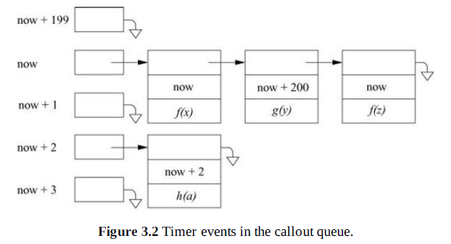
Call out Queue

Slide 10
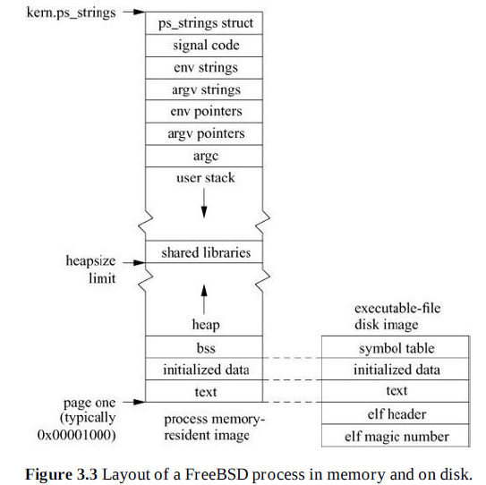

Slide 11
Resource Utilization
The amount of user and system time used by the process
The memory utilization of the process
The paging and disk I/O activity of the process
The number of voluntary and involuntary context switches taken by the process
The amount of inter-process communication done by the process.

Slide 12
Resource Limits
The maximum amount of CPU time that can be accumulated
The maximum bytes that a process can request be locked into memory
The maximum size of a process’s data segment
The maximum size of a process’s stack segment
The maximum amount of private physical memory that a process may have at any given moment
The maximum amount of private or shared physical memory that a process may have at any given moment
The maximum amount of physical memory that a process may have dedicated to socket buffers
The maximum size of a file that can be created by a process
The maximum size of a core file that can be created by a process
The maximum number of simultaneous open files for a process
The maximum number of simultaneous processes allowed to a user

Slide 13
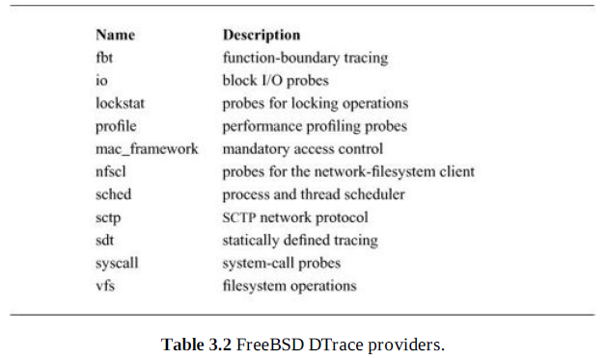

Slide 14
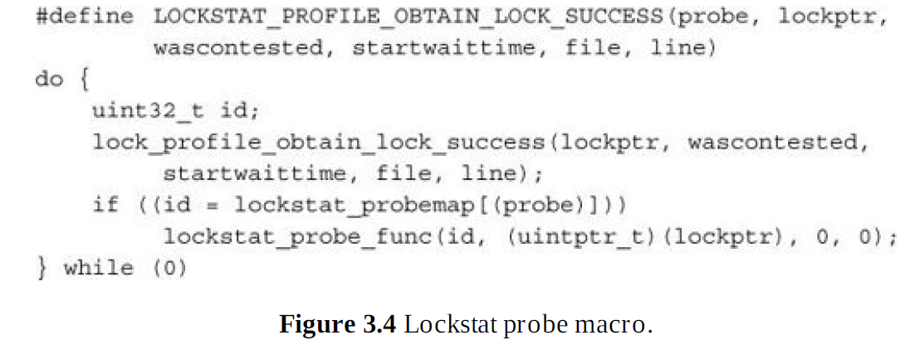

Slide 15
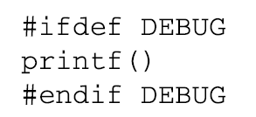
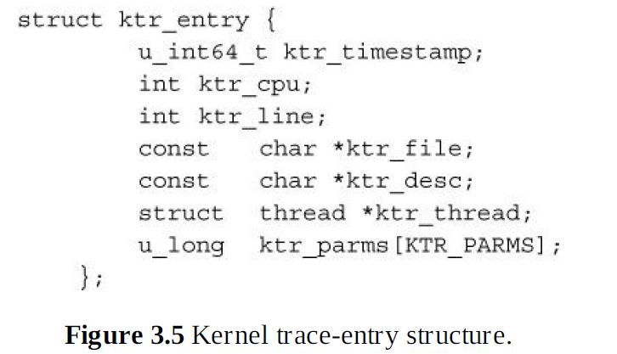

Slide 16
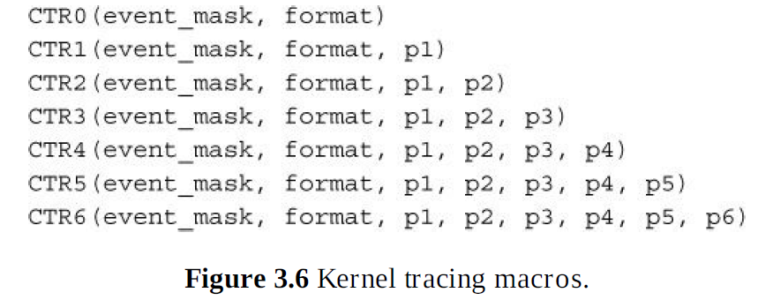

Slide 17
End

