Slide 1
4P13
Week 1
Talking Points

Slide 2
Kernel Organization
Basic kernel facilities: timer and system-clock handling, descriptor management, and process Management
Security features: conventional UNIX model, but also sandboxing, virtualization, event auditing, and cryptographic services
Memory-management support: paging and swapping
Generic system interfaces: the I/O, control, and multiplexing operations performed on Descriptors
Filesystems: files, directories, pathname translation, file locking, and I/O buffer management
Terminal-handling support: the pseudo-terminal interface and terminal line disciplines
Interprocess-communication facilities: sockets
Support for network communication: communication protocols and generic network facilities, such as routing

Slide 3
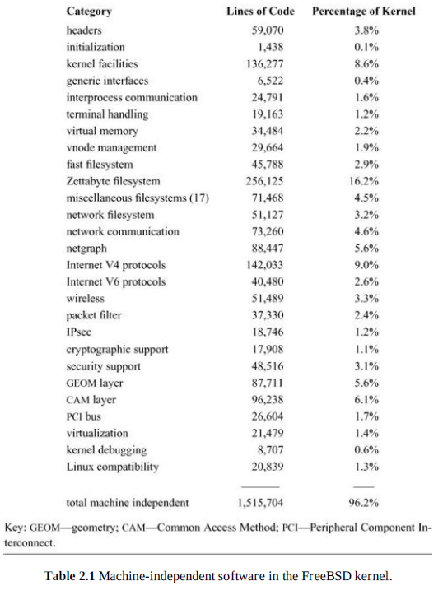
Table 2.1

Slide 4
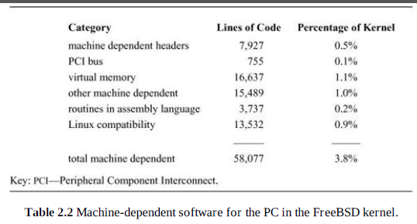
Table 2.2

Slide 5
Process Management
Multi-Tasking
Process Context
  User level state
    Address space state
    Runtime env
    Kernel state
      Scheduling parameters
      Resource controls
      Id info

Slide 6
Process Management
Process Identifier (PID)
  Used by Kernel and User to reference a process
New process (child) is cloned from an existing (parents) process.
  fork
  Inherits properties of the parent
    Think extends in OOP.
  Implies that the new process will execute in the resource env of the parent.
    Address space
    Permissions etc.

Slide 7
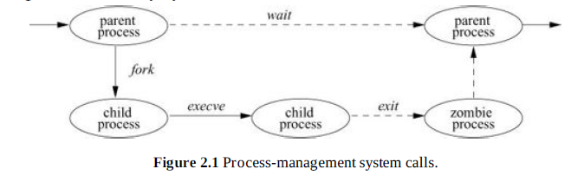
Fig 2.1
execve – execute new process from a file.
  Overlay will get parameters from memory address space of parent.
exit – terminates and returns info back to parent.
  Implies that if parent exits so must all children
  Implies that process priority of parent is inherited by child.

Slide 8
Security
A self-protecting Trusted Computing Base (TCB) guarantees enough system integrity to implement features such as multiple users and key storage.
Strong process isolation using virtual memory ensures that the kernel is protected from user code, and that user processes are protected from one another
Identification and instrumentation of security-relevant operations throughout the kernel to implement access control, resource limits, and event auditing
A coherent privilege model, internal to the kernel, that allows exceptional operations (such as system administration, device-driver implementations) to occur in a structured way despite being outside the regular access-control model
Design abstractions that facilitate future security models, as well as security localization in downstream products; for example, clean separation of policy and mechanism, object-oriented
structure (subject to the limitations of C), and a user space capability-system model providing protection, rather than policy, as the primitive for application compartmentalization
Cryptographic primitives, such as secure random number generation and a library of encryption and signature functions, that can support many different higher-level operatingsystem features and applications

Slide 9
Process Credentials
  UID – user id
  GID – group id
  Passed to processes to allow execution access.
  Setuid & Setgid allow processes to run at elevated priveledges.
Privilege Model
  Up to 200 privilege model
    Old model consisted of 2
      0 root
      other

Slide 10
Jails
  Virtualization which limits a group or processes
    Limited file system
    Memory
    Access to system-calls
    Can provide duplication of file systems into the Jail
Mandatory Access Control –MAC
  Similar to Windows security policy system
  Policies are associated to processes to govern access rights.

Slide 11
Cryptography
  Kernel has built in Random number generator
    Sys-call
  Unidirectional hashes
Memory Mgmt
  All processes run in a segmented system
    Stack, code, heap
      Enforces restrictions rwx
    Each segment is paged to VM
  Allows for memory overlays between kernel and processes, for data transfer.
  Kernel memory is non-paged
    Accessed from a dedicated pool
      Malloc and free

Slide 12
Descriptors
  Can be thought of as a file handle or pointer
    Contains meta info about resource
      Security info etc.
  7 types of IO
    File
    Pipe – STD out to STD in between processes
    Fifo – named Pipe, which has file system control
    Socket – named data stream which can be created between 2 processes, Network capable.
    PosIX IPC – message queue, shared memory, semaphores
    Event Queue – queue of events which control several processes.
    Process descriptors – meta security and control data for a set of processes.

Slide 13
Devices
Devices must operate dynamically.
  Connected and disconnected.
  PnP system
  Requires OS to load and unload drivers as required.
  When a new device is added Kernel must initiate a configuration process.

Slide 14
File Systems
Anchored as a tree with a root.
  chroot can set the current root for a process.
  Only executable by superuser priveledge.
    Processes can be restricted to sub-trees of the file system.
  Any process can chdir to traverse the tree.
  Root file system can link any device with a file system to it.
    mount
    unmount

Slide 15
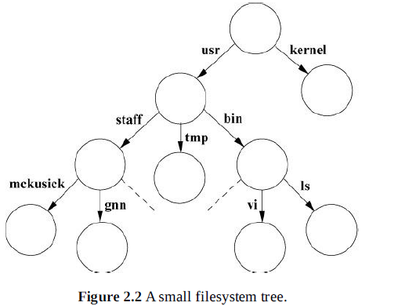
Each directory of the file system can have 3 levels of access.
  Owner, Group, Everyone
  Each of above set to rwx using chmod
  Access control lists further can restrict access to specific users.

Slide 16
NFS
Network File System.
  Required so multiple users can access a common resource.
    servers
  Provides file locking, caching, and access right control.

Slide 17
Inter-process Communications
3 types of domains
  Local
    Processes running on the local machine
  IPv4 and IPv6
    Allows for communications over a network
Sockets provide connection streams between processes.
  Binding a name to a socket creates a file
  Binding an IP creates a network tunnel.

Slide 18
The End

