Slide 1
4P13
Week 5
Talking Points

Slide 2
Security Provided by BSD
a self-protecting Trusted Computing Base (TCB) spanning kernel and userspace;
kernel isolation and process separation based on virtual memory;
authentication and multiplexing of multiple simultaneous users;
discretionary and mandatory access-control models;
sandboxing facilities to contain potentially malicious code;
a range of mitigation techniques such as stack protection;
security-event auditing for accountability and intrusion detection;
Yarrow-based /dev/random supporting hardware and software entropy sources;
support for Trusted Platform Modules (TPMs);
a cryptographic framework supporting hardware and software implementations;
support for full-disk encryption and cryptographic integrity protection;
distributed authentication models (e.g., Kerberos, x.509 certificates);
cryptographically protected network protocols (e.g., ssh, TLS, IPSec); and
binary updates to remedy vulnerabilities discovered after release.

Slide 3
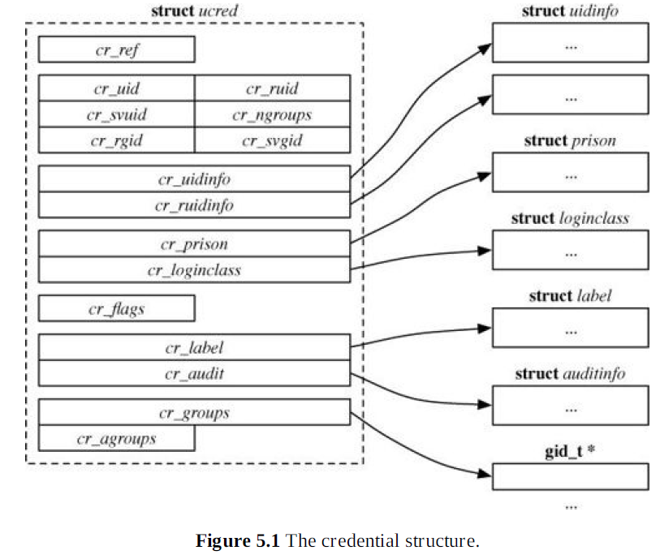

Slide 4
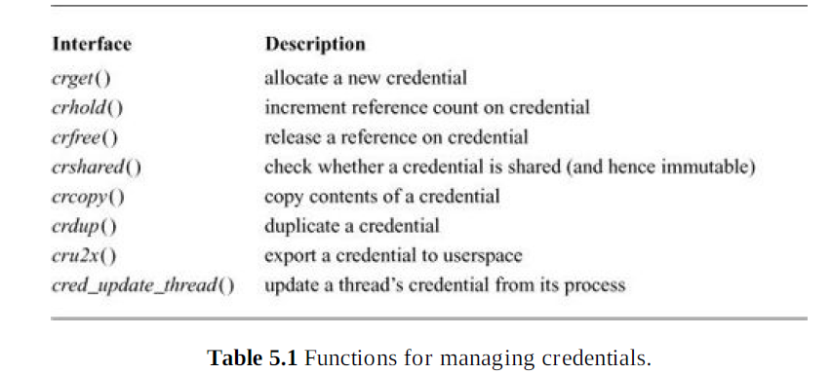

Slide 5
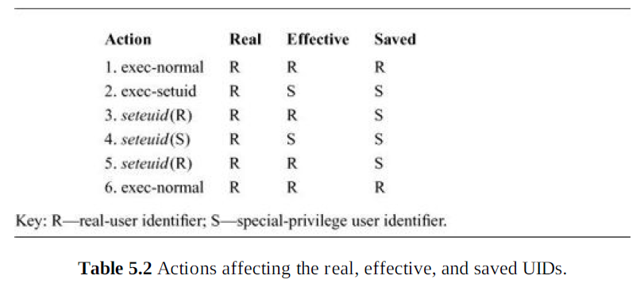

Slide 6
Explicit Privilege granted to user Processes
Kernel management operations that have global consequences across the system, such as rebooting, or configuring IPv4 addresses on a network interface.
Kernel management operations that effectively grant kernel privilege, such as the loading of kernel modules. Misuse of these functions would violate integrity of the TCB.
System management operations that imply system privileges, such as maintenance of system binaries (including the kernel).
Configuring access-control policies and, particularly, setting up process credentials during the login process.
Higher-level management operations that depend on bypassing per-object protections, such as backing up the system, or changing the owner or permissions on a file in the role of system administrator.
Certain classes of debugging operations that offer insight into global behaviors normally limited to avoid information leaks, such as using DTrace or hardware-performance-monitoring counters on the kernel itself.

Slide 7
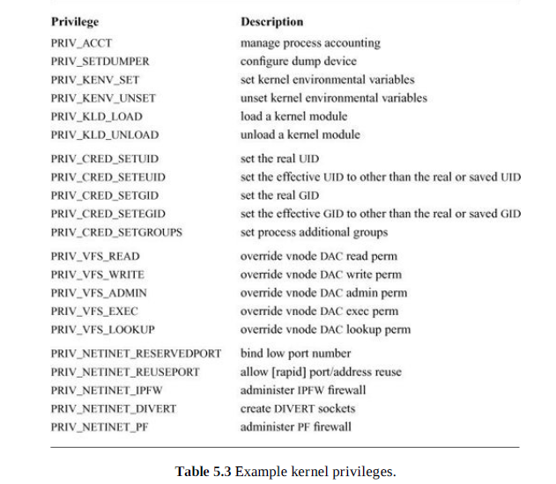

Slide 8
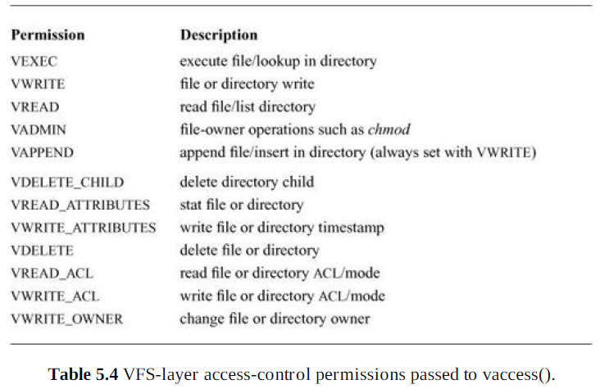

Slide 9
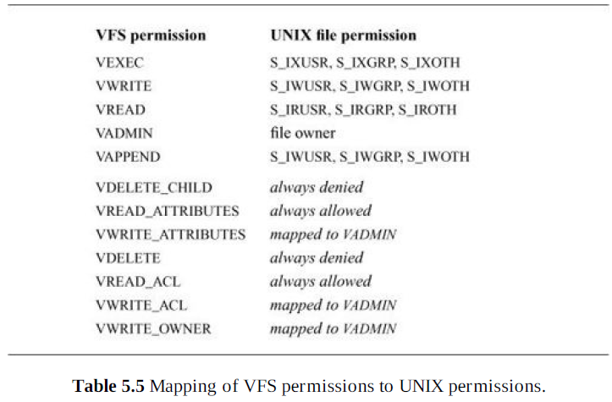

Slide 10
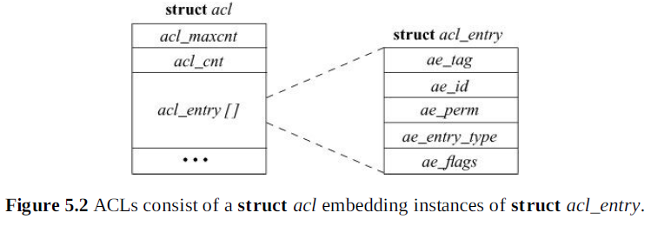

Slide 11
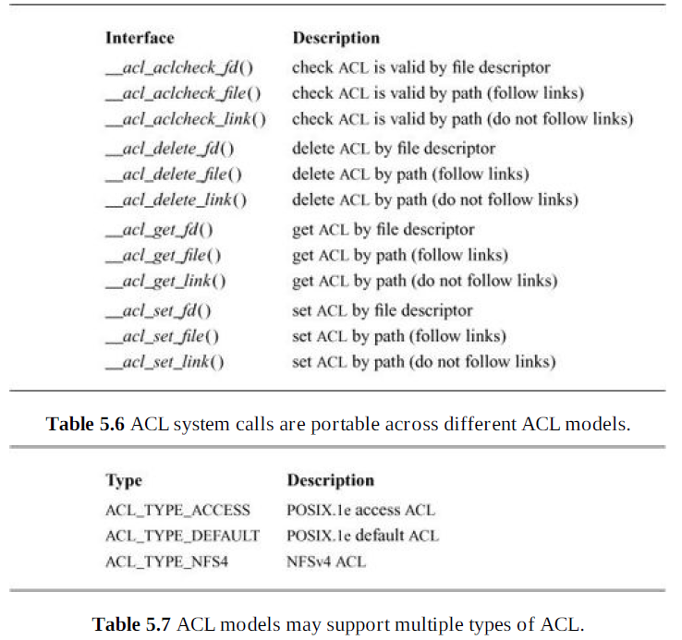

Slide 12
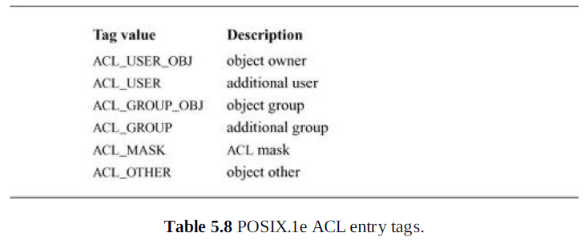

Slide 13
ACL Evaluation Algorithm
1. The file or directory’s access ACL (type ACL_TYPE_ACCESS) is searched for object-owner, mask, and “other” entries, to be consulted at various points in evaluation.
2. If the credential’s effective UID matches the object-owner ACL entry, then the access request is checked against the entry’s permissions. If sufficient, success is returned. If insufficient, appropriate privilege is checked to supplement the entry’s permissions; if sufficient, success is returned. Otherwise, access is denied and no further entries are consulted.
3. If the credential’s effective UID matches an additional user ACL entry, then the access request is checked against the entry’s permissions—limited to those also granted by the ACL mask entry. If sufficient, success is returned. If insufficient, appropriate privilege is checked to supplement the entry’s permissions; if sufficient, success is returned. Otherwise, access is denied and no further entries are consulted.
4. If either one of the credential’s effective or additional GIDs matches the object-group entry or any of the additional group ACL entries, then the access request is checked against the entry’s permissions—limited to those also granted by the ACL mask entry. If any entry is sufficient, success is returned.
5. If no group entries were sufficient without privilege, then any matching group entries will be retried with appropriate privilege checked to supplement the entry’s permissions; if sufficient, success is returned. Otherwise, if there were any matching groups, access is denied and no further entries are consulted.
6. Finally, the ACL “other” entry will be consulted; if sufficient, success is returned. If insufficient, appropriate privilege is checked to supplement the entry’s permissions; if sufficient, success is returned. Otherwise, access is denied.

Slide 14
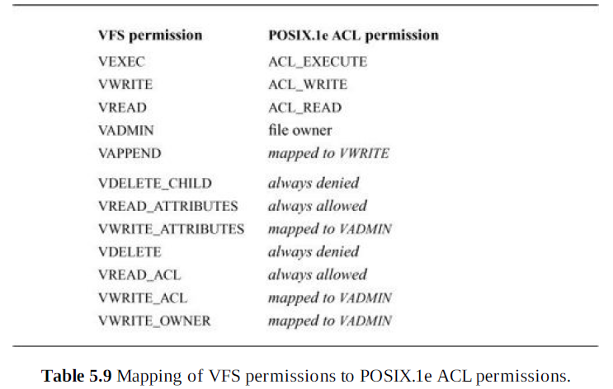

Slide 15
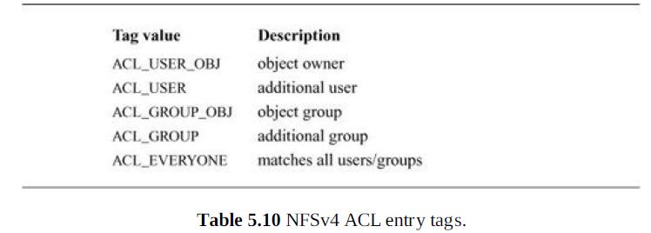

Slide 16
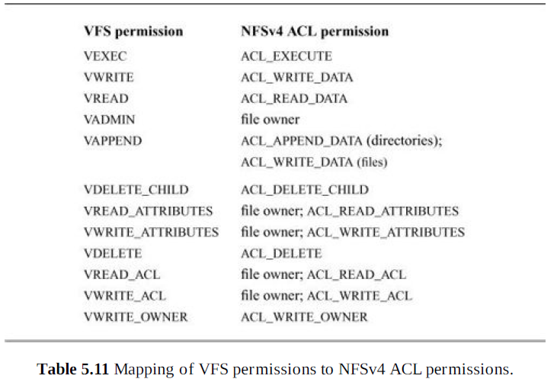

Slide 17
NFSv4 ACL evaluation

Slide 18
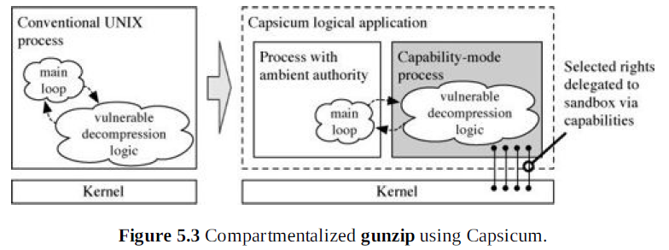

Slide 19
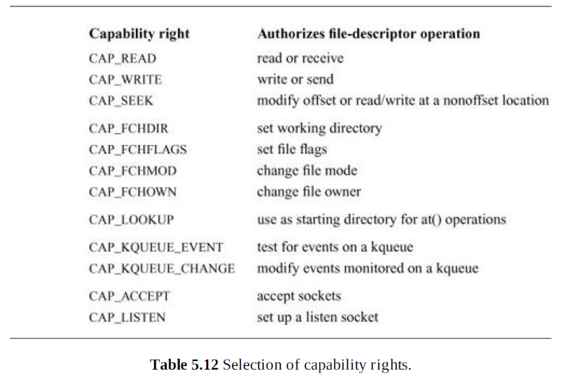

Slide 20
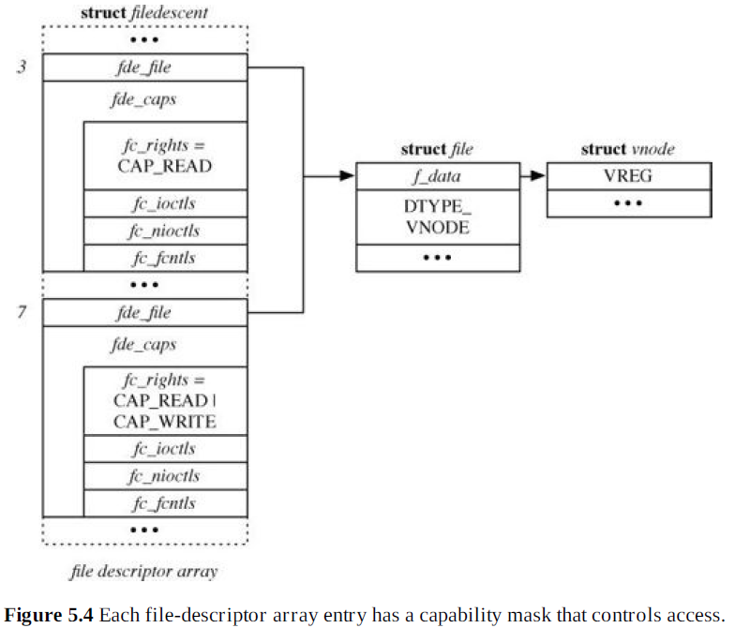

Slide 21
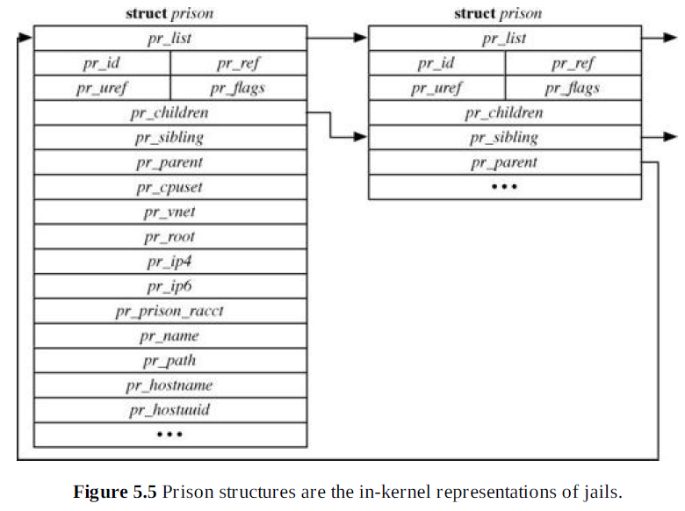

Slide 22
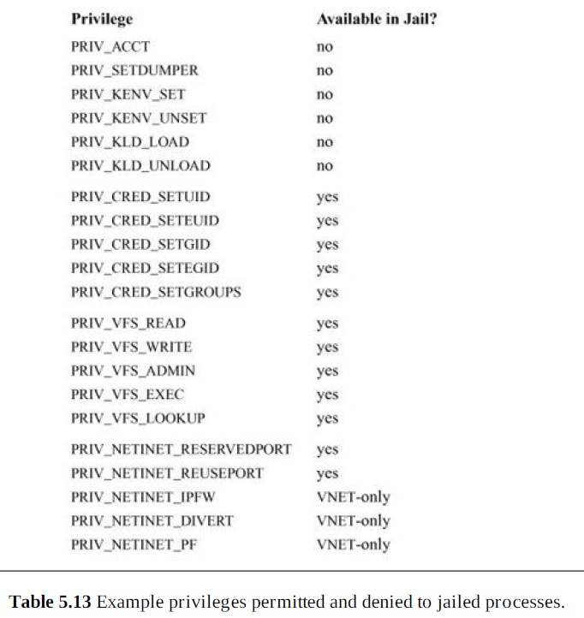

Slide 23
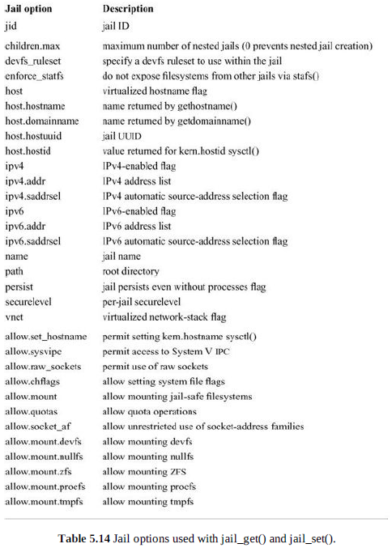

Slide 24
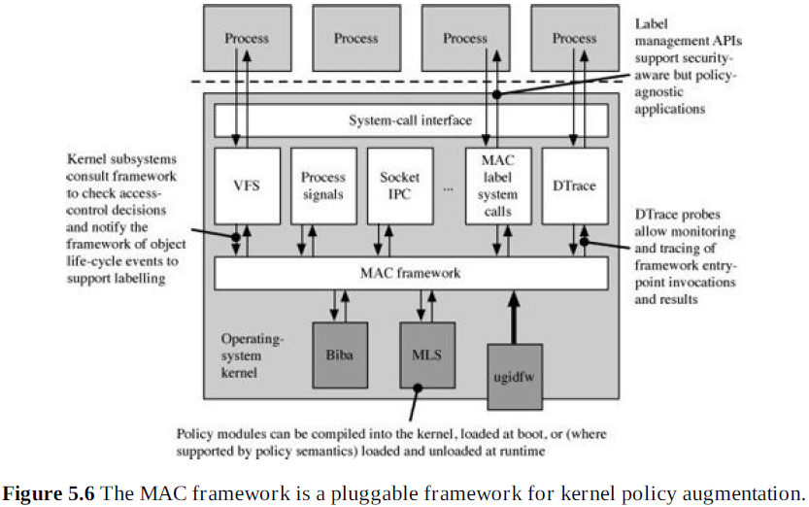

Slide 25
Framework Startup
Framework data structures, locks, and memory allocation are initialized.
Policies compiled into the kernel or loaded before boot are registered.
The global mac_late is set, indicating that from this point onward, kernel objects controlled by the framework may be allocated.
The MAC framework steady state is entered and kernel boot continues.

Slide 26
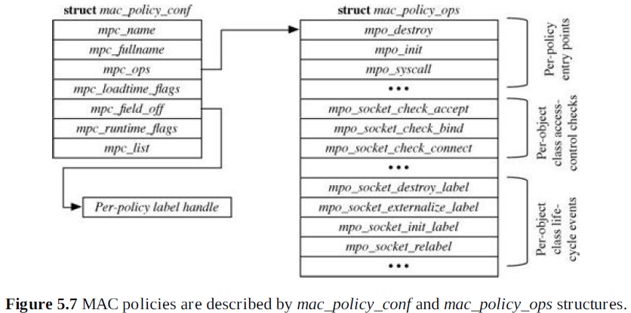

Slide 27
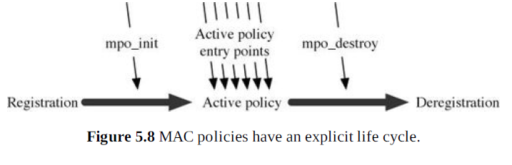

Slide 28
Policy Entry-Point Considerations
Object life-cycle events, such as socket creation and destruction
Access-control requests checking a subject’s use of a method on an object
General and sometimes subject-free decision requests

Slide 29
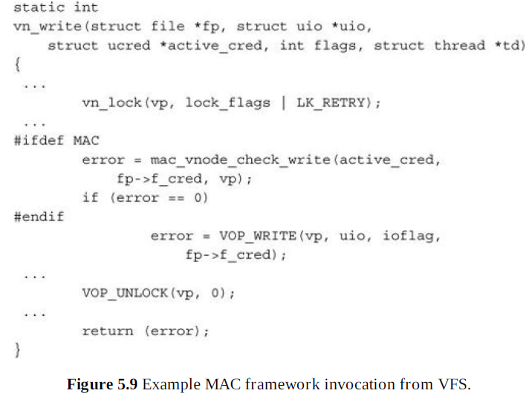

Slide 30
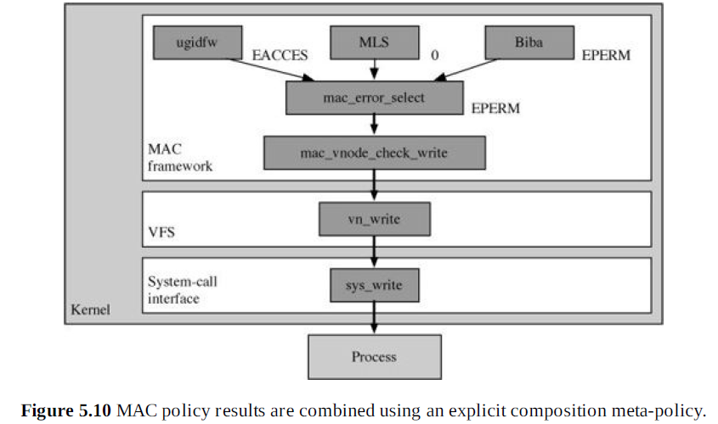

Slide 31
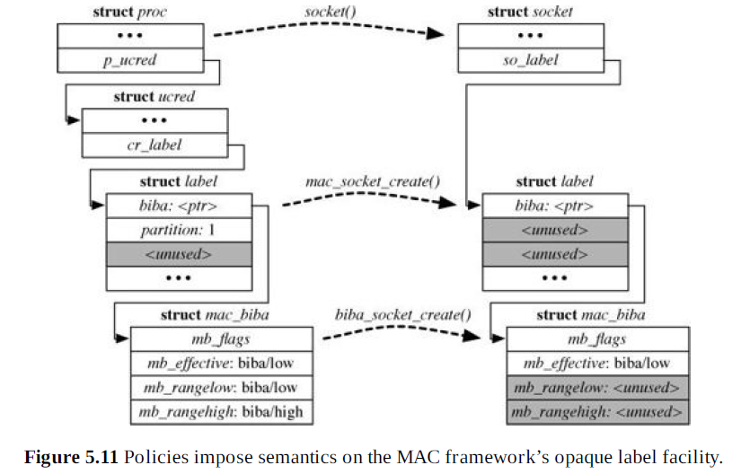

Slide 32
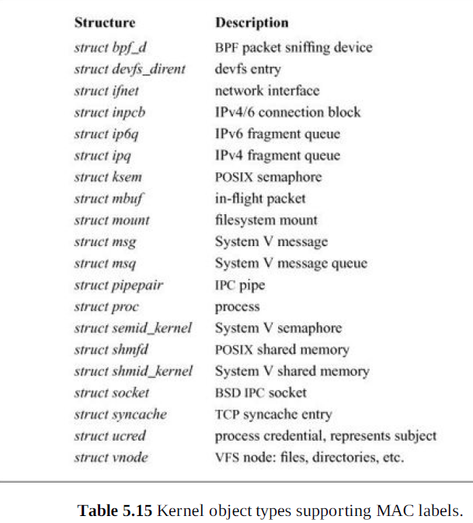

Slide 33
