Slide 1
4P13
Week 12
Talking Points

Slide 2
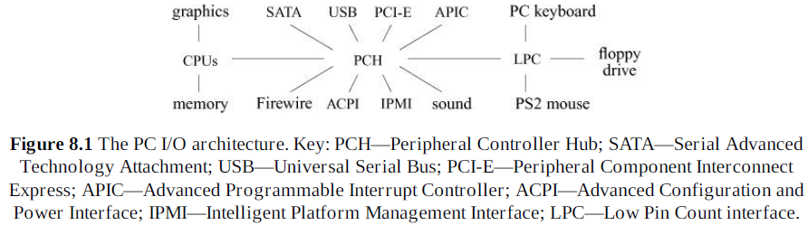

Slide 3
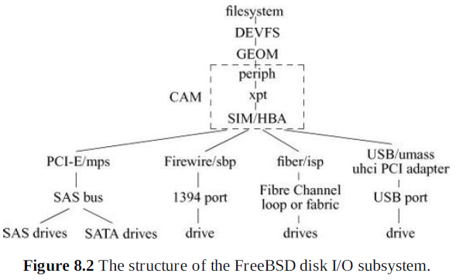

Slide 4
Device Drivers
Auto-configuration and initialization routines
Routines for servicing I/O requests (the top half)
Interrupt service routines (the bottom half)

Slide 5
Interrupt Handling
Collects the relevant hardware parameters and places them in the space reserved for them by the device
Updates statistics on device interrupts
Schedules the interrupt service thread for the device
Clears the interrupt-pending flag in the hardware
Returns from the interrupt

Slide 6
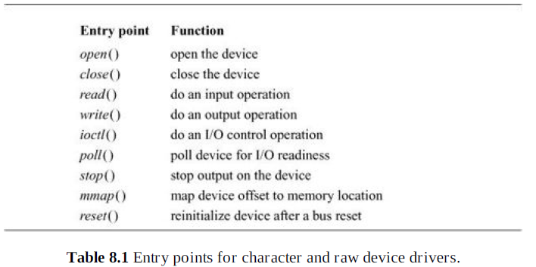

Slide 7
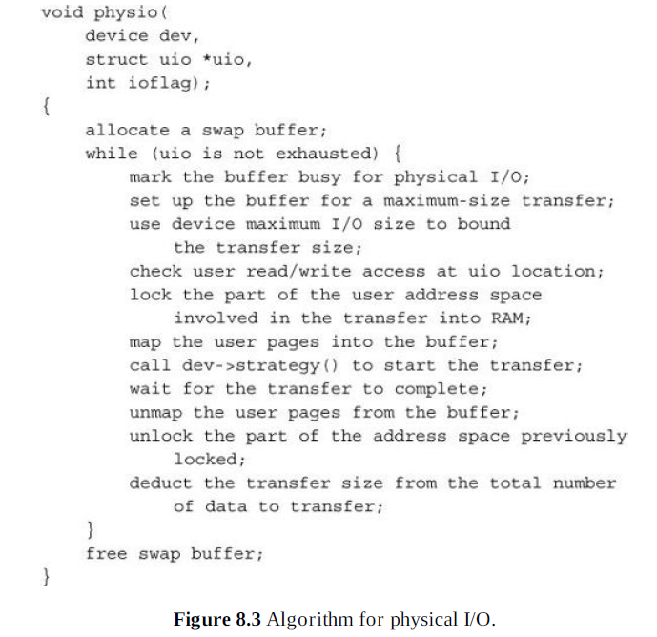

Slide 8
Entry Points for Char Dev Drivers
open
Opens the device in preparation for I/O operations. A device’s open entry point will be called for each open system call on a special-device file or, internally, when a device is prepared for mounting a filesystem with the mount system call. The open() routine will commonly verify the integrity of the associated medium. For example, it will verify that the device was identified during the autoconfiguration phase and, for disk drives, that a medium is present and ready to accept commands.
close
Closes a device. The close() routine is called after the final client interested in using the device terminates. These semantics are defined by the higher-level I/O facilities. Disk devices have nothing to do when a device is closed and thus use a null close() routine. Devices that support access to only a single client must mark the device as available once again.

Slide 9
Entry Points for Char Dev Drivers
read
Reads data from a device. For raw devices, this entry point normally just calls the physio() routine with device-specific parameters. For terminal-oriented devices, a read request is passed immediately to the terminal driver. For other devices, a read request requires that the specified data be copied into the kernel’s address space, typically with the uiomove() routine (see the end of Section 7.1), and then be passed to the device.
write
Writes data to a device. This entry point is a direct parallel of the read entry point: raw devices use physio(), terminal-oriented devices call the terminal driver to do this operation, and other devices handle the request internally.
ioctl
Performs an operation other than a read or write. This entry point originally provided a mechanism to get and set device parameters for terminal devices; its use has expanded to other types of devices as well. Historically, ioctl operations have varied widely from device to device.

Slide 10
Entry Points for Char Dev Drivers
poll
Checks the device to see whether data are available for reading or space is available for writing data. The poll entry point is used by the select and poll system calls in checking file descriptors associated with device special files. For raw devices, a poll operation is meaningless since data are not buffered. Here, the entry point is set to seltrue(), a routine that returns true for any poll request.
mmap
Maps a device offset into a memory address. This entry point is called by the virtual-memory system to convert a logical mapping to a physical address. For example, it converts an offset in:
/dev/mem to a kernel address.
kqfilter
Adds the device to the kernel event list for the calling thread. Kernel events are described in Section 7.1.

Slide 11
Disk Device Entries
strategy
Starts a read or write operation, and return immediately. I/O requests to or from filesystems located on a device are translated by the system into calls to the block I/O routines bread() and bwrite(). These block I/O routines in turn call the device’s strategy routine to read or write data not in the memory cache. Each call to the strategy routine specifies a pointer to a buf structure containing the parameters for an I/O request. If the request is synchronous, the caller must sleep (on the address of the buf structure) until I/O completes.
dump
If performing a dump has been configured during system startup, writes all physical memory to the configured device. Typically, the dump entry point saves the contents of physical memory on secondary storage into an area used for swapping. To speed the dump and to save space, the system can be configured to perform a mini-dump that writes only the physical memory in use by the kernel. The system automatically performs a dump when it detects an unrecoverable error and is about to crash. The dump is used in postmortem analysis to help find the problem that caused the system to crash. The dump routine is invoked with context switching and interrupts disabled; thus, the device driver must poll for device status rather than wait for interrupts. At least one disk device is expected to support this entry point.

Slide 12
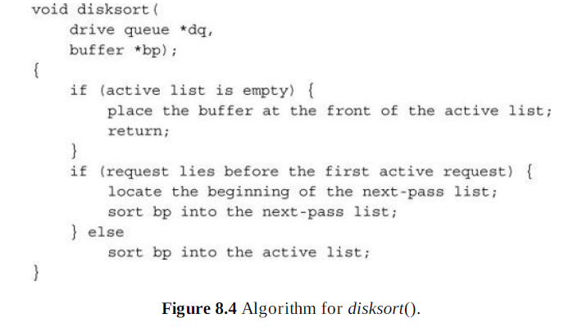

Slide 13
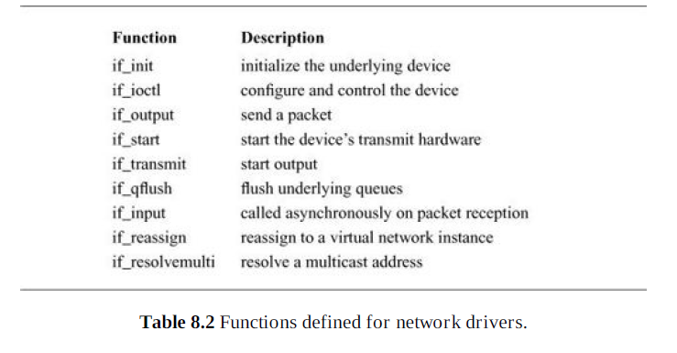

Slide 14
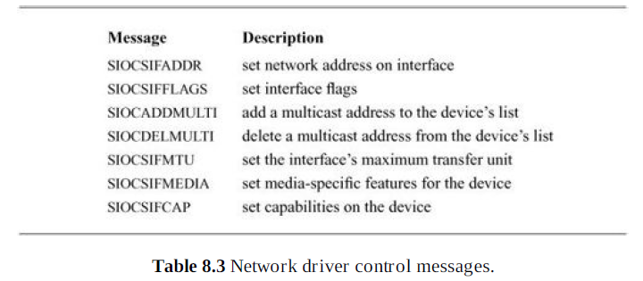

Slide 15
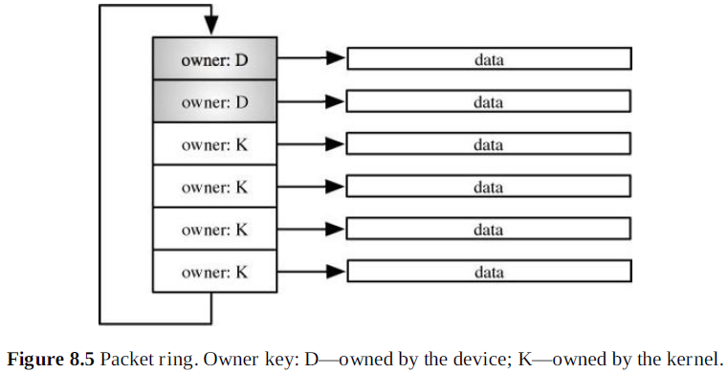

Slide 16
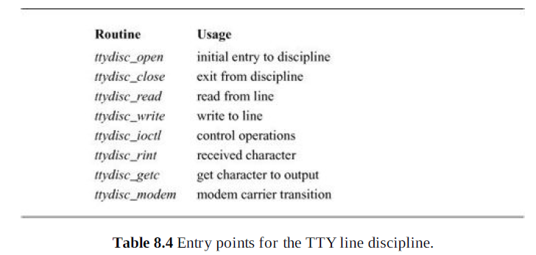

Slide 17
The GEOM Layer
Transformations in GEOM include the following:
Simple base and bounds calculations needed for disk partitioning
Aggregation of disks to provide a RAID, mirrored, or stripped logical volume
A cryptographically protected logical volume
Collection of I/O statistics
I/O optimization such as disk sorting
Journaled I/O transactions

Slide 18
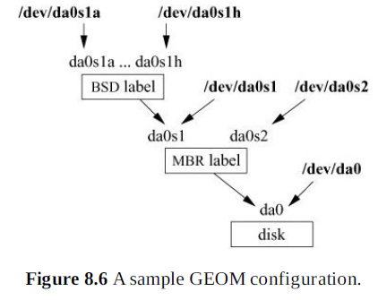

Slide 19
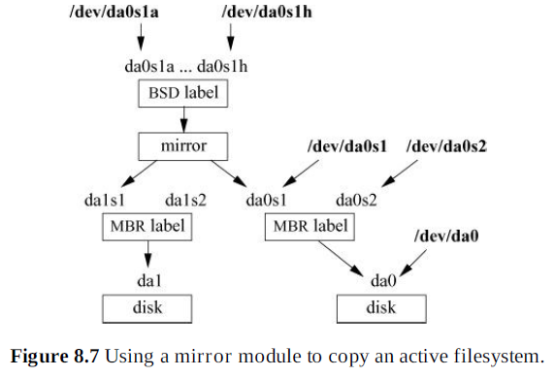

Slide 20
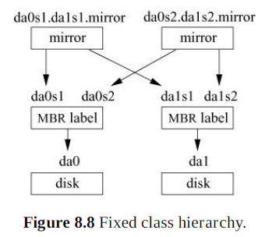
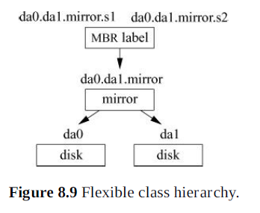

Slide 21
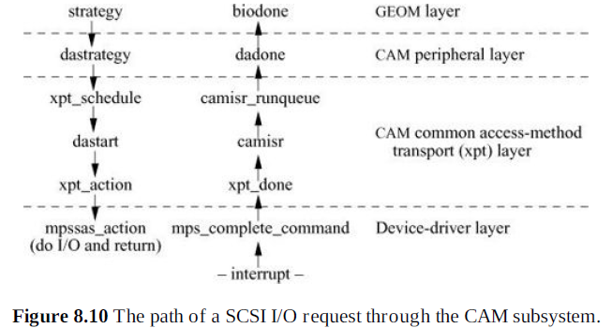

Slide 22
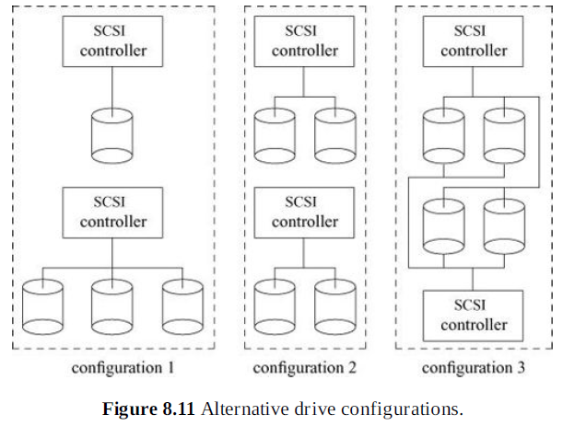

Slide 23
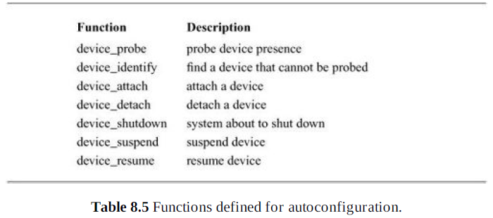

Slide 24
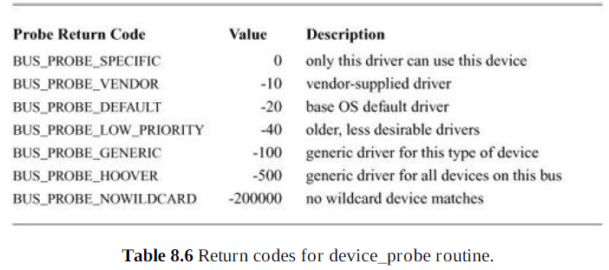

Slide 25
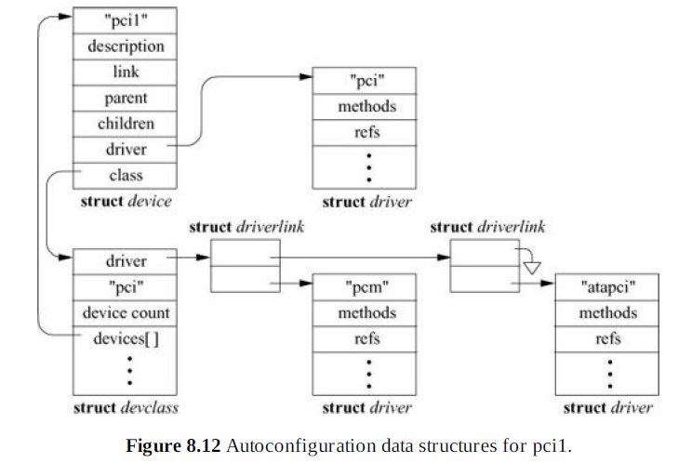

Slide 26
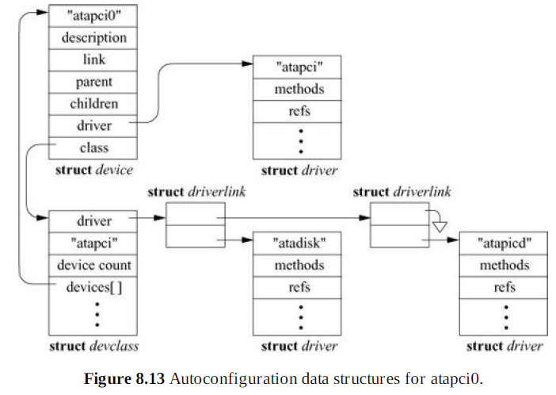

Slide 27
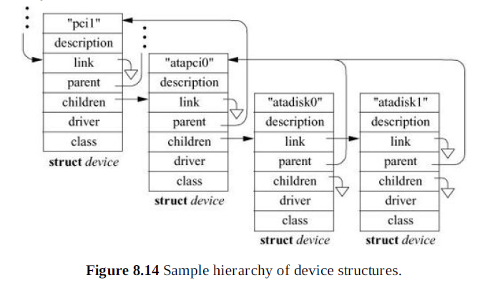

Slide 28
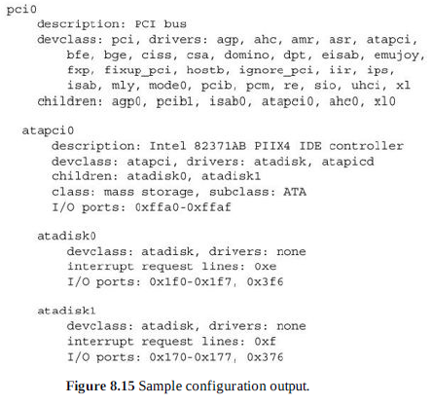
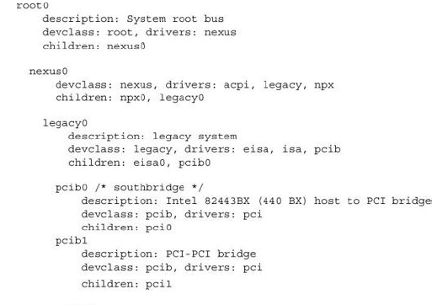

Slide 29
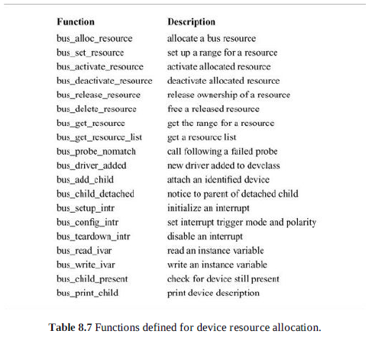

Slide 30
Resource Allocation
  1. Setting the range for the resource
  2. Initial allocation of the resource
  3. Activating the resource
Similarly, resource freeing is done in three steps:
  1. Deactivating the resource
  2. Releasing ownership of the resource to the parent bus
  3. Freeing it

Slide 31
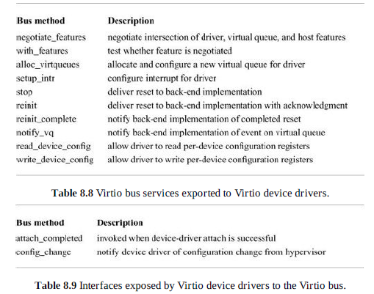

Slide 32
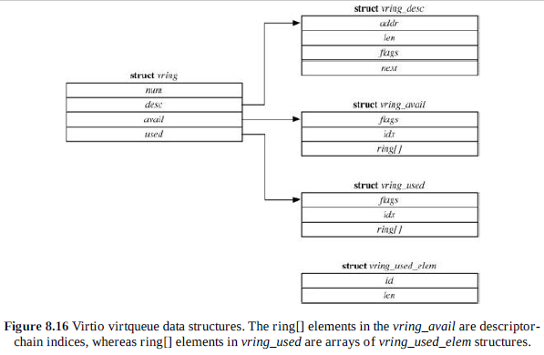

Slide 33
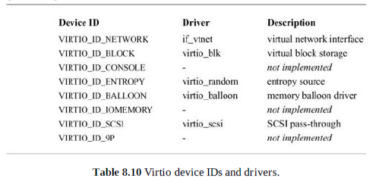

Slide 34
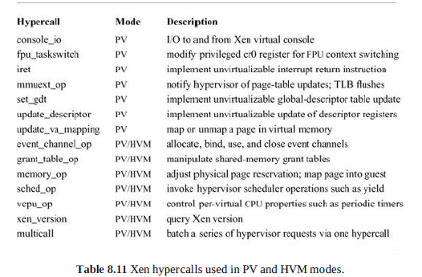

Slide 35
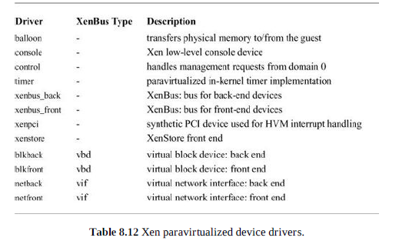

Slide 36
