Slide 1
Week 1
Programming today is a race between software engineers striving to build bigger and better idiot-proof programs, and the Universe trying to produce bigger and better idiots.

Slide 2
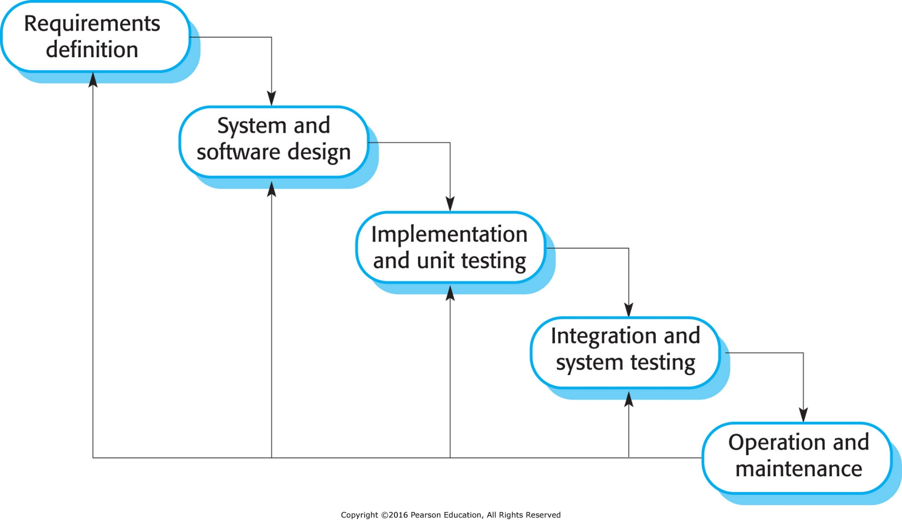
Figure 2.1 The waterfall model

Slide 3
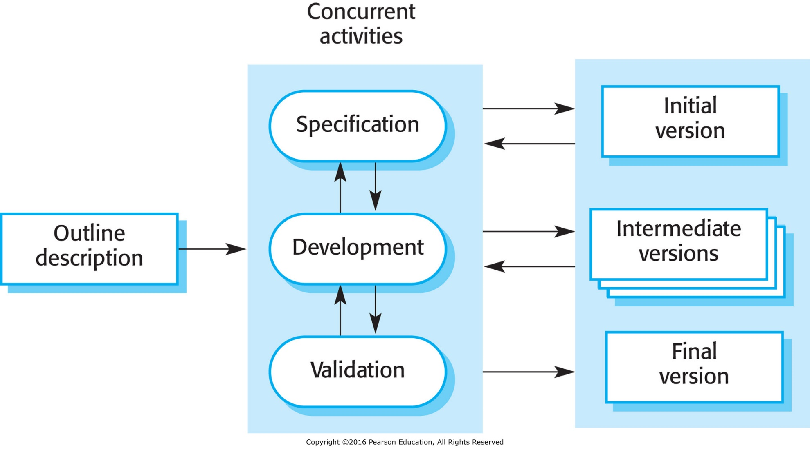
Figure 2.2 Incremental development

Slide 4
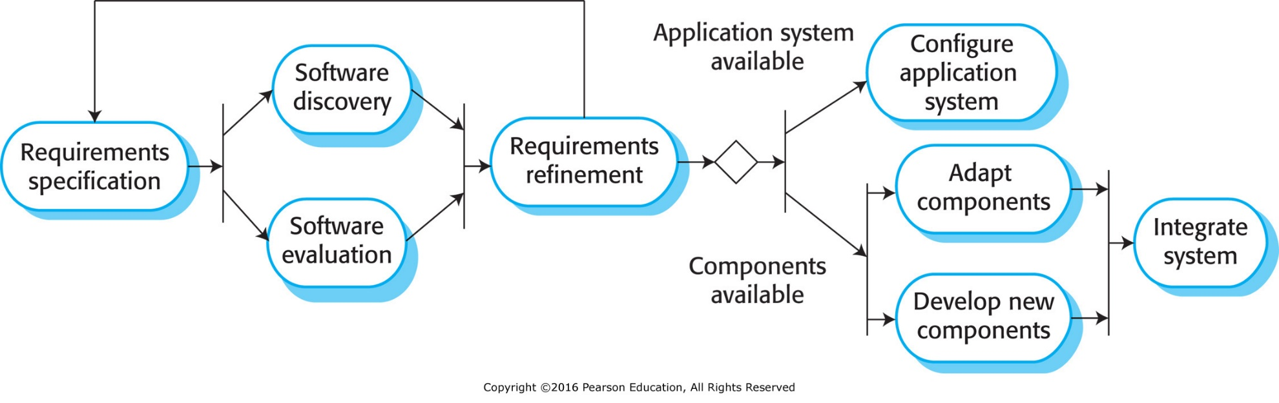
Figure 2.3 Reuse-oriented software engineering

Slide 5
Key process stages
Requirements specification
Software discovery and evaluation
Requirements refinement
Application system configuration
Component adaptation and integration

Slide 6
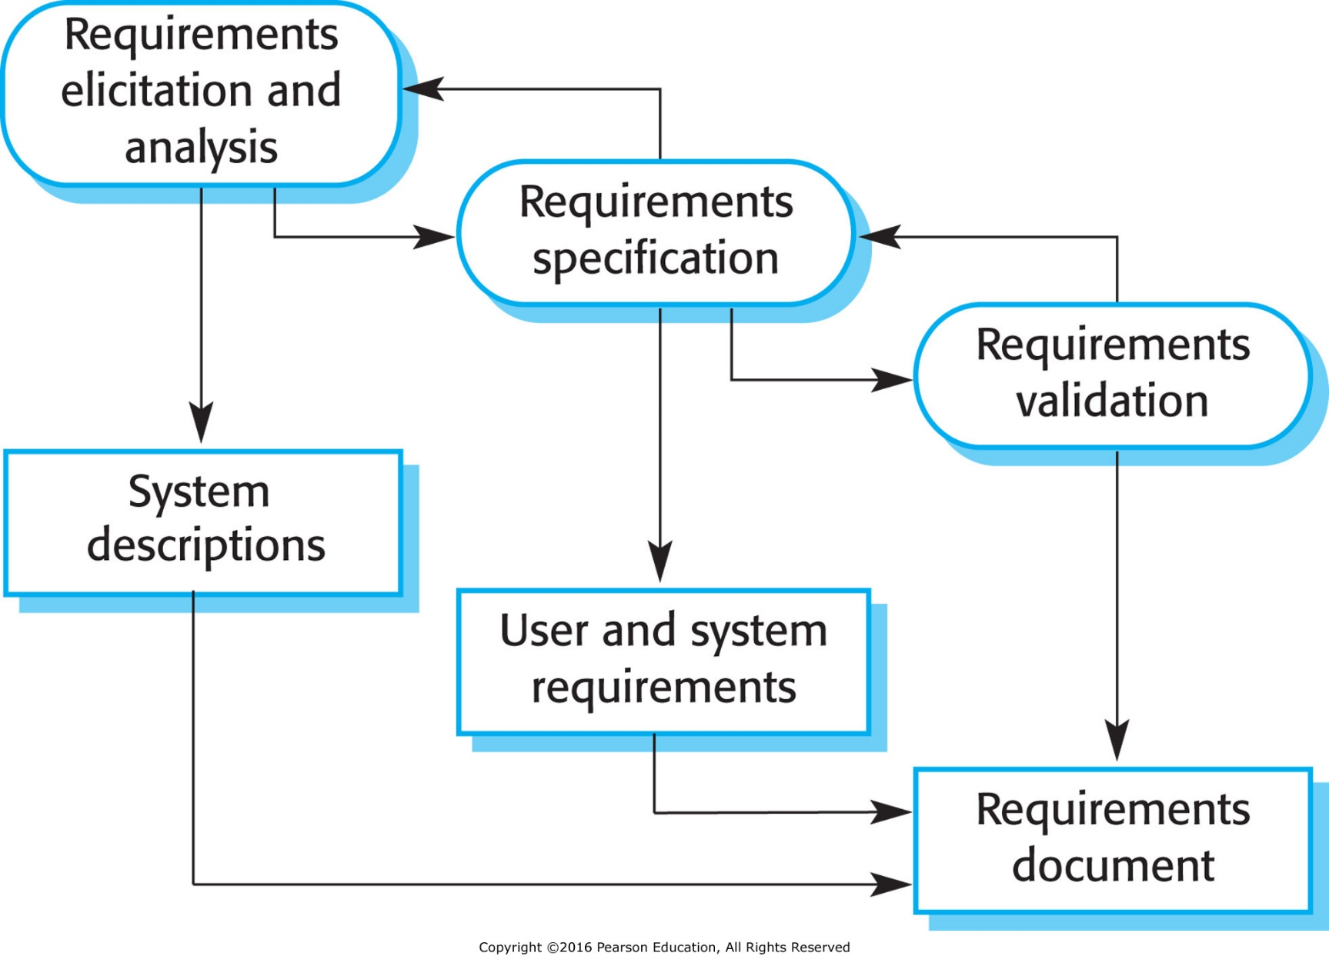
Figure 2.4 The requirements engineering process

Slide 7
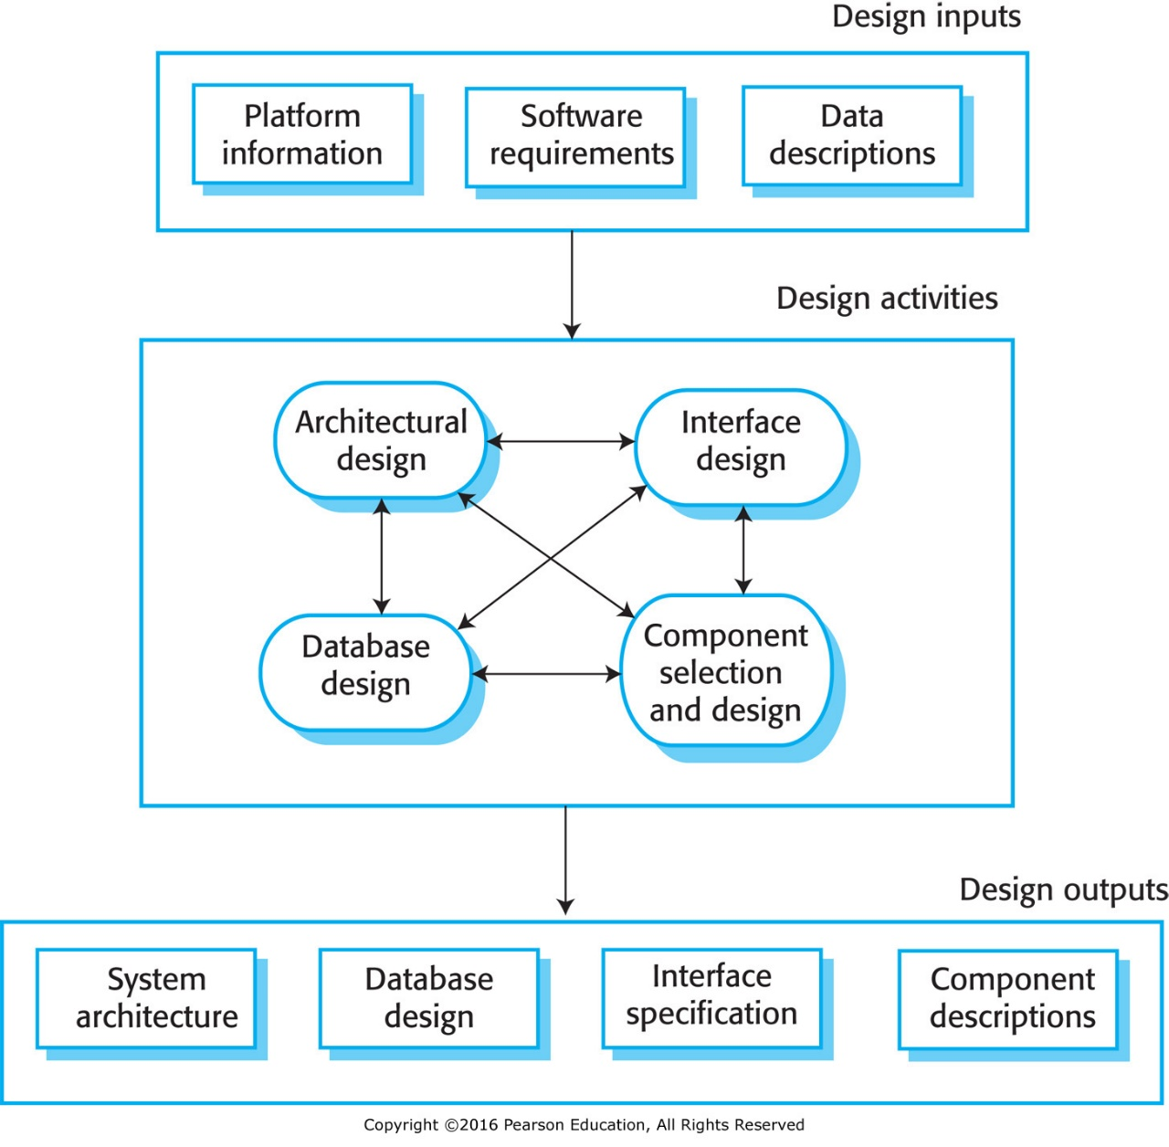
Figure 2.5 A general model of the design process

Slide 8
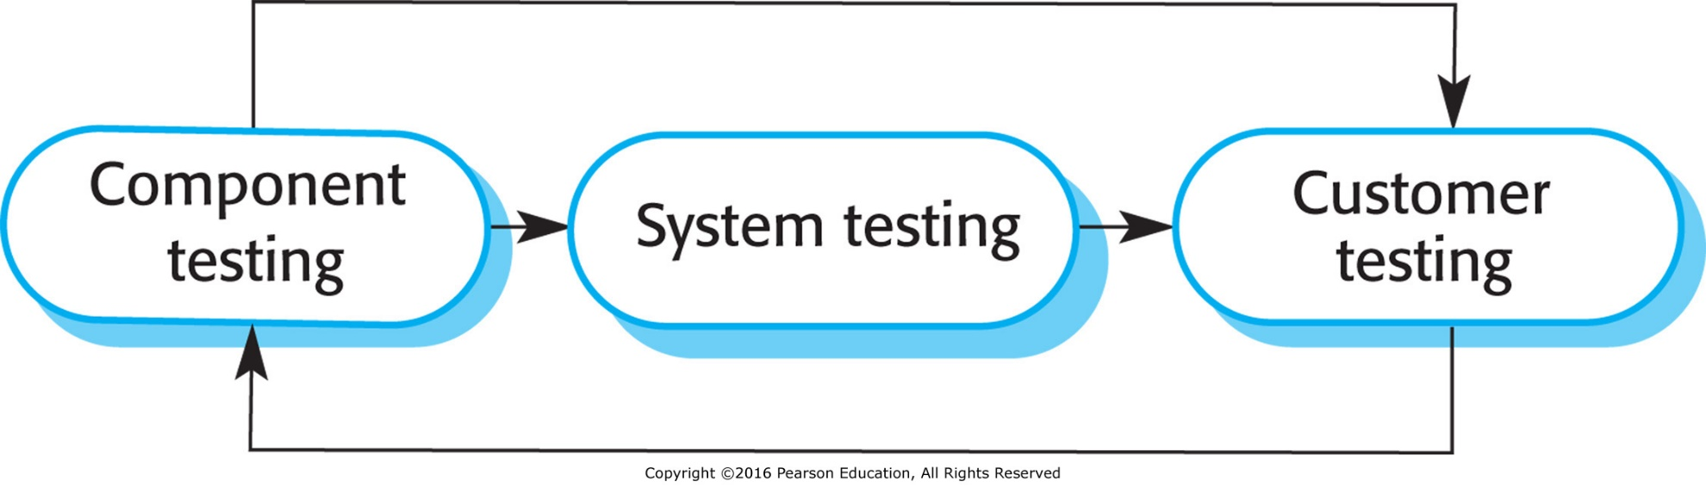
Figure 2.6 Stages of testing

Slide 9
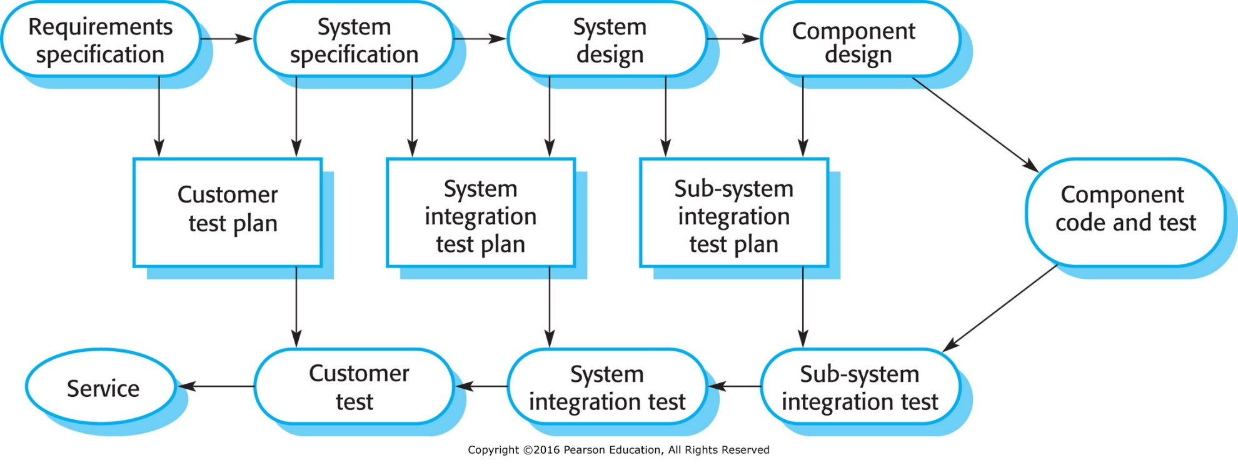
Figure 2.7 Testing phases in a plan-driven software process

Slide 10
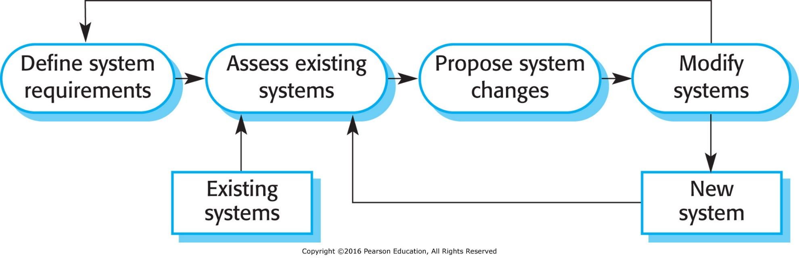
Figure 2.8 Software system evolution

Slide 11
Software prototyping
A prototype is an initial version of a system used to demonstrate concepts and try out design options.
A prototype can be used in:
  The requirements engineering process to help with requirements elicitation and validation;
  In design processes to explore options and develop a UI design;
  In the testing process to run back-to-back tests.

Slide 12
Benefits of prototyping
Improved system usability.
A closer match to users’ real needs.
Improved design quality.
Improved maintainability.
Reduced development effort.

Slide 13
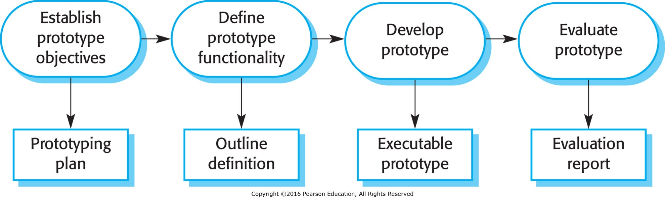
Figure 2.9 Prototype development

Slide 14
Incremental delivery
Rather than deliver the system as a single delivery, the development and delivery is broken down into increments with each increment delivering part of the required functionality.
User requirements are prioritised and the highest priority requirements are included in early increments.
Once the development of an increment is started, the requirements are frozen though requirements for later increments can continue to evolve.
  Prevent development of a moving target.

Slide 15
Incremental development and delivery
Incremental development
  Develop the system in increments and evaluate each increment before proceeding to the development of the next increment;
  Normal approach used in agile methods;
  Evaluation done by user/customer proxy.
Incremental delivery
  Deploy an increment for use by end-users;
  More realistic evaluation about practical use of software;
  Difficult to implement for replacement systems as increments have less functionality than the system being replaced.

Slide 16
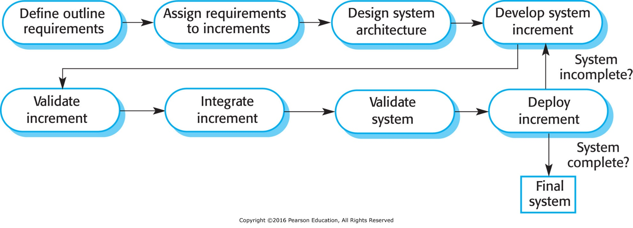
Figure 2.10 Incremental delivery

Slide 17
Incremental delivery advantages
Customer value can be delivered with each increment so system functionality is available earlier.
Early increments act as a prototype to help elicit requirements for later increments.
Lower risk of overall project failure.
The highest priority system services tend to receive the most testing.

Slide 18
Incremental delivery problems
Most systems require a set of basic facilities that are used by different parts of the system.
  As requirements are not defined in detail until an increment is to be implemented, it can be hard to identify common facilities that are needed by all increments.
The essence of iterative processes is that the specification is developed in conjunction with the software.
  However, this conflicts with the procurement model of many organizations, where the complete system specification is part of the system development contract.

Slide 19
Process improvement
Many software companies have turned to software process improvement as a way of enhancing the quality of their software, reducing costs or accelerating their development processes.
  How Software is Developed for Use
Process improvement means understanding existing processes and changing these processes to increase product quality and/or reduce costs and development time.
  Cheaper Better Software.

Slide 20
Approaches to improvement
The process maturity approach, which focuses on improving process and project management and introducing good software engineering practice.
  The level of process maturity reflects the extent to which good technical and management practice has been adopted in organizational software development processes. Highly dependent on skill of development team.
The agile approach, which focuses on iterative development and the reduction of overheads in the software process.
  The primary characteristics of agile methods are rapid delivery of functionality and responsiveness to changing customer requirements.

Slide 21
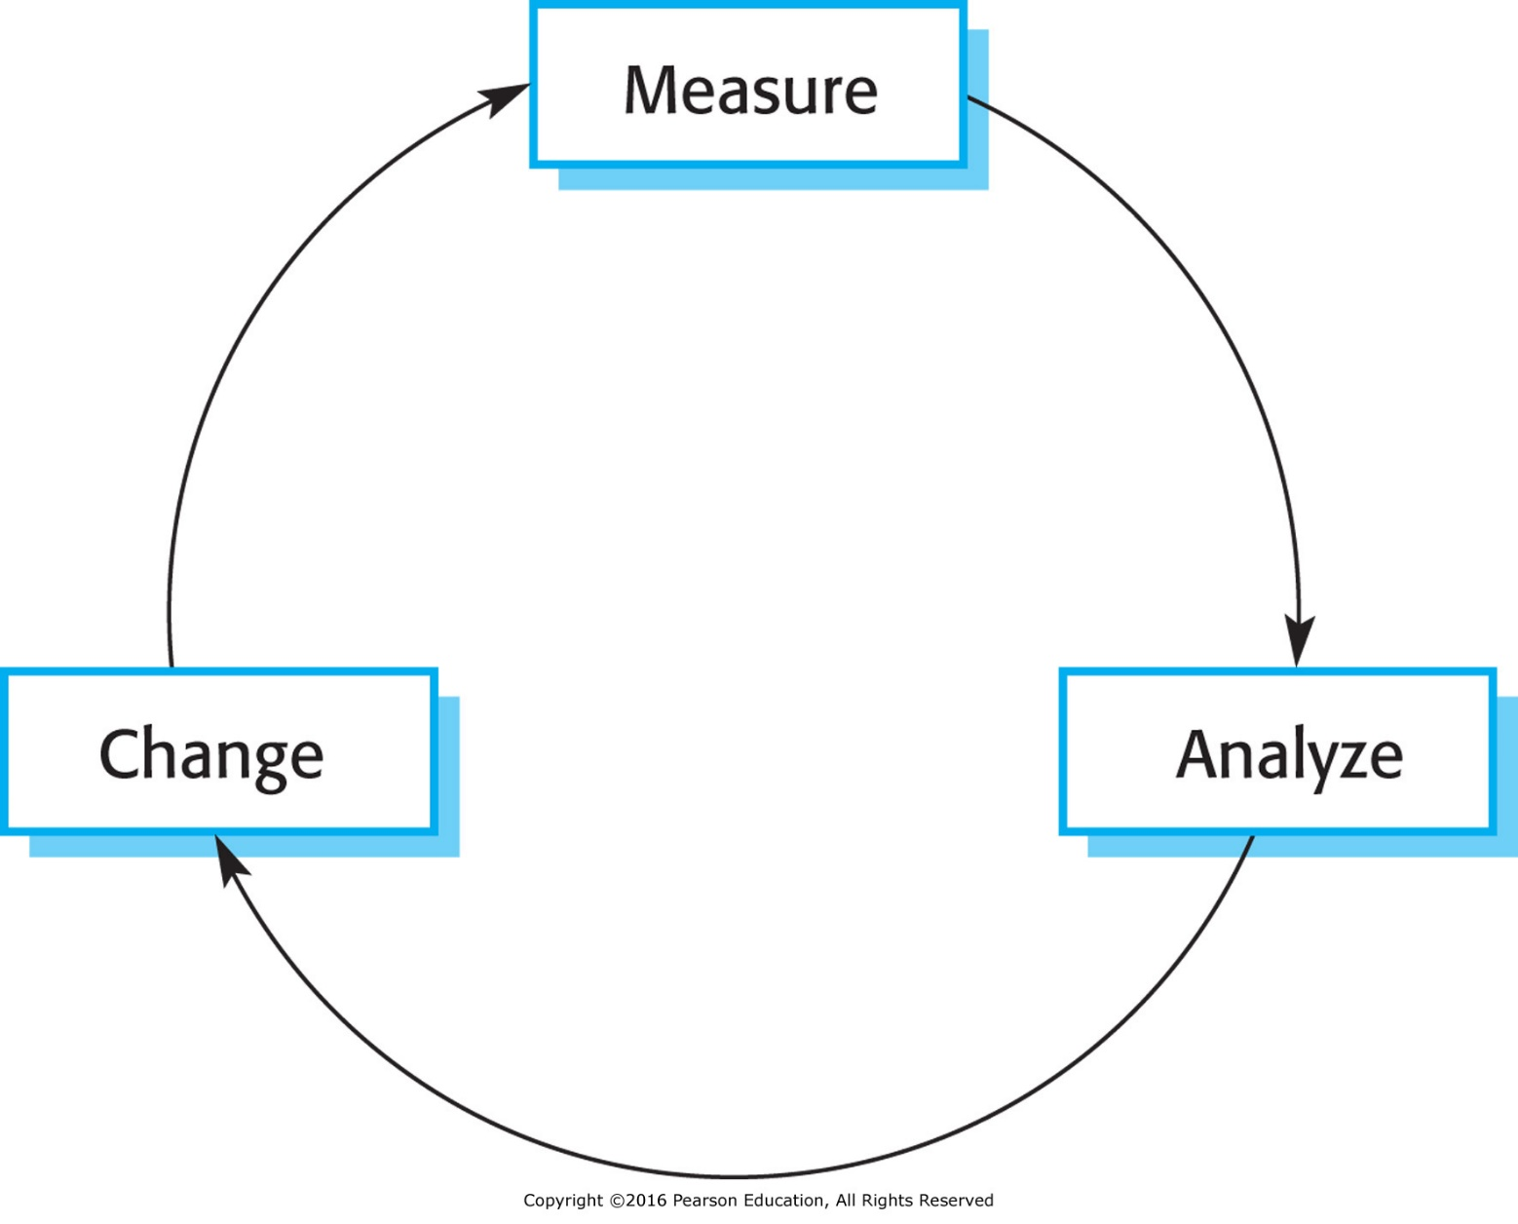
Figure 2.11 The process improvement cycle

Slide 22
Process improvement activities
Process measurement
  You measure one or more attributes of the software process or product. These measurements forms a baseline that helps you decide if process improvements have been effective.
Process analysis
  The current process is assessed, and process weaknesses and bottlenecks are identified. Process models (sometimes called process maps) that describe the process may be developed.
Process change
  Process changes are proposed to address some of the identified process weaknesses. These are introduced and the cycle resumes to collect data about the effectiveness of the changes.

Slide 23
Process measurement
Wherever possible, quantitative process data
should be collected
  However, where organisations do not have clearly defined process standards this is very difficult as you don’t know what to measure. A process may have to be defined before any measurement is possible.
Process measurements should be used to
assess process improvements
  But this does not mean that measurements should drive the improvements. The improvement driver should be the organizational objectives.

Slide 24
Process metrics
Time taken for process activities to be
completed
  E.g. Calendar time or effort to complete an activity or process.
Resources required for processes or activities
  E.g. Total effort in person-days.
Number of occurrences of a particular event
  E.g. Number of defects discovered.

Slide 25
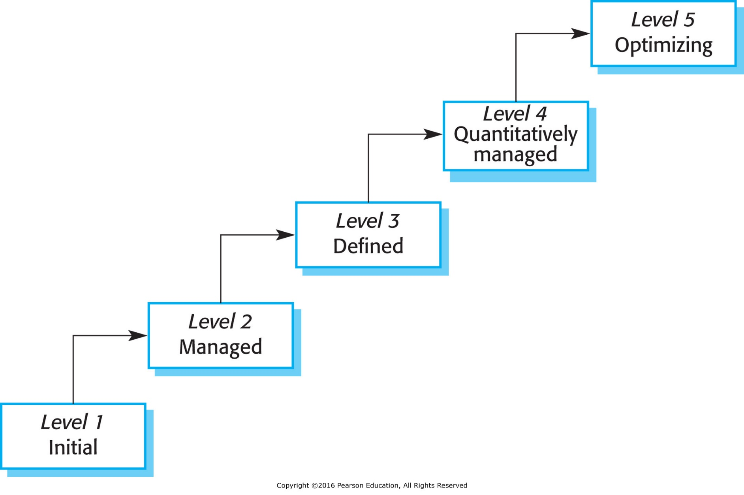
Figure 2.12 Capability maturity levels

Slide 26
The SEI capability maturity model
Initial
  Essentially uncontrolled
Repeatable
  Product management procedures defined and used
Defined
  Process management procedures and strategies defined
  and used
Managed
  Quality management strategies defined and used
Optimising
  Process improvement strategies defined and used

Slide 27
Key points
Software processes are the activities involved in producing a software system. Software process models are abstract representations of these processes.
General process models describe the organization of software processes.
  Examples of these general models include the ‘waterfall’ model, incremental development, and reuse-oriented development.
Requirements engineering is the process of developing a software specification.

Slide 28
Key points
Design and implementation processes are concerned with transforming a requirements specification into an executable software system.
Software validation is the process of checking that the system conforms to its specification and that it meets the real needs of the users of the system.
Software evolution takes place when you change existing software systems to meet new requirements. The software must evolve to remain useful.
Processes should include activities such as prototyping and incremental delivery to cope with change.

Slide 29
Key points
Processes may be structured for iterative development and delivery so that changes may be made without disrupting the system as a whole.
The principal approaches to process improvement are agile approaches, geared to reducing process overheads, and maturity-based approaches based on better process management and the use of good software engineering practice.
The SEI process maturity framework identifies maturity levels that essentially correspond to the use of good software engineering practice.

Slide 30
Agile Methods

Slide 31
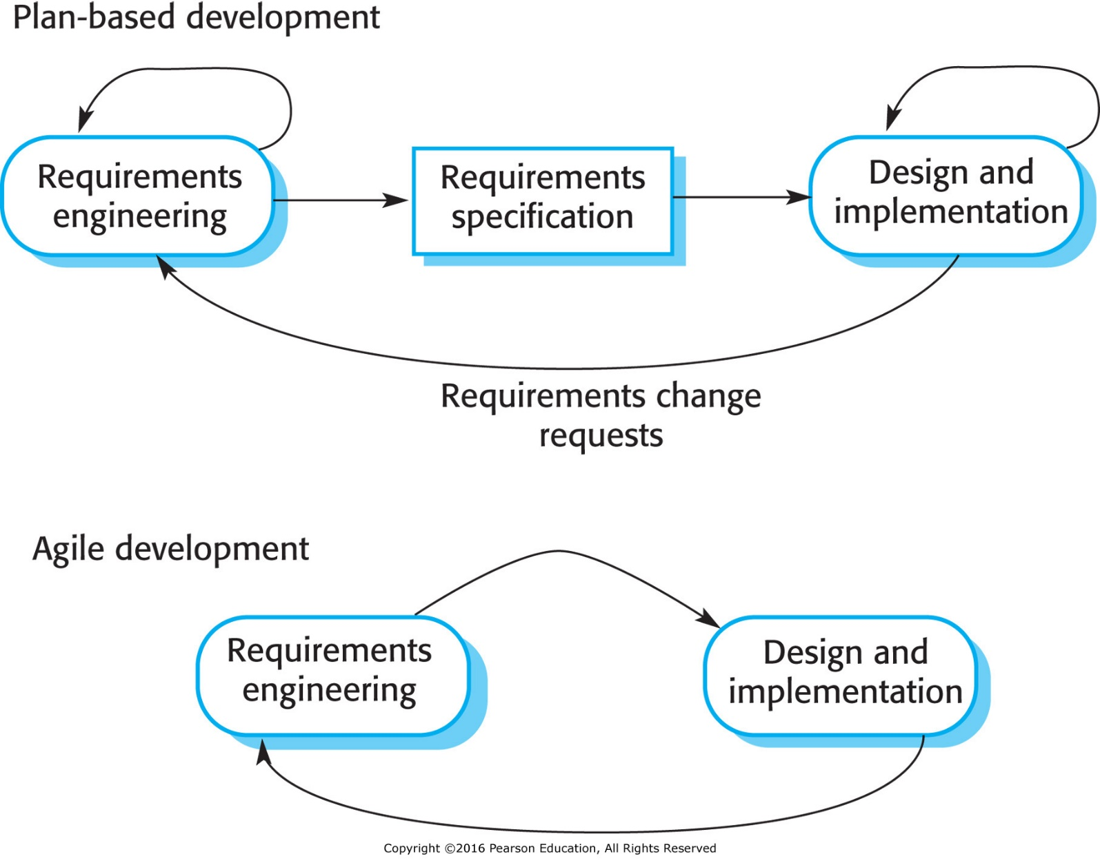
Figure 3.1 Plan-driven and agile development

Slide 32
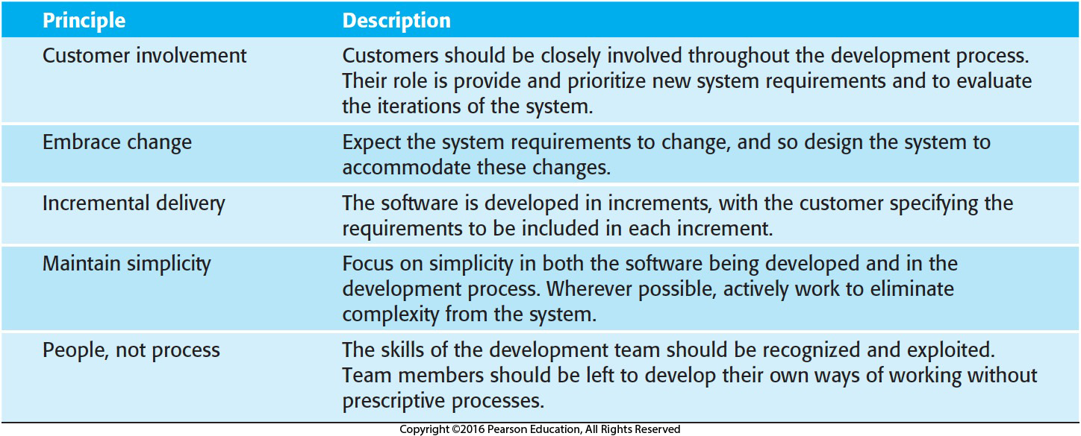
Figure 3.2 The principles of agile methods

Slide 33
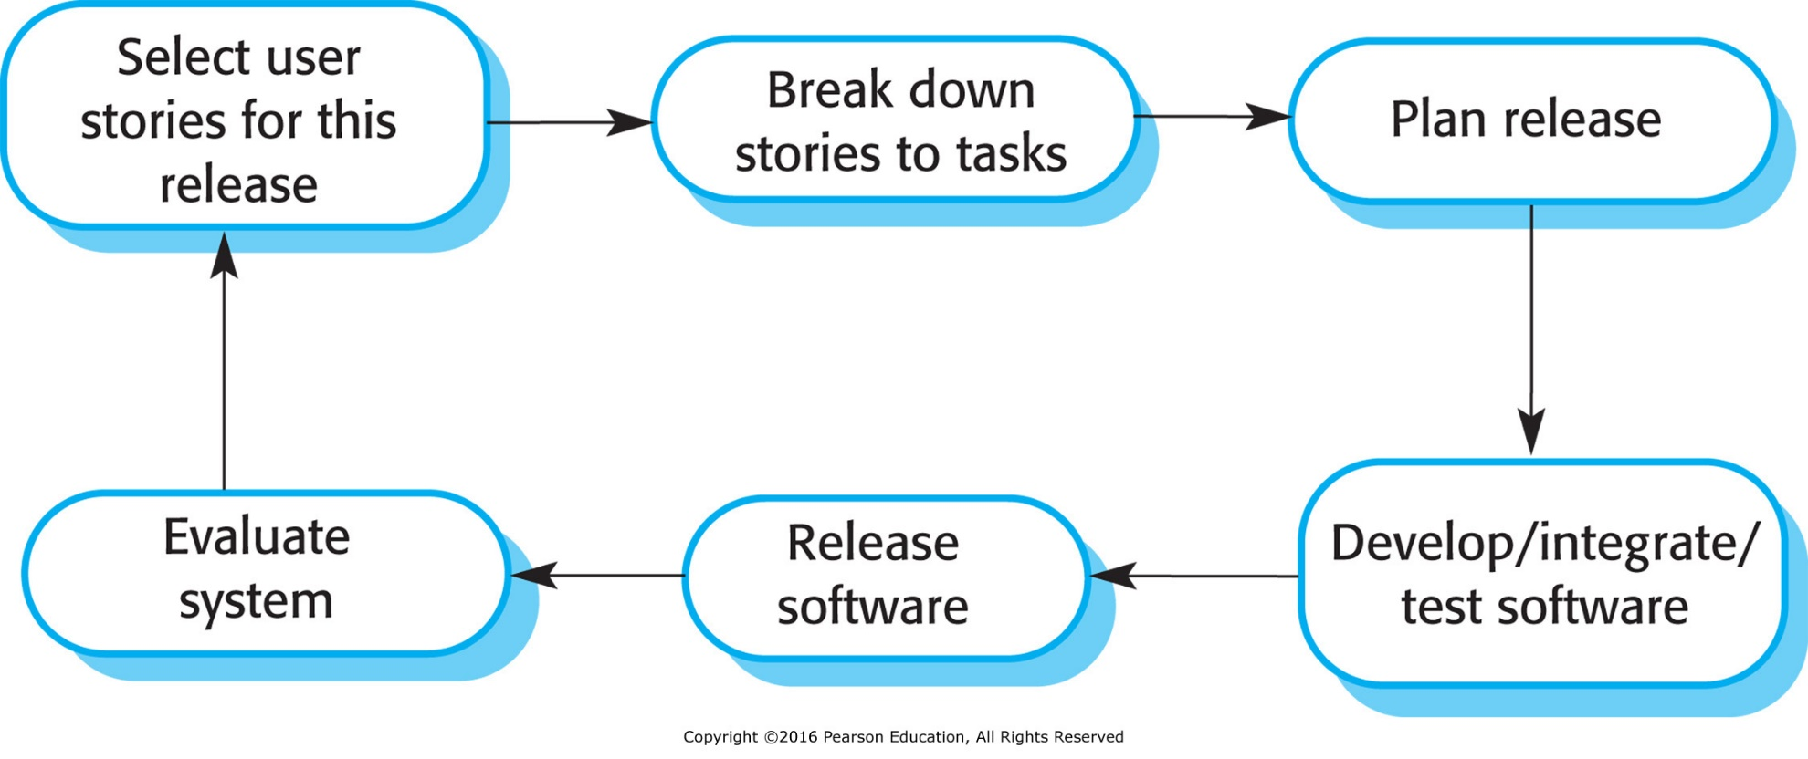
Figure 3.3 The XP release cycle

Slide 34
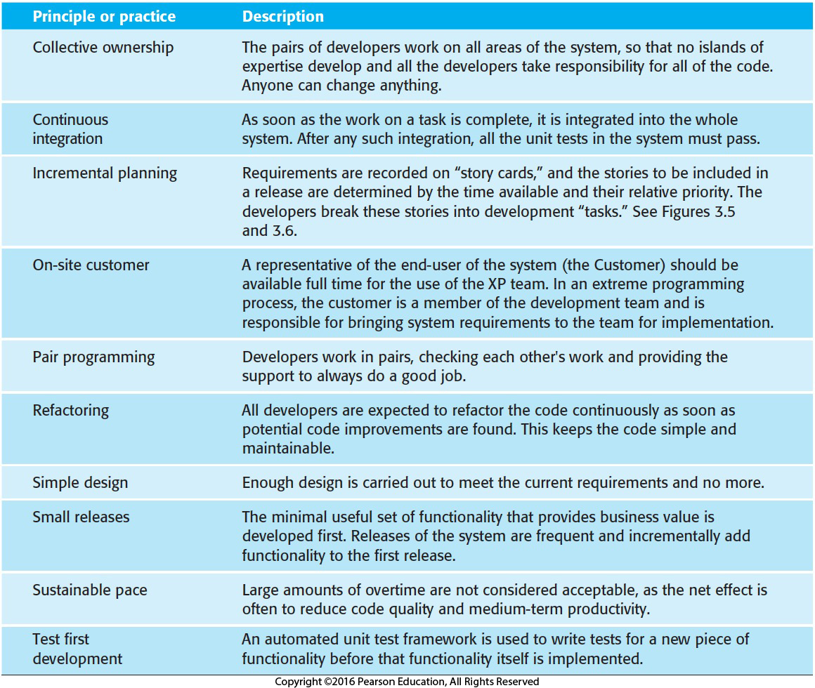
Figure 3.4 Extreme programming practices

Slide 35
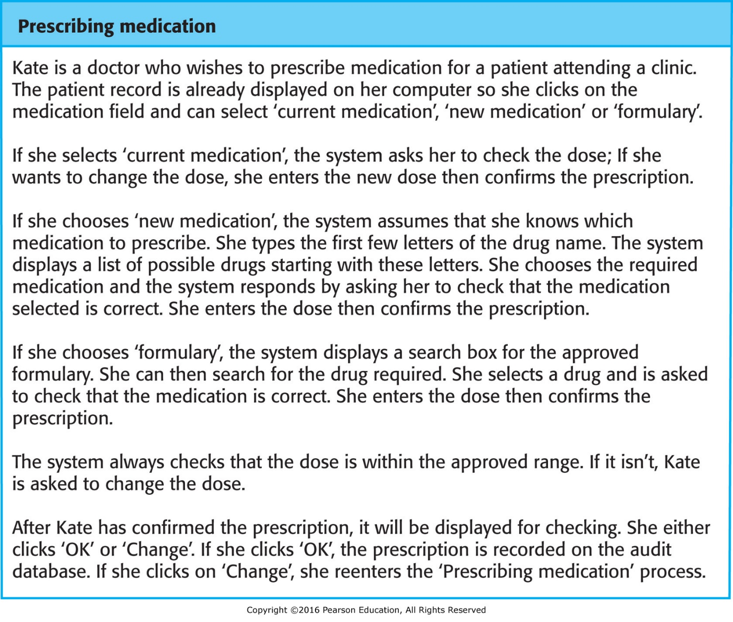
Figure 3.5 A “prescribing medication” story

Slide 36
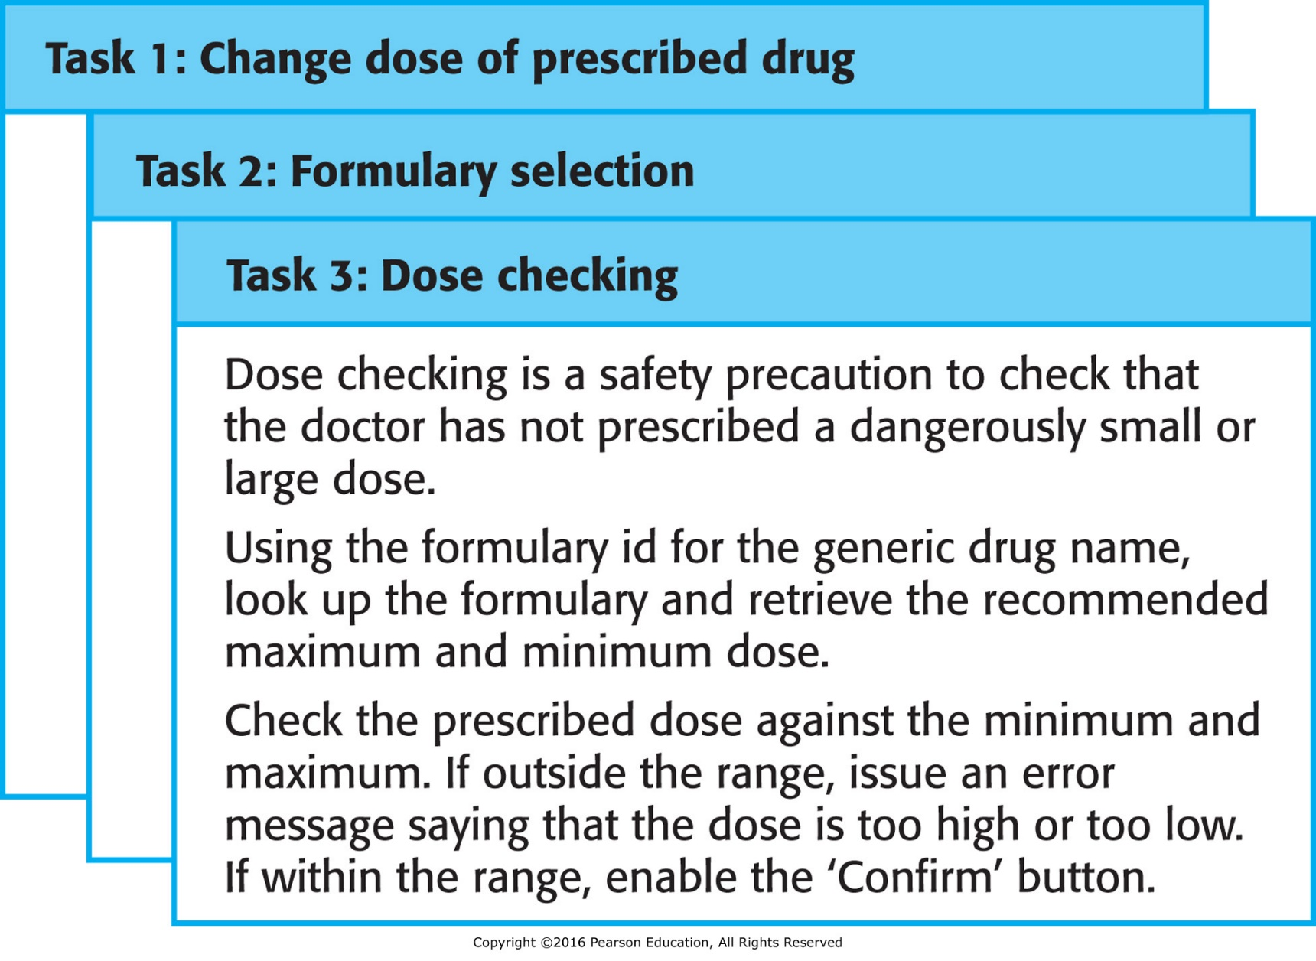
Figure 3.6 Examples of task cards for prescribing medication

Slide 37
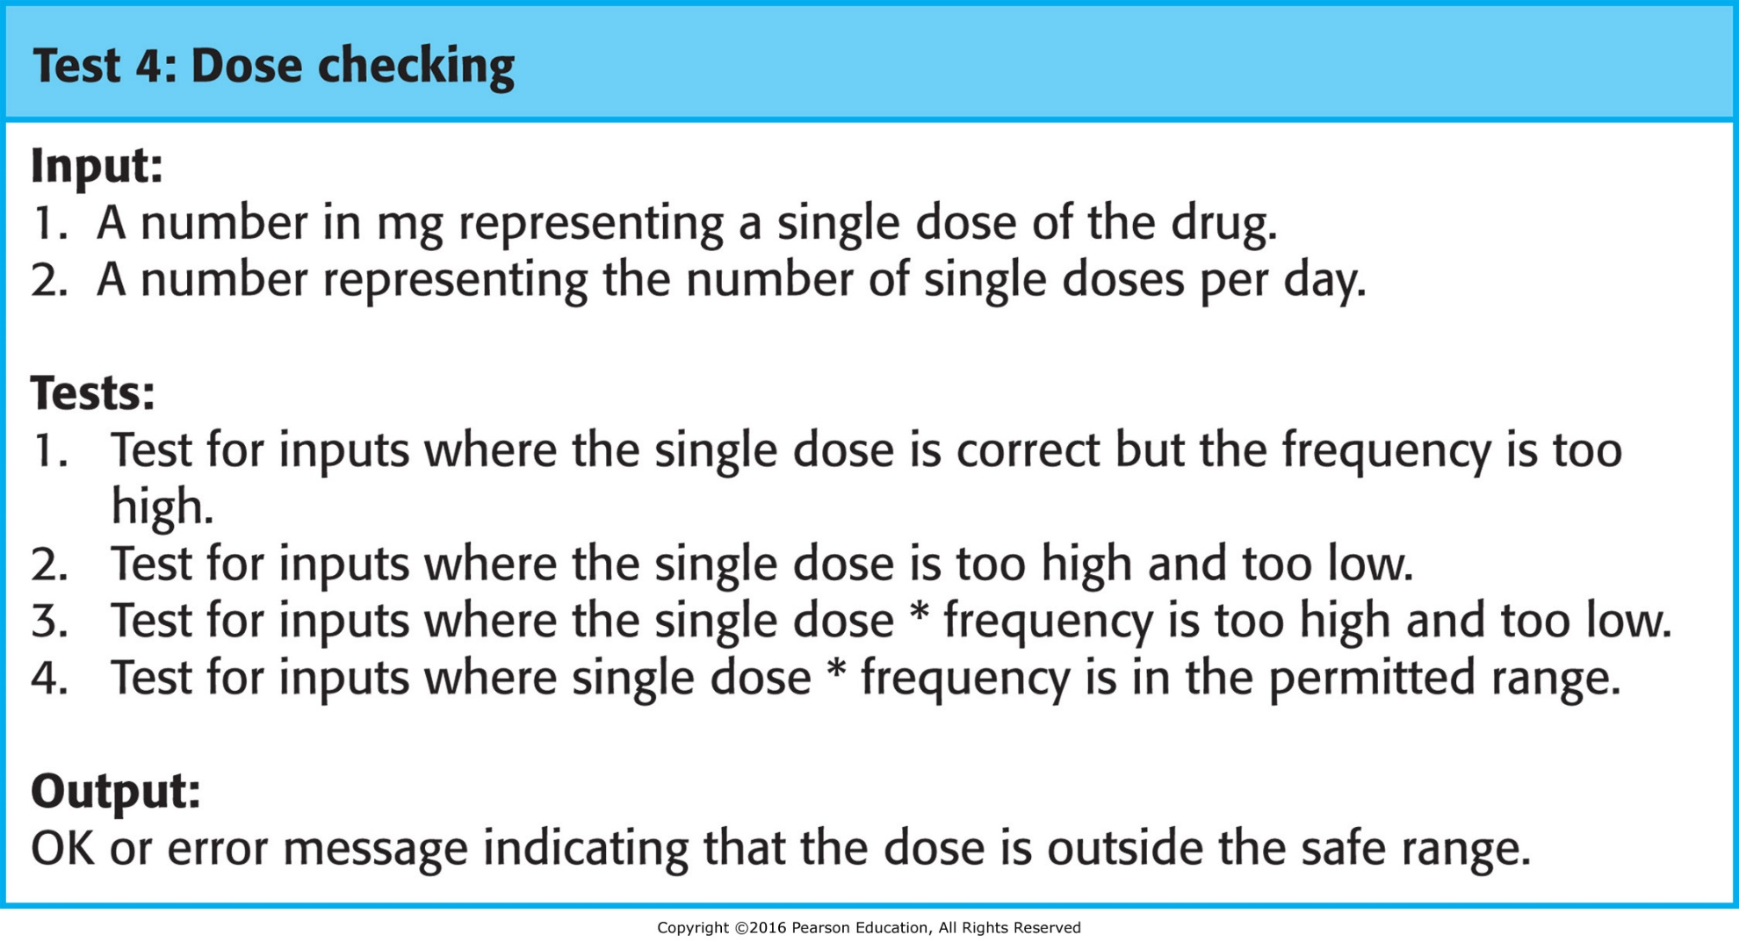
Figure 3.7 Test case description for dose checking

Slide 38
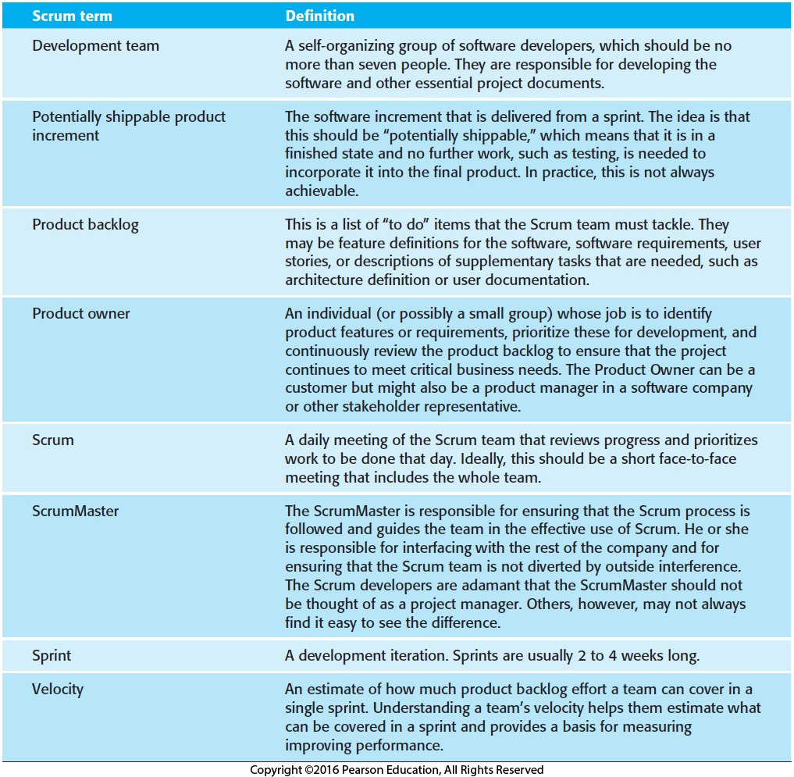
Figure 3.8 Scrum terminology
Manager

Slide 39
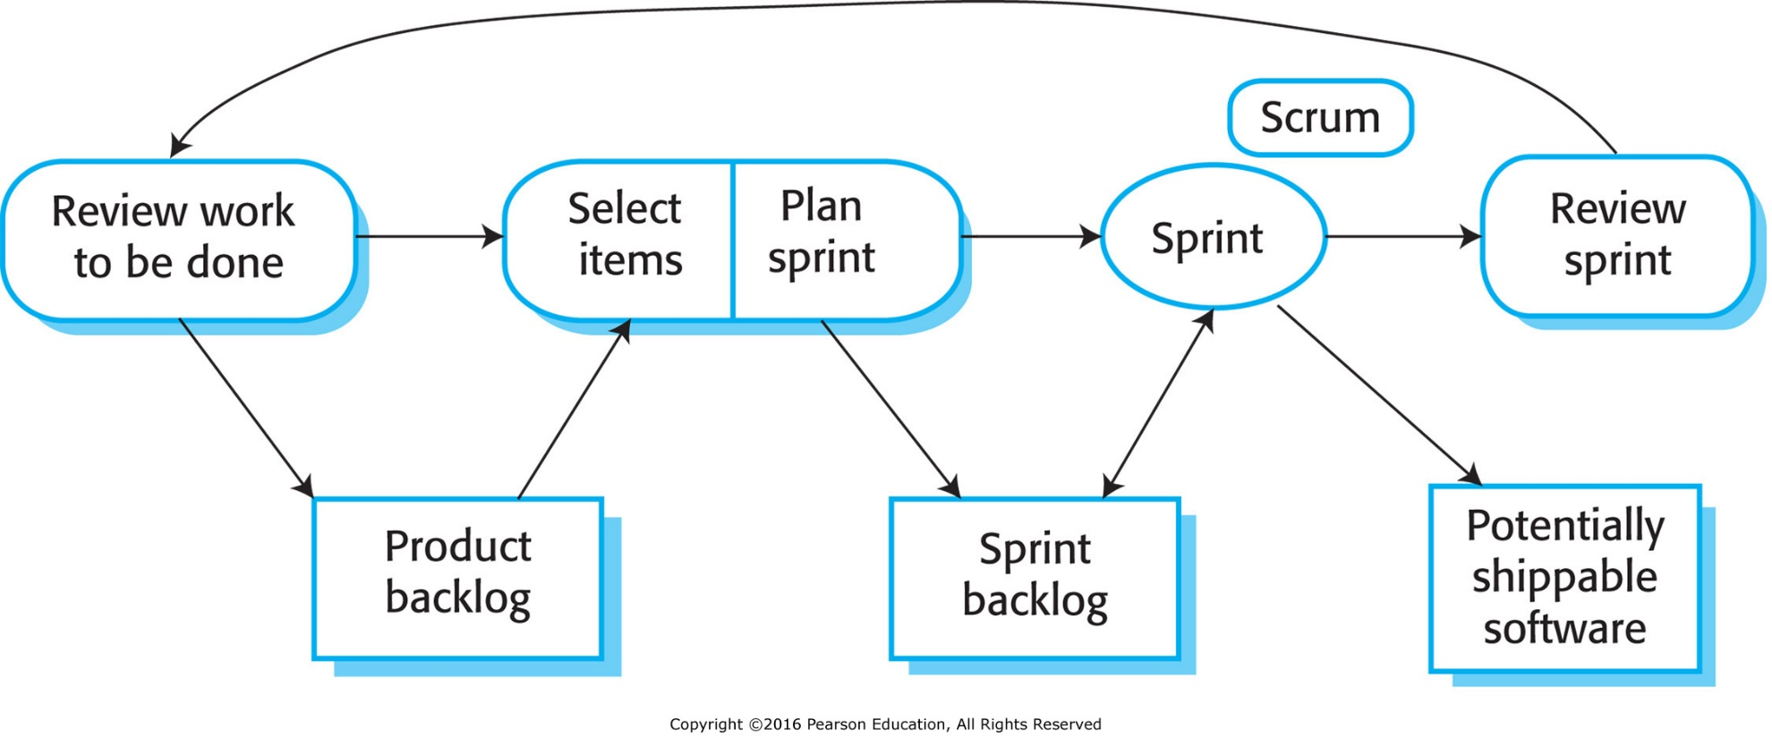
Figure 3.9 The Scrum sprint cycle

Slide 40
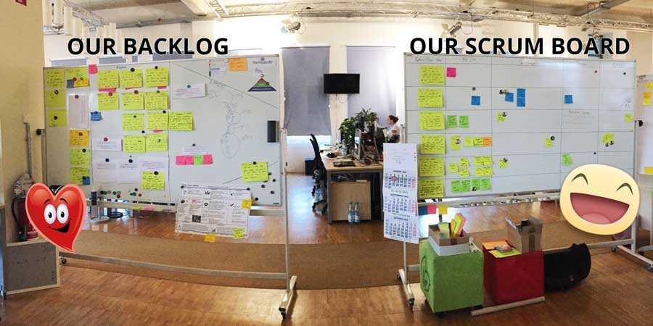
Scrum Room

Slide 41
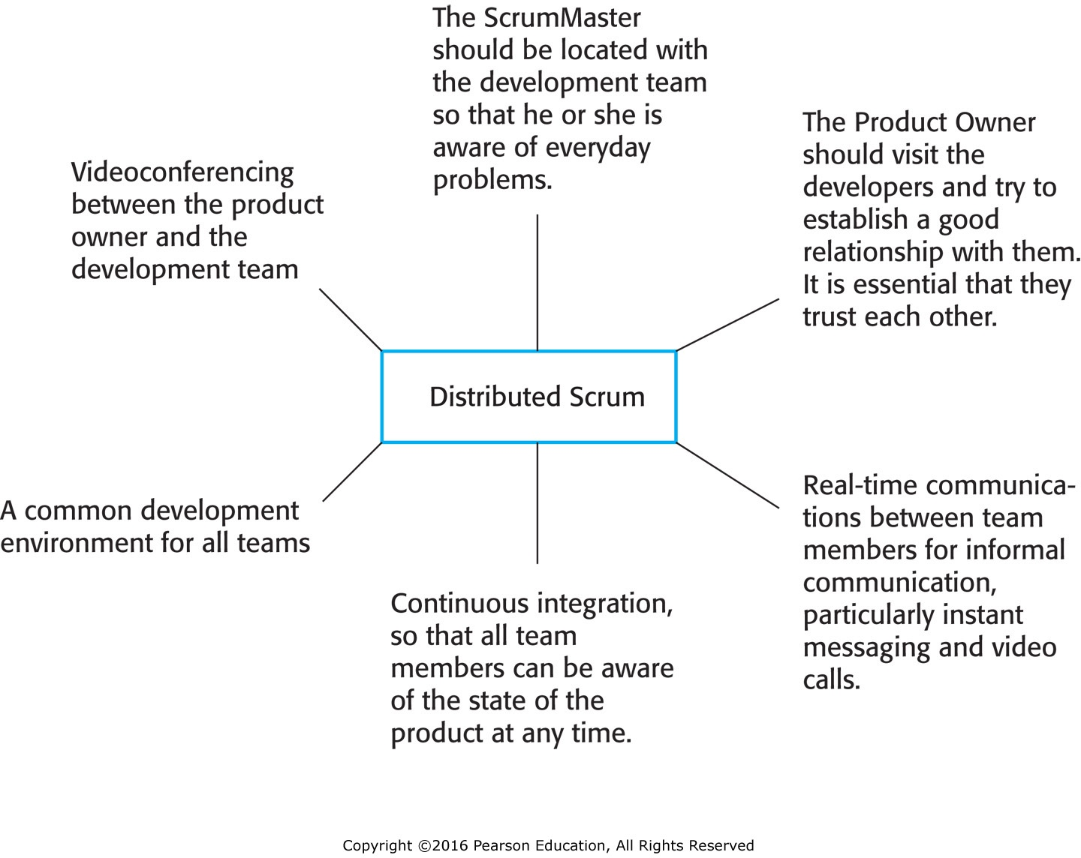
Figure 3.10 Distributed Scrum

Slide 42
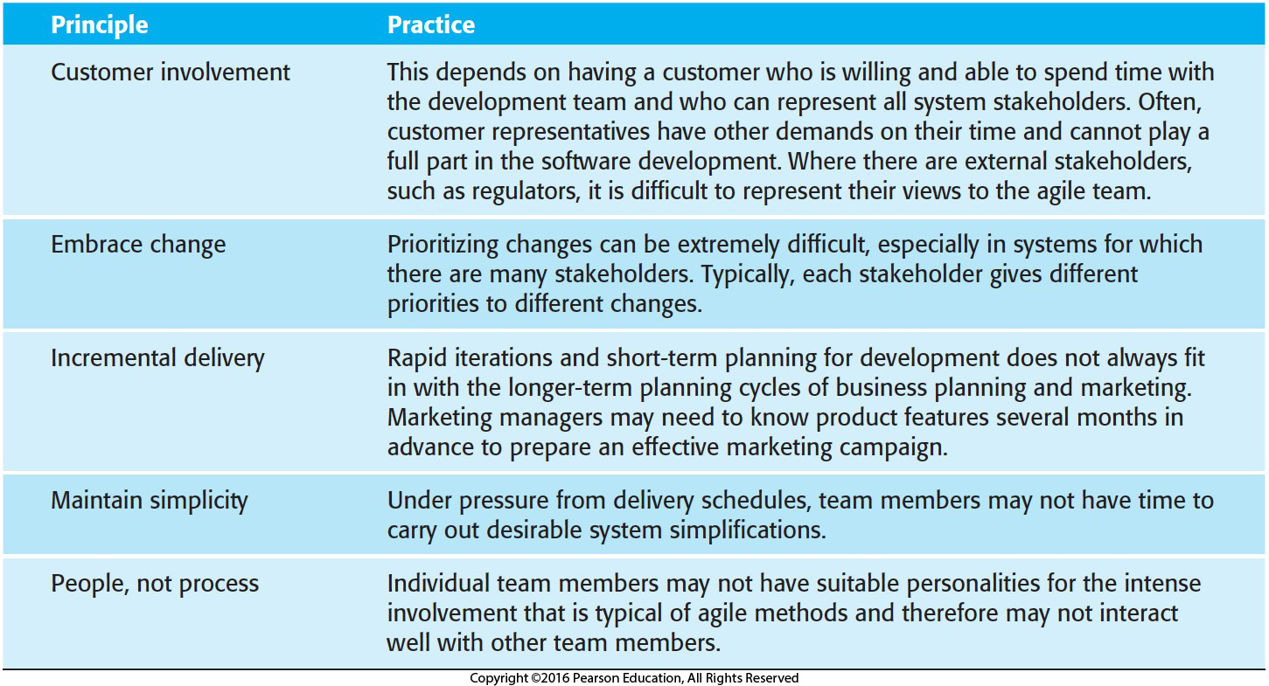
Figure 3.11 Agile principles and organizational practice

Slide 43
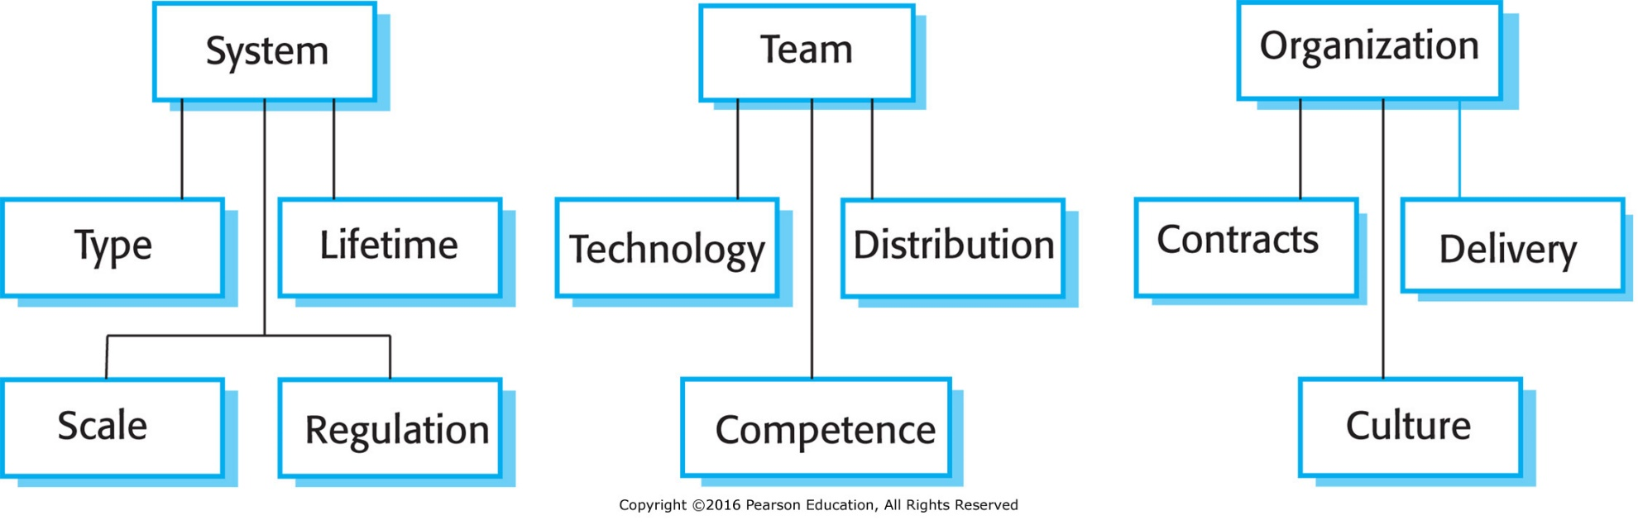
Figure 3.12 Factors influencing the choice of plan-based or agile development

Slide 44
System issues
How large is the system being developed?
  Agile methods are most effective a relatively small co-located team who can communicate informally.
What type of system is being developed?
  Systems that require a lot of analysis before implementation need a fairly detailed design to carry out this analysis.
What is the expected system lifetime?
  Long-lifetime systems require documentation to communicate the intentions of the system developers to the support team.
Is the system subject to external regulation?
  If a system is regulated you will probably be required to produce detailed documentation as part of the system safety case.

Slide 45
People and teams
How good are the designers and programmers in the development team?
  It is sometimes argued that agile methods require higher skill levels than plan-based approaches in which programmers simply translate a detailed design into code.
How is the development team organized?
  Design documents may be required if the team is distributed.
What support technologies are available?
  IDE support for visualisation and program analysis is essential if design documentation is not available.

Slide 46
Organizational issues
Traditional engineering organizations have a culture of plan-based development, as this is the norm in engineering.
Is it standard organizational practice to develop a detailed system specification?
Will customer representatives be available to provide feedback of system increments?
Can informal agile development fit into the organizational culture of detailed documentation?

Slide 47
Agile methods for large systems
Large systems are usually collections of separate, communicating systems, where separate teams develop each system. Frequently, these teams are working in different places, sometimes in different time zones.
Large systems are ‘brownfield systems’, that is they include and interact with a number of existing systems. Many of the system requirements are concerned with this interaction and so don’t really lend themselves to flexibility and incremental development.
Where several systems are integrated to create a system, a significant fraction of the development is concerned with system configuration rather than original code development.

Slide 48
Large system development
Large systems and their development processes are often constrained by external rules and regulations limiting the way that they can be developed.
Large systems have a long procurement and development time. It is difficult to maintain coherent teams who know about the system over that period as, inevitably, people move on to other jobs and projects.
Large systems usually have a diverse set of stakeholders. It is practically impossible to involve all of these different stakeholders in the development process.

Slide 49
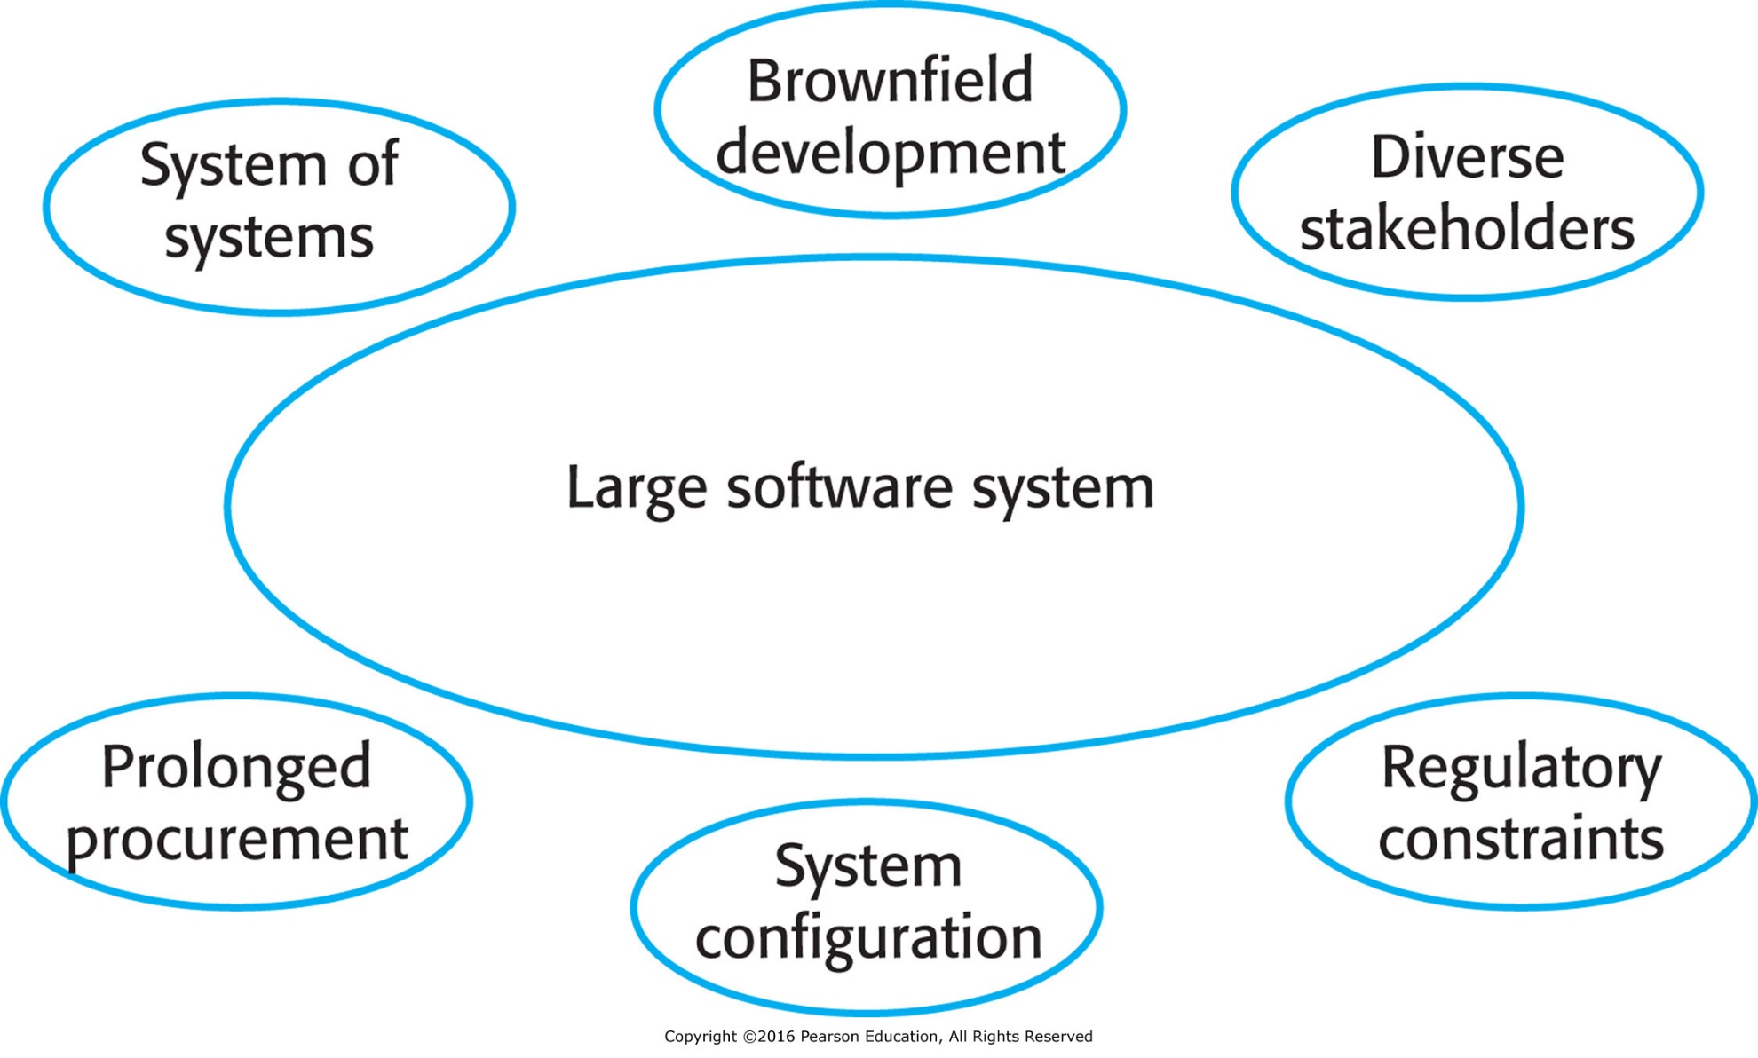
Figure 3.13 Large project characteristics

Slide 50
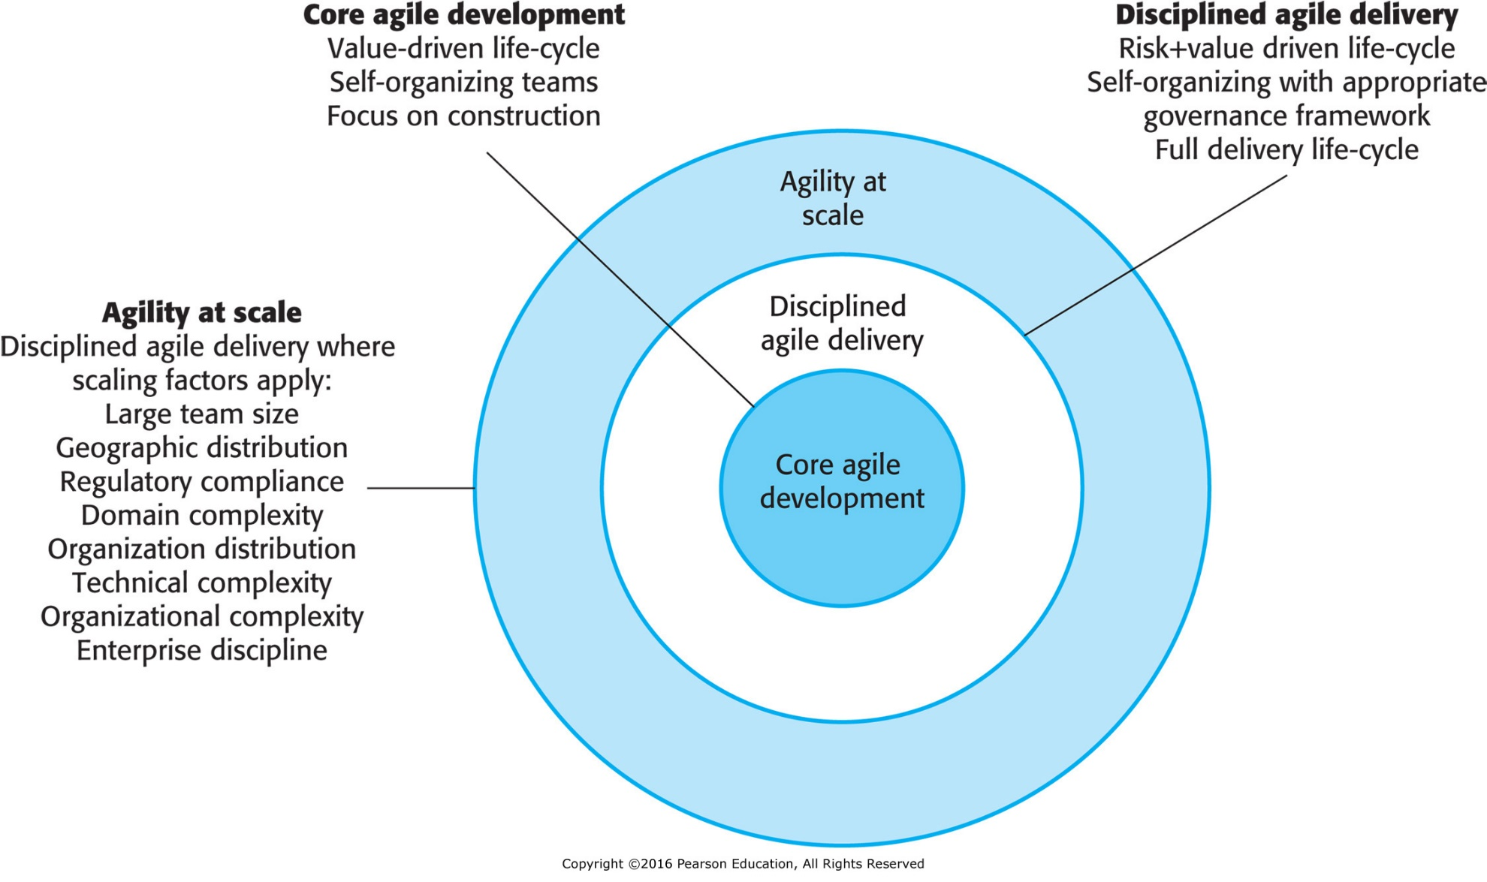
Figure 3.14 IBM’s Agility at Scale model
Source: © IBM 2010

Slide 51
Scaling up to large systems
A completely incremental approach to requirements engineering is impossible.
There cannot be a single product owner or customer representative.
For large systems development, it is not possible to focus only on the code of the system.
  Flight control, requires aeronautical engineering
Cross-team communication mechanisms have to be designed and used.
Continuous integration is practically impossible. However, it is essential to maintain frequent system builds and regular releases of the system.
  E.g. flight control

Slide 52
Multi-team Scrum
Role replication
  Each team has a Product Owner for their work component and ScrumMaster.
Product architects
  Each team chooses a product architect and these architects collaborate to design and evolve the overall system architecture.
Release alignment
  The dates of product releases from each team are aligned so that a demonstrable and complete system is produced.
Scrum of Scrums
  There is a daily Scrum of Scrums where representatives from each team meet to discuss progress and plan work to be done.

Slide 53
Agile methods across organizations
Project managers who do not have experience of agile methods may be reluctant to accept the risk of a new approach.
Large organizations often have quality procedures and standards that all projects are expected to follow and, because of their bureaucratic nature, these are likely to be incompatible with agile methods.
Agile methods seem to work best when team members have a relatively high skill level. However, within large organizations, there are likely to be a wide range of skills and abilities.
There may be cultural resistance to agile methods, especially in those organizations that have a long history of using conventional systems engineering processes.
  Engineers are taught to be thorough.

