Slide 1
1. Coroutining
The left-to-right depth-first control of Prolog is restrictive in writing declarative programs.
Coroutining permits more complex control to be used. However, one pitfall is that debugging becomes more difficult!
Block declaration:
?- block pred(?,?,-,-,?), pred(?,-),.... .
- when all “-” args are uninstantiated, then predicate blocks (waits, stalls).
? otherwise.

Slide 2
Coroutining
% merge 2 ordered lists of integers...
:- block merge(-, ?, -), merge(?, -, -).
merge([ ], Y, Y).
merge(X, [ ], X).
merge([H|X], [E|Y], [H|Z]) :- H < E, merge(X, [E|Y], Z).
merge([H|X], [E|Y], [E|Z]) :- H >= E, merge([H|Z], Y, Z).
merge will suspend when args 1 and 3, or args 2 and 3, are uninstantiated

Slide 3
Coroutining
You can then call merge without regard to whether its lists are instantiated or not...
?- merge(X,Y,M), sort([5,2,4,3], X), sort([6,3,7,9], Y).
merge will suspend until both X and Y have values.
This means that goal and clause order can be (somewhat) ignored with respect to merge. This in turn permits more declarative programs.
Possible to write recursive predicates that continually awaken and suspend as their arguments become instantiated.
If blocked goals never awake, system says they are "floundering“.

Slide 4
Coroutining
some other coroutining builtin's:
when(Condition, Goal) - blocks Goal until Condition satisfied
eg. ?- when(X==Y, p(X,Y,T)).
freeze(?X, Goal) - blocks Goal until variable X is instantiated

Slide 5
2. Concurrent & Parallel Prolog
With ongoing development of multiprocessor computers, one crucial factor is the availability of usable programming languages to exploit these machines.
Logic programming languages are ideally suited for parallel execution.
→ Executing clauses in parallel (OR parallelism)
→ Executing clauses in parallel ( AND parallelism)
parallel logic programming: exploiting full parallelism with a pure logic program
concurrent logic programming: restricting the parallelism of the logic program program, usually with variable markings, unification rules, and special goals.

Slide 6
Guards
• a number of concurrent logic programming languages have been developed
• form of program statements:
H :- G1,...,Gk | B1,...,Bn.
guard
commit
Body
H1 :- G1, G2 | A, B, C.
H2 :- G3, G4 | D, E.
H3 :- G5 | F.
All the clauses are executed in parallel.
The guard goals in each are also executed in parallel.
The first clause whose guard totally succeeds is then used, its body is
executed (in parallel) and the other clauses are killed.
• Thus the guard acts much like the "cut". It reduces the amount of parallelism
that can occur (else too much parallelism).

Slide 7
Concurrent Prolog
Other concurrent LP languages have "flat" guards, which means that the guard goals must be system predicates (relational ops, unification, etc)
Some languages have rules for unification, for example:
unifying the head should not unify variables not defined in that clause
execution of the guard should not unify variables in the Head

Slide 8
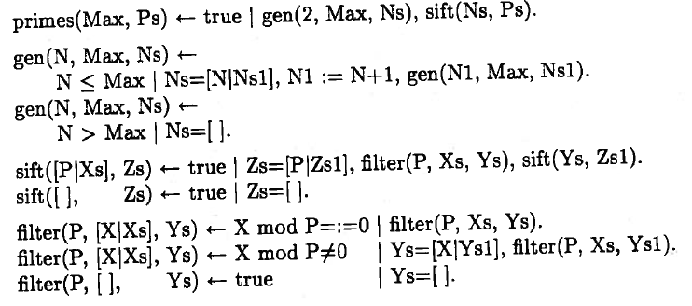
Example
(from Concurrent Prolog v.1, MIT Press, 1987.)

Slide 9
3. Interfacing Sicstus to the world
Real-world applications require using other systems, libraries.
Sicstus Prolog can be integrated with:
C and C++
.NET
multiple Prolog threads
WWW (via Pillow library)
processes (Linda library)
Tcl/Tk interface
Java
others

Slide 10
Prolog and C
Can interface Prolog and C (and C can interface to almost anything...)
eg. I have interfaced my DCTG-GP system to the R library, which is a large, public domain statistics package
When my GP system needs to do some statistical analyses, I send the Prolog arrays of numbers to a C function that I’ve compiled into my Prolog system.
The C function looks like a predicate to Sicstus.
C code has “R” library routines compiled into it.
Does a load of number crunching, and final statistics are then loaded back into a data structure, and returned to Prolog.
Result: fast execution of stats, and I don’t need to rewrite that code!

Slide 11
Prolog and C
Can call C from Prolog (last slide). Can also call Prolog from C (eg. let Prolog searching solve a problem).
foreign resource: set of C functions, defined in one or more files, and installed as an atomic operation in Prolog (ie. single call to a goal)
Sicstus provides utilities to convert between C data and Prolog data structures
Standalone programs create executable C modules that Sicstus will access, and executable Prolog that C program can call.

Slide 12
Prolog code (to be called by C)
connected(From, From, [From], _) :- !. % Graph searching with visited list
connected(From, To, [From| Way], Been) :-
( no_stop(From, Through)
; no_stop(Through, From) ),
not_been_before(Been, Through),
connected(Through, To, Way, Been).
no_stop(’Stockholm’, ’Katrineholm’).
no_stop(’Stockholm’, ’Vasteras’).
(etc.)
not_been_before(Way, _) :- var(Way), !.
not_been_before([Been| Way], Am) :-
Been \== Am,
not_been_before(Way, Am).

Slide 13
C program (excerpt)
/* Create the three arguments to connected/4. */
SP_put_string(from = SP_new_term_ref(), "Stockholm");
SP_put_string(to = SP_new_term_ref(), "Orebro");
SP_put_variable(path = SP_new_term_ref());
/* Open the query. In a development system, the query would look like:
* ?- connected(’Stockholm’,’Orebro’,X).
*/
if (!(goal = SP_open_query(pred,from,to,path,path)))
{
fprintf(stderr, "Failed to open query.\n");
exit(1);
}

Slide 14
4. Other implementations: SWI Prolog
Very portable (Windows, Linux, MaxOS)
well-maintained, solid
free
Lots of extensions
CLP
multi-threading
interfacing to Java, TCP/IP
HTML/XML
BUT... slow.

Slide 15
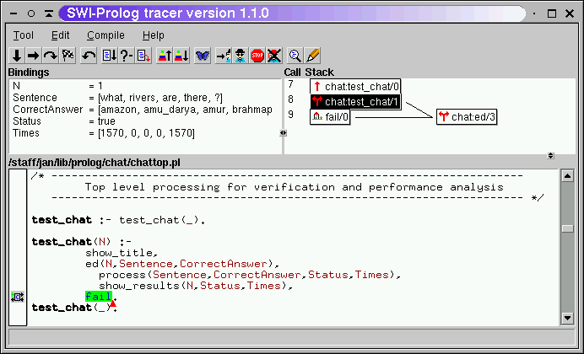
SWI: graphical tracer

Slide 16
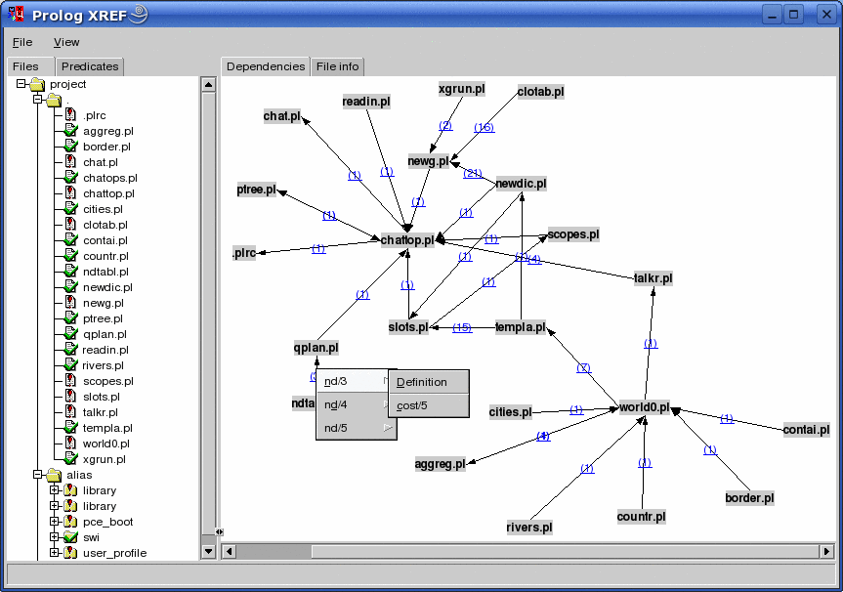
SWI: graphical cross-referencer (file dependency)

Slide 17
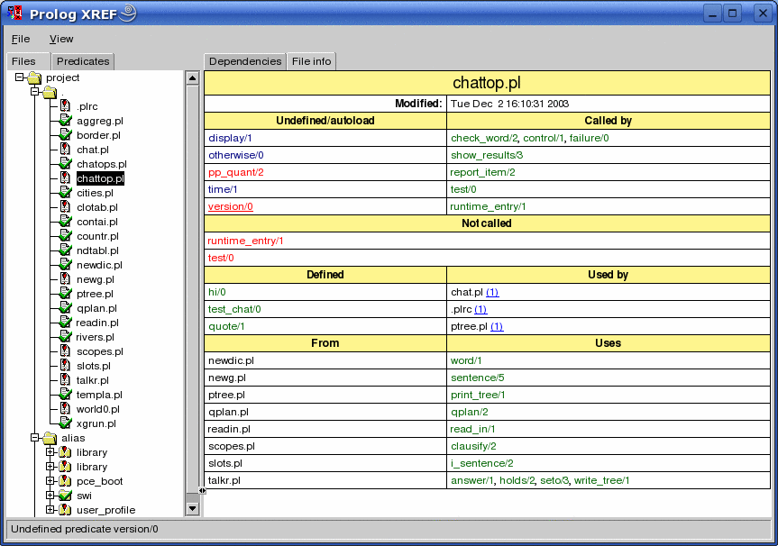
Cross referencer: file info

Slide 18
Strong Typing and Prolog
Prolog as you’ve seen it has been “typeless”.
This can pose big problems. A misspelled constant might fail to unify, which can mean execution errors!
If an entire query fails erroneously, it will be noticed.
But if a subgoal in a rule fails, it might not be seen, and can produce erroneous results elsewhere.
Types are used in programming languages for a reason: they help reduce errors!
But they don’t prevent the most important errors, eg. algorithmic (logic) errors.

Slide 19
Other implementations: Visual Prolog
Download at: www.visual-prolog.com
Features
GUI generation (hence “Visual” Prolog)
object orientation (more later)
strongly typed
algebraic data types (for complex data structures)
graphical development environment
Interfaces to C
and more.
Free for non-commercial use!

Slide 20
Visual Prolog: typing
domains
stringlist = string*.
treetype = tree(string, treetype, treetype) ; empty.
predicates
add_from_list : (stringlist) procedure (i).
treeinsert : (string NewItem, treetype OldTree, treetype Newtree) procedure (i,i,o).
traverse : (string TraverseOrder) procedure (i).
preOrderTraverse : (treetype Tree) procedure (i).
inOrderTraverse : ( treetype Tree) procedure (i).
postOrdertraverse : (treetype Tree) procedure (i).

Slide 21
Visual Prolog: Object Orientation
predicates
onTreesCreate : window::menuItemListener.
clauses
onTreesCreate(_Source, _MenuTag) :-
classtree::add_from_list(["F", "B", "G", "A", "D", "I", "C", "E"]),
stdIO::write("Tree has been created"), stdIO::nl.
predicates
onTreesTraversePreorder : window::menuItemListener.
clauses
onTreesTraversePreorder(_Source, _MenuTag) :-
classtree::traverse("preorder").

Slide 22
Visual Prolog: GUI
predicates
onMessagesAsk2 : window::menuItemListener.
clauses
onMessagesAsk2(_Source, _MenuTag) :-
ButtonPressed = ask("This is the question", ["Button0", "Button1", "Button2"]),
note("You pressed button number ...", tostring(ButtonPressed)).

Slide 23
Other Prolog implementations
http://en.wikipedia.org/wiki/Comparison_of_Prolog_implementations
Benchmarks
http://www.mercury.csse.unimelb.edu.au/information/bench/ratios.html (see local copy)
http://yieldprolog.sourceforge.net/benchmarks.html

Slide 24
5. Prolog summary
Prolog is the most well-known and commonly used logic programming language.
Strengths:
Efficient implementation on current hardware
lots of extensions
large user base
Weaknesses:
pure logic is weak: need messy “cuts” to make thing efficient
no typing in most implementations
other libraries (CLP) needed to make it smarter
Prolog is just one example of using logic as a means for programming.

Slide 25
The Big Picture
Prolog is just one implementation of using logic as a programming language.
The bigger goal is to make higher-level programming languages using logic, because logic is very descriptive and more “human oriented” than traditional languages.
Declarative programming ideal: Describe what to compute, not how to compute.

Slide 26
Other Logic Languages: Goedel
Features:
strong typing
modules
control: flexible control rule (goal selection) with delays
constraints: integers, rationals (fractions)
high-level development tools: debugging, verification, ...
http://www.scs.leeds.ac.uk/hill/GOEDEL/expgoedel.html

Slide 27
Goedel example
MODULE GCD.
IMPORT Integers.
PREDICATE Gcd : Integer * Integer * Integer.
Gcd(i,j,d) <-
CommonDivisor(i,j,d) &
~ SOME [e] (CommonDivisor(i,j,e) & e > d).
PREDICATE CommonDivisor : Integer * Integer * Integer.
CommonDivisor(i,j,d) <-
IF (i = 0 \/ j = 0)
THEN
d = Max(Abs(i),Abs(j))
ELSE
1 =< d =< Min(Abs(i),Abs(j)) &
i Mod d = 0 &
j Mod d = 0.

Slide 28
New languages: Mercury
http://mercurylang.org/
A hybrid functional/logic programming language.
Contains pure Prolog as part of its syntax.
no extralogical Prolog stuff (but other “side effect” calls possible)
Features
purely declarative
:- pred append(list(T), list(T), list(T)).
strong typing
:- mode append(in, in, out).
:- mode append(out, out, in).
strong determinism: indicate when preds are determinate or not
modules and interfaces

Slide 29
Mercury
Strong typing means compiler can make advanced optimizations.
not interpreted like Prolog.
Wicked fast compared to Prolog.
(see earlier benchmarks!)

Slide 30
Mercury example 1
:- module hello.
:- interface.
:- import_module io.
:- pred main(io::di, io::uo) is det.
:- implementation.
main(!IO) :-
io.write_string("Hello, World!\n", !IO).

Slide 31
Mercury example 2: 10th Fibonacci
:- module fib.
:- interface.
:- import_module io.
:- pred main(io::di, io::uo) is det.
:- implementation.
:- import_module int.
:-func fib(int) = int.
fib(N) = (if N =< 2 then 1 else fib(N - 1) + fib(N - 2)).
main(!IO) :-
io.write_string("fib(10) = ", !IO),
io.write_int(fib(10), !IO),
io.nl(!IO).

