Slide 1
Prolog and grammars
Prolog’s execution strategy is useful for writing parsers for natural language (eg. English) and programming languages (interpreters for C, etc.)
Context-Free Grammar: a grammar of terminals and nonterminals
each rule has a nonterminal on the left, and a mix of terminals and nonterminals on the right
eg. let nonterminals be upper-case, terminals be lower-case
S ::= a b
S ::= a S b
represents language a^{n} b^{n} (n ≥ 1)
you can use a grammar to generate strings, and parse/read strings

Slide 2
Prolog and grammars
DCG: Definite Clause Grammar
a notation which permits Prolog to efficiently denote and parse grammars
Notation is converted from file to internal form during consultation
Previous grammar:
s --> [a], [b].
s --> [a], s, [b].
nonterminal: s
terminals: list elements [a], [b]
Calling this grammar: s(ListToParse, Leftover)
?- s([a,a,b,b], [ ]).
?- s([a,a,b,b,c], [c]).
?- s(X, [ ]).

Slide 3
DCG
Previous example has following internal form:
s(A, B) :-
A=[a,b|B].
s(A, B) :-
A=[a|C],
s(C, D),
D=[b|B].
Uses list args to efficiently take apart symbols in string (list).

Slide 4
DCG’s
Back to example: S ::= ab
s --> [a], [b]. (same as: s --> [a, b]. )
s(A, B) :-
A=[a|C],
s(C, D),
D=[b|B].
or
s([a|C], B) :-
s(C, [b|B]).

Slide 5
DCG’s
General translation:
n --> n1, n2, ..., nk.
becomes....
n(List1, Rest) :-
n1(List1, List2),
n2(List2, List3),
...
nk(Listk, Rest).
If any n1,..., nk is a terminal [A], then it is inserted into list: [A|List]

Slide 6
DCG example (p.560)
sentence --> noun_phrase, verb_phrase.
verb_phrase --> verb, noun_phrase.
noun_phrase --> determiner, noun.
determiner --> [a].
determiner --> [the].
noun --> [cat].
noun --> [mouse].
verb --> [scares].
verb --> [hates].
?- sentence(A, [ ]). % parse words in A, remainder is [ ]
A = [a,cat,scares,a,cat];
A = [a,cat,scares,a,mouse] ; etc

Slide 7
Variation: agreement
sentence(Num) --> noun_phrase(Num), verb_phrase(Num).
verb_phrase(Num) --> verb(Num), noun_phrase(_).
noun_phrase(Num) --> determiner(Num), noun(Num).
determiner(singular) --> [a].
determiner(singular) --> [the].
determiner(plural) --> [the].
noun(singular) --> [cat].
noun(plural) --> [cats].
noun(singular) --> [mouse].
noun(plural) --> [mice].
verb(singular) --> [scares].
verb(plural) --> [scare].
verb(singular) --> [hates].
verb(plural) --> [hate].

Slide 8
Agreement
In previous example,
sentence(Num) --> noun_phrase(Num), verb_phrase(Num).
argment ‘Num’ set to singular or plural by noun_phrase (or passed by sentence call). Then verb_phrase must match it as appropriate.
“The cats scare the mice.”
(not “The cats scares the mice.”)

Slide 9
Parse tree
Add new argument that creates parse tree
similar to metainterpreter that created proof tree
sentence(Num, sentence(NP,VP)) -->
noun_phrase(Num, NP), verb_phrase(Num, VP).
verb_phrase(Num, verb_phrase(Verb,NP)) -->
verb(Num, Verb), noun_phrase(_, NP).
noun_phrase(Num, noun_phrase(Det,Noun)) -->
determiner(Num, Det),noun(Num,Noun).
determiner(singular, determiner(a)) --> [a].
determiner(singular, determiner(the)) --> [the].
determiner(plural, determiner(the)) --> [the].
noun(singular, noun(cat)) --> [cat].
noun(plural, noun(cats)) --> [cats].
noun(singular, noun(mouse)) --> [mouse].
noun(plural, noun(mice)) --> [mice].
verb(singular, verb(scares)) --> [scares].
verb(plural, verb(scare)) --> [scare].
verb(singular, verb(hates)) --> [hates].
verb(plural, verb(hate)) --> [hate].

Slide 10
Parse tree
sentence(plural, ParseTree, A,[])
A = [the,cats,scare,a,cat],
ParseTree= sentence(noun_phrase(determiner(the),noun(cats)),verb_phrase(verb(scare),noun_phrase(determiner(a),noun(cat))))

Slide 11
Pretty-printed parse tree
sentence
noun_phrase
determiner
[the]
noun
[cats]
verb_phrase
verb
[scare]
noun_phrase
determiner
[a]
noun
[cat]

Slide 12
Pretty printer for parse tree
prettyprint(E) :- prettyprint2(E, 0).
prettyprint2(A, Indent) :-
A =.. [Type, Subtree1, Subtree2],
!,
nl, tab(Indent), write(Type),
Indent2 is Indent + 3,
prettyprint2(Subtree1, Indent2),
prettyprint2(Subtree2, Indent2).
prettyprint2(A, Indent) :-
A =.. [Type, Subtree],
!,
nl, tab(Indent), write(Type),
Indent2 is Indent + 3,
prettyprint2(Subtree, Indent2).
prettyprint2(A, Indent) :-
!,
nl, tab(Indent), write([A]).

Slide 13
Adding meaning
Translate grammatical phrases into logical meanings.
aka “semantics” in linguistics
works for simple, constrained grammars: eg database queries
difficult for general grammars
see grammar5 on web site
Overall meaning of a sentence is usually a combination of the meanings of its constituent phrases

Slide 14
Meaning (semantics)
Examples
determiners: “a”, “the”
--> exists(X)
combine with noun: “a man”
--> exists(X): man(X)
combine with verb: “a man paints”
--> exists(X): man(X) and paints(X)
“every woman dances” --> all(X): woman(X) => dances(X)
where “=>” is logical implication
“every man that paints dances”
--> all(X): (man(X) and paints(X)) => dances(X)

Slide 15
Meaning
These logical sentences can sometimes be converted into logic program sentences, and then executed:
paints(john).
dances(X) :- man(X), paints(X).
There exists algorithms for converting any logical sentence into logic program statements.
However, these converted statements might not execute in Prolog (infinite branches, etc.)

Slide 16
Adding extra conditions to rules
DCG syntax permits this:
noun_phrase(X)- -> adjective, {call1(X,Y)}, noun, {call2(Y)}.
call1, call2 are just calls to Prolog predicates
These can do additional checks (depth tests?)
If you forget the braces, the list arguments for DCG rules will be inserted into the goals (probably an error!)

Slide 17
Generating sentences
Many DCG grammars will parse and generate sentences.
To generate, you leave a “blank” list to parse. Rules will generate the words.
However, generating terminating sentences depends on the grammar.
Consider these DCG rules for a noun phrase:
noun_phrase - -> adjective, noun_phrase.
noun_phrase - -> noun.
Prolog execution will always select the first clause. This clause calls itself. So there will be a non-terminating list of adjectives.

Slide 18
Stopping infinite recursion
You can add a depth counter argument to rules.
Starts at 0, and you increment it every time a rule calls itself (or calls a rule that calls itself, etc.).
Then you have a depth check at start of each recursive rule. If the depth value > Max depth limit, then don’t let that rule succeed.

Slide 19
Random sentence generation
You can have a “random” selection of rules by using the library call “maybe/1.
?- maybe(0.7). % succeeds approx. 70% of the time.
Therefore, putting maybe/1 calls at the start of rules will let them succeed part of the time. Lets you have random rule selection.
( An interesting alternative approach might be to write a “randomizing” meta-interpreter that randomly selects clauses to use! )
This can make non-termination unlikely, since one rule might not be selected indefinitely. However, huge sentences can still arise.
Depth counter is guaranteed method to prevent nontermination.
Random word selection is similar (random_member in Sicstus lib)

Slide 20
Natural language systems
People working in natural language understanding (NLU) use Prolog as a preferred language of choice.
DCG’s and Prolog search are excellent for implementing executable grammars.
Semantics can be implemented as well.
There are more advanced grammars available for this purpose... (next slide)

Slide 21
DCTG
DCTG: Definite Clause Translation Grammar
example rule:
verb_phrase ::= verb^^V, { transitive(V) }, noun_phrase^^N
<:>
(agree(Num) ::- V^^agree(Num)),
(logical_form(X,P) ::-
V^^logical_form(transitive,X,Y,P1),
N^^logical_form(Y,P1,P)).
verb_phrase: grammar rule (as in DCG’s)
agree/1 and logical_form/2 are “semantic rules”, that are associated with verb_phrase
^^V: variable V points to the “agree” rule found at rule for verb

Slide 22
DCTG
This is called an “attribute grammar”.
Lets you define the syntax (parsing) and semantics (meaning) together for a language.
Researchers in NLU are very interested in the nature of syntax and semantics in languages.
AI researchers are also keenly interested in figuring out how we communicate with language, so that we can automate it on computers!

Slide 23
Using a DCTG in AI
DCTG-GP: a Prolog-based genetic programming (GP) system.
GP is a branch of AI that is interested in automatic programming: have computers program themselves.
GP uses a genetic algorithm (GA) to evolve programs.
GA: a search algorithm inspired by Darwinian evolution
In GP, the GA manipulates programs that are represented as trees (parse trees).

Slide 24
GA algorithm
Generate a population of random individuals.
Assign a “fitness score” to each individual, depending on how will it solves some problem.
Loop until (solution found OR time limit expired)
Select 2 programs based on their fitness (more fit = more likely to select them).
Apply a “crossover” operation to generate offspring.
Apply a “mutation” to randomly change offspring.
Evaluate offspring fitness, and add them to a new population.

Slide 25
GP Tree
Functions: internal nodes
Terminals: leaf nodes

Slide 26
GP crossover

Slide 27
DCTG-GP
Grammatical GP: Instead of just functions and terminals, you use a context-free grammar to define the GP tree.
Lets you use more sophisticated GP languages.
DCTG-GP: define the grammar, as well as the semantics used by the GP system to execute the tree
Rest of GP system is implemented in Prolog as well.

Slide 28
Example DCTG-GP rules:
sentence ::= [decay], species^^A, rate^^B
<:>
construct([sentence(decays, term(nil, Species1), term(nil,nil), [ ], [ ], Rate)]) ::-
A^^construct(Species1),
B^^construct(Rate).
rate ::= [rate], float^^F
<:>
construct(Float) ::- F^^construct(Float).
These are part of a GP language that does biological modeling.

Slide 29
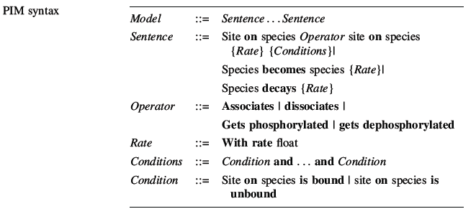
PIM bio-language

Slide 30
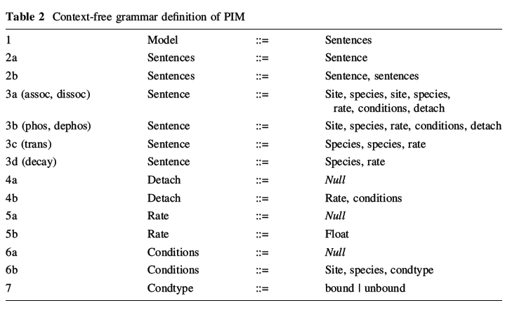
PIM CFG

Slide 31
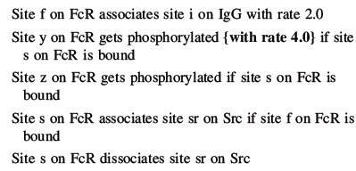
Target PIM model

Slide 32
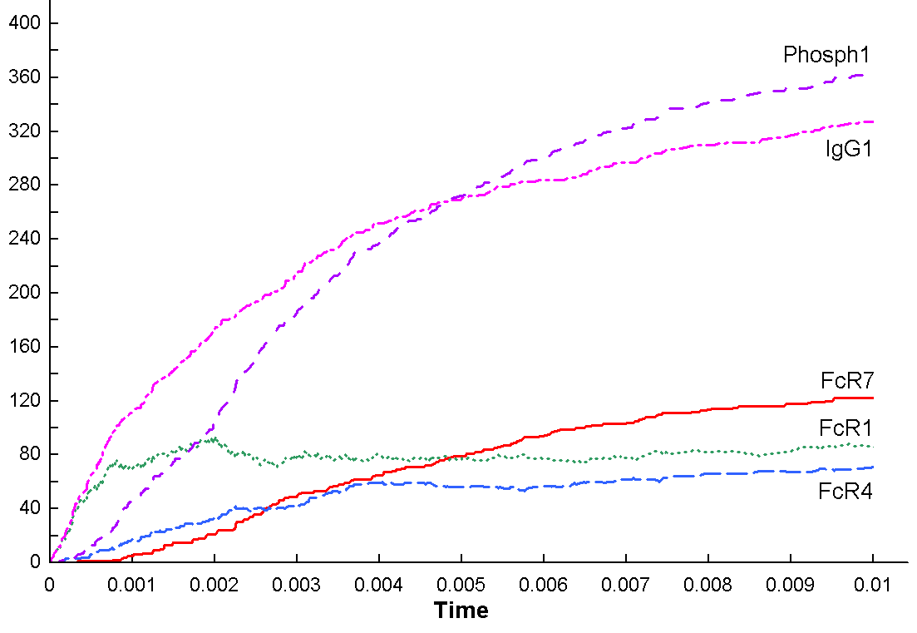
Model simulation

Slide 33
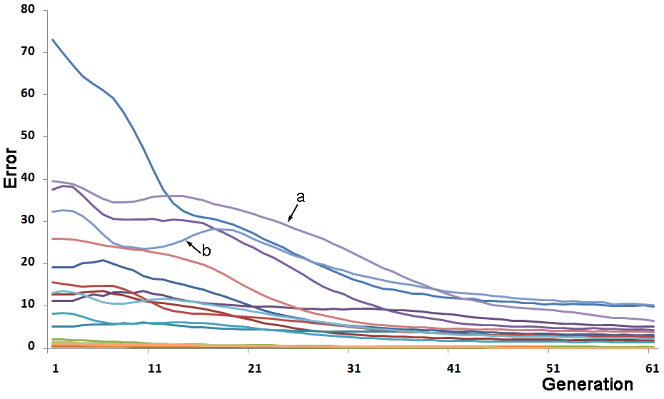
Error: GP model

Slide 34
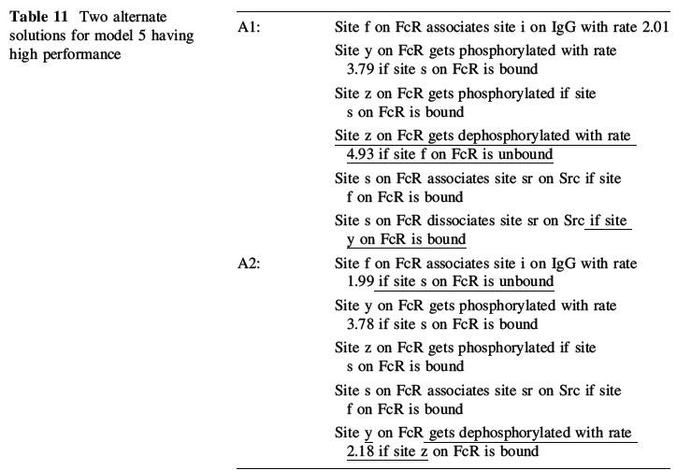
2 GP solutions

Slide 35
System details
DCTG-GP: Implemented in Sicstus Prolog
System invokes 3 external systems
1. PIM translator (external system call)
2. Simulator (external system call)
3. R (compiled into DCTG-GP as C library)
Large statistical library
Used to do statistical analysis during fitness evaluation

