Slide 1
CHAPTER 14:
Documentation and User Support (a.k.a Help)
Designing the User Interface:
Strategies for Effective Human-Computer Interaction
Sixth Edition
Ben Shneiderman, Catherine Plaisant,
Maxine S. Cohen, Steven M. Jacobs, and Niklas Elmqvist
in collaboration with
Nicholas Diakopoulos

Slide 2
Documentation and User Support (a.k.a Help)
Topics
Introduction
Shaping the Content of the Documentation
Accessing the Documentation
Reading from Displays versus Reading from Paper
Online Tutorials and Animated Demonstrations
Online Communities and Avenues for User Support
The Development Process

Slide 3
Introduction
When it comes to learning about computer systems many people experience anxiety, frustration, and disappointment
Even though increasing attention is being paid to improving interface design, complex systems can still benefit context-sensitive, online help
User’s Goal | Help
I want to buy it | Animated demonstration
I want to learn it | Manual, tutorial, guide, animated demonstration
I want to use it | Manual, help, context-sensitive help
I want to solve a problem | Help, FAQ, online community

Slide 4
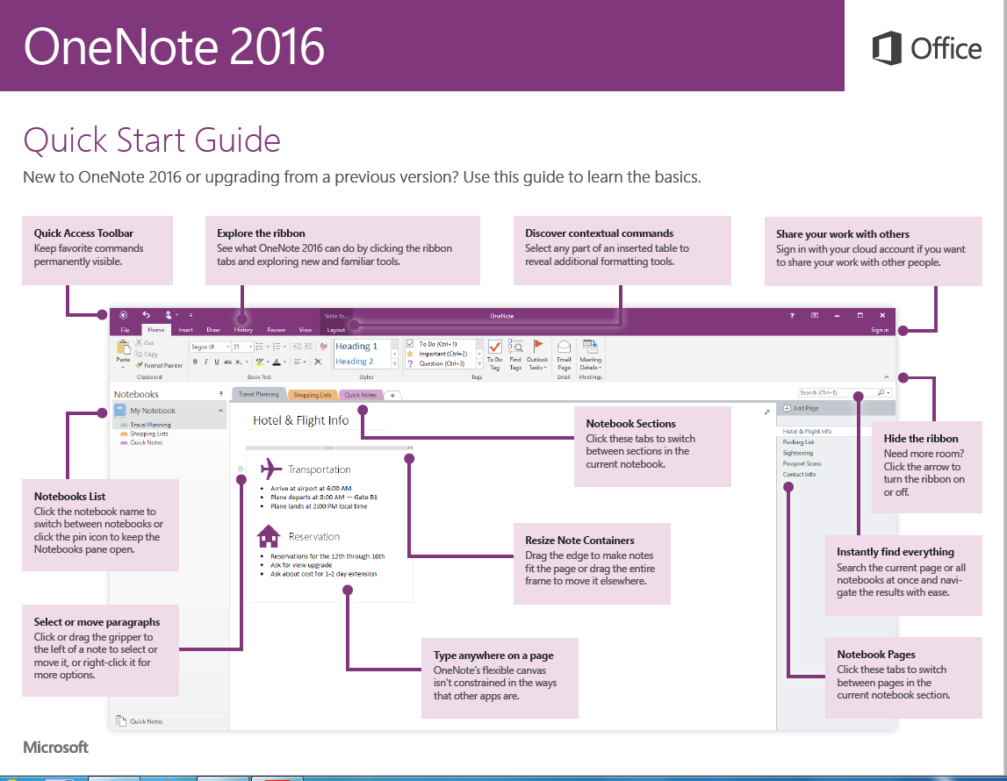
Shaping the Content of the Documentation
This particular quick start guide is for Microsoft OneNote 2016
  it points out common actions for users
  Its goal is to minimize the learning curve for users upgrading from a previous version
  The quick start guide is four pages, this is the first page
  Explanations are provided for the toolbar and the ribbon in addition to other commonly used features
Notes:
Fig. 14.1

Slide 5
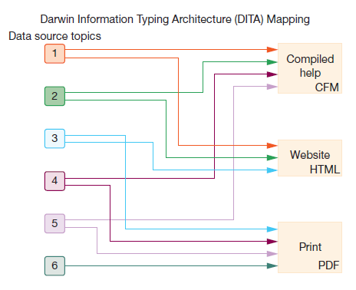
Organization and Writing Style
The documentation content is organized as single source topics created, during the authoring process, with the intention of reuse
  The various documentation end-products (compiled help, website, print) are mapped from the various combinations of the single source topics
Notes:
Fig. 14.2

Slide 6
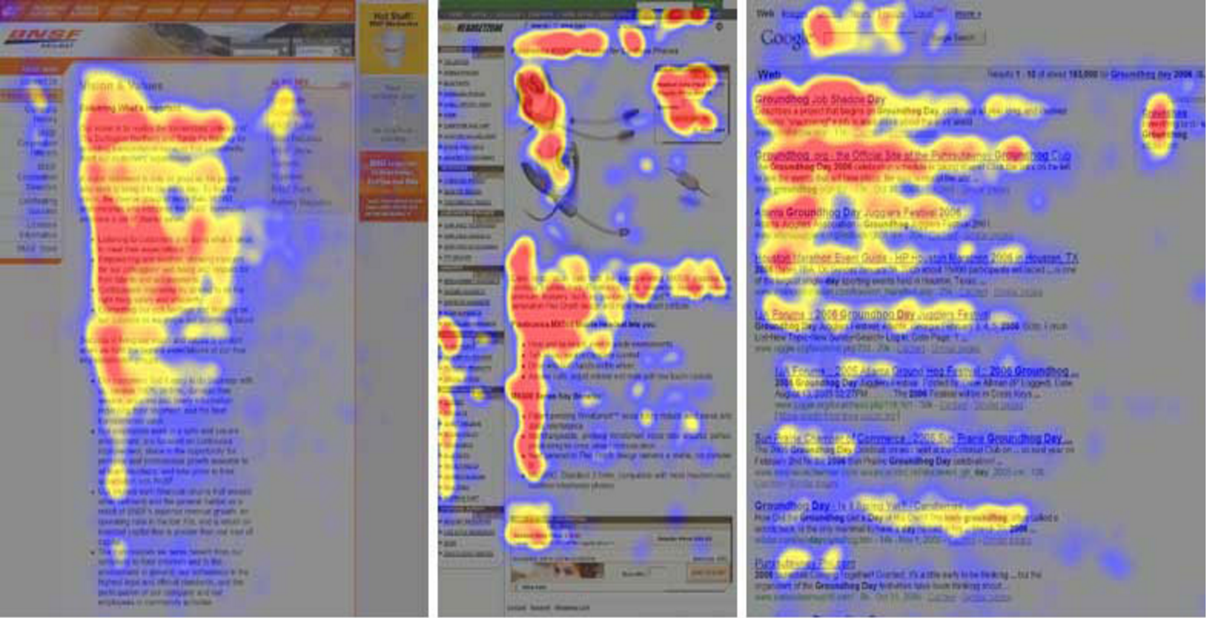
Reading from paper versus from displays
The heat maps from the eye tracking study
  Red indicates the area where the user looked most, yellow indicates fewer views, and blue indicates the fewest views
  Gray is used for areas that were not viewed
The image on the left is from an article in the “About us” section of a corporate web site, the center image is a product page on an e-commerce web site, and the image on the right is from a search engine results page
(Jakob Nielsen)
Notes:
Fig. 14.3

Slide 7
Writing for the Web
Break your text into short sections with clear headings
Start with your key message
Write short sentences and short paragraphs
Use lists and tables – tables may not work well for mobile devices
Write meaningful links (do not use: “click here”)
Illustrate your content

Slide 8
Advantages of Online Documentation
Physical advantages
  available whenever on web-connected electronic device, can’t get lost or misplaced, physical workspace not needed, can be updated rapidly
Navigation features
  can provide index and other search facilities, can link to other external materials and sources
Interactive services
  can bookmark, annotate, and tag, can include graphics, sound, color, and animation, screen readers or other tools can be provided for users with disabilities

Slide 9
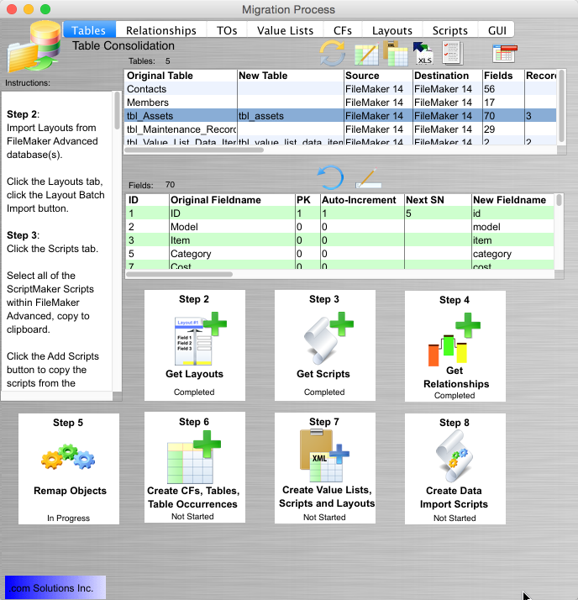
Online Help
This figure provides a step by step approach to the activities in a database migration application
  The details involved in each step can be found on the left hand side
  The actual action and activity is in the middle
  On the bottom is a road map for the steps involved the steps are marked as to their status (completed, in progress, not started)
  For novices it would be easy to insert links to more detailed tutorial-type information
www.fmpromigrator.com
Notes:
Fig. 14.4

Slide 10
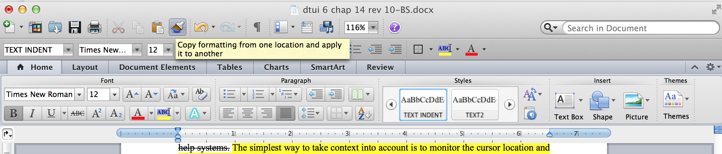
Online Help (continued)
This shows a small tool-tip or fly-over help on Microsoft Word
  Moving the mouse (cursor) over a particular icon causes an explanation of the icon to appear on the screen
Notes:
Fig. 14.5

Slide 11
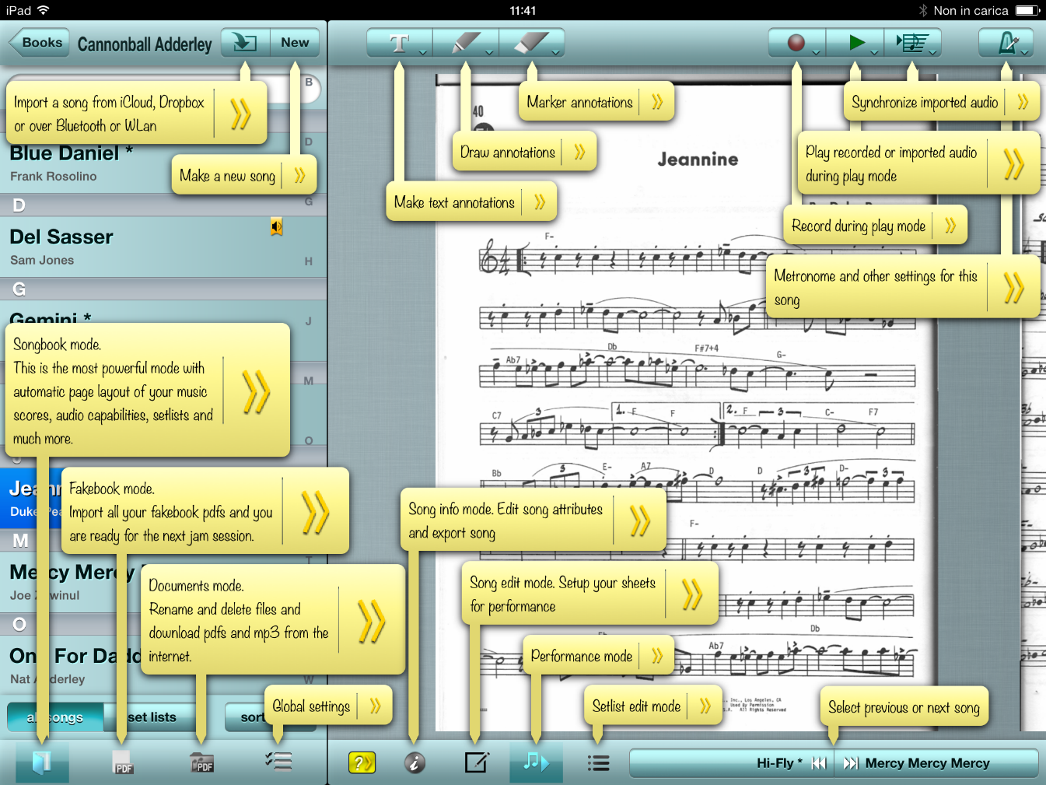
Online Help (concluded)
Since this is a complicated music interface, interactive help is provided for many of the fields
  This figure shows all the help balloons open
  Several standard icons are used such as new, import, record, play, but other specific icons explain the various modes that are available using the tool
http://www.saxopedia.com/2013/12/07/calypso-score-the-perfect-ipad-music-score-reader/
Notes:
Fig. 14.6

Slide 12
Reading from paper versus from displays
Visual fatigue and stress from reading computer displays are common problems, but these conditions respond well to rest, frequent breaks, and task diversity
Even if users are not aware of visual fatigue or stress, their capacity to work with displays may be below their capacity to work with paper documentation
Notes:
Fig. 14.7

Slide 13

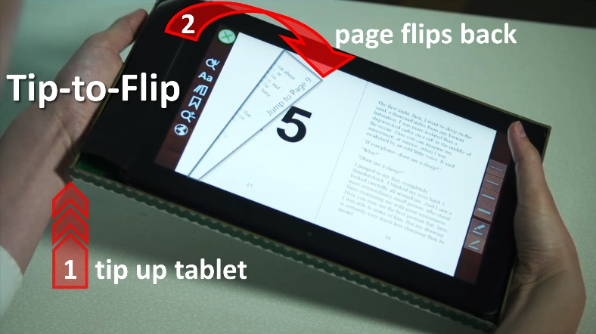
Reading from paper versus from displays (concluded)
Designers should be aware how poor information design can make reading more difficult and disrupt the process
Some guidelines for supporting reading are:
  Don’t use uncommon or unfamiliar vocabulary
  Avoid difficult to read typefaces (all caps is harder to read)
  Avoid text on busy backgrounds
  Avoid information buried in repetition
  Do not use centered text
New eBook devices will be created that support the metaphor from physical books,
allowing the user to flip the pages to scan the contents of the book.
Notes:
Fig. 14.10 and 14.11

Slide 14
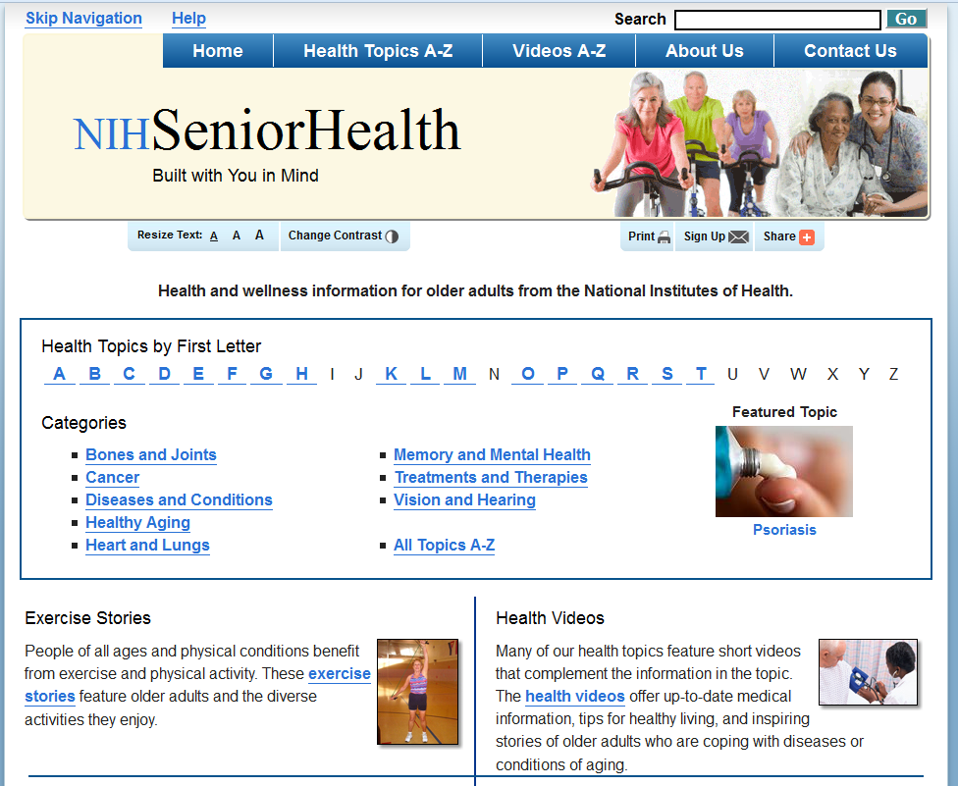
Online manuals and help (example)
The National Institute for Health’s site for seniors (http://www.nihseniorhealth.gov)
has controls to adjust the text size, adjust the contrast, and turn speech on or off.
The font used is a sans-serif font, and the font size is larger than the typical size used on the Web. Several ways are provided to navigate through the information (alphabetical, grouping by category, etc.).
Notes:
Fig. 14.9

Slide 15
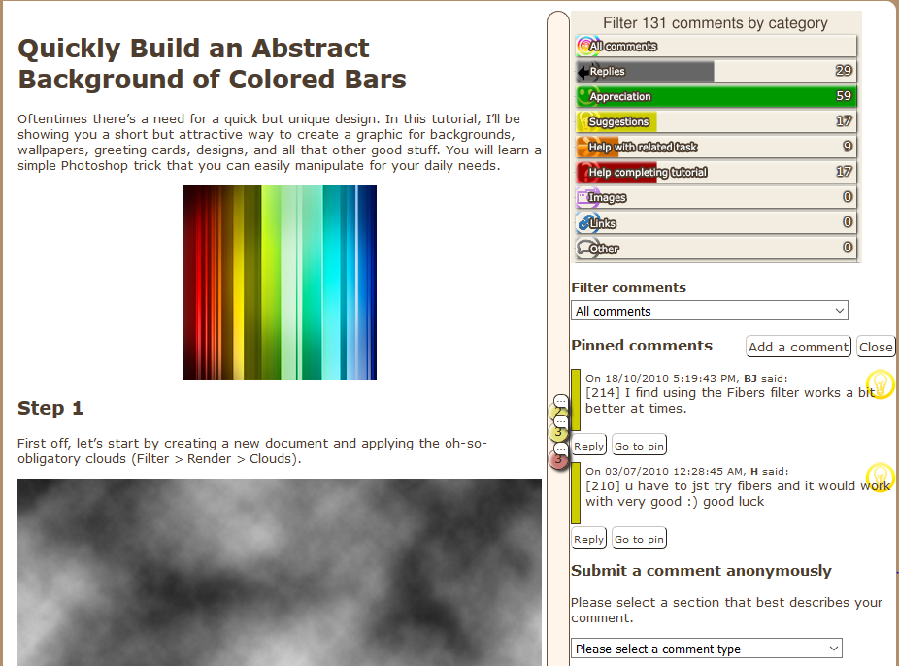
How highlighting, fonts etc. help the user
This is a specialized interface called Tagged Comments
  The comments section can be found in the lower right corner
  Comments can be read and briefly scanned by looking at the included icons (smiley faces)
  In the upper right corner, the user can filter the comments by category
  The tutorial content is seen on the left
  Another window that does not show in this figure would allow a user to submit a comment
Notes:
Fig. 14.12

Slide 16
Development process guidelines
Seek professional content writers and copywriters
Prepare user documentation early (before implementation)
  May act as an alternative to the formal s/w specification.
Set up guideline documents and coordinate and integrate across all involved departments
Review drafts thoroughly
Field-test early editions
Provide feedback mechanisms for readers
Revise to reflect changes regularly

