Slide 1
A+ Guide to Hardware: Managing, Maintaining, and Troubleshooting, Sixth Edition
Chapter 6
Supporting I/O and Storage Devices

Slide 2
Objectives
Learn about the general approaches you need to take when installing and supporting I/O and mass storage devices
Learn how to install and configure several I/O devices, such as barcode readers, biometric devices, digital cameras, webcams, graphic tablets, and touch screens
Learn how to install and configure adapter cards

Slide 3
Objectives
Learn about supporting the video subsystem, including selecting a monitor and video card and supporting dual monitors and video memory
Learn how to support optical drives and flash memory devices

Slide 4
Basic Principles For Supporting Devices
I/O devices may be internal or external
Fundamental principles and concepts:
Every device is controlled by software
Best guide for installation and support: manufacturer
Some devices need application software
A device is no faster than the port/slot it is designed for
Use an administrator account in Windows
Problems are sometimes solved by updating drivers or firmware
Install only one device at a time

Slide 5
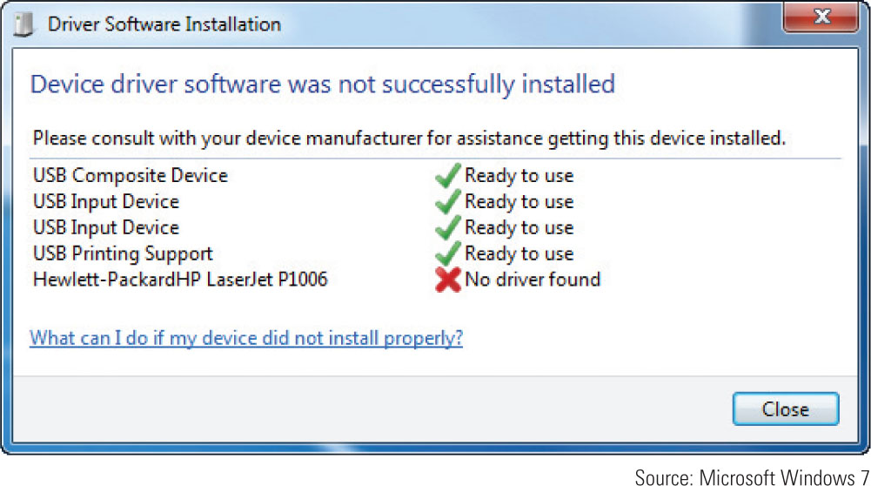
Using the Action Center and Device Manager
Windows 7
Automatically launches Action Center if a problem occurs
Figure 6-1 Windows 7 reports a problem with a driver for a USB printer

Slide 6
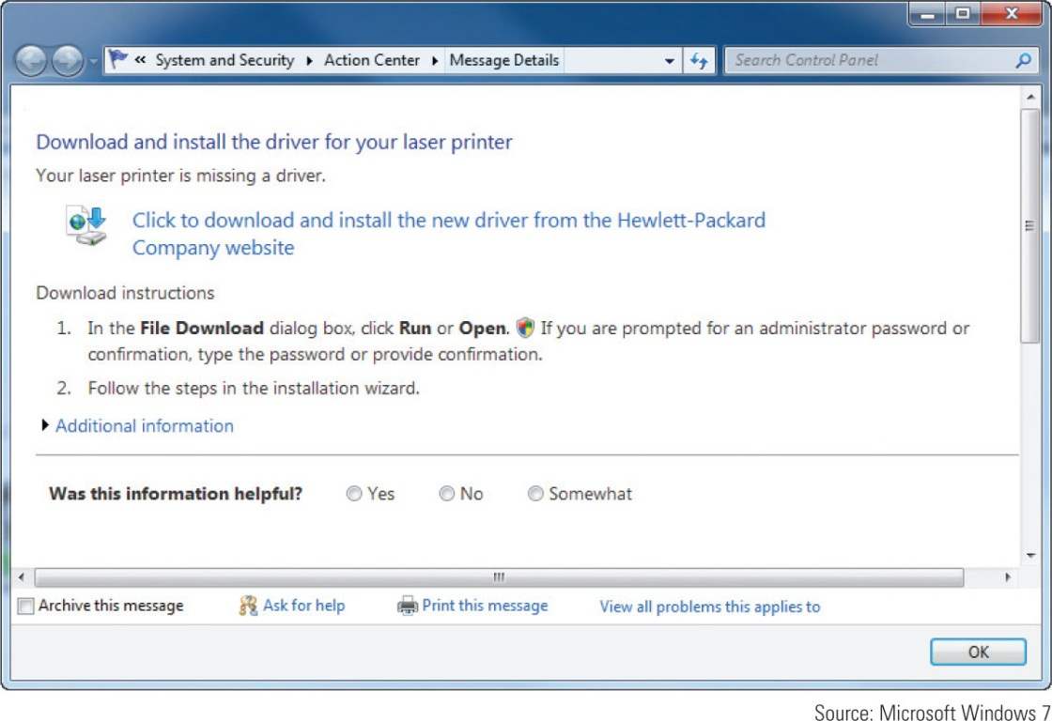
Using the Action Center and Device Manager
If the problem is not resolved after following solutions from Action Center, try Device Manager
Figure 6-2 Windows offers to find the missing USB printer driver

Slide 7
Using the Action Center and Device Manager
Device Manager (devmgmt.msc)
Primary Windows tool for managing hardware
Using Device Manager you can:
Disable or enable a device
Update its drivers
Uninstall a device
Undo a driver update
To access Device Manger:
Click Start, right-click Computer, select Properties on the shortcut menu, Click Device Manager on the System window and respond to UAC box

Slide 8
Using the Action Center and Device Manager
Ways to use Device Manager to solve problems:
Look for error messages offered by Device Manager
Update the drivers or roll back (undo) a driver update
Try uninstalling and reinstalling the device
If Windows is not able to locate new drivers for a device
Download latest driver file from manufacturer’s site
Use 64-bit drivers for 64-bit OS and 32-bit drivers for 32-bit OS
A few devices have firmware on the device that can be flashed

Slide 9
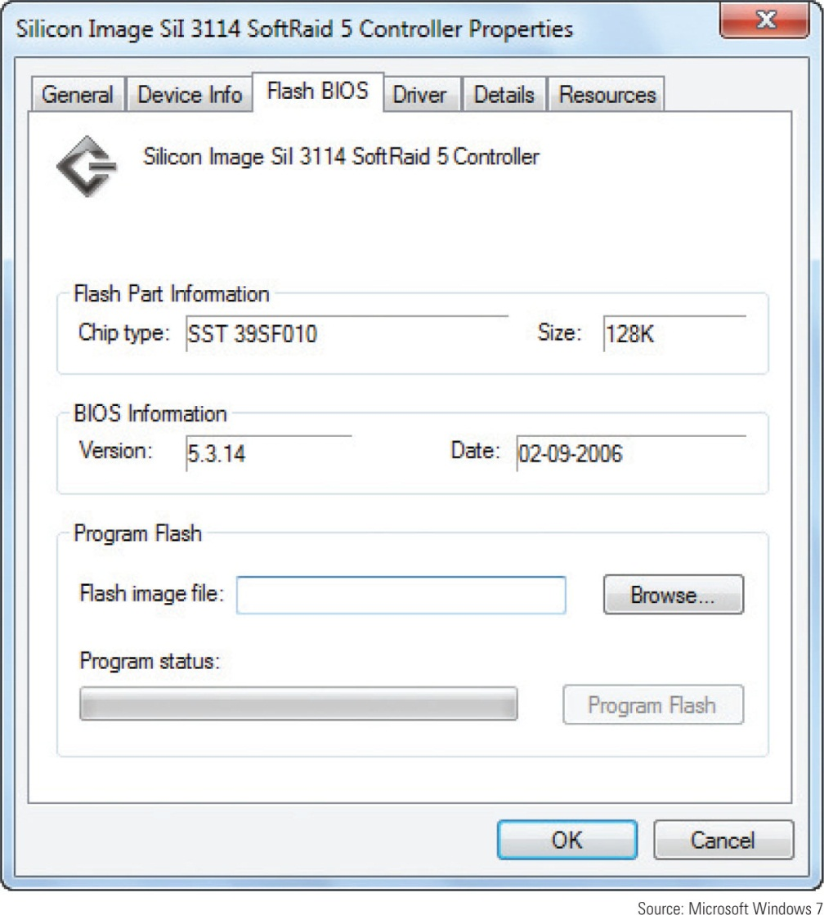
Figure 6-7 Use the device’s properties box to flash the
firmware on some devices

Slide 10
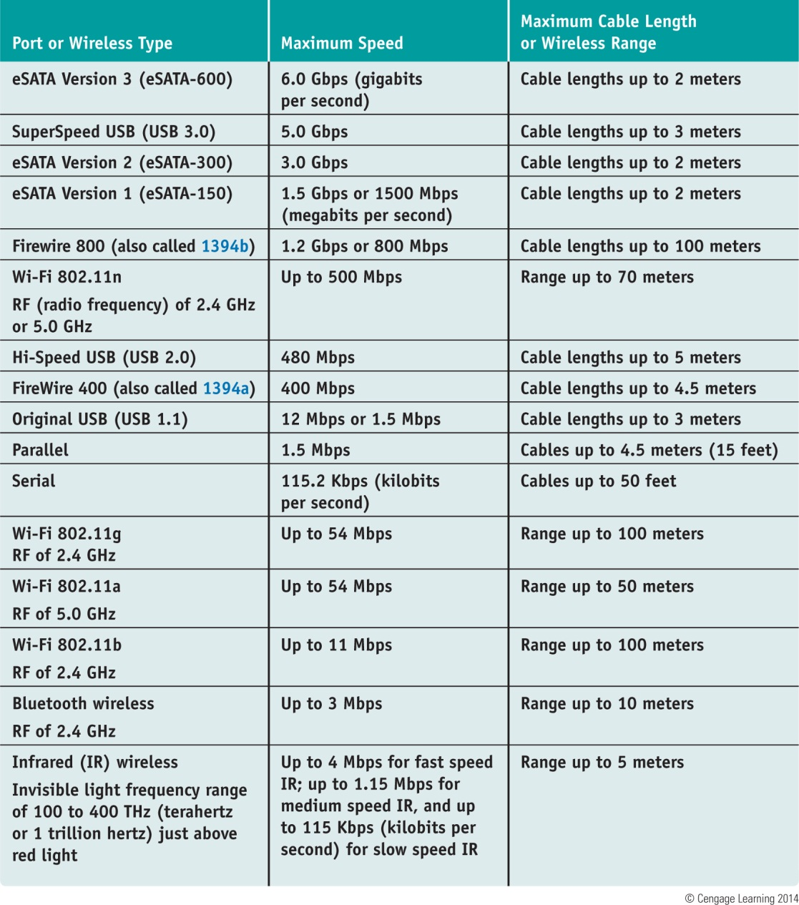
Table 6-1 Data transmission speeds for various port types and wireless connections

Slide 11
Ports and Wireless Connections Used by Peripheral Devices
USB Connections:
The USB Implementers Forum, Inc. uses the following symbols
Figure 6-9 SuperSpeed, Hi-Speed, and Original USB logos appear on
products certified by the USB forum

Slide 12
Ports and Wireless Connections Used by Peripheral Devices
USB Connections (cont’d):
As many as 127 USB devices can be daisy chained together
USB uses serial transmissions and devices are hot-swappable (plug and unplug without powering down)
A USB cable has four wires, two for power and two for communication
Table 6-2 USB connectors

Slide 13
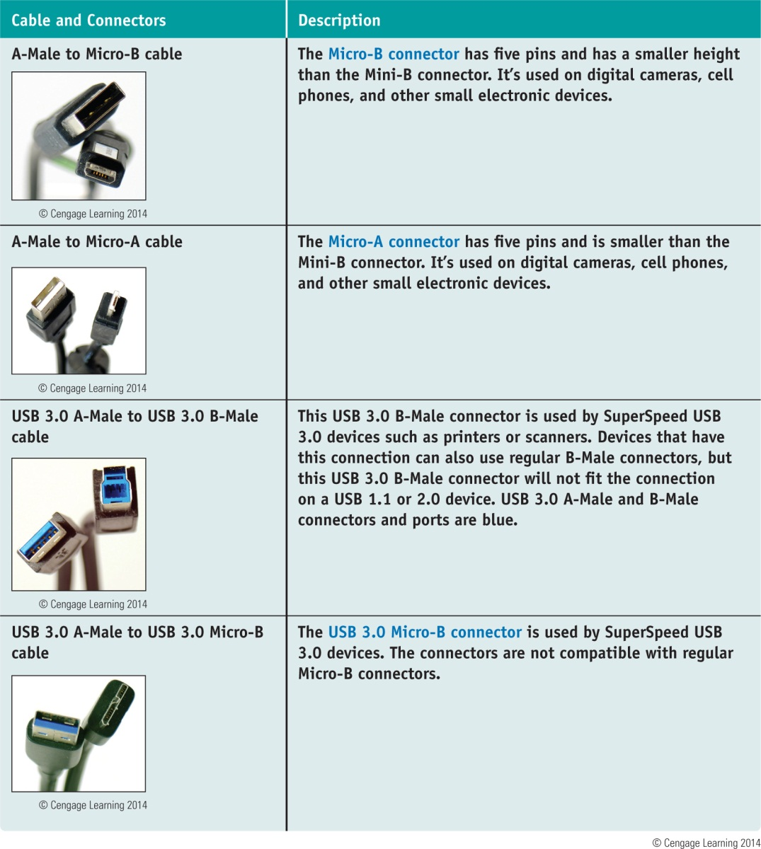
Table 6-2 USB connectors (continued)

Slide 14
Ports and Wireless Connections Used by Peripheral Devices
FireWire (IEEE 1394) Connections
Hardly used in new devices
Uses serial transmissions and devices are hot-swappable
FireWire 800 allows for up to 63 devices and FireWire 400 allows for up to 16 devices to be daisy chained together
FireWire 400 supports two connector types
FireWire 800 uses a 9-pin rectangular connector

Slide 15
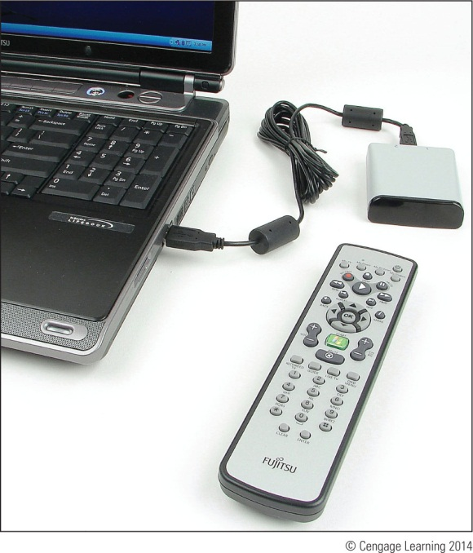
Ports and Wireless Connections Used by Peripheral Devices
Infrared (IR) Connections
Outdated wireless technology mostly replaced by Bluetooth
Referred to as a piconet, based on Master Slave.
Most common use of IR is by remote controls
Figure 6-12 This remote control
Is an infrared device that uses an
IR transceiver connected to a
Notebook by way of USB port

Slide 16
Installing I/O Peripheral Devices
Simple input devices (mouse and keyboard)
Can be controlled by the BIOS or have embedded drivers built into the OS
General procedures to install any peripheral device:
1. Read the manufacturer’s directions
2. Make sure the drivers are written for the proper OS
3. Make sure the motherboard port you are using is enabled
4. Install drivers or plug in the device
5. Install the application software to use the device

Slide 17
Installing I/O Peripheral Devices
Mouse or Keyboard
Plug into a USB or older PS/2 port and OS should automatically recognize it and install generic drivers
For keyboards with special features:
Install drivers that came with the keyboard
Use Device Manager to uninstall, disable, or enable most devices
USB devices are managed through Control Panel

Slide 18
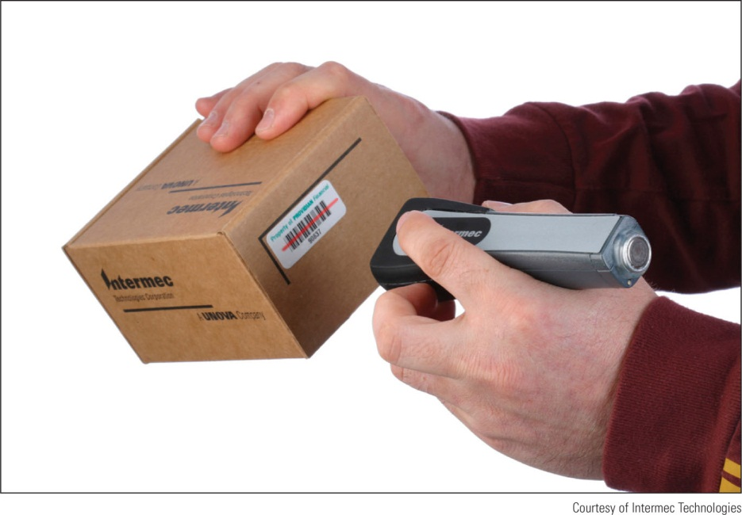
Installing I/O Peripheral Devices
Barcode Readers
Scans barcodes on products
Used to maintain inventory or at point of sale (POS)
Several interface methods
Wireless connection, serial port, USB port, keyboard port
Figure 6-17 Handheld or hands-free
Barcode scanner by Intermec
Technologies

Slide 19
Installing I/O Peripheral Devices
Biometric Devices - inputs a person’s biological data
Additional authentication to control access to sensitive data
Fingerprint reader types may:
Look like a mouse
Use wireless or USB connection
Be embedded on side of keyboard, flash drive or laptop
Read documentation to know if you should install drivers before plugging in device

Slide 20
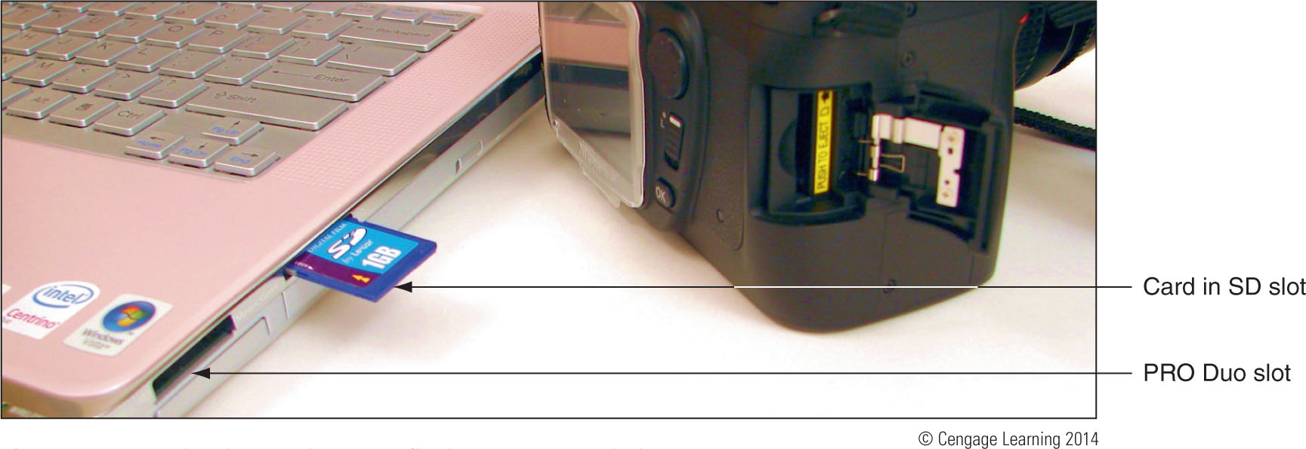
Installing I/O Peripheral Devices
Digital Cameras and Camcorders
Two ways to transfer images to PC
Connect camera to the PC using a cable
Install the memory card in the PC
Figure 6-19 This laptop has two flash memory card slots

Slide 21
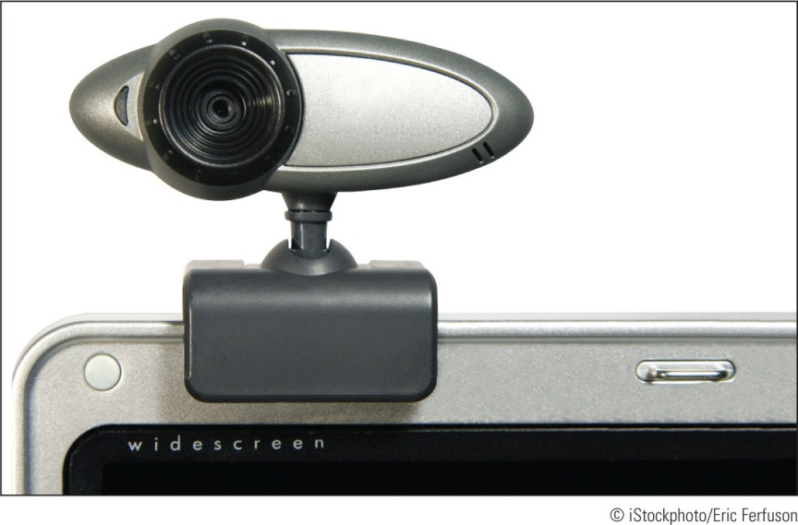
Installing I/O Peripheral Devices
Webcams
Embedded on most laptops
Can be installed using a USB port or other port
Comes with built-in microphone
Figure 6-22 This personal web camera
Clips to the top of your notebook and
Has a built-in microphone

Slide 22
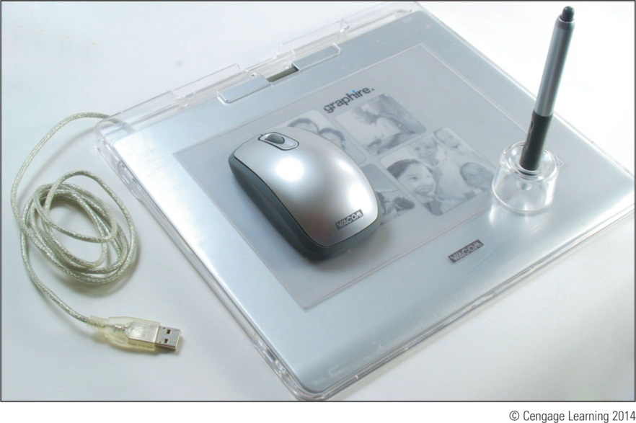
Installing I/O Peripheral Devices
Graphics Tablets (also called digitizing tablet)
Likely to connect by a USB port
Comes with stylus that works like a pencil
Install the same way as other USB devices
Figure 6-24 A graphics tablet and
Stylus are used to digitize a hand
drawing

Slide 23
Installing I/O Peripheral Devices
MIDI Devices
MIDI (Musical instrument digital interface) – set of standards used to represent music in digital form
MIDI standards are used to connect musical equipment such as musical keyboards and mixers
Most sound cards can play MIDI files
MIDI port is a 5-pin DIN port that looks like PS/2 keyboard port (only larger)

Slide 24
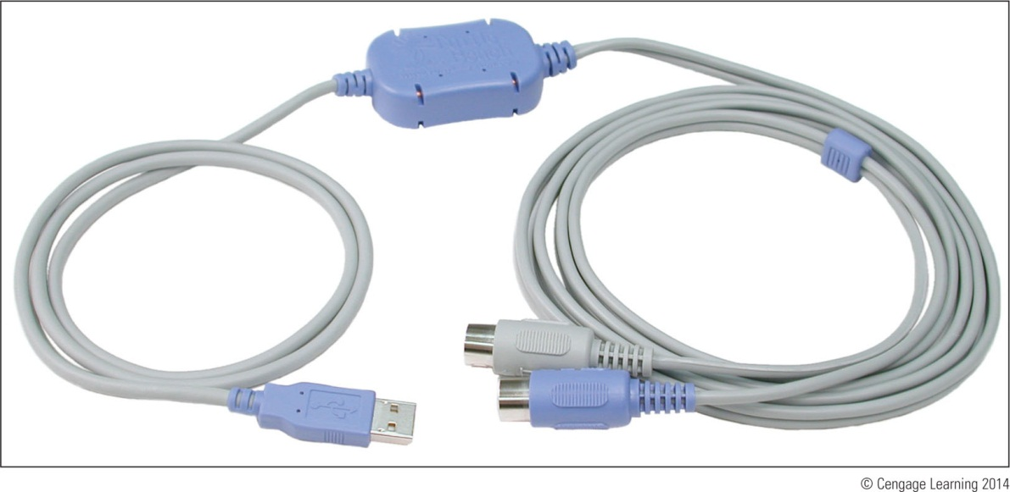
Installing I/O Peripheral Devices
MIDI Devices (cont’d)
Way to connect a musical instrument to PC
MIDI to MIDI, MIDI to USB, USB to USB, and USB to MIDI
Figure 6-26 MIDI-to-USB
cable lets you connect an
electronic musical instrument
to your computer

Slide 25
Installing I/O Peripheral Devices
Touch Screens
Input device that uses a monitor or LCD panel as the backdrop for input options
Some laptops and monitors for desktops have built-in touch screens
Can be installed as an add-on
For most installations, install drivers before connecting by way of a USB port
Use management software that came with the device to control and calibrate

Slide 26
Installing I/O Peripheral Devices
KVM Switches
Keyboard, Video, and Mouse (KVM) switch allows the use of one keyboard, mouse, and monitor for multiple computers
Useful in a server room or testing lab
Does not require device drivers, just plug in cables form each computer to the device
Switch between computers by using a hot key on the keyboard, buttons on KVM switch, or a wired remote

Slide 27
Installing and Configuring Adapter Cards
When preparing to install a adapter card:
Verify card fits an empty expansion slot
Verify device drivers for the OS are available
Back up important data not already backed up
Know your starting point

Slide 28
Installing and Configuring Adapter Cards
General directions to install an adapter card
Read the documentation
If replacing an onboard port, disable port in BIOS setup
Wear ground bracelet, shut down system, unplug power cords and cables, and drain power
Locate slot and prepare for installation
Insert card into expansion slot
Anchor card to top of the slot with screws
Connect any power cords or data cables

Slide 29
Installing and Configuring Adapter Cards
General directions to install an adapter card (cont’d)
Replace the case cover, plug in any essential peripherals
Start the system – Windows should detect a new hardware device and attempt to automatically install the drivers
If a CD came with device, insert and run the setup program
May have to restart the system
If any problems with installation, turn to Device Manager to troubleshoot

Slide 30
Installing and Configuring Adapter Cards
Possible problems and solutions
Whining sound at power up: inadequate power supply
Black screen at power up: disable onboard port
Series of beeps at power up: reseat card and check slot
Error messages about video when Windows starts: conflict in onboard video and video card
Games crash or lock up: update motherboard, video card, sound card drivers, update DirectX, and apply game patches

Slide 31
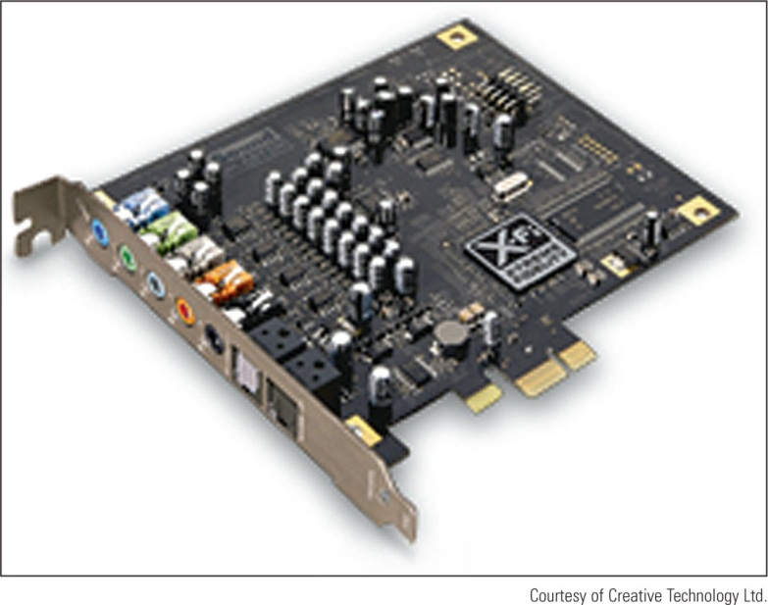
Installing and Configuring Adapter Cards
Sound Cards and Onboard Sound
Can play and record sound and save it in a file
Speaker ports are color-coded
Figure 6-36 Sound Blaster X-Fi
Titanium sound card by Creative
Uses a PCIe x1 slot

Slide 32
Installing and Configuring Adapter Cards
TV Tuner and Video Capture Cards
TV tuner card can turn a PC into a television
Video capture card enables capturing video input and saving it to a file
Some cards are a combination of the two cards above
When installing you will most likely:
Install the drivers, install the card, and then install the application software that comes bundled with card

Slide 33
Supporting the Video Subsystem
Monitor: primary output device of a computer
Two necessary components for video output:
Monitor
Video card (also called video adapter or graphics card) or video port on motherboard

Slide 34
Monitor Technologies and Features
Types of monitors
CRT (cathode-ray tube) – first used in television sets
Largely obsolete
LCD (liquid crystal display) - also called flat panel
First used in laptops
Two grids of electrodes surround center layers
Make up an electrode matrix of rows and columns
Each intersection of row and column forms a pixel
Software manipulates each pixel via electrodes
Image is formed by scanning columns and rows
LED (light-emitting diode) backlighting is used to light the LCD panel

Slide 35
Figure 6-40 Layers of an LCD panel

Slide 36
Monitor Technologies and Features
Types of monitors (cont’d)
Plasma monitor – provides high contrast with better color than LCD monitors
Expensive and heavy
Projector – used to shine a light that projects a transparent image onto a large screen
OLED (organic light-emitting Diode) monitor uses a thin LED layer or film between two grids of electrodes
Does not use backlighting

Slide 37
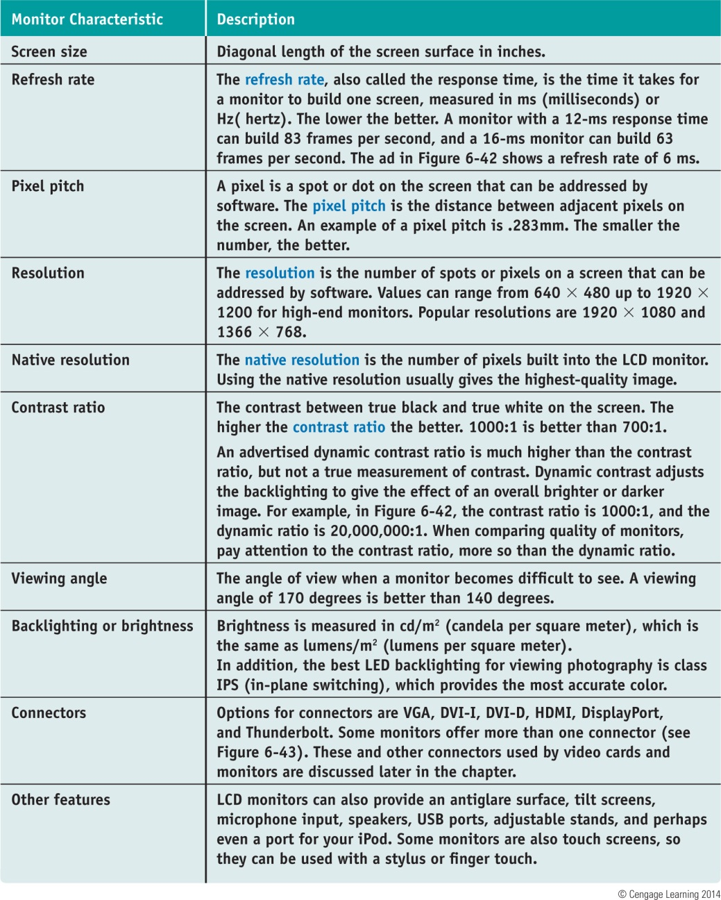
Table 6-3 Important features of a monitor

Slide 38
Video Cards and Connectors
Video cards
Graphic adapters, graphics cards, display cards
Most motherboards have integrated video controller
Can use AGP, PCI, PCI Express motherboard slot
Ports provided by video cards
VGA: red, green, blue video using VGA port (DB-15)
DVI (Digital Visual Interface) - variations of DVI:
DVI-D – only transmits digital data
DVI-I – supports analog and digital signals
DVI-A – only transmits analog data
Single Link or Dual Link – Dual link doubles the power of the signal and can support higher screen resolutions
Most DVD-D and DVI-I ports are dual link

Slide 39
Video Cards and Connectors
Ports provided by video cards (cont’d):
Composite video: also called RGB port
Red, green, and blue are mixed together in the same signal
Does not produce as sharp an image as VGA or S-Video
S-Video (Super-Video): used by some TVs and video equipment
Connector is called a MiniDin-6 and looks like PS/2
Component video: has been split into different components and carried as separate signals

Slide 40
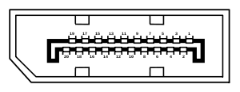
Video Cards and Connectors
Ports provided by video cards (cont’d):
Display Port: designed to replace DVI
Can transmit digital, audio data, and usb
Uses data packet transmissions similar to Ethernet, USB, and PCI Express
Expected to replace VGA, DVI, and HDMI on desktop and laptop computers
HDMI: transmits both digital video and audio
Allows for several types of HDMI connectors (best known is Type A 19-pin)
Only works on DVI-D ports (does not transmit analog)

Slide 41
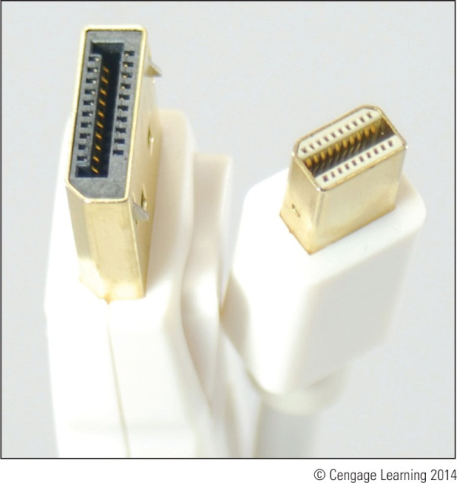
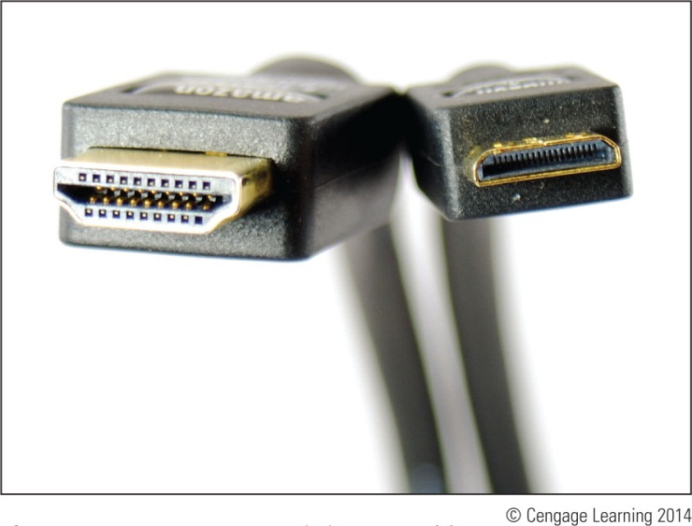
Figure 6-52 DisplayPort to
Mini DisplayPort cable
Figure 6-53 HDMI to miniHDMI cable

Slide 42
Changing Monitor Settings
Monitor buttons
Can adjust horizontal and vertical position of the screen
Can change the brightness and contrast settings
On laptops, function keys are usually used instead of buttons
Windows utilities can also be used to change monitor settings

Slide 43
Video Memory and Windows 7/Vista
Graphics processing unit (GPU) – also called visual processing unit (VPU)
Uses graphics RAM installed on the card
Most video cards use:
DDR2, DDR3, Graphics DDR3 (GDDR3), GDDR4, GDDR5 memory
Some video cards have as much as 2 GB of graphics memory

Slide 44
Video Memory and Windows 7/Vista
Windows7/Vista Aero requirements
128 MB video memory, DirectX 9 or higher, Windows Display Driver Model (WDDM)
DirectX – developmental tool developers can use to write multimedia applications
DirectX diagnostics program: dxdiag.exe
Displays information about hardware
Helps diagnose problems with DirectX
Graphics memory can be embedded on video card, system memory, or a combination of both
Use Advanced settings under Adjust Screen Resolution to see available video memory

Slide 45
Supporting Storage Devices
Storage devices to support might include:
Optical discs
USB flash drives
Memory cards

Slide 46
File System Used by Storage Devices
File system – used to manage data stored on a device
Overall structure the OS uses to name, store, and organize files on a drive
In Windows, each storage device is assigned a driver letter
Formatting – installing a new file system on a device
Types of file systems:
NTFS, exFAT, FAT32 and FAT

Slide 47
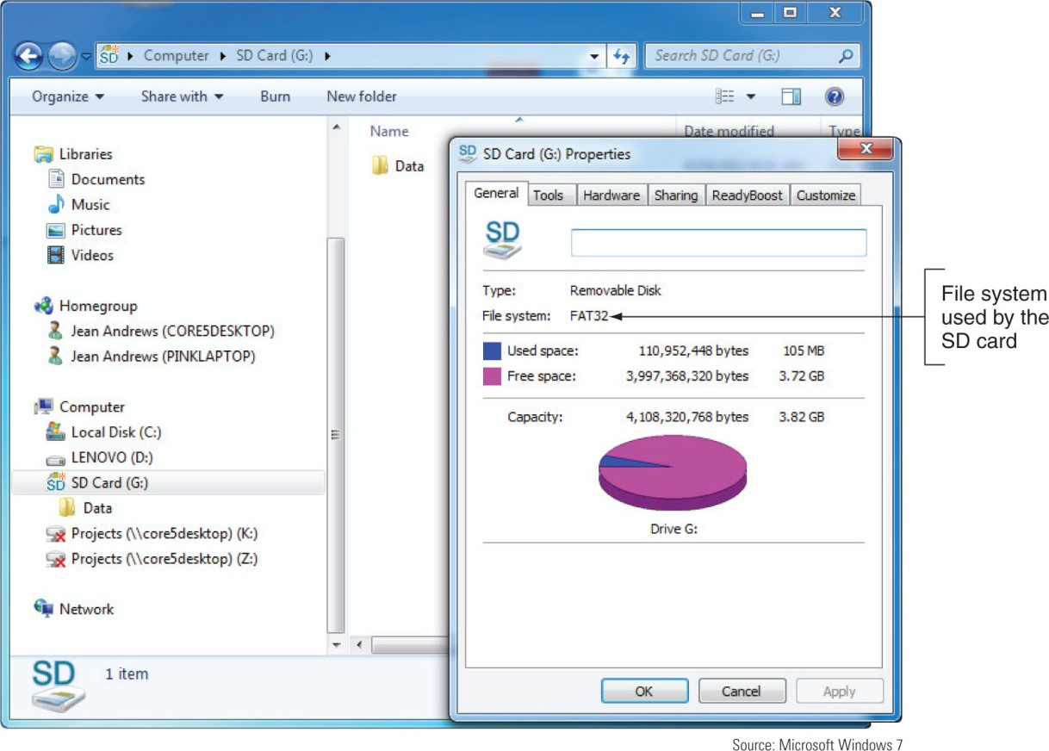
Figure 6-59 This 4 GB SD card is using the FAT32
file system

Slide 48
Standards Used by Optical Drives
CDs, DVDs, and Blu-ray discs (BD) use similar laser technologies
Tiny lands and pits on surface represent bits read by a laser beam
CD drives use CDFS (Compact Disc File System)
DVD and Blue-ray drives use UDF (Universal Disk Format) file system
Internal optical drive interfaces with motherboard via an IDE or SATA connection
External might use eSATA, FireWire, or USB

Slide 49
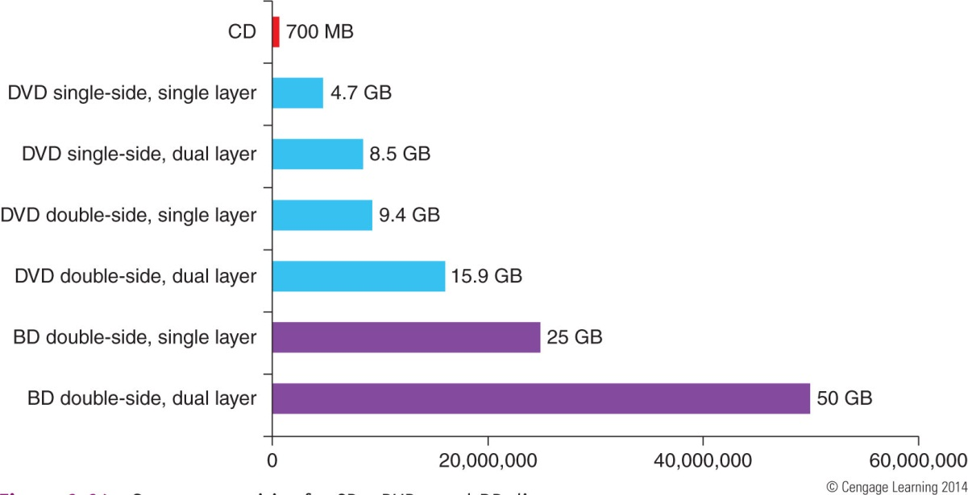
Standards Used by Optical Drives
Data can be written to:
One side of a CD
One or both sides of a DVD or Blu-ray disc
DVD or Blu-ray disc can hold in two layers on each side
Figure 6-64 Storage
Capacities for CDs, DVDs,
And BD discs

Slide 50
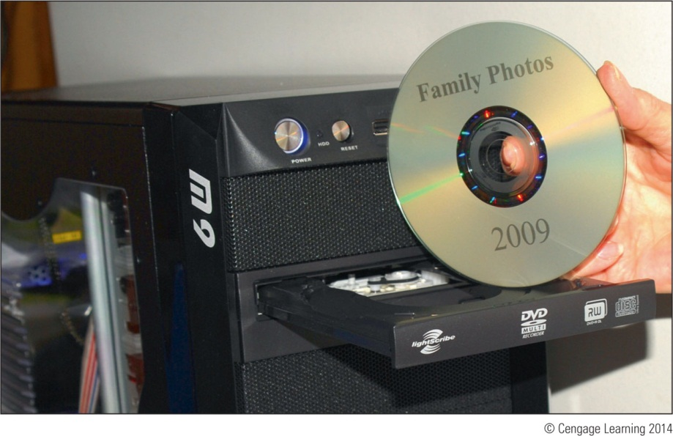
Standards Used by Optical Drives
Feature to look for in an optical drive:
Ability to burn labels on the top of a disc
Two technologies are Labelflash and LightScribe
Both the drive and disc must support the technology
Figure 6-66 This disc label was
written using a DVD burner that
supports LightScribe

Slide 51
Installing An Optical Drive
Internal optical drives use a SATA, IDE, or SCSI interface
An optical drive that shares a cable with a hard drive can slow down the hard drive’s performance
If hard drive and optical drive must share a cable, make the hard drive the master
On motherboards that have one SATA connection and one IDE connection, use SATA connections for all hard drives
Optical drives are usually installed in top bay of case

Slide 52
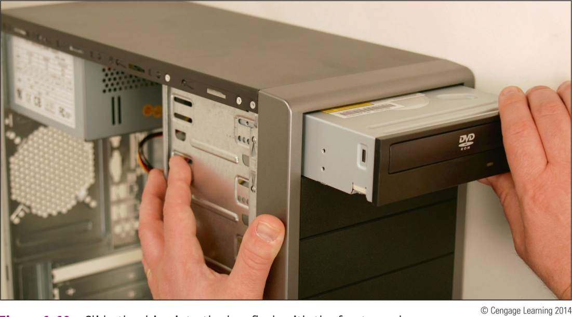
Installing An Optical Drive
Windows 7/Vista/XP supports optical drives using its own embedded drivers
Windows should recognize drive after Found New Hardware Wizard completes
Figure 6-69 Slide the drive into
the bay flush with the front
panel

Slide 53
Solid-State Storage
Solid-state storage:
SSD hard drives, USB flash drives, and memory cards
USB flash drives go by many names:
Flash pen drive, jump drive, thumb drive, and key drive
Use FAT or exFAT file system
Windows 7/Vista/XP has embedded drivers to support flash drives

Slide 54
Solid-State Storage
Memory cards might be used in:
Digital cameras, tablets, cell phones, MP3 players, digital camcorders, etc…
SD (Secure Digital) Association is responsible for standards:
1.x (regular SD)
2.x (SD High Capacity or SDHC)
3.x (SD eXtended Capacity or SDXC)

Slide 55
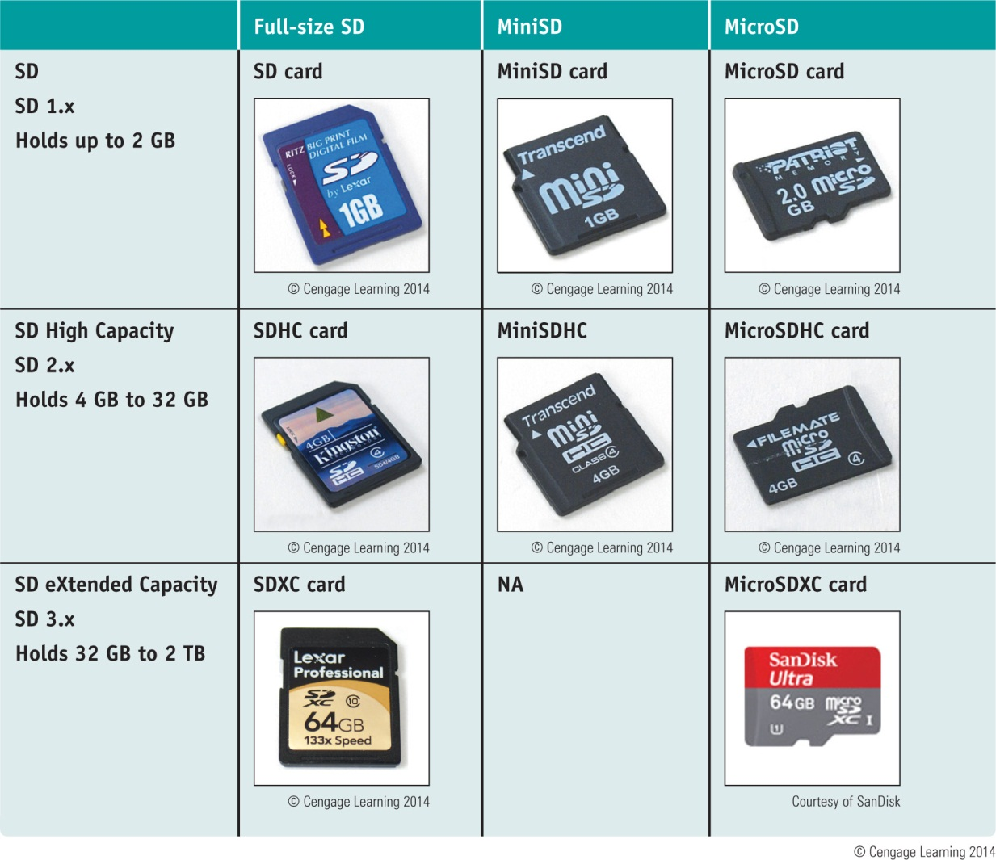
Table 6-5 Flash memory cards that follow the SD Association standards

Slide 56
Solid-State Storage
SDHC and SDXC slots are backward compatible with SD cards
Cannot use:
SDHC card in an SD slot
SDXC card in an SDHC or SD slot
SD and SDHC cards use FAT file system
SDXC cards use exFAT file system

Slide 57
Table 6-6 Flash memory cards

Slide 58
Summary
Adding new devices to a computer require installing hardware and software
Use Device Manager to manage and troubleshoot hardware
Popular I/O ports on a motherboard include eSATA, FireWire, and USB
Wireless connections can use Wi-Fi 802.11a/b/g/n, Bluetooth, and Infrared standards
USB connectors include A-Male, B-Male, Mini-B, Micro-B, Micro-A, USB 3.0 B-Male, USB 3.0 Micro-B

Slide 59
Summary
When installing devices, use 32-bit drivers for a 32-bit OS and 64-bit drivers for a 64-bit OS
Biometric input devices collect biological data in order to authenticate access to a system
Generally, Windows detects new adapter cards and installs appropriate drivers
Types of monitors include CRT, LCD, plasma, projector, and OLED monitor
Video ports might be VGA, DVI-I, DVI-D, DVI-A, composite video, S-Video, component video, DisplayPort, HDMI, and HDMI mini ports

Slide 60
Summary
File systems a storage device might use in Windows include NTFS, exFAT, and FAT
Optical discs can be recordable (CD-R) or rewritable (DVD-RW)
Types of flash memory standards include SD, MiniSD, MicroSD, SDHC, MiniSDHC, MicroSDHC, SDXC, MicroSDXC
Other memory cards include Memory Stick PRO Duo, Memory Stick PRO, Memory Stick Micro M2, CompactFlash I and II, and xD-Picture Card

