Slide 1

A+ Guide to Hardware:
Managing, Maintaining, and Troubleshooting, Sixth Edition
Chapter 5
Supporting Hard Drives

Slide 2
Objectives
Learn about the technologies used inside a hard drive and how a computer communicates with a hard drive
Learn how to select and install a hard drive
Learn about tape drives and floppy drives

Slide 3
Hard Drive Technologies and Interface Standards
Hard disk drive (HDD) or hard drive sizes
  2.5" size for laptop computers
  3.5" size for desktops
  1.8" size for low-end laptops, other equipment

Slide 4
Technologies Used Inside a Hard Drive
Solid state drive (SSD) or solid state device (SSD)
  No moving parts
  Built using nonvolatile flash memory stored on EEPROM (Electronically Erasable Programmable Read Only Memory) chips
  Memory in an SSD is called NAND flash memory
  Lifespan is based on the number of write operations to the drive
  Expensive technology, but faster, more reliable, last longer, and use less power than magnetic drives

Slide 5
Technologies Used Inside a Hard Drive
Magnetic hard drive
  One, two, or more platters, or disks
    Stacked together, spinning in unison inside a sealed metal housing
  Firmware controls data reading, writing and motherboard communication
  Read/write heads are controlled by an actuator
  Data is organized in concentric circles, called tracks
    Tracks are divided into segments called sectors
  Most current drives use 4096-byte sectors
Hybrid hard drives use both technologies
  Operating system must support it

Slide 6
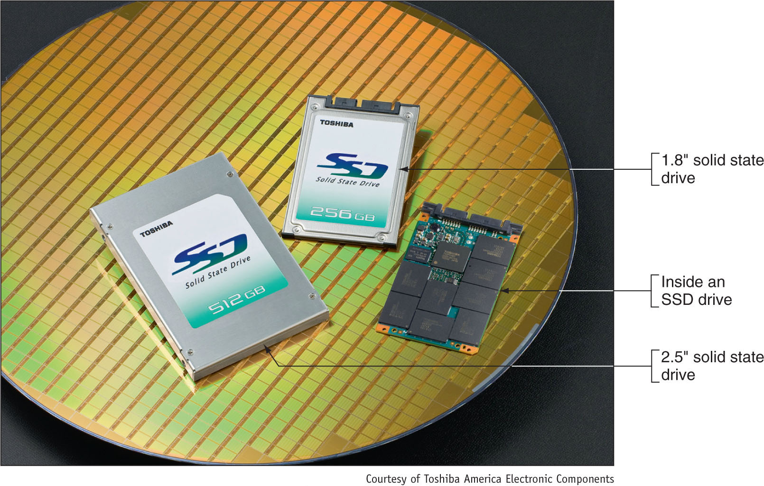
Figure 5-2 Solid-state drives by Toshiba

Slide 7
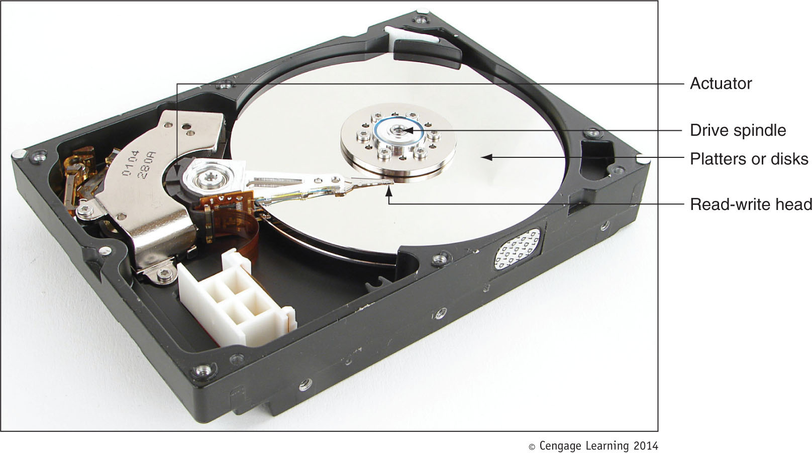
Figure 5-3 Inside a magnetic hard drive

Slide 8
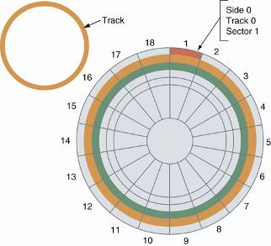
Figure 8-4 3 1 -inch, high-density floppy disk showing tracks and sectors

Slide 9
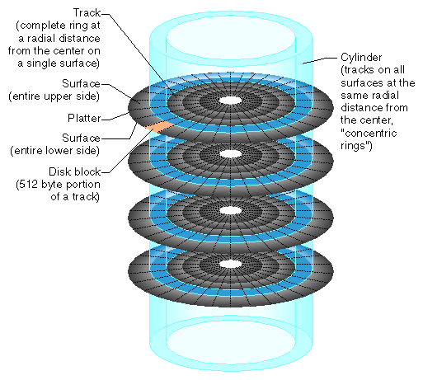

Slide 10
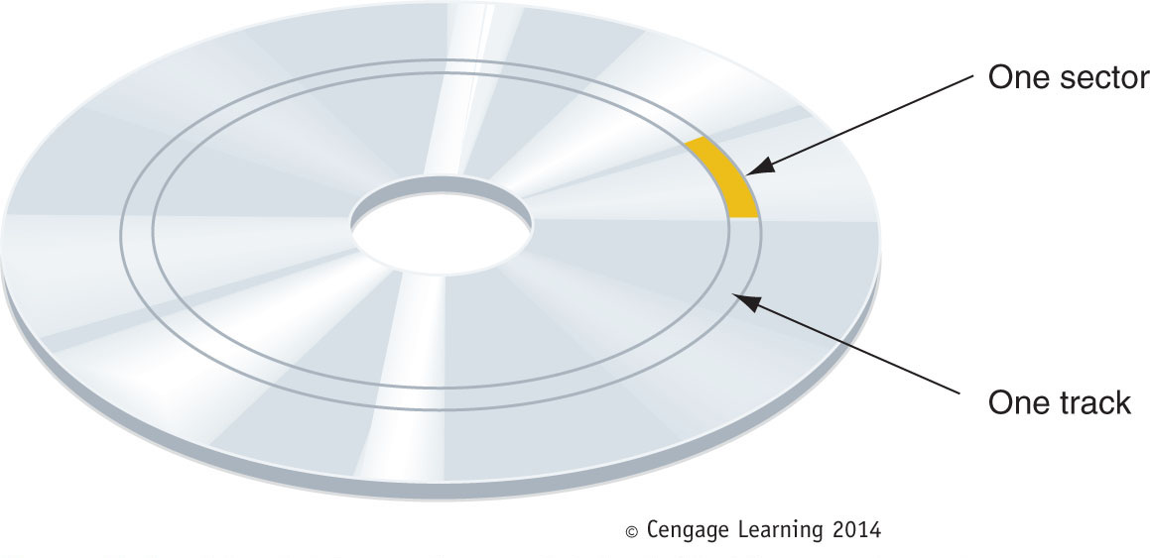
Figure 5-4 A hard drive or floppy disk is divided into tracks and
sectors; several sectors make one cluster

Slide 11
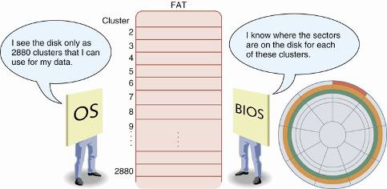
Figure 8-6 Clusters, or file allocation units, are managed by the OS in the file allocation table, but BIOS manages these clusters as one or two physical sectors on the disk

Slide 12
Low-Level Formatting
Magnetic Drives
Two formatting levels:
  Low-level: mark tracks and sectors
  High-level: create boot sector, file system, root directory
Manufacturer currently perform most low-level formats
  Using the wrong format program could destroy drive
  If necessary, contact manufacturer for format program
Problem: track and sector markings fade
  Solution for older drives: perform low-level format
  Solution for new drive: backup data and replace drive
Note: zero-fill utilities do not do low-level formats

Slide 13
Low-Level Format
SSD
SSDs are memory chips, Low-Level Format does not apply.
However, memory chips can experience failure over time. Thus the bad block can be formatted out.
  Prevents info from being written to the respective block.
Zero-fill, allows for faster writes, since a used block must be erased prior to write.

Slide 14
Cluster Size
Volume Size | FAT16 Cluster Size | FAT32 Cluster Size | NTFS Cluster Size
7 MB–16 MB | 2 KB | Not supported | 512 bytes
17 MB–32 MB | 512 bytes | Not supported | 512 bytes
33 MB–64 MB | 1 KB | 512 bytes | 512 bytes
65 MB–128 MB | 2 KB | 1 KB | 512 bytes
129 MB–256 MB | 4 KB | 2 KB | 512 bytes
257 MB–512 MB | 8 KB | 4 KB | 512 bytes
513 MB–1,024 MB | 16 KB | 4 KB | 1 KB
1,025 MB–2 GB | 32 KB | 4 KB | 2 KB
2 GB–4 GB | 64 KB | 4 KB | 4 KB
4 GB–8 GB | Not supported | 4 KB | 4 KB
8 GB–16 GB | Not supported | 8 KB | 4 KB
16 GB–32 GB | Not supported | 16 KB | 4 KB
32 GB–2 terabytes | Not supported | Not supported* | 4 KB

Slide 15
Calculating Drive Capacity on Older Drives
Constant number of sectors per track
The formula was straightforward:
  Cylinders x heads x sectors/track x 512 bytes/sector
Example: 855 cylinders, 7 heads, 17 sectors/track
  855 x 7 x 17 x 512 bytes/sector = 52,093,440 bytes
  Divide by 1024 twice to convert to 49.68 MB capacity

Slide 16
Drive Capacity for Today’s Drives
The OS reports the capacity of hard drives
Accessing capacity data using Windows Explorer
  Right-click the drive letter
  Select Properties on the shortcut menu
Calculating total capacity if drive is fully formatted
  Record capacity of each logical drive on hard drive
  Add individual capacities to calculate total capacity
Reporting total capacity (regardless of formatting)
  Windows 2000/XP: use Disk Management
  Windows 9x: use Fdisk

Slide 17
GPT support
Windows 32 bit
  Can read/write Win 2003 server, Vista – Win 8
  Can only boot Win 8.
Windows 64 bit
  Can read/write XP – Win 8
  Can boot Win 2003 server to Win 8.
    Hence a reason XP was phased out.
OS X
  Some support 10.4 – 10.6

Slide 18
Technologies Used Inside a Hard Drive
Low-level formatting – sector markings are written to the hard drive at the factory
  Not the same as high-level formatting performed for Operating System installation
Firmware, BIOS and OS use logical block addressing (LBA) to address all hard drive sectors
  Size of each sector + total number of sectors determine drive capacity
S.M.A.R.T – Self-Monitoring Analysis ad Reporting Technology
  Used to predict when a drive is likely to fail

Slide 19
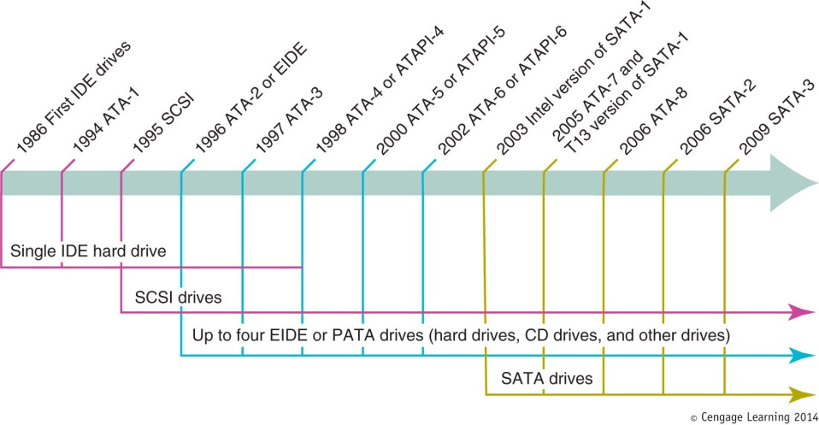
Interface Standards Used By a Hard Drive
Current internal hard drives methods
  Parallel ATA (PATA) and Serial ATA (SATA)
External hard drive methods
  External SATA (eSATA), SCSI, FireWire, USB, Fibre Channel
Figure 5-5 Timeline of interface standards used by internal drives

Slide 20
Interface Standards Used by a Hard Drive
Interface standards define data speeds and transfer methods with a computer system
  Also define types of cables and connectors
Standards
  Developed by Technical Committee T13
  Published by American National Standards Institute (ANSI)

Slide 21
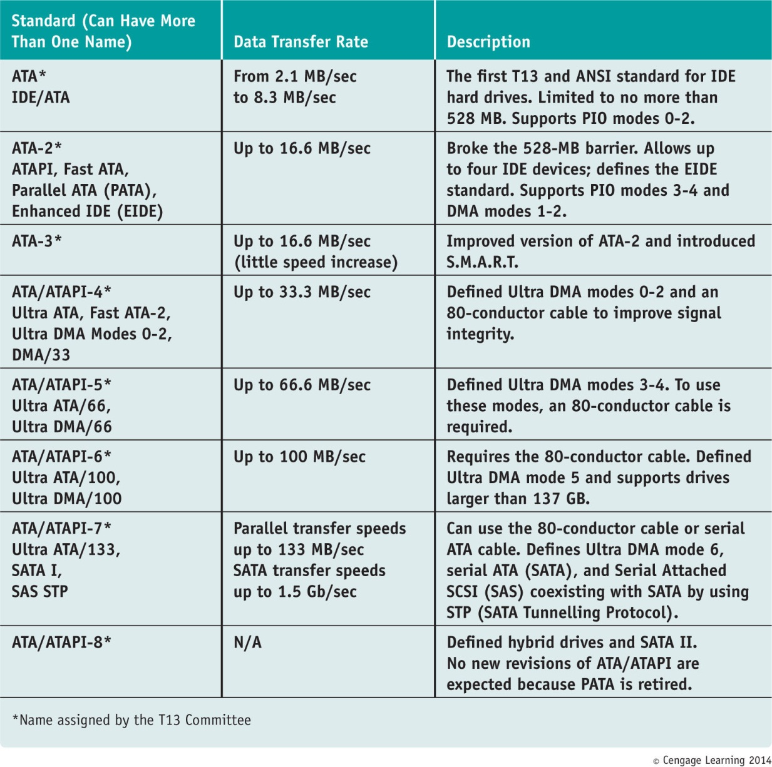
Table 5-1 Summary of ATA interface standards for storage devices

Slide 22
Parallel ATA or EIDE Drive Standards
Parallel ATA or EIDE drive standards or Integrated Drive Electronics (IDE)
  Allows one or two IDE connectors on a motherboard
    Each use 40-pin data cable
  Advanced Technology Attachment Packet Interface
    Required by optical drives (e.g., CD or DVD)
Types of PATA ribbon cables
  Older cable
    40 pins and 40 wires
  80-conductor IDE cable
    40 pins and 80 wires
  Maximum recommended length of either is 18”

Slide 23
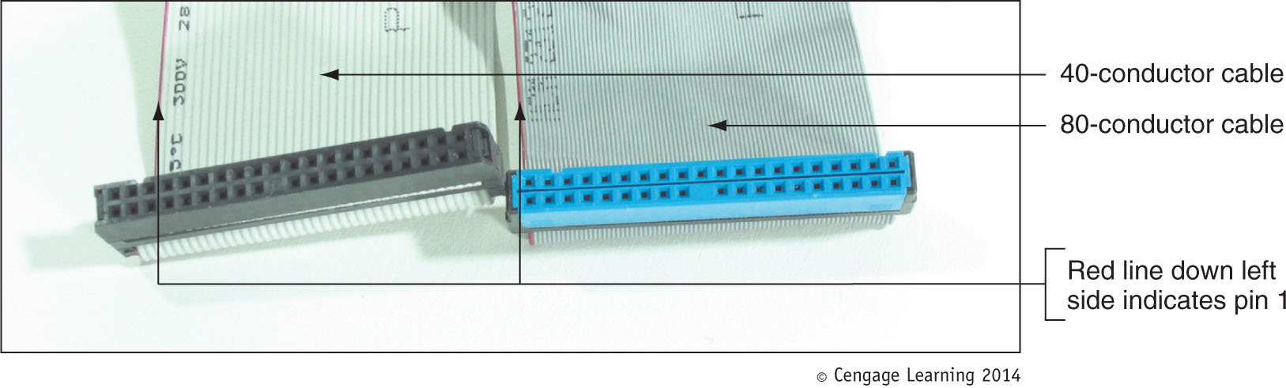
Figure 5-9 In comparing the 80-conductor cable to the 40-conductor cable, note they are
about the same width, but the 80-conductor cable has many more and finer wires

Slide 24
Parallel ATA or EIDE Drive Standards
Transferring data between hard drive and memory
  Direct memory access (DMA) transfer mode
    Transfers data directly from drive to memory without involving the CPU
    Seven DMA modes
  Programmed Input/Output (PIO) transfer mode
    Involves the CPU, slower than DMA mode
    Five PIO modes used by hard drives
  Ultra DMA
    Data transferred twice for each clock beat, at the beginning and again at the end

Slide 25
Parallel ATA or EIDE Drive Standards
Startup BIOS
  Autodetects drive and selects fastest mode that drive and BIOS support
Independent Device Timing
  Motherboard chipset feature
  Supported by most chipsets today
  Allows two hard drives to share same parallel ATA cable but use different standards
  Allows two drives to run at different speeds as long as motherboard supports them

Slide 26
Serial ATA Standards
Serial ATA standards
  Developed by a consortium of manufacturers
    Serial ATA International Organization (SATA-IO)
  Uses serial data path rather than traditional parallel data path
  Advantages
    Faster than PATA interfaces and used by all drive types
    Multiple connectors are easy to configure
    Supports hot-swapping (hot-plugging)
      Connect and disconnect drive while system is running
    Internal cable length: up 1 meter
    Cable does not hinder airflow (narrower than PATA)

Slide 27
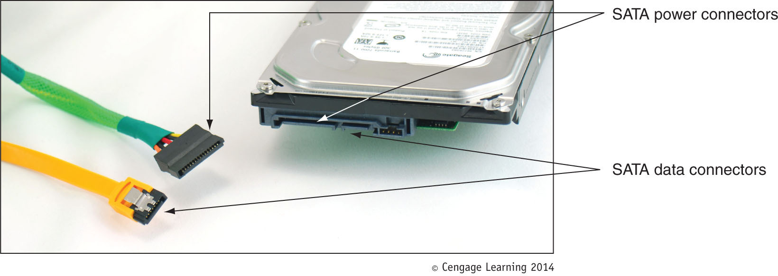
Figure 5-12 A SATA data cable and SATA power cable

Slide 28
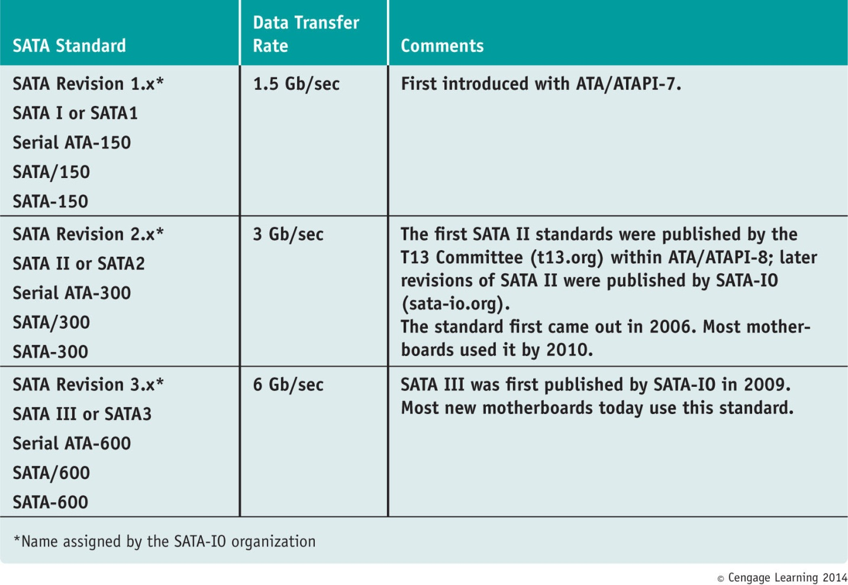
Table 5-2 SATA Standards

Slide 29
Serial ATA Standards
Serial ATA standards (cont’d.)
  Motherboard or expansion card can provide external SATA (eSATA) ports for external drives
  External SATA (eSATA)
    eSATA drives use special external shielded serial ATA cable up to 2 meters long
  Purchasing considerations
    SATA standards for the drive and motherboard need to match for optimum speed
    If no match, system runs at the slower speed

Slide 30
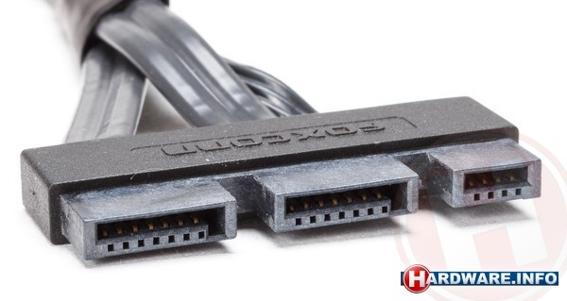
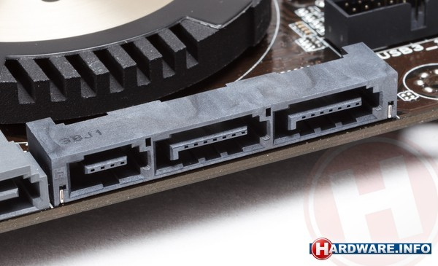
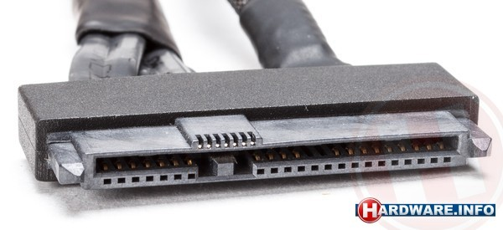
SATAe
Above - Mother board
Top Right – Cable for MB side
Right – Cable, SSD side.

Slide 31
SCSI Technology
Small Computer System Interface standards
  Used primarily in servers
  Support either 7 or 15 devices (standard dependent)
  Provides better performance than ATA standards
SCSI subsystem
  SCSI controller types: embedded or host adapter
  Host adapter supports internal and external devices
  Daisy chain: combination of host adapter and devices
  Each device on bus assigned SCSI ID (0 - 15)
  A physical device can embed multiple logical devices
    Assigned a Logical Unit Number (LUN)

Slide 32
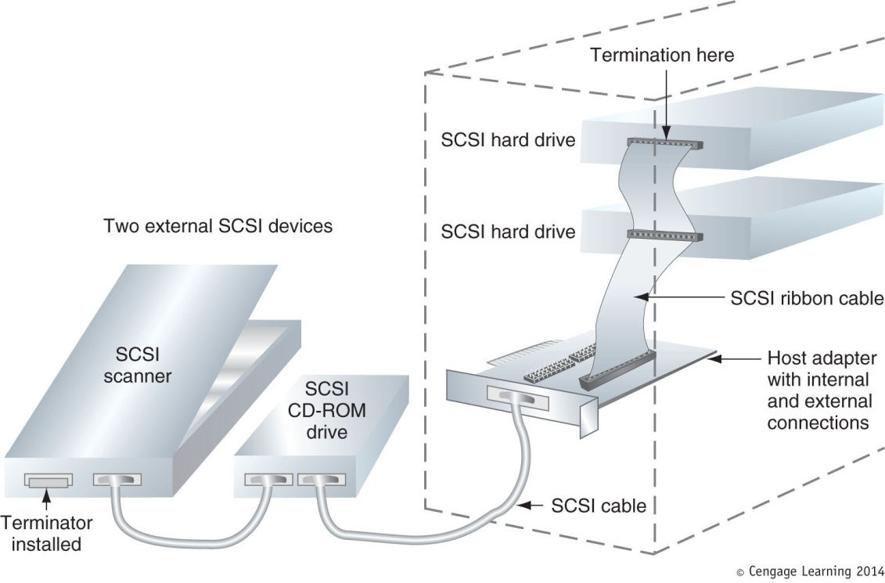
Figure 5-15 Using a SCSI bus, a SCSI host adapter card can support internal and external SCSI devices

Slide 33
SCSI Technology
Terminating resistor
  Plugged into last device at end of the chain
  Reduces electrical noise or interference on the cable
Categories of SCSI Standards
  8-bit (narrow SCSI)
    Uses 50-pin SCSI connector (A cable) or 25-pin SCSI connector that looks like a parallel port (DB-25)
  16-bit (wide SCSI)
    Uses 68-pin SCSI connector (P cable)

Slide 34
SCSI Technology
Various SCSI versions
  SCSI-1, SCSI-2, and SCSI-3
    Also known as regular SCSI, Fast SCSI, Ultra SCSI
Serial attached SCSI (SAS)
  Allows for more than 15 devices on single chain
  Uses smaller, longer, round cables
  Uses smaller hard drive form factors, larger capacities
  Compatible with serial ATA

Slide 35
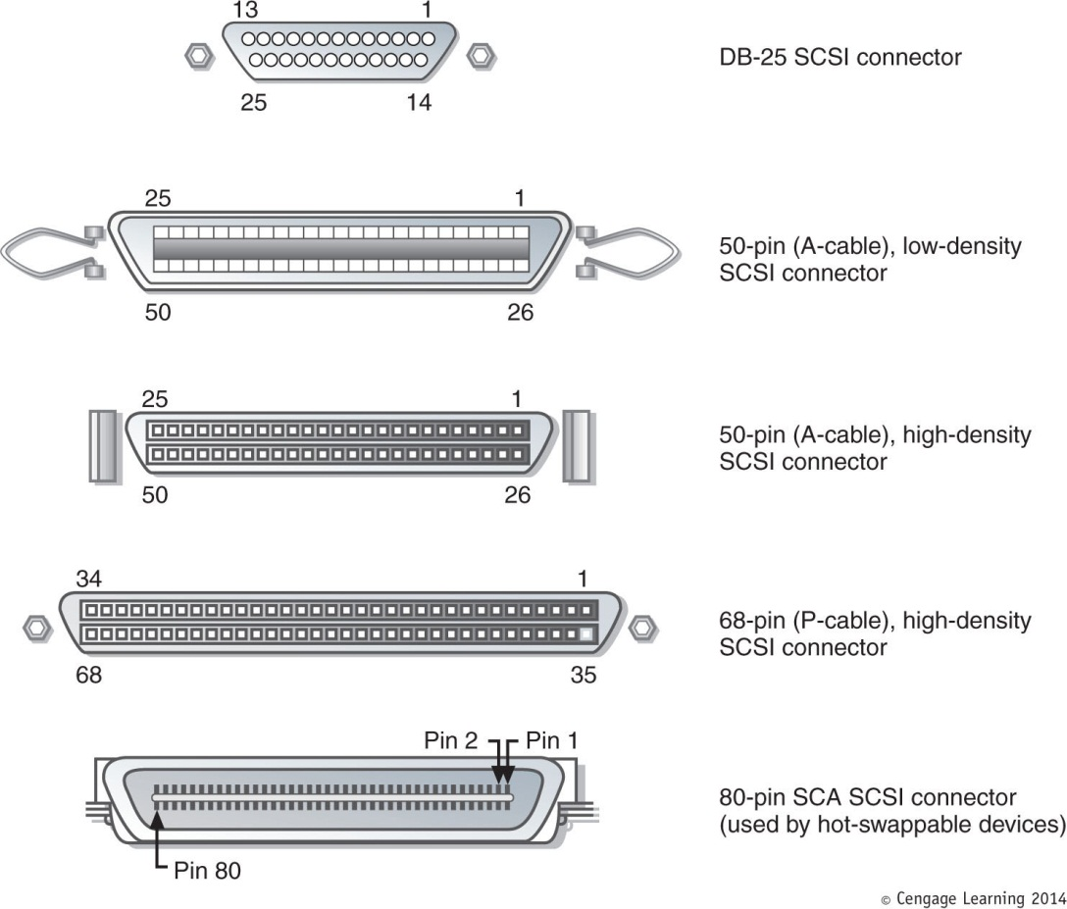
Figure 5-18 The most popular SCSI connectors are 50-pin, A-cable connectors
For narrow SCSI and 68-pin, P-cable connectors for wide SCSI

Slide 36
SCSI Speeds
Interface | Alternative names | Specification document | Connector | Width (bits) | Clock ^{[3]} | Maximum
 |  |  |  |  |  | Throughput ^{[4]} | Length (single ended) ^{[5]} | Length LVD | Length HVD | Devices ^{[6]}
SCSI-1 |  | SCSI-1 | IDC50; Centronics C50 | 8 | 5 MHz | 5 MB/s | 6 m | NA | 25m | 8
Fast SCSI |  | SCSI-2 | IDC50; Centronics C50 | 8 | 10 MHz | 10 MB/s | 1.5-3 m | NA | 25m | 8
Fast-Wide SCSI |  | SCSI-2; SCSI-3 SPI | 2 x 50-pin (SCSI-2); 1 x 68-pin (SCSI-3) | 16 | 10 MHz | 20 MB/s | 1.5-3 m | NA | 25m | 16
Ultra SCSI | Fast-20 | SCSI-3 SPI | IDC50 | 8 | 20 MHz | 20 MB/s | 1.5-3 m | NA | 25m | 8
Ultra Wide SCSI |  | SCSI-3 SPI | 68-pin | 16 | 20 MHz | 40 MB/s | 1.5-3 m | NA | 25m | 16
Ultra2 SCSI | Fast-40 | SCSI-3 SPI-2 | 50-pin | 8 | 40 MHz | 40 MB/s | NA | 12m | 25m | 8
Ultra2 Wide SCSI |  | SCSI-3 SPI-2 | 68-pin; 80-pin SCA-2 | 16 | 40 MHz | 80 MB/s | NA | 12m | 25m | 16
Ultra3 SCSI | Ultra-160 | SCSI-3 SPI-3 | 68-pin; 80-pin SCA-2 | 16 | 40 MHz DDR | 160 MB/s | NA | 12m | NA | 16
Ultra-320 SCSI |  |  | 80-pin | 16 | 80 MHz DDR | 320 MB/s | NA | 12m | NA | 16
Ultra-640 SCSI |  |  | 80-pin | 16 | 160 MHz DDR | 640 MB/s | ?? |  |  | 16

Slide 37
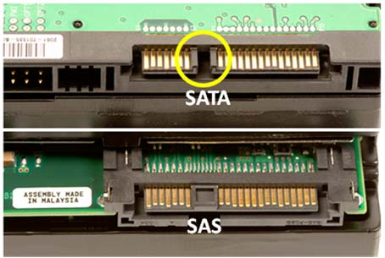
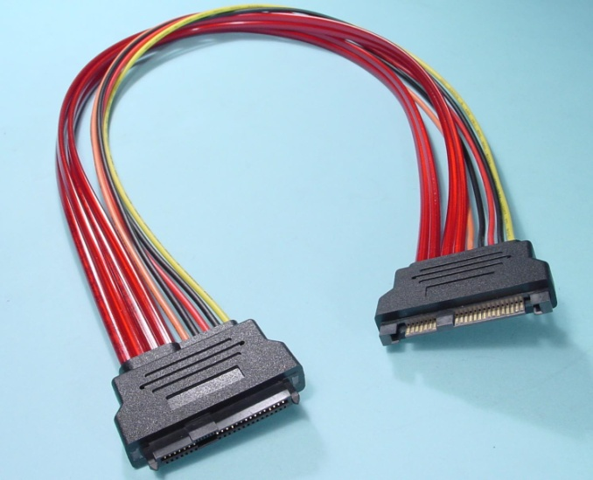
SAS drives
Serial Attached SCSI
  Creates a network of serial scsi devices.
  Uses a serial cable which connects into an imitator (like a router)

Slide 38
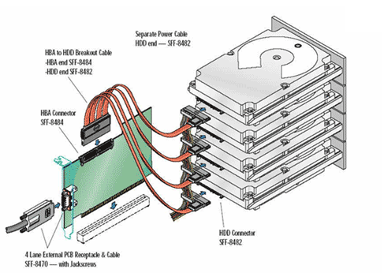
SAS Drives
Typically found in higher end commercial systems

Slide 39
Advantages of SAS
Full duplex: transmit data in both directions at the same time.
Error recovery & reporting: more robust then SATA
Multi-path i/o: 1:many i/o capable
Command set is more robust allowing many of the above features.
Can use higher signalling voltages allowing integration to backplane systems.
  Larger disk arrays.

Slide 40
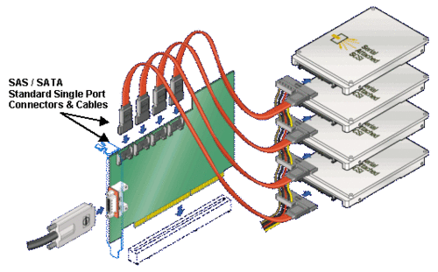
SAS to SATA

Slide 41
How to Select and Install Hard Drives
Topics covered
  Selecting a hard drive
  Installation details for SATA drive, IDE drive
  How to install hard drive in a bay too wide for drive
  How to set up a RAID system

Slide 42
Selecting a Hard Drive
Hard drive must match OS and motherboard
  Need to know what standards the motherboard or controller card providing the drive interface can use
  Consult documentation for the board or card
BIOS uses autodetection to prepare the device
  Drive capacity and configuration selected
  Best possible ATA standard becomes part of configuration

Slide 43
Selecting a Hard Drive
Considerations:
  Drive capacity
    Today’s desktop hard drives range from 60 GB – 2 TB
  Spindle speed
    Most common is 7200 RPM
    The higher the RPMs, the faster the drive
  Interface standard
    Use standards the motherboard supports
  Cache or buffer size
    Ranges from 2 MB to 64 MB

Slide 44
Steps to Install a Serial ATA Drive
Some SATA drives have two power connectors
  Choose only one to use
  Never install two power cords at the same time
If you have a SATA drive and a PATA connector (or vice versa)
  Purchase an adapter to make the drive fit the motherboard connection
  Can also purchase a SATA and/or PATA controller card

Slide 45
Steps to Install a Serial ATA Drive
Step 1: Know your starting point
  How is your system configured?
  Is everything working properly?
  Write down what you know about the system
Step 2: Read the documentation and prepare your work area
  Read all installation instructions first
  Visualize all the steps
  Protect against ESD and avoid working on carpet

Slide 46
Steps to Install a Serial ATA Drive
Step 2: Read the documentation and prepare your work area (cont’d)
  Handle the drive carefully
  Do not touch any exposed circuitry
  Drain static electricity from the package and from your body by touching metal for at least 2 seconds
  Do not place the drive on the computer case or on a metal table

Slide 47
Steps to Install a Serial ATA Drive
Step 3: Install the drive
  Turn off the computer and unplug it
  Decide which bay will hold the drive
  Slide drive in the bay and secure it (use two screws on both sides)
  Use correct motherboard serial ATA connector
  Connect a 15-pin SATA or 5-pin Molex power connector from the power supply to the drive
  Check all connections and power up the system
  Verify drive recognized correctly via BIOS setup

Slide 48
Steps to Install a Serial ATA Drive
Now ready to prepare the hard drive for first use
  Boot from Windows setup CD or DVD
    Follow directions on the screen to install Windows on the new drive
  If installing a second hard drive with Windows installed on first drive use Windows Disk Management utility to partition and format the second drive

Slide 49
Steps to Install a Serial ATA Drive
Installing a drive in a removable bay
  Unplug the cage fan from its power source
  Turn handle on each locking device counterclockwise to remove it
  Slide the bay to the front and out of the case
  Insert hard drive in the bay
    Use two screws on each side to anchor the drive in the bay
  Slide the bay back into the case
  Reinstall the locking pins

Slide 50
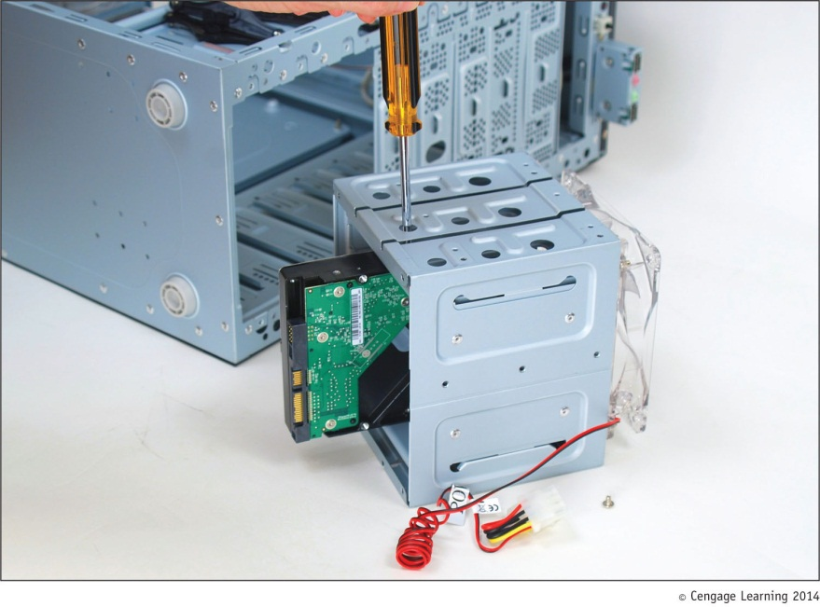
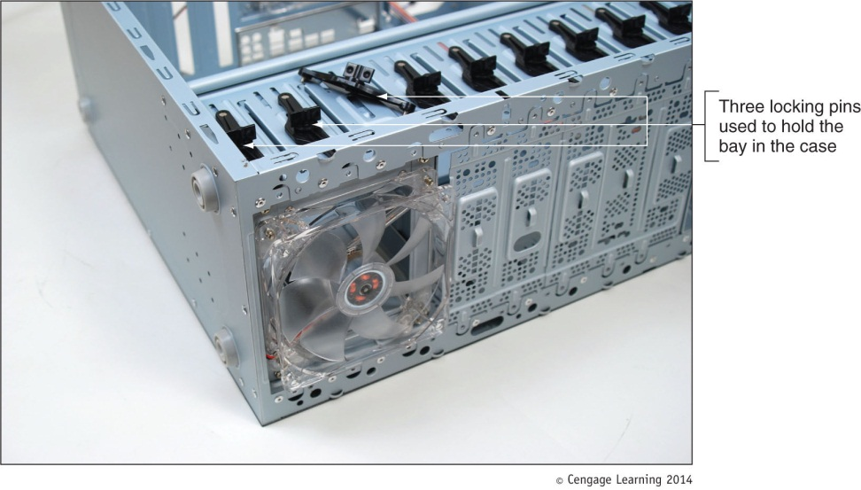
Figure 5-30 The removable bay has a fan in front and is anchored to the case with locking pins
Figure 5-31 Install the hard drive in the bay using two screws on each side of the drive

Slide 51
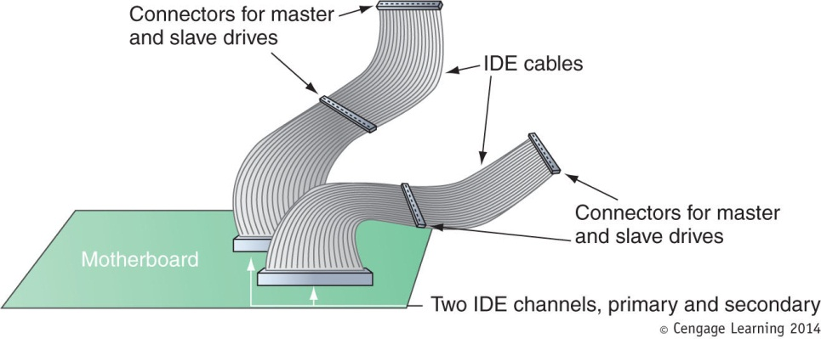
Steps to Configure and Install a Parallel ATA Drive
Configurations for four EIDE devices in a system:
  Primary IDE channel, master device
  Primary IDE channel, slave device
  Secondary IDE channel, master device
  Secondary IDE channel, slave device
Figure 5-35 A motherboard supporting PATA has two IDE channels; each can support a master and slave drive using a single EIDE cable

Slide 52
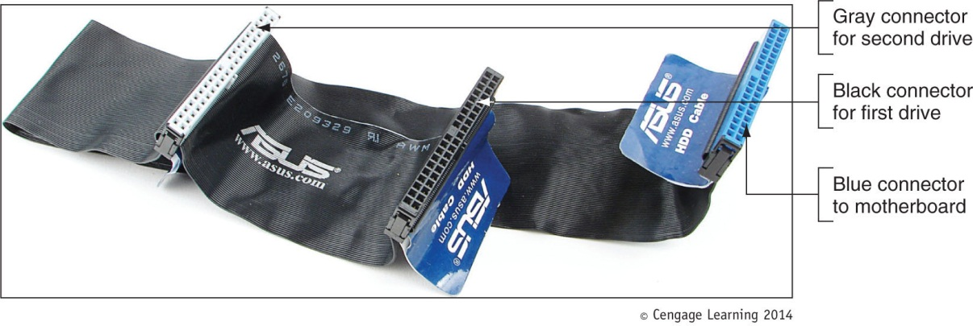
Steps to Configure and Install a Parallel ATA Drive
Master or slave designations are made by:
  Setting jumpers or DIP switches
  Use special cable-select data cable
  Color-coded connectors
    Blue end connects to motherboard; black end connects to drive
Figure 5-36 80-conductor cable connectors are color-coded

Slide 53
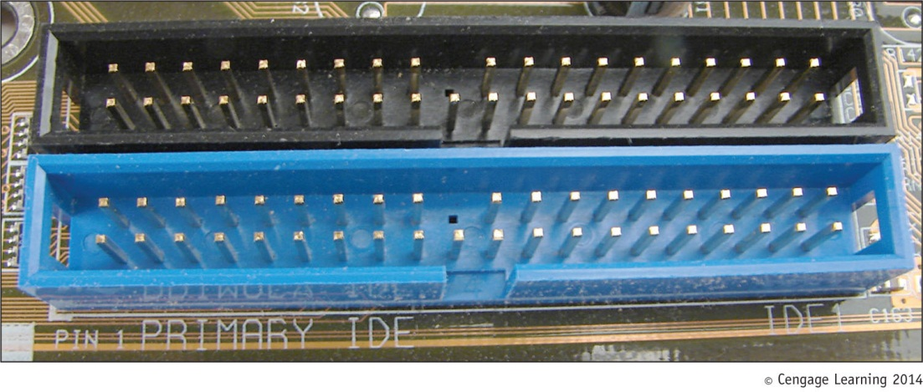
Steps to Configure and Install a Parallel ATA Drive
Motherboard color-coding
  Primary channel connector: blue
  Secondary channel connector: black
  Ensures ATA/66/100/133 hard drive installed on the primary IDE channel
Figure 5-37 The primary IDE channel connector is often color-coded as blue

Slide 54
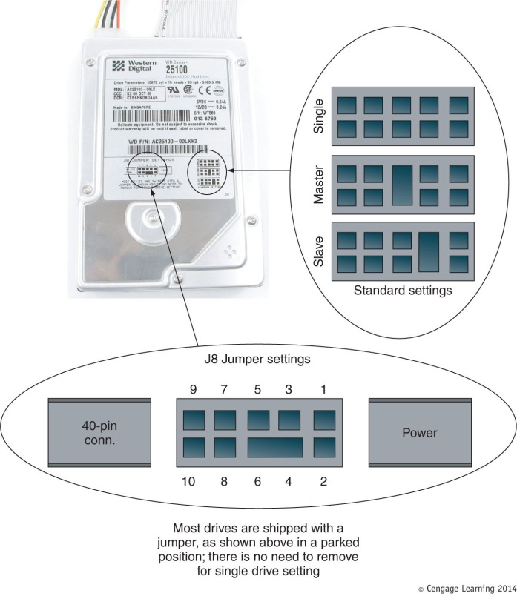
Steps to Configure and Install a Parallel ATA Drive
Step 1: Open case, decide how to configure drives
Step 2: Set the jumpers on the drive
Figure 5-38 A PATA drive most likely will have diagrams of jumper settings for master and slave options printed on the drive housing

Slide 55
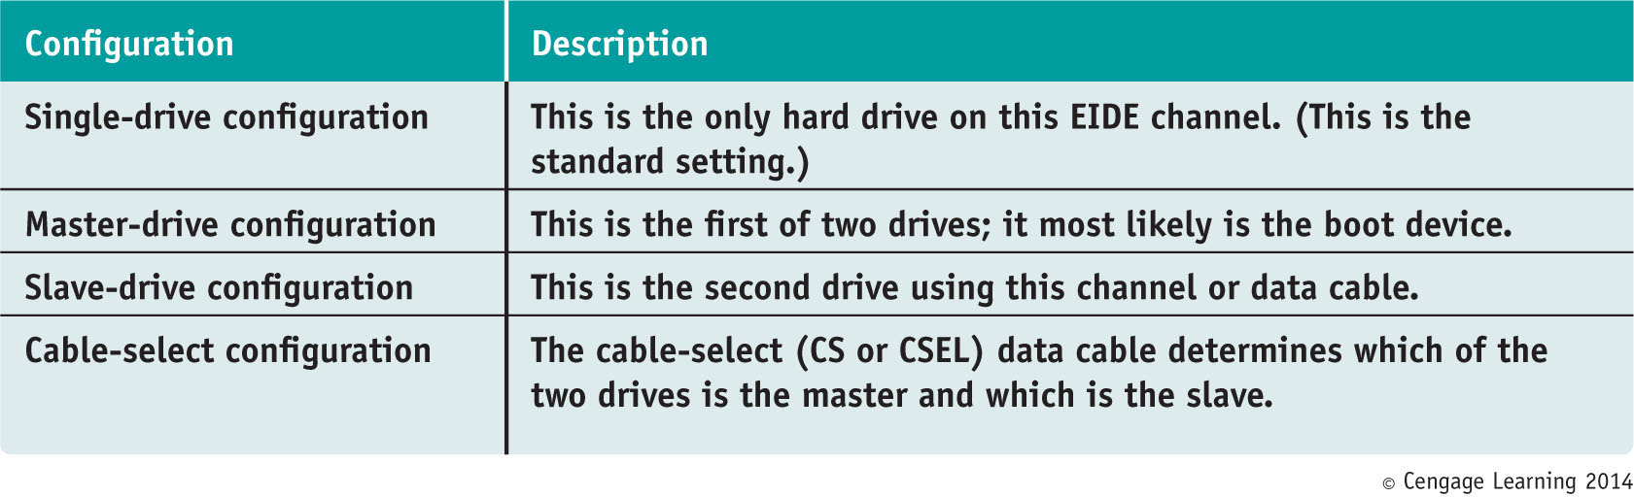
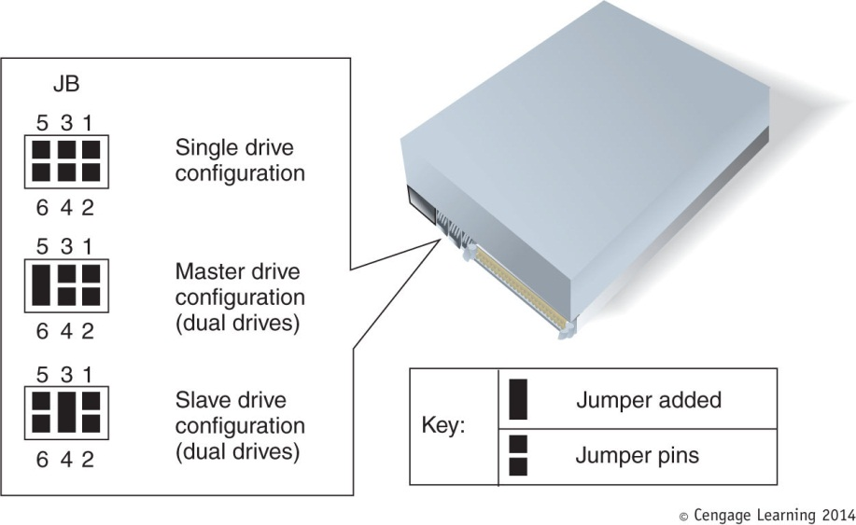
Table 5-4 Jumper settings on a parallel ATA hard drive
Figure 5-39 Jumper settings on a hard drive and their meanings

Slide 56
Steps to Configure and Install a Parallel ATA Drive
Step 3: Mount the drive in the bay
  Decide whether to connect data cable before or after inserting bay inside the computer case
    Then install drive in bay and connect the cable in whichever order works best
  Connect data cable to IDE connector on motherboard
  Install a power connection to each drive
  Before replacing case cover verify installation

Slide 57
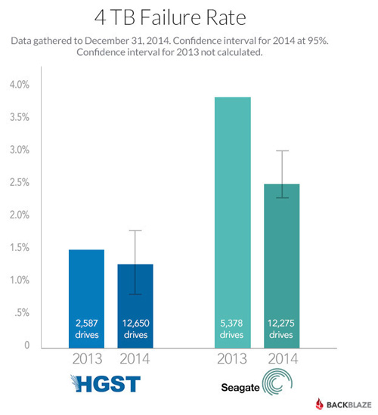
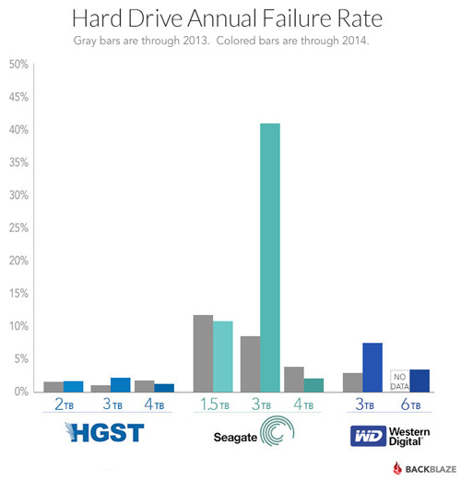
Hard Drive Failure by Manufacture
2015 study

Slide 58
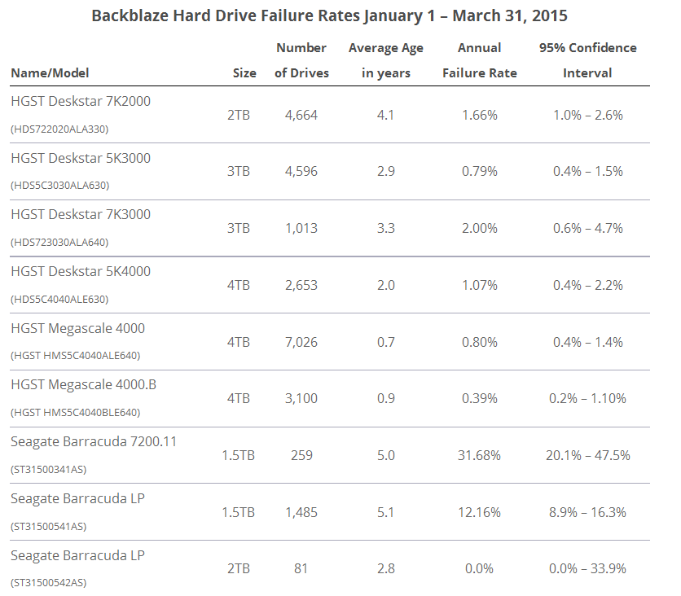

Slide 59
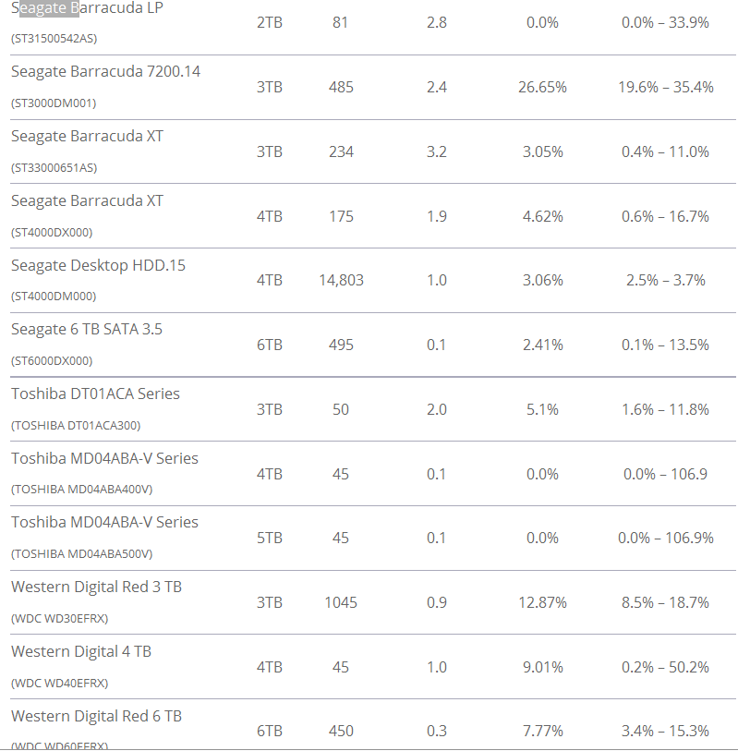

Slide 60
Setting Up Hardware RAID
RAID (Redundant Array of Inexpensive Disks)
  Also: Redundant Array of Independent Disks
  A technology that configures two or more hard drives to work together as an array of drives
Why use RAID?
  To improve fault tolerance by writing two copies of it, each to a different hard drive
  To improve performance by writing data to two or more hard drives to that a single drive is not excessively used

Slide 61
Types of RAID
Spanning – sometimes called JBOD (just a bunch of disks)
  Uses two hard drives to hold a single Windows volume
  When one drive is full, data is written to second drive

Slide 62
RAID Controllers
Redundant Array of Independent (or Inexpensive) Disks
Level 0 -- Striped Disk Array without Fault Tolerance: Provides data striping (spreading out blocks of each file across multiple disk drives) but no redundancy. This improves performance but does not deliver fault tolerance. If one drive fails then all data in the array is lost.
Level 1 -- Mirroring and Duplexing: Provides disk mirroring. Level 1 provides twice the read transaction rate of single disks and the same write transaction rate as single disks.
Level 2 -- Error-Correcting Coding: Not a typical implementation and rarely used, Level 2 stripes data at the bit level rather than the block level.

Slide 63
Level 4 -- Dedicated Parity Drive: A commonly used implementation of RAID, Level 4 provides block-level striping (like Level 0) with a parity disk. If a data disk fails, the parity data is used to create a replacement disk. A disadvantage to Level 4 is that the parity disk can create write bottlenecks.
Level 5 -- Block Interleaved Distributed Parity: Provides data striping at the byte level and also stripe error correction information. This results in excellent performance and good fault tolerance. Level 5 is one of the most popular implementations of RAID.
Level 6 -- Independent Data Disks with Double Parity: Provides block-level striping with parity data distributed across all disks.
Level 0+1 – A Mirror of Stripes: Not one of the original RAID levels, two RAID 0 stripes are created, and a RAID 1 mirror is created over them. Used for both replicating and sharing data among disks.
Level 10 – A Stripe of Mirrors: Not one of the original RAID levels, multiple RAID 1 mirrors are created, and a RAID 0 stripe is created over these.
Level 7: A trademark of Storage Computer Corporation that adds caching to Levels 3 or 4.
RAID S: EMC Corporation's proprietary striped parity RAID system used in its Symmetrix storage systems.

Slide 64
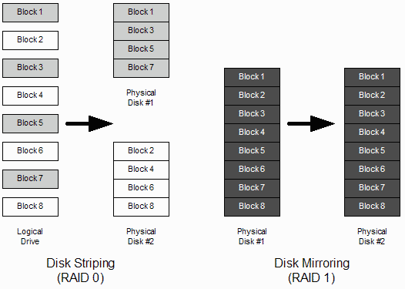
RAID 0 & 1 http://www.adtron.com/expertise/activeraid.html

Slide 65
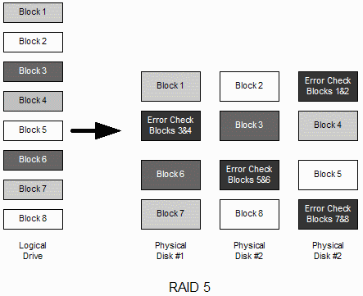
RAID 5
RAID 5 ensures that if one of the disks in the striped set fails, its contents can be extracted using the information on the remaining functioning disks.

Slide 66
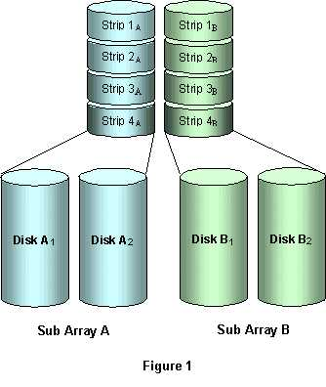
RAID 10
Striping + Mirrors, improves performance and give redundancy.

Slide 67
How to Implement Hardware RAID
Hardware implementation
  Hardware RAID controller or RAID controller card
    Motherboard does the work, Windows unaware of hardware RAID implementation
Software implementation uses operating system
Best RAID performance
  All hard drives in an array should be identical in brand, size, speed, other features
If Windows installed on a RAID hard drive RAID must be implemented before Windows installed

Slide 68
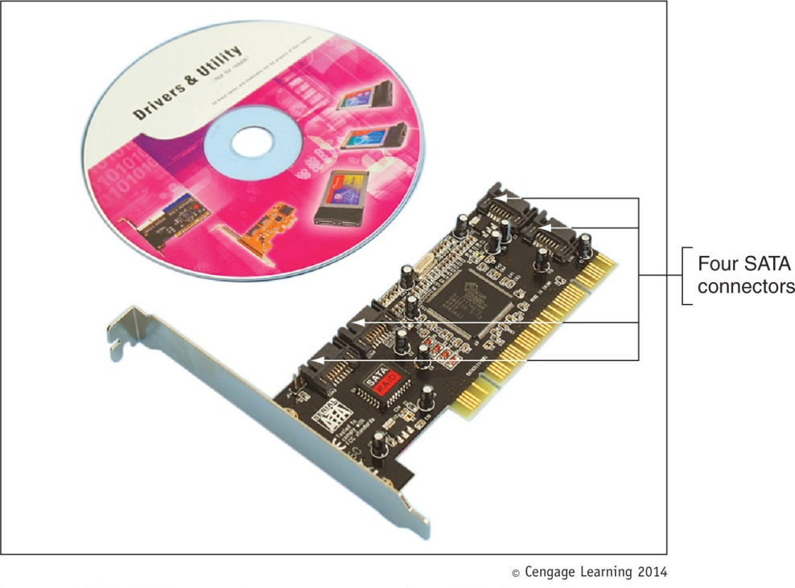
Figure 5-45 RAID controller card provides four SATA internal connectors

Slide 69
How to Implement Hardware Raid
General directions to install RAID 5 array using three matching SATA drives
  Install drives in the computer case and connect each to motherboard
  Boot system and enter BIOS setup
    Verify drives recognized, select option to configure SATA, and select RAID
  Reboot the system
    Press Ctrl and I to enter the RAID configuration utility
  Select option 1 to “Create RAID Volume”
    Select RAID 5 (Parity), stripe size value, volume size
    Create volume

Slide 70
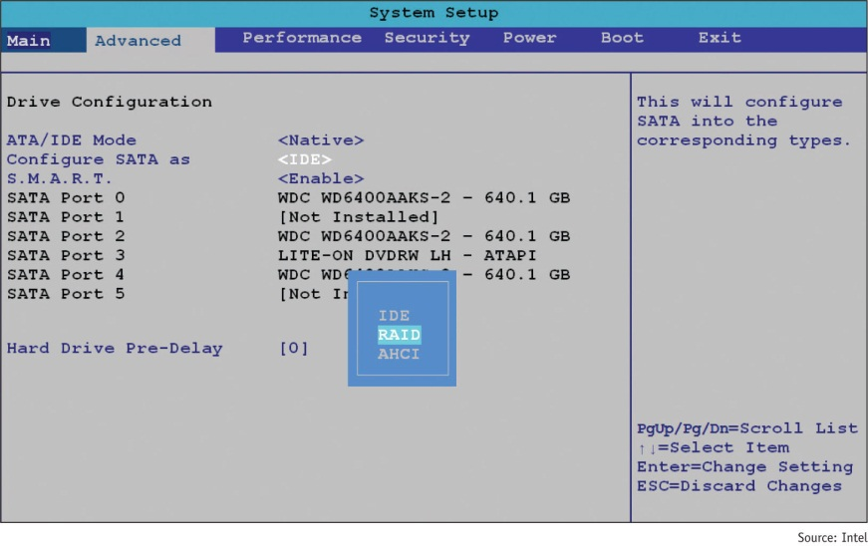
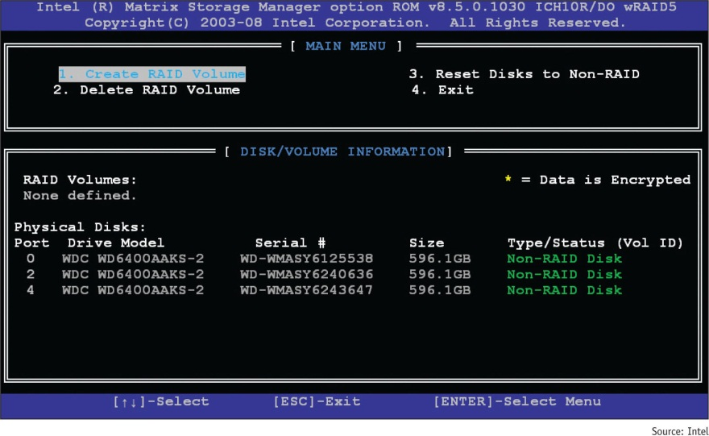
Figure 5-47 Configure SATA ports on the motherboard to enable RAID
Figure 5-48 BIOS utility to configure a RAID array

Slide 71
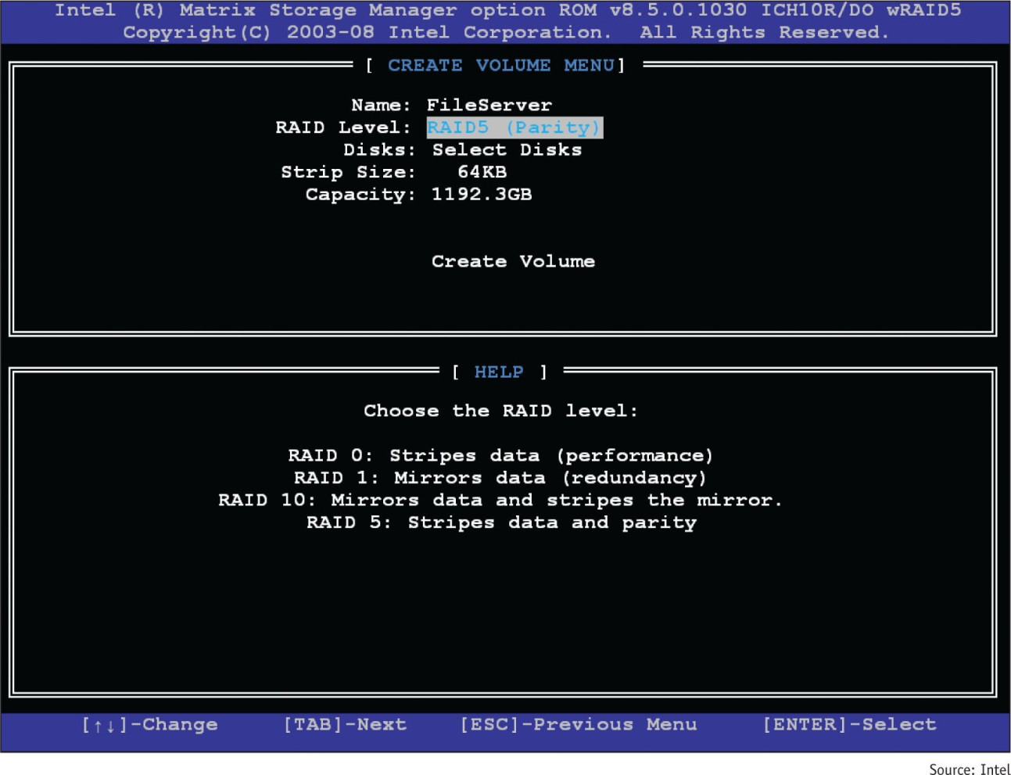
Figure 5-49 Make your choices for the RAID array

Slide 72
About Tape Drives and Floppy Drives
Tape drives can use a SATA, PATA, or SCSI interface
As a technician, you may be called on to support old floppy drives
Both tape drives and floppy drives are covered in this section

Slide 73
Installing Tape Drives and Selecting Tape Media
Tapes drives – an inexpensive way of backing up a hard drive
WORM (write once read many) – assures data written will not be deleted or overwritten
Disadvantage: data is stored by sequential access
  To read data from anywhere on the tape, you must start at the beginning of the tape and read until you find the data you want
  Slow and inconvenient

Slide 74
Installing Tape Drives and Selecting Tape Media
Two kinds of tapes:
  Full-sized data cartridges
  Minicartridges
    More popular because their drives can fit into a standard 3-inch drive bay of a PC case
When selecting a tape drive, consider:
  How many and what type of cartridges the drive can use
  How it interfaces with the computer
External drives can connect to a computer using a USB, FireWire, SCSI, SAS, or eSATA port

Slide 75
Installing a Floppy Drive
Floppy disk drive (FDD)
  3 ½” floppy disk format
  Holds only 1.44 MB of data
  Floppy drive subsystem
    Floppy drive, ribbon cable, power cable, connections
    Today’s floppy drive cables have a connector at each end to accommodate a single drive
    Older cables have an extra connector or two in the middle of the cable for a second floppy drive

Slide 76
Installing a Floppy Drive
Install the drive in a bay as you would a hard drive
Connect floppy drive data cable and power cord to motherboard
  If you connect the cable the wrong way, the drive light will stay lit and will not work
  Be sure the end of the cable with the twist connects to the drive and the other end to the motherboard
Replace cover, turn on computer, and enter BIOS setup to verify installation

Slide 77
OEM vs Retail
Purchased in large lots by PC manufactures.
Sold as Drive + Jumpers
Disk manufacture does not sell a warranty to PC manufacture.
Cost is cheaper.
Warranty falls to the PC manufacture.
Purchased in small lots, i.e. 1, by individuals or small PC shops.
Sold in a box, with cables, jumpers, instructions.
Costs more then OEM
Warranty is per manufacture.
Drives may or may not be marked as OEM, up to purchaser to ask the right question.
Gray market drives, those purchased as OEM, sold as Retail.

Slide 78
Troubleshooting Hard Drives
Problems occur before and after installation
Problems may be hardware or software related
Hardware-related problems will be addressed

Slide 79
Problems with Hard Drive Installations
CMOS setup does not reflect new hard drive
  Solution: Enable autodetection and reboot system
Error message: “ Hard drive not found.”
  Reseat the data cable and reboot the PC
Error message: “No boot device available.”
  Insert bootable disk and restart the machine
Error message 601 appears on the screen
  Connect the power cord to the floppy disk drive
Error message: “Hard drive not present”
  Restore jumpers to their original state

Slide 80
Problems with Hard Drive Installations (continued)
Things to check if CMOS setup does not show drive
  Does your system BIOS recognize large drives?
  Is autodetection correctly configured in CMOS setup?
  Are the jumpers on the drive set correctly?
  Are the power cord and data cable connected?

Slide 81
How to Approach a Hard Drive Problem After the Installation
Some post-installation problems
  Corrupted data files
  A corrupted Windows installation
  A hardware issue preventing system from booting
Preparation steps
  Start with the end user: conduct an interview
  Prioritize what you have learned
    Example: make data backup your first priority
  Be aware of available resources
    Examples: documentation, Internet, Technical Support

Slide 82
Hard Drive Hardware Problems
Causes of problems present during boot:
  Hard drive subsystem
  Partition table
  File system on the drive
  Files required for the OS to boot
Some things to do if POST reveals problem
  Check the jumper settings on the drive
  Check the cable for frayed edges or other damage
  Try booting from another media; e.g. setup CD
  Check manufacturer Web site for diagnostic software

Slide 83
Hard Drive Hardware Problems (continued)
Bumps are bad
  A scratched surface may cause a hard drive crash
  Data may be recovered, even if drive is inaccessible
Invalid drive or drive specification
  System BIOS cannot read partition table information
  Boot from recovery CD and check partition table
  To be covered in later chapters
Bad sector errors
  Problem due to fading tracks and sectors
  Solution: replace the drive

Slide 84
Summary
A hard disk drive (HDD) comes in 3.5” for desktop and 2.5” for laptops
A hard drive can be magnetic, solid-state, or hybrid
Most hard drives use the ATA interface standards
Two ATA categories are parallel ATA and serial ATA
S.M.A.R.T is a self-monitoring technology whereby the BIOS monitors the health of a hard drive
SCSI interface standards include narrow and wide SCSI and can use a variety of cables and connectors

Slide 85
Summary
When selecting a hard drive, consider storage capacity, technology, spindle speed, interface standard, and buffer size
SATA drives require no configuration and are installed using a power cord and a data cable
PATA drives require you to set a jumper to determine if the drive will be the single drive, master, or slave on a single cable
RAID technology uses an array of hard drives to provide fault tolerance and/or improvement in performance

Slide 86
Summary
Hardware RAID is implemented using the motherboard BIOS or a RAID controller card
Software RAID is implemented in Windows
Tape drives are an inexpensive way to back up an entire hard drive or portions of it
Today’s floppy disks are 3.5” high-density disks that hold 1.44 MB of data
After a floppy disk drive is installed, you must configure the drive in BIOS setup

