Slide 1

A+ Guide to Hardware:
Managing, Maintaining, and Troubleshooting, Sixth Edition
Chapter 9
Connecting to and Setting up a Network

Slide 2
Objectives
Learn about the TCP/IP protocols and standards Windows uses for networking
Learn how to connect a computer to a network
Learn how to configure and secure a multifunction router on a local network

Slide 3
Historical Overview
Elements providing an overview of networks
  The different sizes of networks
  The different technologies used by networks
  Some networking terms
Network types commonly encountered
  Ethernet
  Wireless networks
  Telephone networks
  Mostly outdated token ring and FDDI networks

Slide 4
Sizes of Networks
A network links two or more computers
PAN (personal area network)
  Consists of personal devices at close range
LAN (local area network)
  Covers a small local area such as a home, or office
MAN (metropolitan area network)
  Covers a large campus or city
WAN (wide area network)
  Covers a large geographical area; e.g., the Internet

Slide 5
Networking Technologies
Factors driving network evolution:
  The type of data the network is intended to support
  The data capacity on the network
  How a network is to fit among other networks
Bandwidth (data throughput or line speed):
  Analog systems: measured in cycles/sec (hertz or Hz)
  Digital systems: measured in bps, Kbps, or Mbps
As networks grow, the need for bandwidth grows

Slide 6
Additional Terms Used in Networking
Node (host): one device on a network; e.g., server
Network adapter: interfaces a PC with a network
  Network interface card (NIC): fits in a PCI slot
Adapter (MAC, physical, or hardware) address:
  48-bit (6-byte) id number hard-coded on card
  Example: 00-0C-6E-4E-AB-A5
Network protocols: rules of communication
Packets (datagrams or frames)
  Basic unit of data transmitted on a network

Slide 7
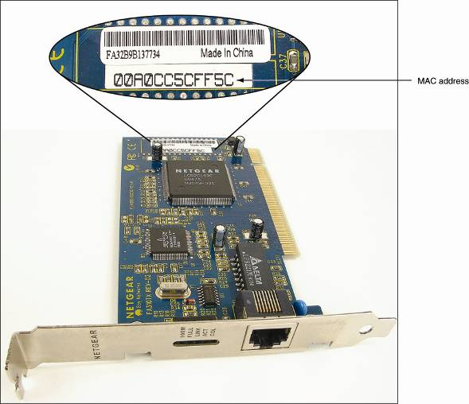
Figure 17-1 Ethernet network card showing its MAC address

Slide 8
Introducing Ethernet
Ethernet types (categorized by speed):
  10-Mbps Ethernet
  100-Mbps or Fast Ethernet
  1000-Mbps or Gigabit Ethernet
  10-Gigabit Ethernet
Types of cabling used:
  Two kinds of twisted-pair
    Unshielded twisted pair (UTP): four pairs of twisted wire
    Shielded twisted pair (STP): protected from EMI
  Coaxial cable: single copper wire with braided shield
  Fiber-optic: glass strands inside protective tubing

Slide 9
Table 17-2 Variations of Ethernet and Ethernet cabling

Slide 10
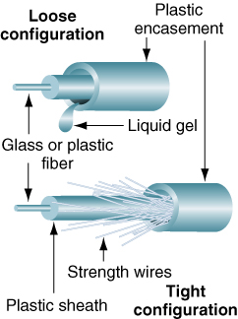
Figure 17-4 Fiber-optic cables contain a glass core for transmitting light

Slide 11
Introducing Ethernet (continued)
Topology: arrangement of nodes in a network
Bus topology: connects all nodes with a line (no hub)
Star topology
  Connects nodes to central hub (or switch)
  The hub broadcasts a data packet to every device
  Switch uses a table to route packet to receiving device
Scale networks by adding switches
Star bus topology:
  Multiple switches form a bus network
  Nodes connected to each switch form a star

Slide 12
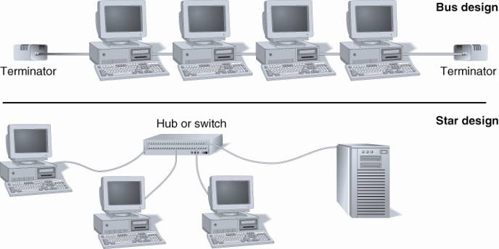
Figure 17-6 Nodes on an Ethernet network can be connected to one another in a star or bus formation

Slide 13
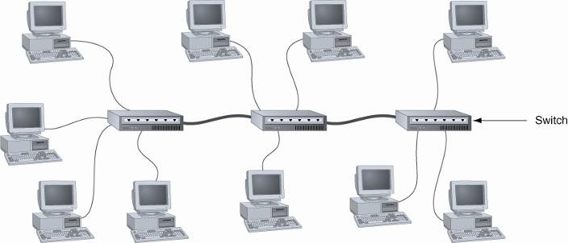
Figure 17-10 A star bus network uses more than one switch

Slide 14
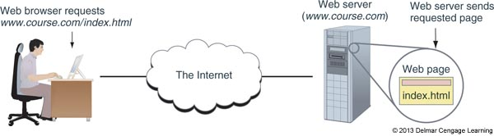
Understanding TCP/IP and Windows Networking
Client/server applications
  Two computers and two applications involved
  Communication occurs three levels
    Hardware, operating system, application
    Dependent on one computer addressing the other
Figure 9-1 A web browser (client software) requests a web page from a web server (server software); the web server returns the requested data to the client

Slide 15
Layers of Network Communication
When two devices communicate, they must use the same protocols (language)
  Almost all networks today use a group or suite of protocols known as TCP/IP (Transmission Control Protocol/Internet Protocol)
Data is broken up into segments and each segment is put into a packet
  A packet contains the data and information that identifies the type of data, where it came from, and where it is going

Slide 16
Introducing Ethernet (continued)
Attenuation: the weakening of a transmitted signal
Repeater: device used to amplify a signal in a LAN
Amplifier repeater: simply amplifies incoming signal
Signal-regenerating repeater
  Reads and copies the signal (without noise)
  Transmits an exact duplicate of the original
Ethernet uses a signal-regenerating repeater
  A switch or hub can act as the repeater

Slide 17
Layers of Network Communication
Level 1: Hardware level
  Root level of communication
    Wireless or network cables
    Phone lines or TV cable lines
  Includes the network adapter and MAC address
    MAC (media access control) address is a unique 48-bit hexadecimal number hard-coded on the card by the manufacturer
    Also known as hardware address, physical address, adapter address, or Ethernet address
  Communication protocols used

Slide 18
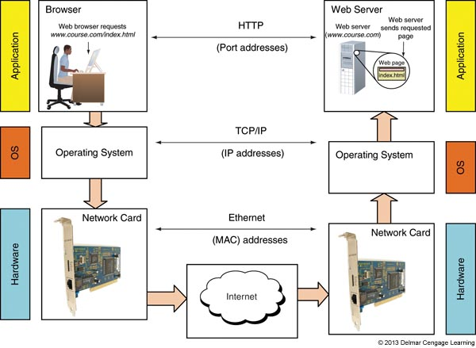
Figure 9-2 Network communication happens in layers

Slide 19
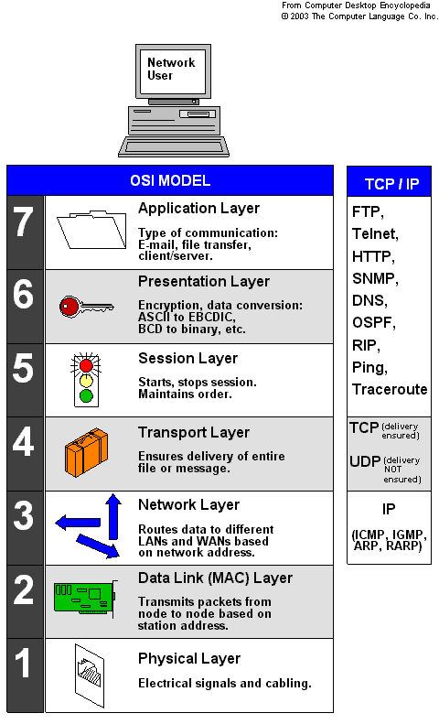
TCP/IP

Slide 20
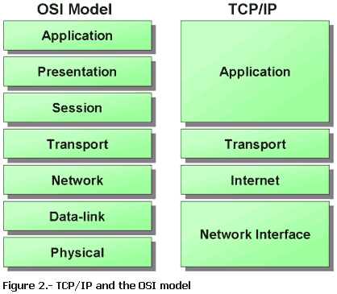
TCP/IP

Slide 21
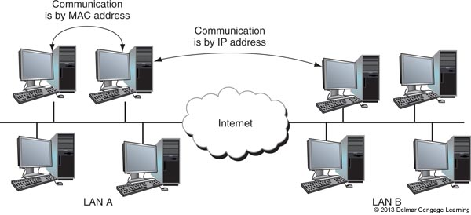
Layers of Network Communication
Level 2: Operating system level
  Manages communication between itself and another computer using TCP/IP
  Uses IP addressing
Figure 9-4 Computers on the same LAN use MAC addresses to communicate, but computers on different LANs use IP addresses to communicate over the Internet

Slide 22
Layer of Network Communication
Layer 2: Operating system level: (cont’d)
  IP address
    32-bit or 128-bit number that is assigned to a network connection
    Used to find computers on networks and subnetworks, including the Internet

Slide 23
Layers of Network Communication
Level 3: Application level
  Client communicates with other server applications
  Port number
    Uniquely identifies computer application
  Socket
    IP address followed by a colon and port number
    E-mail example: 136.60.30.5:25
    Web server example: 136.60.30.5:80

Slide 24
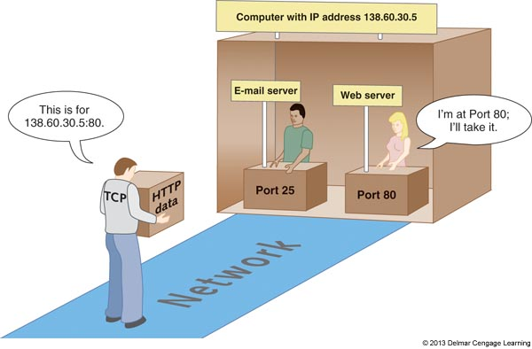
Figure 9-5 Each server running on a computer is
addressed by a unique port number

Slide 25
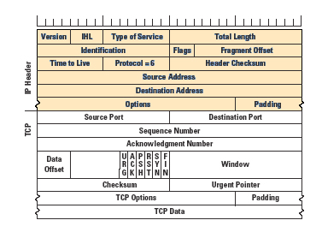
TCP/IP Packet

Slide 26
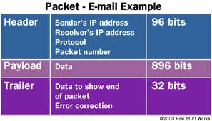
Example of E-Mail Packet
Typical e-mail packet
Trailer contains ECC information to verify the data integrity.

Slide 27
How IP Addresses Get Assigned
A MAC address is embedded on a network adapter at a factory
IP addresses are assigned manually or by software
  Static IP address: manually and permanently assigned to a computer or device
  Dynamic IP address: assigned by a server each time the device connects to the network
    A DHCP (dynamic host configuration protocol) server assigns addresses to a DHCP client that is requesting an address

Slide 28
How IP Addresses Get Assigned
An IP address has 32 or 128 bits
Internet Protocol version 4 (IPv4) – uses a 32-bit address to identify a network connection
  Currently a shortage of IPv4 IP addresses
Internet Protocol version 6 (IPv6) was created partly due to the shortage of IPv4 addresses
  Uses a 128-bit IP address
Internet Assigned Numbers Authority (IANA) is responsible for keeping track of assigned IP addresses

Slide 29
How IPv4 IP Addresses Are Used
IP address: 32 bits long, made up of 4 groups, each 8 bits long
  Four decimal numbers separated by periods
    72.56.105.12
  Largest possible 8-bit number
    11111111 (255 decimal)
  Largest possible decimal IP address
    255.255.255.255
    11111111.11111111.11111111.11111111 binary
  Octet: each of the four decimal numbers
    0 to 255, 4.3 billion potential IP addresses

Slide 30
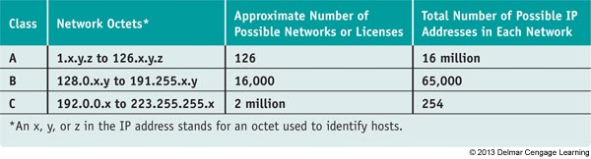
How IPv4 IP Addresses Are Used
IP address identifies network and host
  Classes are based on the number of possible IP addresses in each network within each class
Table 9-1 Classes of IP addresses

Slide 31
How IPv4 IP Addresses Are Used
Class A addresses:
  First octet identifies the network and last three can be used to identify the host
Class B addresses:
  First two octets identify the network and last two can be used to identify the host
Class C addresses:
  First three octets identify the network and the last octet can be used to identify the host

Slide 32
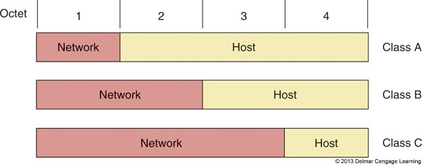
How IPv4 IP Addresses Are Used
Class D addresses: octets 224 through 239
  Multicasting
Class E addresses: octets 240 through 254
  Research
Figure 9-7 The network portion and host portion for each class of IP addresses

Slide 33
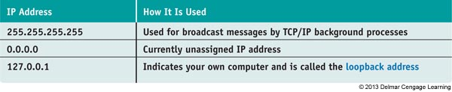
How IPv4 IP Addresses Are Used
A few IP addresses are reserved for special use by TCP/IP and should not be assigned to a device
Table 9-2 Reserved IP addresses

Slide 34
How IPv4 IP Addresses Are Used
Subnets using IPv4
  Large networks can and should be divided into smaller networks called subnetworks or subnets
  To divide a network into subnets, you designate part of the host portion of the IP address as a subnet
Example: Class A network of 69.0.0.0
  On network 69 you could have 16 million hosts
  You can divide this network into 256 subnets by using the second octet for the subnet address
  Possible network numbers would range from 69.0.x.y – 69.255.x.y

Slide 35
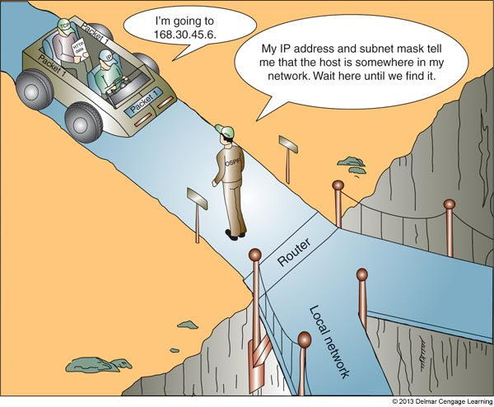
How IPv4 IP Addresses Are Used
The subnet mask identifies which part of an IP address is the network id and which is the host id
Subnet masks help a device know if an IP address is part of it’s network or belongs to another
Figure 9-8 A host can
Always determine if an IP
Address is on its
network

Slide 36
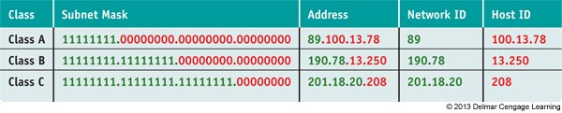
How IPv4 IP Addresses Are Used
Subnet masks
  Group of ones followed by a group of zeros
  Classful subnet masks: all ones, all zeros in an octet
  Classless subnet mask: mix of zeros and ones
Table 9-3 Default subnet masks for classes of IP addresses

Slide 37
How IPv4 IP Addresses Are Used
A network is divided into a subnet when the subnet mask takes some of the host portion for the network ID
Example: Dividing 69.0.0.0 into 256 subnets
  The subnet mask would be 255.255.0.0 instead of 255.0.0.0
  Therefore, an address of 69.12.34.56 with a subnet mask of 255.255.0.0 yields:
    Network id = 69.12.0.0
    Host id = 34.56

Slide 38
How IPv4 IP Addresses Are Used
Public IP addresses: available to the Internet
Private IP addresses: used on private network
  Use router with NAT (Network Address Translation) redirection for Internet access
    NAT: a TCP/IP protocol that substitutes the public IP address of the router for the private IP address of a computer that needs to communicate on the Internet
  IEEE recommend the following be used:
    10.0.0.0 through 10.255.255.255
    172.16.0.0 through 172.31.255.255
    192.168.0.0 through 192.168.255.255

Slide 39
How IPv6 IP Addresses Are Used
IPv6 address has 128 bits written as 8 blocks of hexadecimal numbers separated by colons
  Example: 2001:0000:0B80:0000:0000:00D3:9C5A:00CC
  Each block is 16 bits
  Leading 0s in a 4-character hex block can be eliminated. For example, the IP address above:
    2001:0000:B80:0000:0000:D3:9C5A:CC
  If blocks contain all zeros, they can be written as double colons. From IP address above:
    2001:0000:B80::D3:9C5A:CC
    Only one set of double colons is used

Slide 40
How IPv6 IP Addresses Are Used
Terms used in the IPv6 standards:
  Link (local link): a local area network (LAN) or wide area network (WAN) bound by routers
  Interface: node’s attachment to a link
    Can be logical or physical
    Logical attachment is used for tunneling (used by IPv6 to transport IPv6 packets over an IPv4 network)
  Interface ID: last 64 bits or 4 blocks of an IP address
  Neighbors: two or more nodes on the same link

Slide 41
How IPv6 IP Addresses Are Used
Three tunneling protocols for IPv6 packets to travel over an IPv4 network:
  ISATAP (Intra-Site Automatic Tunnel Addressing Protocol)
  Teredo – addresses intended to be used by this protocol always begin with the same 32-bit prefix (called fixed bits) which is 2001
  6TO4 – older protocol being replaced by Teredo or ISATAP

Slide 42
How IPv6 IP Addresses Are Used
Three types of IPv6 addresses:
  Unicast address: packets are delivered to a single node on a network
  Multicast address: packets are delivered to all nodes on a network
  Anycast address: used by routers; identifies multiple destinations and packets are delivered to the closest destination

Slide 43
How IPv6 IP Addresses Are Used
There are three types of unicast addresses:
  Global unicast (global address): can be routed on the Internet
    Most begin with the prefix 2000::/3
    The /3 indicates the first three bits are fixed and always 001
  Link-local unicast (link-local or local address): can be used for communicating with nodes in same link
    Most begin with FE80::/64
    Begins FE80 followed by enough zeros to make 64 bits
  Unique local address (ULA): identifies a specific site within a large organization
    Prefixes are FC00::/7 and FD00::/8

Slide 44
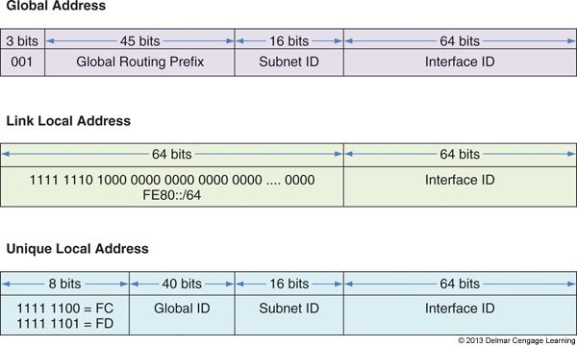
Figure 9-10 Three types of IPv6 unicast addresses

Slide 45
View IP Address Settings
Use the ipconfig command in a command prompt window to show the IPv4 and IPv6 addresses assigned to all network connections
IPv6 addresses are followed by a % sign and a number
  The number is called the zone ID or scope ID and is used to identify the interface in a list of interfaces of a computer
  Refer to Figure 9-11 on the next slide

Slide 46
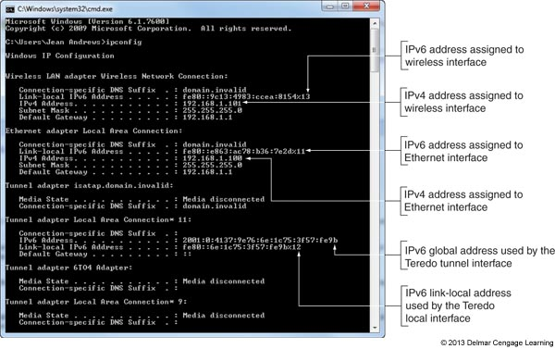
Figure 9-11 The ipconfig command showing IPv4 and IPv6
addresses assigned to this computer

Slide 47
Character-based Names Identify Computers and Networks
Character-based names: substitute for IP addresses
  Host name (computer name): name of a computer
  Workgroup name: identifies a workgroup
  Domain name: identifies a network
  Fully qualified domain name (FQDN): identifies computer and network to which it belongs
    Uses name resolution
    DNS server finds IP address when FDQN known
    Windows uses a host file

Slide 48
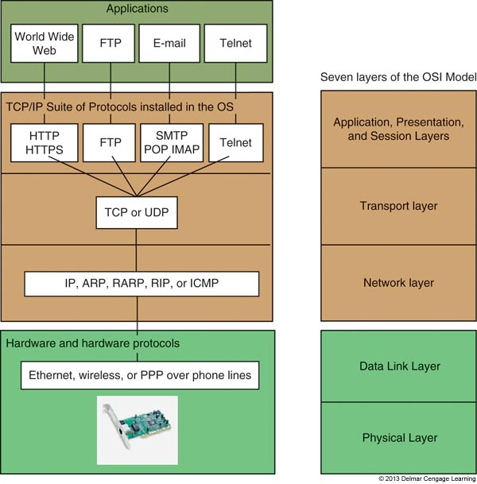
TCP/IP Protocol Layers
Figure 9-14 How software, protocols, and technology on a TCP/IP network relate to each other

Slide 49
TCP/IP Protocols Used By The OS
TCP (Transmission Control Protocol)
  Connection-oriented protocol
    Checks whether data is received and resends if it is not
    When a TCP packet reaches destination, an acknowledgement (ack) is sent back to the source
    If source does not receive ack, it resends the data
    Used by Web browsers and e-mail
UDP (User Datagram Protocol)
  Connectionless protocol (best-effort)
    Used for broadcasting and streaming video

Slide 50
TCP/IP Protocols Used By Applications
HTTP (Hypertext Transfer Protocol)
HTTPS (HTTP secure) protocol
    Encrypts and decrypts data before sent and processed
SMTP (Simple Mail Transfer Protocol)
  Used to send e-mail message
  SMTP AUTH (SMTP Authentication)
POP and IMAP
  Delivery of email message
Telnet
  Remotely control a computer

Slide 51
TCP/IP Protocols Used By Applications
LDAP (Lightweight Directory Access Protocol)
  Used by clients when an application needs to query a database
SMB (Server Message Block)
  Used by Windows to share files and printers
FTP (File Transfer Protocol)
  Transfer files between two computers
  Can use browsers, Windows Explorer, or third party software to transfer files using FTP

Slide 52
TCP/IP Protocols Used By Applications
SSH (Secure Shell)
  Used to pass login information to a remote computer and control that computer over a network
SFTP (Secure FTP)
  Uses encryption to transfer files
SNMP (Simple Network Management Protocol)
  Used to monitor network traffic
RDP (Remote Desktop Protocol)
  Used by the Windows Remote Desktop and Remote Assistance utilities to connect to and control a remote computer

Slide 53
Connecting A Computer To A Network
Connecting a computer to a network
  Quick and easy in most situations
Topics covered
  Connecting to a network using Ethernet, wireless, and dial-up connections

Slide 54
Connect To a Wired Network
Steps
  1. Install network adapter
  2. Connect network cable to Ethernet RJ-45 port and network port (wall jack, router, switch)
    Verify lights
  3. Windows assumes dynamic IP addressing
    Automatically configures the network connection
  4. Verify Internet connectivity

Slide 55
Connect To a Wired Network
Troubleshooting
  Verify Device Manager recognizes adapter without errors
    If error occurs, try updating NIC drivers
  If adapter has no errors, open Network and Sharing Center
    A red X indicates a problem
    Click X to start Windows Network Diagnostics
  After Windows has resolved the problem
    Should see a clear path from the computer to the Internet

Slide 56
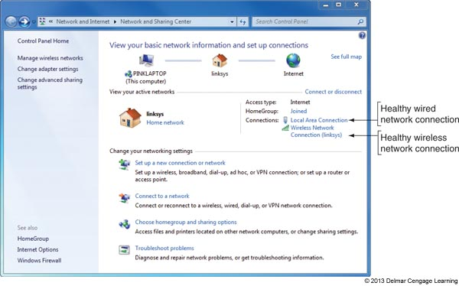
Figure 9-21 The Network and Sharing Center reports
two healthy network connections

Slide 57
Connect To a Wired Network
Follow these steps to verify and change TCP/IP settings:
  Click Change adapter settings in the Network and Sharing Center
    In Network Connections window, right-click local area connection and select Properties from Shortcut menu
  Select TCP/IPv4 and click Properties
  Default setting is dynamic IP addressing
  To change to static select Use the following IP address
    Enter IP address, subnet mask, and default gateway

Slide 58
Connect To a Wired Network
Follow these steps to verify and change TCP/IP settings: (cont’d)
  If you have the IP addresses of DNS servers, check Use the following DNS server addresses and enter up to two IP addresses
  If using a laptop that moves from one network to another and one network uses static:
    Click Alternate Configuration and select User configured to enter static IP address information
    If General tab is configured for dynamic, computer will first try to use that but will apply static if dynamic is not available

Slide 59
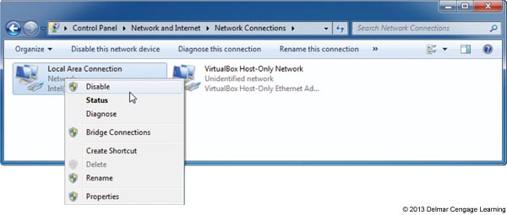
Connect To a Wired Network
Follow these steps to verify and change TCP/IP settings: (cont’d)
  Close all boxes and windows and try to access network resources
  If still don’t connect, try to disable and enable the network connection
Figure 9-24 To reset
A network connection,
Disable and enable the
connection

Slide 60
Connect To a Wireless Network
Wireless networks types
  unsecured public hotspots or secured private hotspots
Steps to connect to a wireless network using Windows 7:
  Install wireless adapter
  Embedded wireless: turn on wireless device
  A yellow star in the network icon on taskbar indicates hotspots are available
  Enter the security key or password and click OK

Slide 61
Connect To a Wireless Network
Steps to connect to a wireless network using Windows 7: (cont’d)
  If network is unsecured, verify that Windows has configured the network as a Public network
  Test the connection
    For some hotspots, a home page appears and you must enter a code or agree to the terms of use

Slide 62
Connect To a Wireless Network
Wireless networks are created using access points
Methods used by access points to secure wireless networks:
  A security key is required
  SSID is not broadcasted
    SSID (Service Set Identifier) = name
  Only computers with registered MAC addresses are allowed to connect
    To find out the MAC address of a computer use the ipconfig /all command

Slide 63
Connect To a Wireless WAN (Cellular) Network
Needed to connect to a wireless wide area network (WWAN):
  Hardware and software
  Subscriber Identification Module (SIM) card: flash memory card that contains all information you need to connect to a cellular network:
    Password and other authentication information
    Encryption standards
    Services that your subscription includes

Slide 64
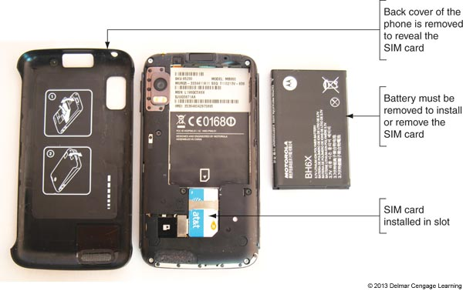
Figure 9-35 A SIM card contains proof that your device can
use a cellular network

Slide 65
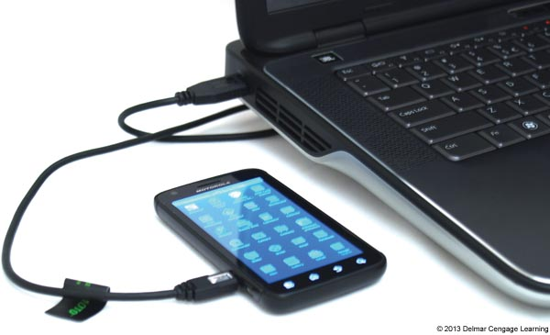
Connect To a Wireless WAN (Cellular) Network
Options for hardware and software:
  Use an embedded mobile broadband modem
  Tether your cell phone to your computer
  Use a USB broadband modem
Figure 9-36 Tether your cell
phone to your laptop using
a USB cable

Slide 66
Connect To a Wireless WAN (Cellular) Network
How to connect to a cellular network:
  Using an embedded broadband modem: insert the SIM card provided by your mobile operator
    Also need to use software either provided by your OS or your mobile operator
  Using your cell phone: install software provided by mobile operator and tether your phone to your computer
  Use a USB broadband modem: Ensure SIM card is inserted in the device then insert the modem into a USB port
    Windows finds the device and software installed on the device automatically runs

Slide 67
Create A Dial-Up Connection
Bare-bones installation steps
  Install internal or external dial-up modem
  Plug phone line into PC modem port and wall jack
  Open Network and Sharing Center window, click Set up a connection or network, select Set up a dial-up connection, click Next
  Enter ISP information, click Connect

Slide 68
Create A Dial-Up Connection
To use the connection
  Go to Network and Sharing Center
    Click Connect to a network
    Select dial-up connection, click Connect, click Dial
    You will hear modem dial up the ISP and make the connection

Slide 69
Create A Dial-Up Connection
Troubleshooting tips:
  Verify phone line and modem are working
  Check Dial-up Connection Properties box for errors
  Dial the number manually from a phone
  Try another phone number
  Listen for number being dialed
  Remove and reinstall dial-up connection

Slide 70
Setting Up A Multifunction Router For A SOHO Network
In order to setup a SOHO (small office or home office) network you need to know:
  How to configure a multipurpose router
    Stands between the network and the Internet
  How to set up and secure a wireless access point
    Most SOHO routers are also a wireless access point

Slide 71
Functions Of A SOHO Router
Function 1: As a router, stands between the ISP network and the local network, routes traffic between
Function 2: As a switch, manages several network ports that can be connected to wired computers or other network devices
Function 3: As a DHCP server, all computer receive their IP address from this server
Function 4: As a wireless access point, a wireless computer can connect to the Internet

Slide 72
Functions Of A SOHO Network
Function 5: As a firewall, blocks unwanted traffic from the Internet and provides Network Address Translation (NAT) so that computers can use private or local link IP addresses
  Can also restrict Internet access for computers
Function 6: As an FTP server, can connect an external hard drive and FTP firmware on router can be used to share files with network users

Slide 73
Install and Configure the Router on the Network
Always follow direction of the manufacturer but the following are general steps:
  1. On one of the computers on the network, launch the router setup program on the CD that came with it
    The setup program will instruct you to make physical connections necessary
  2. You will be given opportunity to change the SSID and password (recommended that you do)
    May be asked whether to allow automatic updating
  3. Test the connection by using the browser to access the Internet

Slide 74
Install and Configure the Router on the Network
Use a browser and firmware on the router to configure the router:
  1. Open browser and enter IP address of router
    Enter admin as the username and use the password entered during setup
  2. Use menus on the main setup page of the router firmware to change router’s configuration
    Every router is different so poke around until you find the setting you need to configure
    When finished, click Save Settings and close browser

Slide 75
Install and Configure the Router on the Network
Configuration changes to possibly make to router’s configuration:
  Change Router password
  Change SSID and configure the DHCP server
  View assignments make by ISP
  Assign static IP addresses
  Configure the firewall to disable all ports
  Improve QoS for an application

Slide 76
Install and Configure the Router on the Network
Port Filtering: used to open or close certain ports
  Applications are assigned these ports so you are filtering or controlling what applications can or cannot get through a firewall
Port Forwarding: when firewall receives a request for communication from the Internet to a specific computer and port, the request will be allowed and forwarded to that computer
Port Triggering: opens a port when a PC on the network initiates communication through another port
A demilitarized zone (DMZ): a computer or network that is not protected by a firewall

Slide 77
Install and Configure the Router on the Network
Tips when using port forwarding or port triggering:
  Must lease a static IP address from your ISP
  For port forwarding to work, the computer on your network must have a static IP address
  If the computer using port triggering stops sending data, the router might close the triggered port before communication is complete
  Using port forwarding, your computer and network are more vulnerable
    You are allowing external users directly into your private network

Slide 78
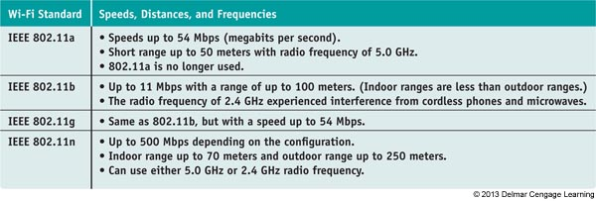
Set Up A Wireless Network
Wi-Fi (Wireless Fidelity) standards have evolved over the years
  Technical name is IEEE 802.11 standards
Table 9-6 Older and current Wi-Fi standards

Slide 79
Set Up A Wireless Network
802.11n: latest Wi-Fi standard
  Uses multiple input/multiple output (MIMO), which means a device can use two or more antennas to improve performance
Most wireless devices today are 802.11 b/g/n compatible
Place your router or wireless access point in the center of where you want your hotspot
  Higher position works better than a lower position
  Also place in a physically secure place

Slide 80
Set Up A Wireless Network
802.11n network configuration options to consider:
  The radio frequency (RF) the network will use
    Choices are 5 GHz and 2.4 GHz
  The older wireless devices that will use the network
    If network consists of older 802.11b/g devices, network must support 2.4 GHz frequency
  RF interference
  The channel the network will use
  The channel width for the network
    (40 or 20 MHz)
  Radio power level the device will use

Slide 81
Set Up A Wireless Network
Securing a wireless network:
  Method 1: Requiring a security key and using data encryption
    Three main protocols for encryption
      WEP (Wired Equivalent Privacy) – no longer considered secure because key used for encryption is static
      WPA (Wi-Fi Protected Access) – also called TKIP and is stronger than WEP because encryptions keys are constantly changing
      WPA2 (also called 802.11i standard) – latest and best encryption standard

Slide 82
Set Up A Wireless Network
Securing a wireless network: (cont’d)
  Method 2: Disable SSID broadcasting
    Not considered a strong security method because software can be used to discover an SSID that is not broadcasted
  Method 3: Filter MAC addresses
    Considered a weak security measure and does not use encryption
  Wi-Fi Protected Setup (WPS): generates the SSID and key using a random string of hard-to-guess letters and numbers

Slide 83
Summary
Network communication happens at three levels
  Hardware, operating system, and application
At the hardware level, a network adapter has a MAC address that uniquely identifies it on a network
Using TCP/IP, the OS identifies a network connection by an IP address
At the application level, a port address identifies an application
An IPv4 address has 32 bits and an IPv6 address has 128 bits

Slide 84
Summary
TCP/IP application protocols include: FTP, HTTP, and Telnet
TCP/IP protocols at the operating system level include TCP and UDP
A PC support technician must know how to configure TCP/IP settings and make a wired or wireless connection to an existing network
The best method to secure a wireless network is to use encryption

Slide 85
Summary
A multifunction router for a SOHO network might serve several functions including a router, a switch, a DHCP server, a wireless access point, a firewall using NAT, and an FTP server
Change the router’s SSID and password as soon as you install it
To secure a wireless access point, enable MAC address filtering, disable SSID broadcasting, and enable encryption (WPA2, WPA, or WEP)

