Slide 1
Software Development
  The leadership instinct you are born with is the backbone. You develop the funny bone and the wishbone that go with it.
  Elaine Agather

Slide 2
Software Development
Phases
Analysis
  problem statement
  requirements specification
  system analysts
  inputs and outputs
  system model
Design
  class specifications
  architectural plan
  system designers
Coding
  coding according to specifications
  programmers

Slide 3
Phases of
Software Development

Slide 4
Testing
  unit level testing
  integration testing
  system testing
  testers
Debugging
  based on test results
Production
  trainers
  technical support
Maintenance
  releases
  versions
Documentation
  user documentation
  technical documentation
  technical writers

Slide 5
Case Study: Grade Report System
Problem statement
Analysis
  develop requirements specification
    refine statement
  determine inputs and outputs
    Graphical User Interface (GUI)
    report formats
  develop model
    select object/classes
    determine relationships

Slide 6
Problem Statement

Slide 7
Analysis
Refinement
  marking scheme?
Inputs
  course name
  bases and weights for each piece of work
  number of students
  for each student:
    student #, name and mark for each piece of work
  class list
    text file with class (student) information
  mark data arrives over time
    requires persistence
      binary file
    application to create a new course
    application to enter/update mark data final mark computation application

Slide 8
Analysis.
Outputs
  forms
    marking scheme info
    student info
    course info
  Reports
    final mark report
      for each student
        student number and final grade
      summary statistics: course average
    others?

Slide 9
Refined Problem Statement

Slide 10
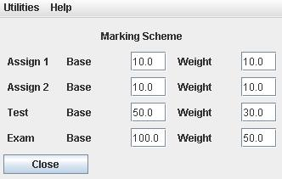
Marking Scheme Display Form

Slide 11
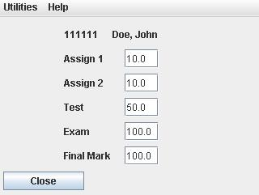
Student Display Form

Slide 12
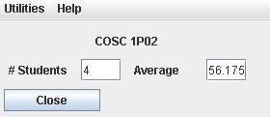
Course Display Form

Slide 13
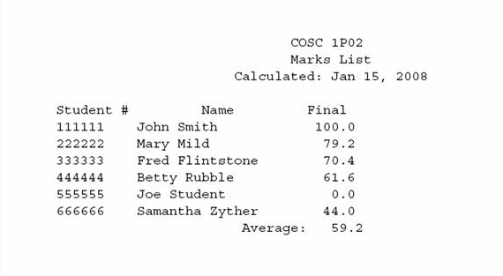
Grade Report Format

Slide 14
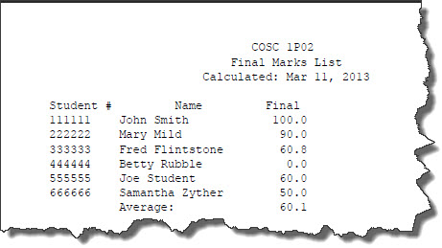
Grade Report Format

Slide 15
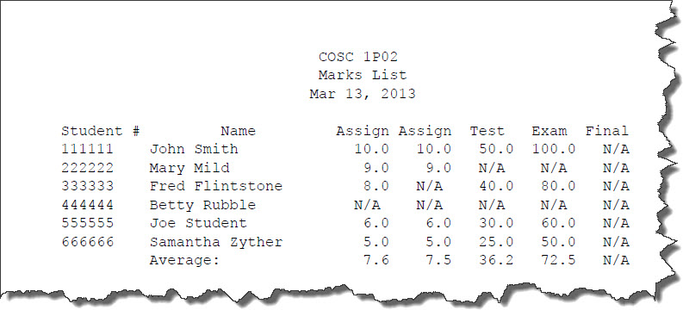
Mark Report Format

Slide 16
Analysis..
Object/Classes
  nouns in problem specification
  candidate objects
  eliminate values, duplicates and irrelevant entities
Model
  relationships between classes
  multiplicity

Slide 17
Selecting Candidate Objects
A system is needed to keep track of the marks for students in a course. A class list of student name and number is available at the start of the course. Throughout the term, marks are recorded for students in the course in each of a number of pieces of work (e.g. assignments, tests, exam). When the course is complete, a final mark is computed for each student based on their marks in these pieces of work according to a marking scheme and a course average is computed. The marking scheme defines, for each piece of work, its base mark and weight towards the final mark.

Slide 18
Candidate Objects and Identified Objects

Slide 19
Analysis Model

Slide 20
Software Development
  Fact is, you saved my life today. But I'd rather it was my fault I got shot than your fault I didn't.
  Jack Beauregard to Nobody
  (My Name is Nobody : 1973)

Slide 21
Design
Classes identified in analysis
Additional classes
  implementation classes
  main class
Goal: detailed class descriptions
CRC card
  class
  responsibilities
  collaborators
  four cards, one per class
  do responsibilities for knowing first
  then responsibilities for doing
  fill in collaborators

Slide 22
Analysis Model

Slide 23
CRC card

Slide 24
Responsibilities for Knowing
Nouns in problem statement
  keep values
  others from analysis/experience
Assign each to a class
  consider real-world
  don’t duplicate in another class
Example:
  student number and marks in Student
  bases and weights in MarkingScheme
  average final mark in Course

Slide 25
Selecting Values
A system is needed to keep track of the marks for students in a course. A class list of student name and number is available at the start of the course. Throughout the term, marks are recorded for students in the course in each of a number of pieces of work (e.g. assignments, tests, exam). When the course is complete, a final mark is computed for each student based on their marks in these pieces of work according to a marking scheme and a course average is computed. The marking scheme defines, for each piece of work, its base mark and weight towards the final mark.

Slide 26
Field Values

Slide 27
Responsibilities for Doing
Verbs (actions) in problem statement
  keep relevant
Assign each to a class
  who knows data?
  collaboration to access data
Example
  computing final mark
    Student and MarkingScheme
  generate report
    Course and Report
  average
    Course
CRC cards

Slide 28
Selecting Candidate Actions

Slide 29
Identified Tasks

Slide 32
Design Model

Slide 33
Architecture
Main class
  identified class or new
  Course could be part of something larger
  could have applications involving a course
  new class (FinalGrades)
Collaborations
  who controls interaction?
    i.e. which is client which is server, source of resource
Architectural plan
  persistence
    various applications access information over time
    all classes persistent
  sequential processing
    Process students in order.

Slide 34
Detailed Design
Class design
  responsibility for knowing
    instance variables
  responsibility for doing
    methods
Interfaces
  class specifications including method declarations
  methods identified as “doing” in CRCs
  accessor and updater methods
  fill in parameter types
Generalization
  design for future use
Forms and Reports
  Can be represented by Classes?

Slide 35
Interfaces
Specification for classes
  constants and method headers only
No implementation
  cannot create objects of interface type
  create objects of implementation classes
Defines a type
  can declare variables of interface type
  can assign objects of any implementation type
    subtype
Can be compiled
  can be referenced in other classes without an implementation

Slide 37
Package
package abc;
import whatever.*
Implementation of Object subtype 1
Interface specification
Defines the:
object
methods
constants
Defines an interface object type
Other classes interact
Implementation of Object subtype 2
Interface specification
Defines the:

Slide 38
Class Design
Interface Course
  accessor methods
  updater methods?
  other methods
Interface Student
  accessor methods
  updater methods?
  other methods

Slide 39
Course Design
Defines only the visible portion of the object, instance variables and constructors are not specified.
All classes in Student_Records will belong to the same unit.
package Student_Records;
public interface Course {
public String getCourseName ( );
public MarkingScheme getScheme ( );
public int getNumStd ( );
public double getCourseAve ( );
public void doRecordMarks ( );
public void doUpdateMarks ( );
public void calcFinalGrades ( );
public void doReport ( );
} // Course
Defines a class specification.
Mark update application, not part of grade report.
Produces the Student Grades Report.

Slide 40
Student Design
package Student_Records;
public interface Student {
public String getStNum ( );
public String getName ( );
public double getMark ( int num );
public double getFinalMark ( );
public void calcFinalMark( MarkingScheme scheme );
public void update ( MarkingScheme scheme );
} // Student
Student is responsible for calculating its final mark based on the marking scheme.
The marking scheme is passed so student knows about it.
Used to extend the application to a complete grade management system

Slide 41
Interface MarkingScheme
  accessor methods
  updater methods
  other methods
Interface Work
  accessor methods
  updater methods
  other methods

Slide 42
MarkingScheme Design
The students marks and the work will likely be an array, thus we get a position which corresponds to a work item. e.g. Assignment.
CalcFinalMark, in turn calls apply with the student object. Easier since most of the info is in marking scheme. The return will be the students final mark.

Slide 43
Work Design
Simple class representing the individual pieces of work. The work name is/will be set during construction.

Slide 44
Implementation
Coding by programmers
  responsible for a specific class
  implementation can be done in any order
May be multiple applications in system
  e.g. Student Records System
    new course setup
    mark entry
    mark reporting
    final grade computation with report*

Slide 45
Coding
Contract
  interface provides specification
  interfaces for other classes
    collaborators – what can be used
Implementation Classes
  implements clause
  requirements
Instance variables
  from “knowing” in CRCs
  others as needed for implementation
Methods
  As required by the interface
  Additional support is provided by private local methods.

Slide 46
Class MarkingSchemeImpl
Persistent
Instance variables
Constructor
  for initial setup
Identified methods
  accessor/updater
  apply
    weighted sum
  display
Support (private) methods

Slide 47
Class StudentImpl
Persistent
Represents single student
Instance variables
Constructor
  initial setup
  initializes marks (-1)
Identified methods
  accessor/updater
  calcFinalMark
    delegates to MarkingScheme
  update
    for mark update application

Slide 48
Class WorkImpl
Persistent
Instance variables
Constructor
  initializes fields
  For new course
Identified methods
  accessor/updater

Slide 49
Class CourseImpl
Persistent – contains students and marking scheme
Instance variables
Constructor
  initial setup only, creation of the object, afterward it becomes persistent.
  initializes classAve (-1)
Identified methods
  accessor/updater
  doUpdateMarks, doMarkReport
    other applications
  calcFinalGrades
    process each student
      Writes a detail line to the report
    compute average
    write summary (gets average using course accessor)
  display
Support methods

Slide 50
Class MarkingSchemeForm
Visibility
  marking scheme data
GUI for marking scheme display
Not persistent
Instance variables
Constructor
  builds form
Methods
Local methods

Slide 51
Main class (FinalGrades)
Object creation
  All persistent object are assumed to exist
  The course object is read from disk.
Course object will be modified (average grade) so this is a file update (1 record)
Course object does work
Write updated Course object (file)
Cleanup

Slide 52
Class CourseForm
Visibility
  course data
GUI for course information display
Not persistent
Instance variables
Constructor
  builds form
Methods
Local methods

Slide 53
Class FinalGradeReport
One of the Report types
Not persistent
Instance variables
Constructor
  initializes report on ReportPrinter
Identified methods
  writeDetailLine
  writeSummary
    must use accessor to get average (cannot change method header)
Support methods

Slide 54
Testing
Class stubs
  collaborator classes?
  class stub implements same interface so is pluggable
  method stubs
Test harness
  replaces main class for testing
  perform desired tests
    test all methods and constructors
  repeatable
Integration testing & system test
Test sets
  sets of test data to test all possibilities
  test ends of ranges
    0, 1 and other number of students
    0, full and other marks
  predicted output
  prepare ahead of time and keep on file

Slide 55
Debugging, Production
& Maintenance
Debugging
  apply program to test data
  when unexpected output, re-code, re-design and/or re-analyze
    System.out.println
Production
  when satisfies all tests, release to users
Maintenance
  correction of errors found in field (hopefully few)
  addition of new features
    re-analyze etc.
  change of specification
    re-analyze etc.

Slide 56
Marking Scheme Test
public class MarkingSchemeTest {
private MarkingScheme scheme; // object to test
private Student aStudent; // student stub object for tests
public MarkingSchemeTest ( ) {
Work[] work;
work = new Work[4];
work[0] = new WorkImpl("W1",15,25);
work[1] = new WorkImpl("W2",15,25);
work[2] = new WorkImpl("W3",15,25);
work[3] = new WorkImpl("W4",15,25);
scheme = new MarkingSchemeImpl(work);
aStudent = new StudentStub();
}; // constructor
private void run ( ) {
double mark; // computed mark
scheme.display();
System.out.println("Number of pieces of work: "+scheme.getNumWork());
for ( int i=0 ; i<scheme.getNumWork() ; i++ ) {
System.out.println("Work"+i+": "+scheme.getName(i)+", "
+scheme.getBase(i)+", "+scheme.getWeight(i));
};
mark = scheme.apply(aStudent);
System.out.println("Calculated mark: "+mark);
}; // runTest
aStudent is implemented as a stub. Looks like aStudent, but is functionally brain dead.
When aStudent is passed to the apply method, calls to aStudent’s methods will produce pre-determined responses.

Slide 57
Student Stub
public class StudentStub implements Student, Serializable {
private static final long serialVersionUID = 99990003L;
public StudentStub ( ) {
}; // constructor
public String getStNum ( ) {
System.out.println("Student.getStNum() called");
return "stdNum";
}; // getStNum
public String getName ( ) {
System.out.println("Student.getName() called");
return "StdName";
}; // getName
public double getMark ( int num ) {
System.out.println("Student.getMark("+num+") called");
if ( num == 0 ) {
return -1;
}
else {
return num * 5;
}
}; // getMark
etc. etc.
Constructor creates an object with no functionality, i.e. no instance variables.
All other methods get implemented in a similar way.
Write a simple message to system out so the tester knows what is going on.
Method call expects a return value, so return something which is consistent with the type.

Slide 58
The End

